Slide 1
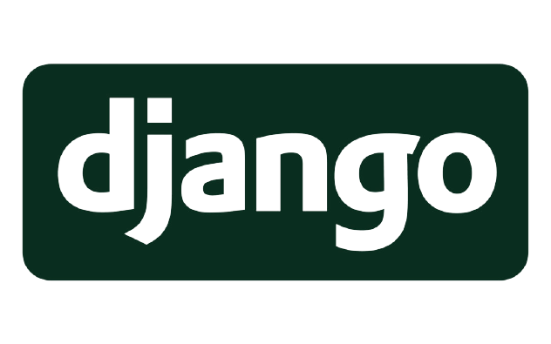
Presentation of:
By:
De La Torre Tenorio Edilberto
Sanchez Basilio Melissa Monserrat
Talla Lerma Jesus Guadalupe
Saldivar Valenzuela Guillermo Alonzo

Slide 2

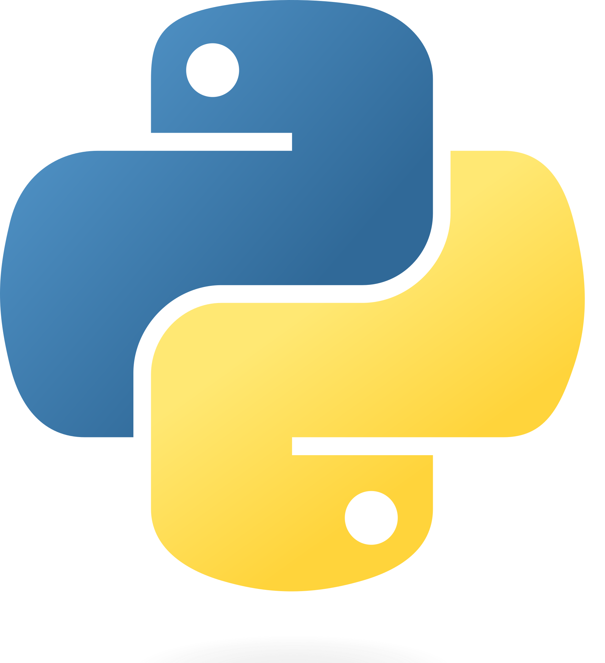
What is Django?

Slide 3
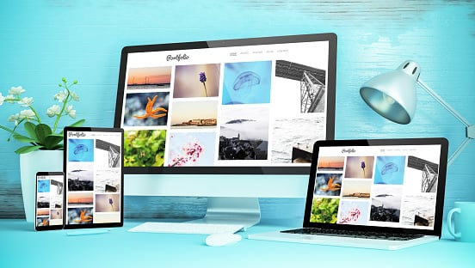
What is Django used for?

Slide 4
Advantages
Disadvantages
Rapid development
Not suitable for small projects
Python web-framework
Does not provide multiprocessor support
Security
Learning Django is not easy for new devs
Community support
Monolithic framework

Slide 5
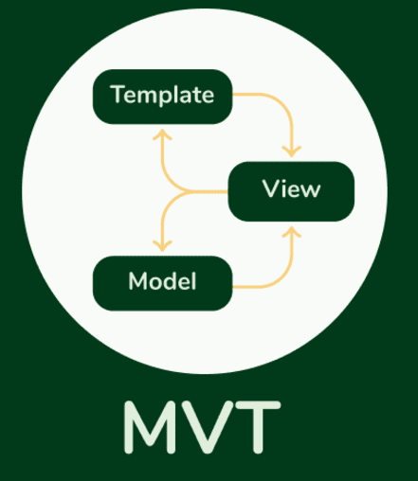
How does Django work?

Slide 6
Characteristics of:
• Django is a versatile framework that can be used to create a wide array of applications in various domains.
• Django is used to build all types of content management systems, social networks as well as scientific computing platforms.
• Using the Django framework saves the time of developers and helps in the rapid development of web apps.
• SEO is Search Engine Optimization as from the name it means that adding your website to the search engine such that it appears in the top results. This is a special feature of Django due to which it has edge over others.

Slide 7
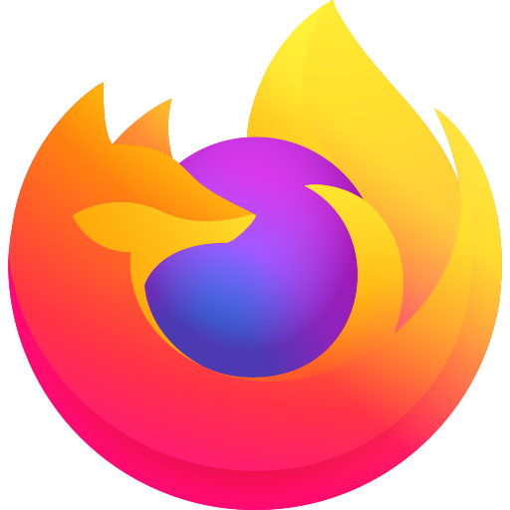




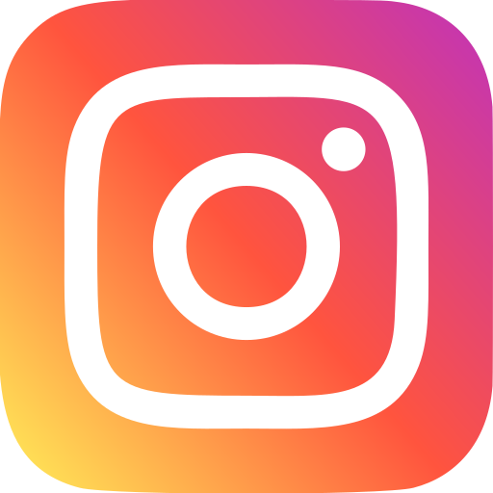

Examples of usage

Slide 8
Thank you for your attention!

