Slide 1
Implementing CI/CD Pipelines in a NetDevOps Environment
Network to Code
Jeff Kala, Eric Chou, Taylor Dawson
AutoCon2
November, 2024

Slide 2
Introduction

Slide 3

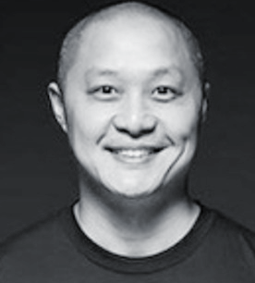

Who is standing in front of you
Jeff Kala
Principal Architect
Eric Chou
Network Automation Advocate
Taylor Dawson
Senior Sales Engineer

Slide 4
DevOps Principles

Slide 5
What is DevOps?
- Developers
- QA Engineers
- Operators
- System
Administrators
- Network Administrators

Slide 6
People + Process + Tools
People
Process
Tools

Slide 7
DevOps Overview
Shorten Development to Deployment life cycle
Closely related to Agile and Lean software development
Design
Develop
Feedback
Deployment

Slide 8

Lean Principles
Eliminate Waste
(not adding value to customer)
Empower team for decision making
Deliver as fast
as possible
Amplify
learning
Decide as late as possible
Build integrity in the process
Optimize the whole

Slide 9

Agile Software Development
Customer Focus
Embrace change and adapt
Frequent delivery of working software
Collaboration
Motivated
teams
Face-to-Face conversations
Continuous improvement

Slide 10
NetDevOps
Network Engineering follows the same process: design, develop, deployment, operate, monitoring.
Requirements / Design
Develop
Deployment
New Requirements
Monitoring
Operate

Slide 11
Summary of Principles
Collaboration Environment with joint responsibilities
Continuous Cycles (development, integration, learning, monitoring, feedbacks, etc.)
Speed up time to market (small teams, individual empowerment, incremental changes)
Automation in all steps
Embrace failure and learn from them
Customer-focused

Slide 12
NetDevOps Practices
Version Control
Automated Testing (unittest to integration testing)
Continuous Integration
Continuous Delivery or Deployment
Active participation with high-trust for individuals
Peer Review
Blameless culture between Developers and Operators

Slide 13
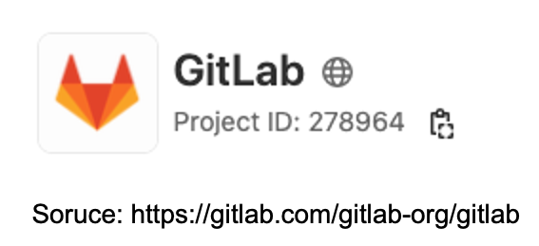
Continuous Integration / Deployment
Dev
Development
Check-In (Version Controlled)
Deployment
Automated Testing
Ops

Slide 14
Today’s Labs

Slide 15
CI / CD Labs
Lab 1 - Basic Git Operations
Lab 2 - First Pipeline in GitLab
Lab 3 - Collaboration Tools
Lab 4 - Source Code Checks
Lab 5 - Generate Configs
Lab 6 - Testing Frameworks

