Slide 1
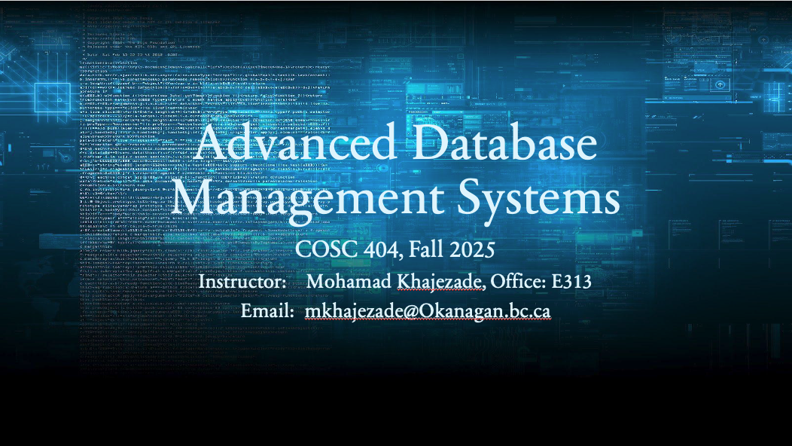

Slide 2
COSC 404 – PL/SQL
Transactions

Slide 3
Transaction Review
A transaction is a fundamental concept in database management. It is a sequence of one or more SQL statements treated as a single, indivisible unit of work.
The ACID properties, which stand for Atomicity, Consistency, Isolation, and Durability, are crucial in understanding how transactions work.
Atomicity ensures that all the statements within a transaction are treated as a single, all-or-nothing operation. If any part of the transaction fails, the entire transaction is rolled back (undone).

Slide 4
Transaction Review
A transaction is a logical unit of work containing one or more SQL statements.
A transaction is an atomic unit.
  This means the effects of all the SQL statements in a transaction can be either all applied (committed to the database) or all undone (rolled back from the database).

Slide 5
Transaction Review
A Transaction
Begins with the first executable SQL statement.
Ends when it is committed or rolled back, either explicitly with a COMMIT or ROLLBACK statement or implicitly when a DDL statement is issued.
Explicit end:
  Commit; Rollback;
Implicit end:
  Execute a DDL statement. Example: CREATE, DROP, RENAME, or ALTER..

Slide 6
Committing
Means changes in the transaction be made permanent.
Changes become visible to other users after commit.

Slide 7
Rollback
If an SQL statement causes an error during execution, all statement effects are rolled back. The effect of the rollback is as if that statement had never been run.
This is called statement-level rollback.
An example of such an error is attempting to insert a duplicate value in a primary key. Single SQL statements involved in a deadlock (competition for the same data) can also cause a statement-level rollback. Errors discovered during SQL statement parsing, such as a syntax error, have not yet been run, so they do not cause a statement-level
A SQL statement that fails causes the loss only of any work it would have performed itself. It does not cause the loss of any work that preceded it in the current transaction.

Slide 8
Rollback
ROLLBACK: Undoes the changes made in the transaction, returning the data to its previous state.

Slide 9
Example of using Commit and Rollback
CREATE TABLE teams (city varchar2(20), name varchar2(20));
INSERT INTO teams VALUES ('Toronto', 'Raptors');
INSERT INTO teams VALUES ('Los Angeles', 'Lakers');
ROLLBACK;
Notice that after creating the table and running the insert statements, once you run the ROLLBACK statement, the transaction (logical unit of work containing one or more SQL statements) has its effects removed from the table (i.e. no inserted values)

Slide 10
Example of using Commit and Rollback
INSERT INTO teams VALUES ('Toronto', 'Raptors');
INSERT INTO teams VALUES ('Los Angeles', 'Lakers');
COMMIT;
Now run the COMMIT statement afterwards, which will essentially make the changes made by our transaction permanent.
To ensure try running another ROLLBACK afterwards and notice there is no changes to our table.

Slide 11
Autonomous Transactions
Autonomous transactions in PL/SQL are special types of transactions that are independent of the main transaction.
These autonomous transactions allow you to execute SQL statements that are not affected by the main transaction and can commit or roll back independently of the main transaction.
This is particularly useful in scenarios where you need to log information, generate audit records, or perform other tasks without interfering with the main business transaction.

Slide 12
Autonomous Transactions
Any block of PL/SQL code (anonymous, procedure, function, or trigger) can be performed in an autonomous transaction by including:
PRAGMA AUTONOMOUS_TRANSACTION;
in the DECLARE section of the block and providing a COMMIT statement at the point in the code where you want the transaction to end and be committed (typically the last statement). That COMMIT statement will not perform a commit of the main transaction.

Slide 13
Autonomous Transactions
The effects to the database of the PL/SQL code executed in a trigger will be rolled back if the transaction that started the trigger is rolled back (via a rollback statement, for example).
One of the obvious problems with this behaviour occurs when a trigger's purpose is to add entries into an audit table when an UPDATE, DELETE, or INSERT is performed.
Although we may always want to track any modification attempts regardless of whether they were rolled back or not, this behaviour would remove audit records inserted as part of the same transaction.
To resolve this issue, we can require that the executable code of a PL/SQL block be performed in a transaction that is committed independent of the main transaction. In this case, main transaction refers to the transaction that generated the triggering event.
Such an independently committed event is referred to as an Autonomous Transaction.

Slide 14
Example
Create a table
CREATE TABLE Lecture_Audit_LOG (audit_time date, message varchar2(40));
Run the following anonymous PL/SQL block followed by SELECT statement:
DECLARE
v_msg VARCHAR2(40) := 'Updating the Audit table';
BEGIN
INSERT INTO Lecture_audit_log VALUES (SYSDATE, v_msg);
dbms_output.put_line('Inserted a record into LAB5_audit_log');
END;
SELECT * FROM Lecture_audit_log;

Slide 15
Example
Notice that a row has indeed been inserted into Lecture_audit_log. Now run a ROLLBACK statement and rerun the SELECT statement.
ROLLBACK;
SELECT * FROM Lecture_audit_log;
Notice that the row has been removed from Lecture_audit_log.
Now let's make the executable code in the PL/SQL block be run in an autonomous transaction. First let's add a row to Lecture_audit_log:
INSERT INTO Lecture_audit_log VALUES (SYSDATE, 'Inserted a record - before block');

Slide 16
Example
Verify that the INSERT was accomplished. Now, run the anonymous block as before, but with the code highlighted in bold added:
DECLARE
v_msg VARCHAR2(40) := 'Updating the Audit table';
PRAGMA AUTONOMOUS_TRANSACTION;
BEGIN
INSERT INTO Lecture_audit_log VALUES (SYSDATE, v_msg);
dbms_output.put_line('Inserted a record into Lecture_audit_log');
COMMIT;
END;

Slide 17
Example
SELECT * FROM Lecture_audit_log;
You see two the two rows as expected:
17-NOV-21 Inserted a record - before block
17-NOV-21 Updating the Audit table
Now run a ROLLBACK statement and rerun the SELECT statement. Notice that just the first row has been removed from LAB5_audit_log. This row stays:
17-NOV-21 Updating the Audit table
The remaining row was inserted as part of the autonomous transaction. The INSERT performed in the main transaction was the one that disappeared (was removed by the rollback).

Slide 18
Example 2
Consider the trigger bellow. It inserts an audit record in customerAudit when an update or delete occurs.
CREATE OR REPLACE TRIGGER customer_AUD
AFTER UPDATE OR DELETE ON customers
FOR EACH ROW
DECLARE
v_msg VARCHAR2(55) := 'Update to customer: ';
v_count NUMBER := 0;
BEGIN
v_msg := v_msg || :OLD.ID;
INSERT INTO customerAudit VALUES (USER, SYSDATE, v_msg);
END;

Slide 19
Example 2
So, run:
UPDATE CUSTOMERS SET name = 'Bob Joey' WHERE ID = 3100005;
Notice how you get the updated customer in the table and an audit is made in the customer audit.

Slide 20
Example 2
But, the user can later rollback the changes. You would still like to capture the fact that someone was attempting to change a row even if they rollback.
OK. Easy fix, right? Just insert a commit near the end of the executable part of the trigger. Couple of issues.
  This essentially would disable the rollbacks (after DML commands) for the table that the trigger is attached to. – BAD IDEA and generate an error
  Oracle doesn’t allow you to commit in a trigger unless it was part of an Autonomous Transaction that was started in the trigger.

Slide 21
Example 2 - Autonomous Transaction
Use the pragma AUTONOMOUS_TRANSACTION
CREATE OR REPLACE TRIGGER customer_AUD
AFTER UPDATE OR DELETE ON customers
FOR EACH ROW
DECLARE
v_msg VARCHAR2(55) := 'Update to customer: ';
v_count NUMBER := 0;
pragma AUTONOMOUS_TRANSACTION;
BEGIN v_msg := v_msg || :OLD.ID;
INSERT INTO customerAudit VALUES (USER, SYSDATE, v_msg);
commit;
END;

Slide 22
Example 2 - Autonomous Transaction
Now run:
UPDATE CUSTOMERS SET name = 'Bob Joey' WHERE ID = 3100005;
-- main transaction generating trigger event
Notice the changes in the table
Now run ROLLBACK;
Notice how customers is changed back to its original state, but the audit still remains in the audit table

Slide 23
Oracle Transactions
In Oracle you can set transactions to one of
READ COMMITTED – a transaction can read data updated by other transactions once the data changes have been committed.
SERIALIZABLE transactions can’t see changes (committed or uncommitted) made by other transactions after the transactions has started. For example, If transaction A is serializable, transaction A will not see changes committed by transaction B after transaction A has started.
Oracle also has READ ONLY
Note this applies for the next transaction to be run
Notes:
Read Committed: In the "Read Committed" isolation level, a transaction sees only data that has been committed by other transactions. It ensures that data read by one transaction is not changed or deleted by other transactions until the reading transaction is completed. This level provides a good balance between data consistency and concurrency.
Serializable (Transaction Isolation Level):
Serializable is the highest level of transaction isolation in a database. In a serializable transaction, it provides the highest level of data consistency and isolation from other transactions. It ensures that the results of a transaction are as if it was the only transaction executing on the database, even when multiple transactions are running concurrently.
Read Only (Access Permission):
Read Only refers to the access permissions associated with a user, role, or session in a database. When a user or session is granted "READ ONLY" access, it means that they are only allowed to perform read operations on the database and are not permitted to make any modifications to the data, such as INSERT, UPDATE, or DELETE statements.
Key characteristics of a "READ ONLY" access permission:
Users can execute SELECT statements to retrieve data but cannot make any changes to the data.
This access level is often used for reporting or querying-only users who should not be able to modify the database.

Slide 24
Oracle Code
Oracle code:
Set the Isolation Level
SET TRANSACTION ISOLATION LEVEL READ COMMITTED;
SET TRANSACTION ISOLATION LEVEL SERIALIZABLE;
SET TRANSACTION READ ONLY;
To save the networking and processing cost of beginning each transaction with a SET TRANSACTION statement, you can use the ALTER SESSION statement to set the transaction isolation level for all subsequent transactions:
ALTER SESSION SET ISOLATION_LEVEL = SERIALIZABLE;
ALTER SESSION SET ISOLATION_LEVEL = READ COMMITTED;
Notes:
For each transaction you have to set the level, so if you want to do for all then you use the alter session things.

Slide 25
Exercise
Exercise: Based on:
staff(ID, Name, pay),
staffAudit(uName, UpdateTime, msg)
staffAudit_ALL (uName, UpdateTime, msg)
Provide a PL/SQL solution to the following problem.
When a user UPDATEs staff.pay, a record should be inserted into staffAudit. The record should only persist if the UPDATE persists.
When a user UPDATEs staff.pay, by increasing the pay by more than 20%, a record should also be inserted into staffAudit_ALL. The msg should include the pay increase percentage. This record should persist even if the UPDATE does not persist.

Slide 26
Exercise - Tables
CREATE TABLE staff(id number, name varchar2(20), pay number);
CREATE TABLE staffAudit(uName varchar2(20), UpdateTime date, msg varchar2(60));
CREATE TABLE staffAudit_ALL (uName varchar2(20), UpdateTime date, msg varchar2(60));
INSERT INTO staff VALUES (1, 'John', 20);
INSERT INTO staff VALUES (2, 'Bob', 40);
INSERT INTO staff VALUES (3, 'Joey', 10);

Slide 27
Exercise - Solution
On GitHub Repository

Slide 28
Next Class…
Collections

