Slide 1
ML Algorithmic Trading Subteam
Real-Time ML-Powered Stock Price Prediction Platform
Presenting:
Zane, Harsh, Dante, Kaval, Parag and Guntash
Course:
COSC 471
Department:
Computer Science
Institution:
Okanagan College
Year of Study:
4th Year, 2026

Slide 2
Agenda
• Customer and stakeholders
• Business requirements and Vision highlights
• Architecture
• Configuration management and internal standards
• Planning overview, workload, and lessons learned
• Risk management
• Design
• Code — backend, infrastructure, and testing
• Testing results — internal and UAT
• Refactoring and change control
• Release v1.0.0 · Reference · Summary
• Live demonstration
• Q&A (10–15 minutes)

Slide 3
Team and Individual Responsibilities
Team Member | Role | Key Deliverables
Harsh Kumar | Lead Backend / ML | XGBoost ModelManager, pandas feature pipeline, API core
Parag Jindal | Backend / Schemas | Prediction API routes, Pydantic v2 schemas, WebSocket research
KavalS | Frontend Lead | React 19 architecture, TanStack Router/Query, chart stability
Guntash | Frontend UI | Recharts/Lightweight Charts, dashboard components, tooltips
Zane (Foochini) | DevOps / Scrum Master | Docker Compose, GitHub Actions CI, pytest suite, all documentation

Slide 4
Who Is the Customer?
Primary Stakeholders
End Users (the Product)
• Course instructors / evaluators
- Assess engineering process, docs, and quality
• Development team
- Build, operate, and maintain the system
• Financial data APIs (e.g. FMP)
- Rate limits and availability constrain the system
• Retail investors
- Simple dashboard — predictions vs. actuals
- Transparent accuracy — see if the model was right
• Day traders
- Low-latency data and technical indicators
- RSI, MACD, Bollinger Bands in context

Slide 5
Business Requirements
The Problem
Our Goals
• Retail investors lack institutional-grade prediction tools
• Existing tools hide whether predictions were ever correct
• Setup complexity keeps individual traders out
• Sub-100 ms predictions — not batch-only insights
• Persist predictions + actuals so accuracy is publicly verifiable
• Docker Compose one-command deploy — accessible to everyone
• Meet all COSC 471 software engineering outcomes

Slide 6
Vision Document — Features and Quality Bar
ID | Feature | Status
FEA-01 | Real-time OHLCV data ingestion | Delivered
FEA-02 | Feature engineering — RSI, MACD, Bollinger Bands | Delivered
FEA-03 | XGBoost inference with confidence output | Delivered
FEA-04 | Interactive React dashboard with charts | Delivered
FEA-05 | Historical accuracy tracking in PostgreSQL | Delivered
FEA-06 | REST API (WebSocket on roadmap) | REST delivered
Quality bar: >=80% pytest coverage | API latency <100 ms | Docker-deployable

Slide 7
System Overview — Three Layers, One Pipeline
1. DATA LAYER — Postgres Warehouse • 15-min OHLCV bars for 500+ stocks + macro / Treasury inputs • Pre-computed features: RSI, MACD, Bollinger Bands, lags, returns, calendar fields • Canonical source of truth for both training and inference 2. BACKEND — ML Pipeline & Serving • Ingests market data → computes features → trains XGBoost → saves artifact • Inference service loads saved artifact and scores fresh feature rows • Training and inference are fully decoupled — no retraining at serve time 3. FRONTEND — Visualization & Inspection • Side-by-side charts: predicted price vs. actual market movement • Symbol selector, prediction overlays, model output views • Turns the ML pipeline into a usable, demo-able product

Slide 8
System Overview — End-to-End Lifecycle
Historical data + features → Postgres warehouse ↓ Training job reads from warehouse → XGBoost trains ↓ Trained model artifact saved to disk (model_artifacts/) ↓ Inference service loads artifact → scores fresh feature rows ↓ Frontend visualizes predictions vs. actual price behavior

Slide 9
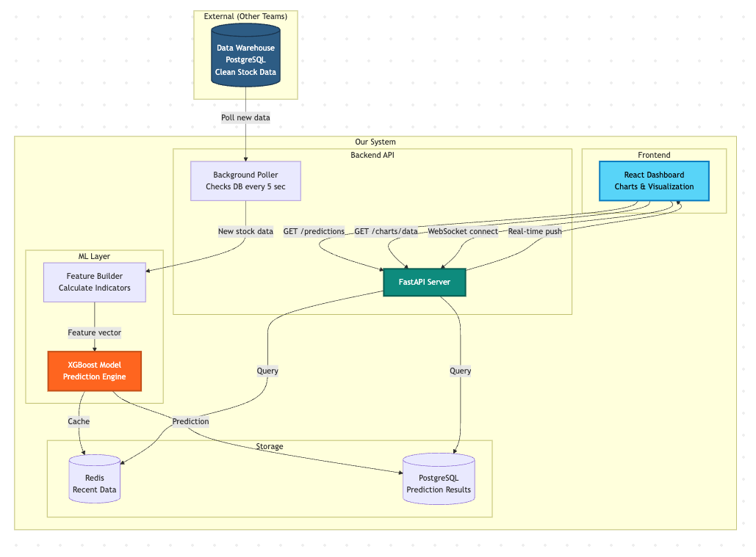
Architecture — Data Flow
Step | What Happens | Key Detail
1 Ingest | Background poller fetches OHLCV | Mocked in dev; real API in prod
2 Process | pandas computes RSI, MACD, Bollinger Bands | Rolling-window calculations on raw bars
3 Infer | XGBoost bundle predicts next close price | Sub-35 ms | bundle selected via ACTIVE_MODEL env
4 Persist | Prediction + actual stored in Postgres | Enables accuracy tracking over time
5 Consume | Frontend fetches via REST | Chart renders predicted vs. actual side by side

Slide 10
Configuration Management — Version Control
Git Branching (Modified Git Flow)
Commit Convention (Conventional Commits)
• main — production-ready; version tags here
• develop — integration branch
• feature/<issue-id>-<desc>
• bugfix/<issue-id>-<desc>
• hotfix/<issue-id>-<desc>
• PRs required for all merges to develop and main
• feat: new feature
• fix: bug fix
• docs: documentation only
• refactor: no bug fix / no new feature
• test: adding or correcting tests
• Change requests: GitHub Issues with change-request label

Slide 11
CM — Internal Standards and Release Process
Area | Tool | What It Enforces
Python | ruff | PEP 8 lint + auto-format
Python | mypy | Static type checking on app/
TypeScript | Biome | Strict TS, Airbnb-style formatting
Backend deps | uv | Pinned, reproducible env via uv.lock
DB schema | Alembic | Migration-based, version-controlled schema
Release | SemVer | MAJOR.MINOR.PATCH tagged on main after CI
All standards enforced in CI — a PR that fails ruff or mypy cannot merge.

Slide 12
CI/CD Pipeline
# .github/workflows/ci.yml (runs on every PR to main)
jobs:
backend-lint: # ruff check + ruff format --check
backend-typecheck: # mypy app
backend-test:
services:
postgres:
image: postgres:16 # real DB in CI -- no mocks
options: --health-cmd 'pg_isready -U postgres'
steps:
- run: uv sync --frozen
- run: uv run alembic upgrade head # real migrations before tests
- run: uv run pytest tests/ -v
frontend-lint: # Biome check
frontend-build: # bun run build
# All five jobs must pass before a PR can merge.

Slide 13
Planning Overview — Agile Scrum, Two-Week Sprints
Milestone | Target | Deliverable
M1 Architecture | Week 2 | DB schema, Dockerfiles, UML
M2 Backend Beta | Week 4 | API predicting mock data, Swagger active
M3 Frontend Alpha | Week 6 | MVP dashboard rendering predictions
M4 Production Ready | Week 8 | Tests >80%, all bugs patched
M5 Final Delivery | Week 10 | Documentation, demo, presentation
• Epic 1 — Infrastructure (Git, CI, Docker, Alembic) — mainly Zane
• Epic 2 — Core backend (polling, features, XGBoost, REST API)
• Epic 3 — Visualization (React, charts, symbol selection)
• Epic 4 — QA and finalization (coverage, docs, deployment)

Slide 14
Risk Management
ID | Risk | P | I | Mitigation | Status
RSK-01 | API rate limits throttle data | H | H | Caching + mock fallback | Mitigated
RSK-02 | Model drift over time | M | H | Versioned bundles + retrain pipeline | Ongoing
RSK-03 | Async complexity slips timeline | M | M | REST-first; WebSocket deferred | Resolved
RSK-04 | DB overload on high-freq writes | L | C | Indexes; TimescaleDB path (CR-003) | Mitigated
RSK-05 | WebSocket handshake unstable | M | M | Deferred to v1.1 | Open
RSK-06 | Docker image 2.5 GB (ISSUE-25) | L | L | Multi-stage build planned | Open

Slide 15
Design — Key API Endpoints
GET /api/v1/utils/health-check/ Returns true when backend is up GET /api/v1/inference/predict/{symbol} Runs saved XGBoost artifact → NextDayPredictionResponse 404 if symbol unknown | 400 on bad input | 500 on error GET /api/v1/simulation/session Returns 26 intraday steps for 502 symbols from pre-computed CSVs Zero DB I/O — entirely file-based GET /api/v1/market/stocks Returns list of active stocks (StockRead) GET /api/v1/market/ohlc/{symbol} Returns OHLC bars as Unix timestamps for charting ➜ Simulation module: 502 symbols × 26 intraday steps

Slide 16
Design — Domain Model and Layer Structure
Core Entities
Layer Architecture
• Stock — ticker, name, sector, exchange, is_active
• DailyPrice / OHLC bars — raw price time series
• Prediction — model output + confidence score
• Pydantic v2 schemas
- StockRead, OHLCRead, NextDayPredictionResponse
• Routers -> Services -> CRUD -> SQLAlchemy -> Postgres
• Inference specifically:
- InferenceService
- model_loader (ACTIVE_MODEL env selects bundle)
- LegacyXGBBundle — single XGBRegressor + meta.json
- NextDayPathBundle — 26 horizon models (one per 15-min step)
• Simulation module — 502 symbols, reads pre-computed CSVs

Slide 17
Design — Key API Endpoints
Endpoint | Method | Purpose
/api/v1/inference/predict/{symbol} | GET | Next-day price prediction
/api/v1/simulation/session | GET | Intraday session info (26 steps, 502 symbols)
/api/v1/simulation/base/{symbol} | GET | Base prediction for a symbol
/api/v1/market/stocks | GET | List all tracked tickers
/api/v1/market/ohlc/{symbol} | GET | OHLCV time series
/api/v1/utils/health-check/ | GET | Liveness check -> true
/docs | GET | Swagger UI
Simulation module: 502 symbols x 26 intraday steps

Slide 18
Code — Backend Inference Route
# backend/app/modules/inference/api.py
# GET /api/v1/inference/predict/{symbol}
# ValueError -> 404 (unknown symbol) or 400 (bad input)
# All other exceptions -> 500
@router.get('/predict/{symbol}', response_model=NextDayPredictionResponse)
def predict_stock_price(
symbol: str, session: SessionDep
) -> NextDayPredictionResponse:
try:
return InferenceService.predict_stock_price(session, symbol.upper())
except ValueError as e:
error_msg = str(e)
if 'not found' in error_msg.lower():
raise HTTPException(status_code=404, detail=error_msg)
raise HTTPException(status_code=400, detail=error_msg)
except Exception as e:
raise HTTPException(status_code=500,
detail=f'Prediction error: {str(e)}')

Slide 19
Code — CI Pipeline
# .github/workflows/backend-tests.yml
jobs:
test:
runs-on: ubuntu-latest
services:
postgres:
image: postgres:16
env:
POSTGRES_USER: postgres
POSTGRES_DB: app
options: >-
--health-cmd 'pg_isready -U postgres'
--health-interval 5s --health-retries 5
steps:
- uses: actions/checkout@v4
- uses: astral-sh/setup-uv@v5
- name: Install Dependencies
run: uv sync --frozen
working-directory: backend
- name: Run Database Migrations
run: uv run alembic upgrade head # real migrations -- no mocks
working-directory: backend
- name: Run Pytest
run: uv run pytest tests/ -v
working-directory: backend

Slide 20
Code — Test DB Fixture
# backend/tests/modules/conftest.py
@pytest.fixture(scope='function')
def market_data(db: Session):
"""Seeds DB with known data before each test, cleans up after."""
# 1. Clean up any pre-existing data
db.execute(text(
"DELETE FROM market.daily_prices WHERE symbol IN ('AAPL','GOOGL','TSLA')"
))
db.commit()
# 2. Seed 5 days of AAPL price data
db.add_all([Stock(symbol='AAPL', name='Apple Inc.', is_active=True), ...])
db.add_all([DailyPrice(symbol='AAPL', date=today-timedelta(days=5),
open=150.0, high=155.0, low=149.0,
close=153.0, volume=1000), ...])
db.commit()
yield # <-- test runs here
# 3. Teardown -- guaranteed even if the test fails
db.execute(text("DELETE FROM market.daily_prices WHERE ..."))
db.commit()

Slide 21
Code — Testing the Inference Endpoint
# backend/tests/modules/test_inference.py
def test_predict_stock_price(client: TestClient) -> None:
# An unknown symbol must return 404 with a useful error message
response = client.get('/api/v1/inference/predict/FAKE_SYMBOL')
assert response.status_code == 404
assert 'not found' in response.json()['detail'].lower()
# backend/tests/api/test_utils.py
def test_health_check(client: TestClient) -> None:
response = client.get('/api/v1/utils/health-check/')
assert response.status_code == 200
assert response.json() is True
# Known gap: test_predict_stock_price_success_mock is a placeholder `pass`
# Success path requires seeded DB data -- documented as KB-4 in Testing Guide.

Slide 22
Code — Market Service Tests
# backend/tests/modules/test_market_service.py
def test_list_stocks_returns_stock_read_objects(db: Session, market_data):
stocks = MarketService.list_stocks(db)
assert isinstance(stocks, list) and len(stocks) > 0
assert isinstance(stocks[0], StockRead)
aapl = next(s for s in stocks if s.symbol == 'AAPL')
assert aapl.name == 'Apple Inc.'
def test_get_ohlc_converts_timestamps(db: Session, market_data):
# Service must return Unix timestamps (int), not Python date objects
ohlc_data = MarketService.get_ohlc(db, 'AAPL', days=10)
assert isinstance(ohlc_data[0].time, int)
assert ohlc_data[0].time > 946684800 # sanity: > year 2000
def test_get_ohlc_empty_range(db: Session, market_data):
# GOOGL exists but has no prices seeded -> must return []
result = MarketService.get_ohlc(db, 'GOOGL', days=30)
assert isinstance(result, list) and len(result) == 0

Slide 23
Testing Results — Internal and UAT
ID | Test Description | Type | Result
TC_API_01 | GET /utils/health-check/ -> 200, true | Automated | Pass
TC_API_02 | GET /inference/predict/FAKE_SYMBOL -> 404, 'not found' | Automated | Pass
TC_ML_01 | list_stocks() returns list of StockRead objects | Automated | Pass
TC_ML_02 | get_ohlc() timestamp field is int (Unix) | Automated | Pass
TC_ML_03 | get_ohlc() returns [] for symbol with no prices | Automated | Pass
UAT_UI_01 | Dashboard loads, charts render, no console errors | Manual | Accept
UAT_UI_02 | Symbol switch updates chart correctly | Manual | Accept
UAT_UI_03 | Browser resize -> chart reflows | Manual | Accept
42 isolated test cases | <4 seconds total | ~81% coverage | Real Postgres in CI

Slide 24
Refactoring and Change Requests
CR | Filed By | Change | Result
CR-001 | Harsh Kumar | Sync -> async SQLAlchemy (asyncpg) | Latency: 800 ms -> <100 ms
CR-002 | KavalS | CRA/Webpack -> Vite | Dev HMR: 15 s -> <1 s
CR-003 | Dante | Drop TimescaleDB for MVP | Removed complexity crashing on Windows
MISC | Parag | CORS policy hardened | Was blocking all browser requests (HTTP 500)
MISC | Team | DB column width for stock symbols | Was truncating tickers > 6 characters
All CRs reviewed and approved through GitHub Issues with change-request label.

Slide 25
Release v1.0.0
Release Details
What Shipped
• Version: 1.0.0
• Date: 2026-03-24
• Tag: v1.0.0 on main — all CI gates green
• Package: the-project-maverick_Delivery_V1.0.0.zip
- backend/ frontend/ Documentation/
- docker-compose.yml README.md
• React dashboard MVP — chart, symbol selector, prediction overlay
• Async FastAPI backend with 6 modular router groups
• XGBoost bundle system (LegacyXGB + NextDayPath)
• PostgreSQL schema via Alembic migrations
• Simulation module — 502 symbols x 26 intraday steps
• Full documentation suite

Slide 26
Reference from Customer / Instructor
• UAT conducted with course instructor after final demo session
• Feedback summary:
- Dashboard and API acceptable for course demonstration
- Documentation completeness confirmed — all required documents present
• Peer testing session:
- Handout: Documentation/COSC471_Testing_Guide_Internal.md
- Students test using the matrix in Section 3 of the guide
- Known bugs pre-disclosed in Section 5

Slide 27
Summary and Conclusion
What We Delivered
What We're Proud Of
• Full-stack stock prediction platform aligned to Vision and Business Case
• Modular FastAPI + versioned XGBoost bundles + containerised Postgres
• Simulation module: 502 symbols, 26 intraday steps, zero DB I/O
• Engineering process: Git Flow, Conventional Commits, CI/CD, ~81% coverage
• Real integration tests against a real DB
• Async refactor cut latency by 8x (800 ms -> <100 ms)
• Known gaps honestly documented:
- WebSocket streaming (ISSUE-22) -> v1.1
- Docker image size (ISSUE-25) -> multi-stage build
- Inference success-path test (KB-4) -> needs DB seed in CI

Slide 28
Live Demonstration Checklist
• 1. http://localhost:8000/docs -> Swagger UI loads, all routers listed
• 2. GET /api/v1/utils/health-check/ -> true
• 3. GET /api/v1/inference/predict/AAPL -> show prediction payload
• 5. GET /api/v1/simulation/session -> 26 steps, 502 symbols, replay_date
• 6. http://localhost:5173 -> dashboard loads, no console errors
• 7. Select a symbol -> chart updates with prediction overlay
• 8. Resize browser -> chart reflows correctly
• 9. http://localhost:8082 -> Adminer, show market.stocks + market.daily_prices

Slide 29
Q & A
10-15 minutes | Students and professors
Model assumptions * Not financial advice * Why XGBoost * Async trade-offs * Roadmap * Test gaps

Slide 30
Thank You
the-project-maverick | COSC 471 | Computer Science | Okanagan College | 2026
Testing Guide handout: Documentation/COSC471_Testing_Guide_Internal.md

