Slide 1

Note: The data and information in this document is reflective of a hypothetical situation and client. This document is to be used for KPMG Virtual Internship purposes only.
Sprocket Central Pty Ltd
Data analytics approach

Slide 2
Note: The data and information in this document is reflective of a hypothetical situation and client. This document is to be used for KPMG Virtual Internship purposes only.
Agenda
Introduction
Data Exploration
Model Development
Interpretation

Slide 3
Note: The data and information in this document is reflective of a hypothetical situation and client. This document is to be used for KPMG Virtual Internship purposes only.
Introduction
Customer Occupation and Location Matter
However, bigger variety of data is required for better insights

Slide 4
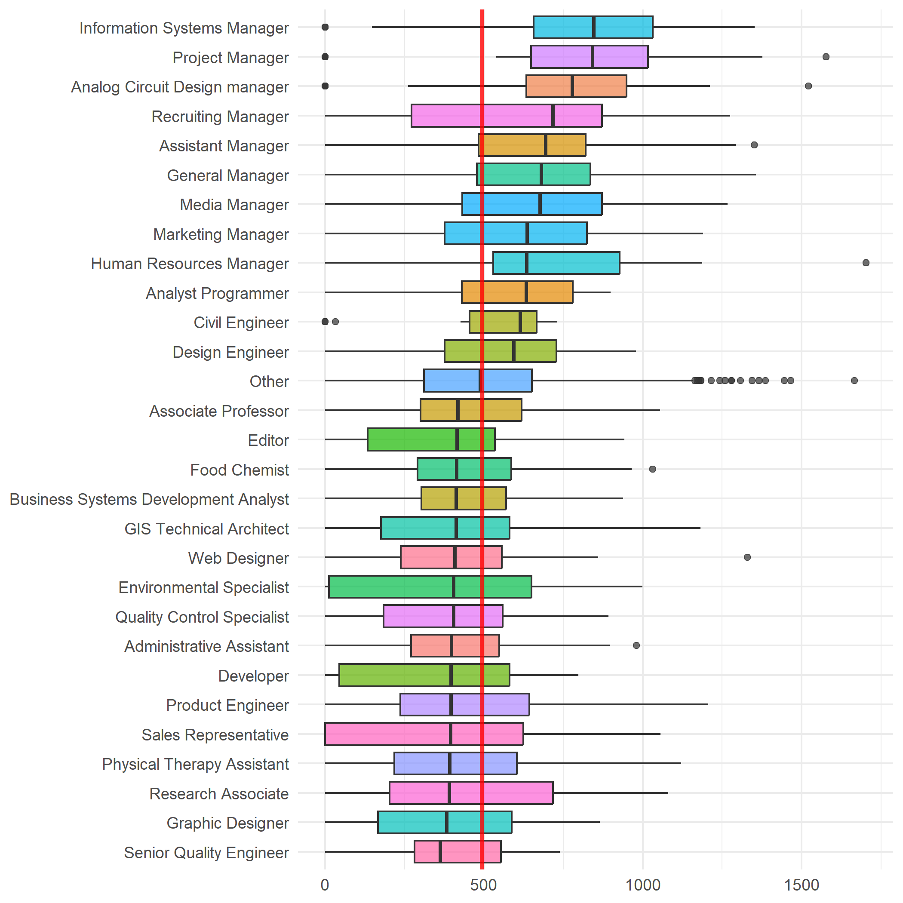
Note: The data and information in this document is reflective of a hypothetical situation and client. This document is to be used for KPMG Virtual Internship purposes only.
Data Exploration
Customer Occupation
Managers are the most lucrative
Income and amount of Free Time may confound this variable

Slide 5
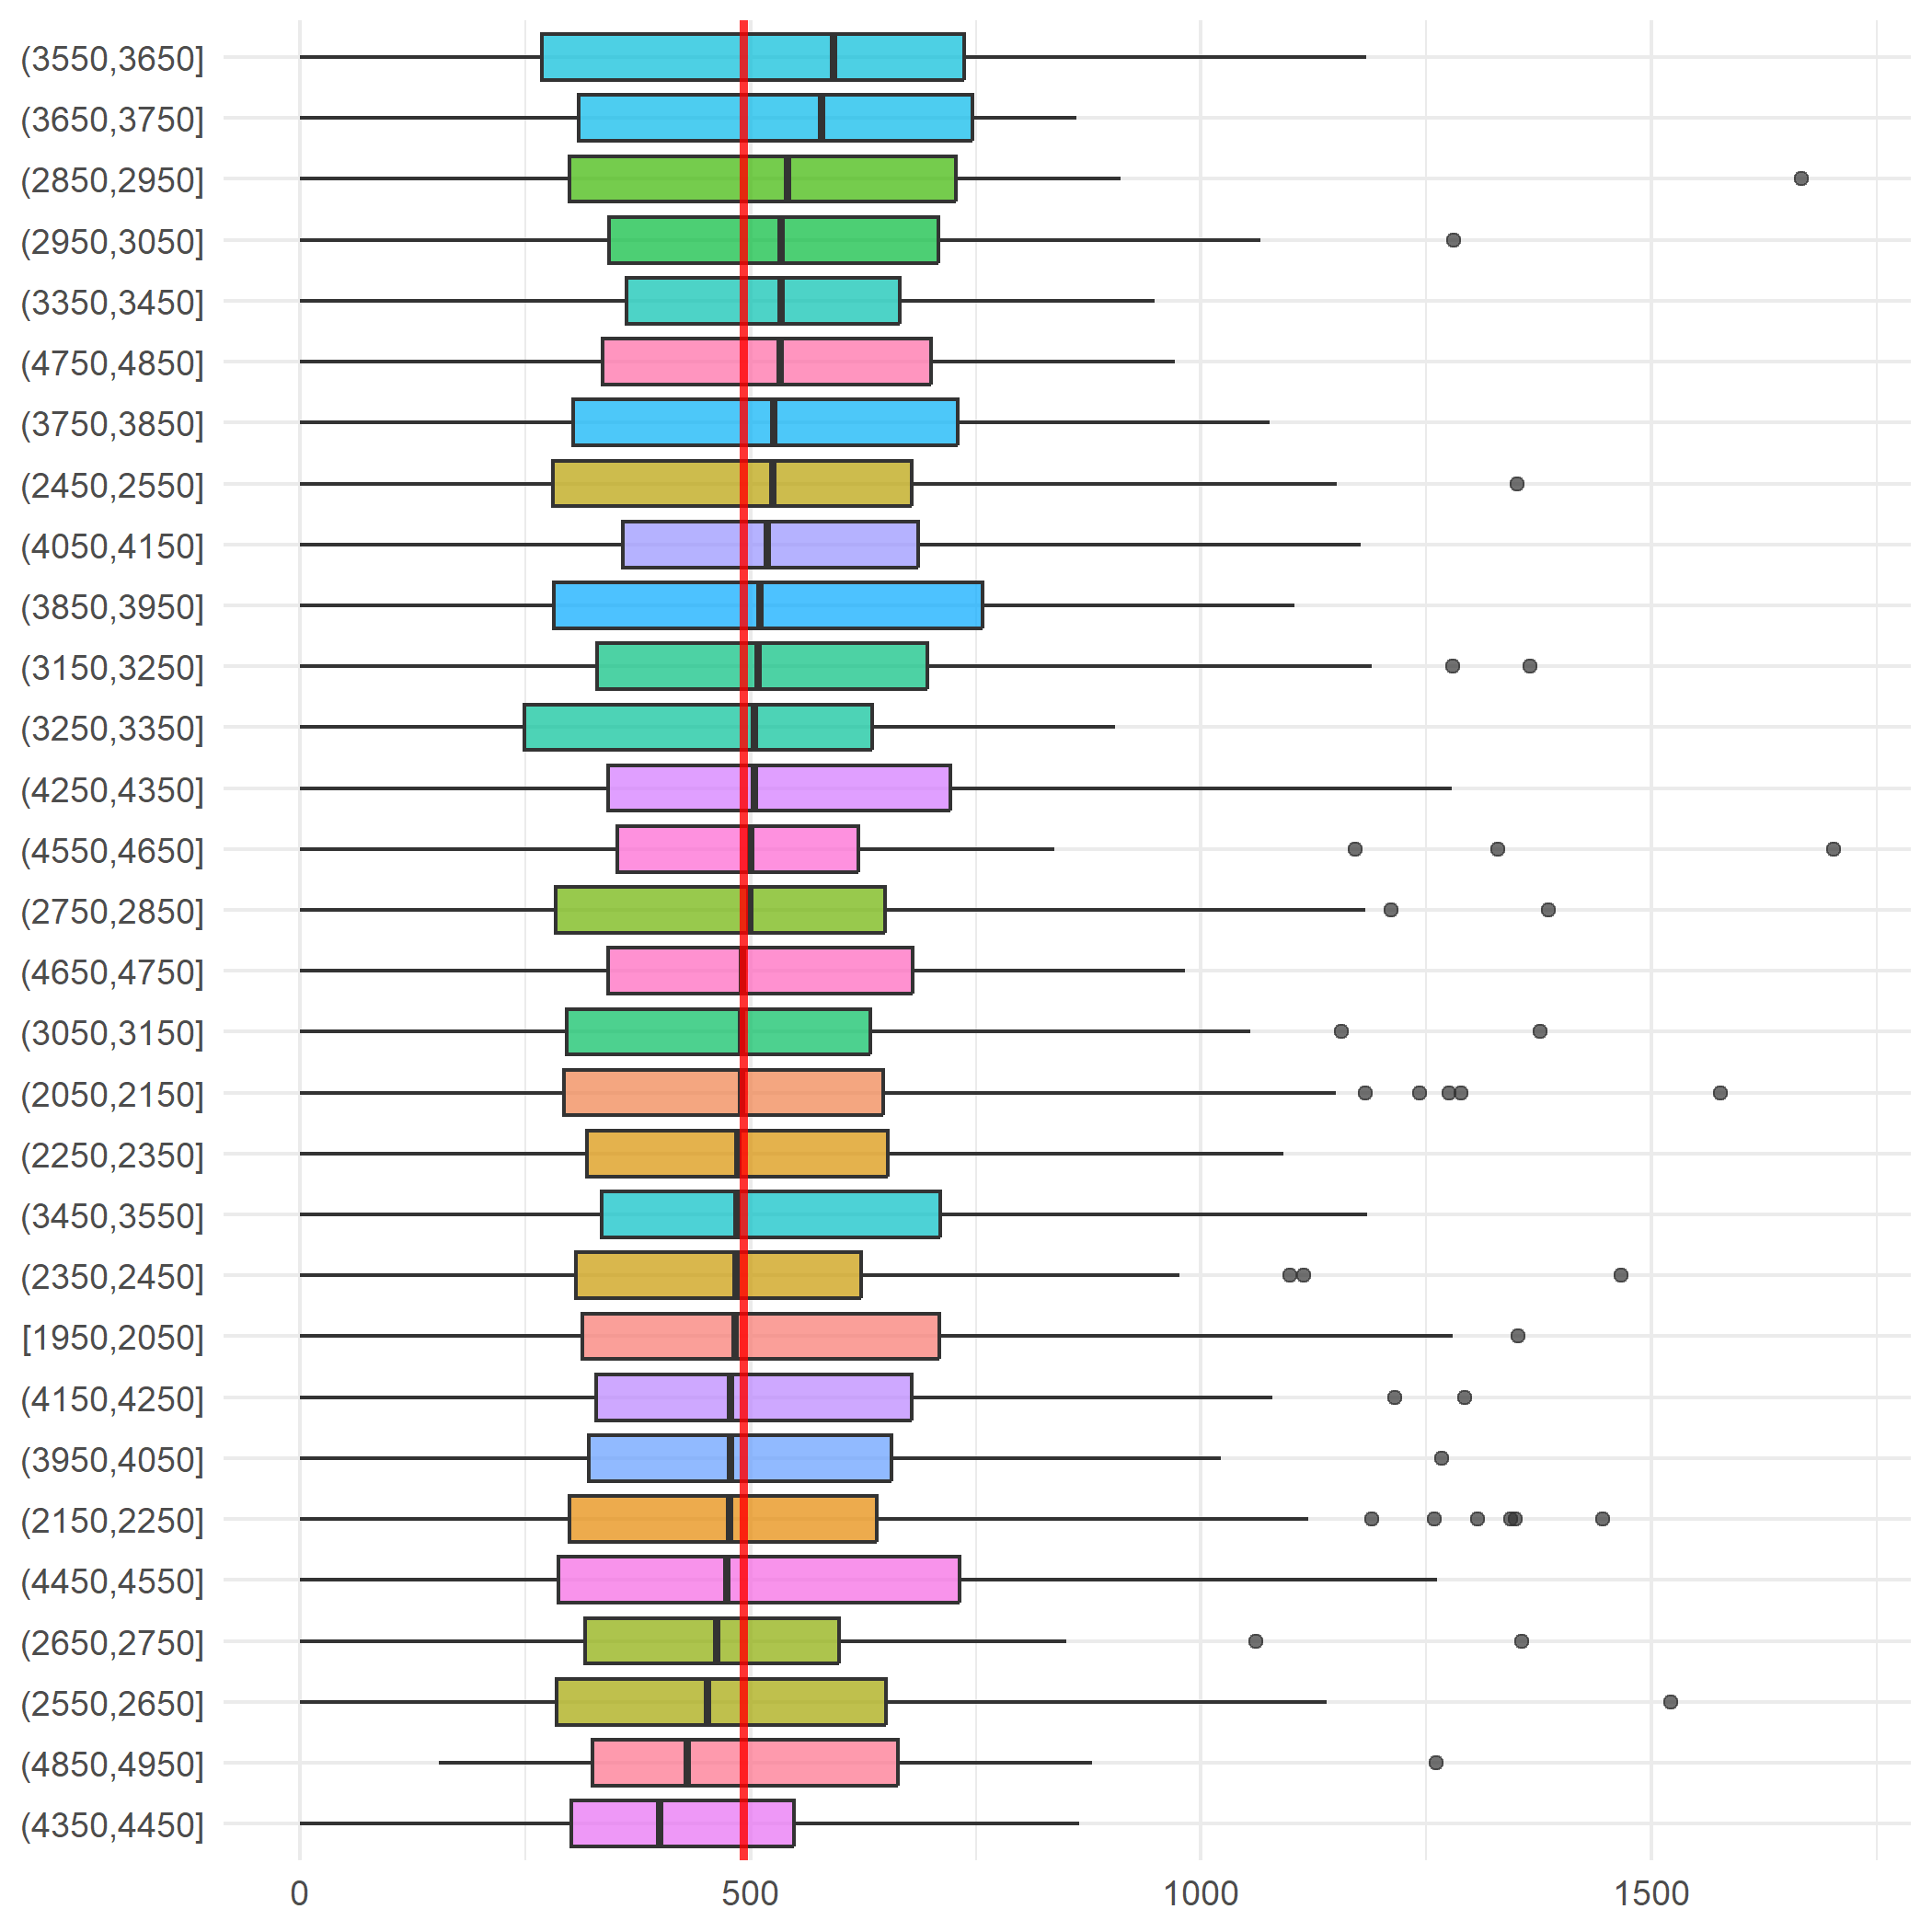
Note: The data and information in this document is reflective of a hypothetical situation and client. This document is to be used for KPMG Virtual Internship purposes only.
Data Exploration
Location
Some locations might be more suitable for cycling
Place any supporting images, graphs, data or extra text here.

Slide 6
Note: The data and information in this document is reflective of a hypothetical situation and client. This document is to be used for KPMG Virtual Internship purposes only.
Model Development
Four Different ML Algorithms and Ensemble Predictions
Since data isn’t very rich different algorithms were utilized
All models had bad model fits
Still could acquire information
Informed decision making is possible

Slide 7
Note: The data and information in this document is reflective of a hypothetical situation and client. This document is to be used for KPMG Virtual Internship purposes only.
Interpretation
Better Data is Needed for Making Interpretations
Existing data set isn’t equipped with strong predictors to make inferences
Variable set should be expanded in the data collection phase
More observations are always welcome

