Slide 1
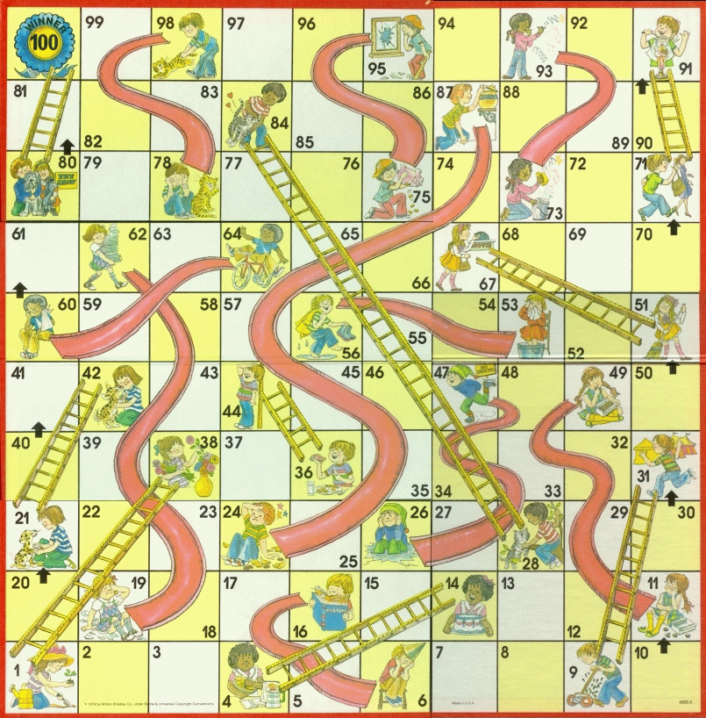
(RE)START
FAST MODE: OFF
0
0
0
0
PLAYERS
A
Annie
P
Paul
A
Aaron
N
Nicole
1
6
2
5
3
4
SPIN

