Slide 1
FOREIGN POLICY OF PAKISTAN

Slide 2
WHAT IS FOREIGN POLICY?
THE FOREIGN POLICY IS ESTABLISHMENT AND
DEVELOPMENT OF RELATIONS AND CORDIAL
FRIENDSHIP WITH OTHER COUNTRIES IN ORDER TO
PROTECT THE NATIONAL INTEREST BY TAKING
APPROPRIATE STEPS AT INTERNATIONAL LEVEL.

Slide 3
ACCORDING TO QUAID-E-AZAM :
“OUR FOREIGN POLICY IS ONE OF FRIENDLINESS AND GOODWILL TOWARDS ALL THE NATIONS OF THE WORLD . WE DO NOT CHERISH ANY AGGRESSIVE DESIGNS AGAINST ANY NATION OR COUNTRY . WE BELIEVE IN THE POLICY OF HONESTY AND FAIRPLAY IN ALL NATIONAL AND INTERNATIONAL DEALINGS AND ARE PREPARED TO CONTRIBUTE OUR UTMOST IN PROMOTING PEACE AND PROSPERITY AMONG THE NATIONS OF THE WORLD . PAKISTAN WILL NEVER BE FOUND LACKING IN EXTENDING ITS MATERIAL AND MORAL SUPPORT TO OPPRESS A SUPPRESS PEOPLE OF THE WORLD AND IN UPHOLDING THE PRINCIPLES OF THE UNITED NATION CHARTER ”

Slide 4
OBJECTIVES
Class | Group 1 | Group 2
 | 82 | 95
Class 2 | 76 | 88
Class 3 | 84 | 90
DEVELOP FRIENDLY RELATIONS
ECONOMIC DEVELOPMENT
SECURITY OF NATIONAL INTEREST
DEFENSE OF IDEOLOGICAL FRONTIERS
NUCLEAR POLICY
UTILIZATION OF NATURAL RESOURCES
CONTROL OF TERRORISM
GEO – STRATEGIC INTEREST
PRESERVATION OF INDEPENDENCE

Slide 5
BASIC PRINCIPLES
NON – INTERFERENCE
CORDIAL RELATIONS WITH MUSLIM COUNTRIES
KASHMIR ISSUE
NUCLEAR DISARMAMENT
RELATIONS WITH SUPERPOWERS
MEMBER OF ORGANIZATIONS
PRESERVATION OF INDEPENDENCE

Slide 6
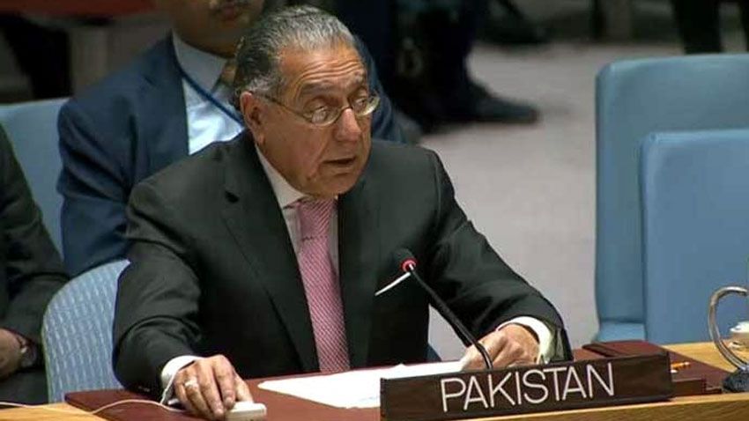
NON - INTERFERENCE
PAKISTAN’S FOREIGN POLICY ENSURES A COMPLETE
NON – INTERFERENCE IN INTERNAL AFFAIRS OF THE STATE ,
PROHIBITING ANY NATION OR SOVEREIGN
AUTHORITY TO INTERVENE IN ANY OF
THE MATTERS OF COUNTRY . ALSO TO
PRESERVE THE NATIONAL AND CRUCIAL
SOVEREIGNTY OF PAKISTAN IN ALL THE
BILATERAL ISSUES RAISED IN UNITED NATIONS SECURITY COUNCIL .

Slide 7
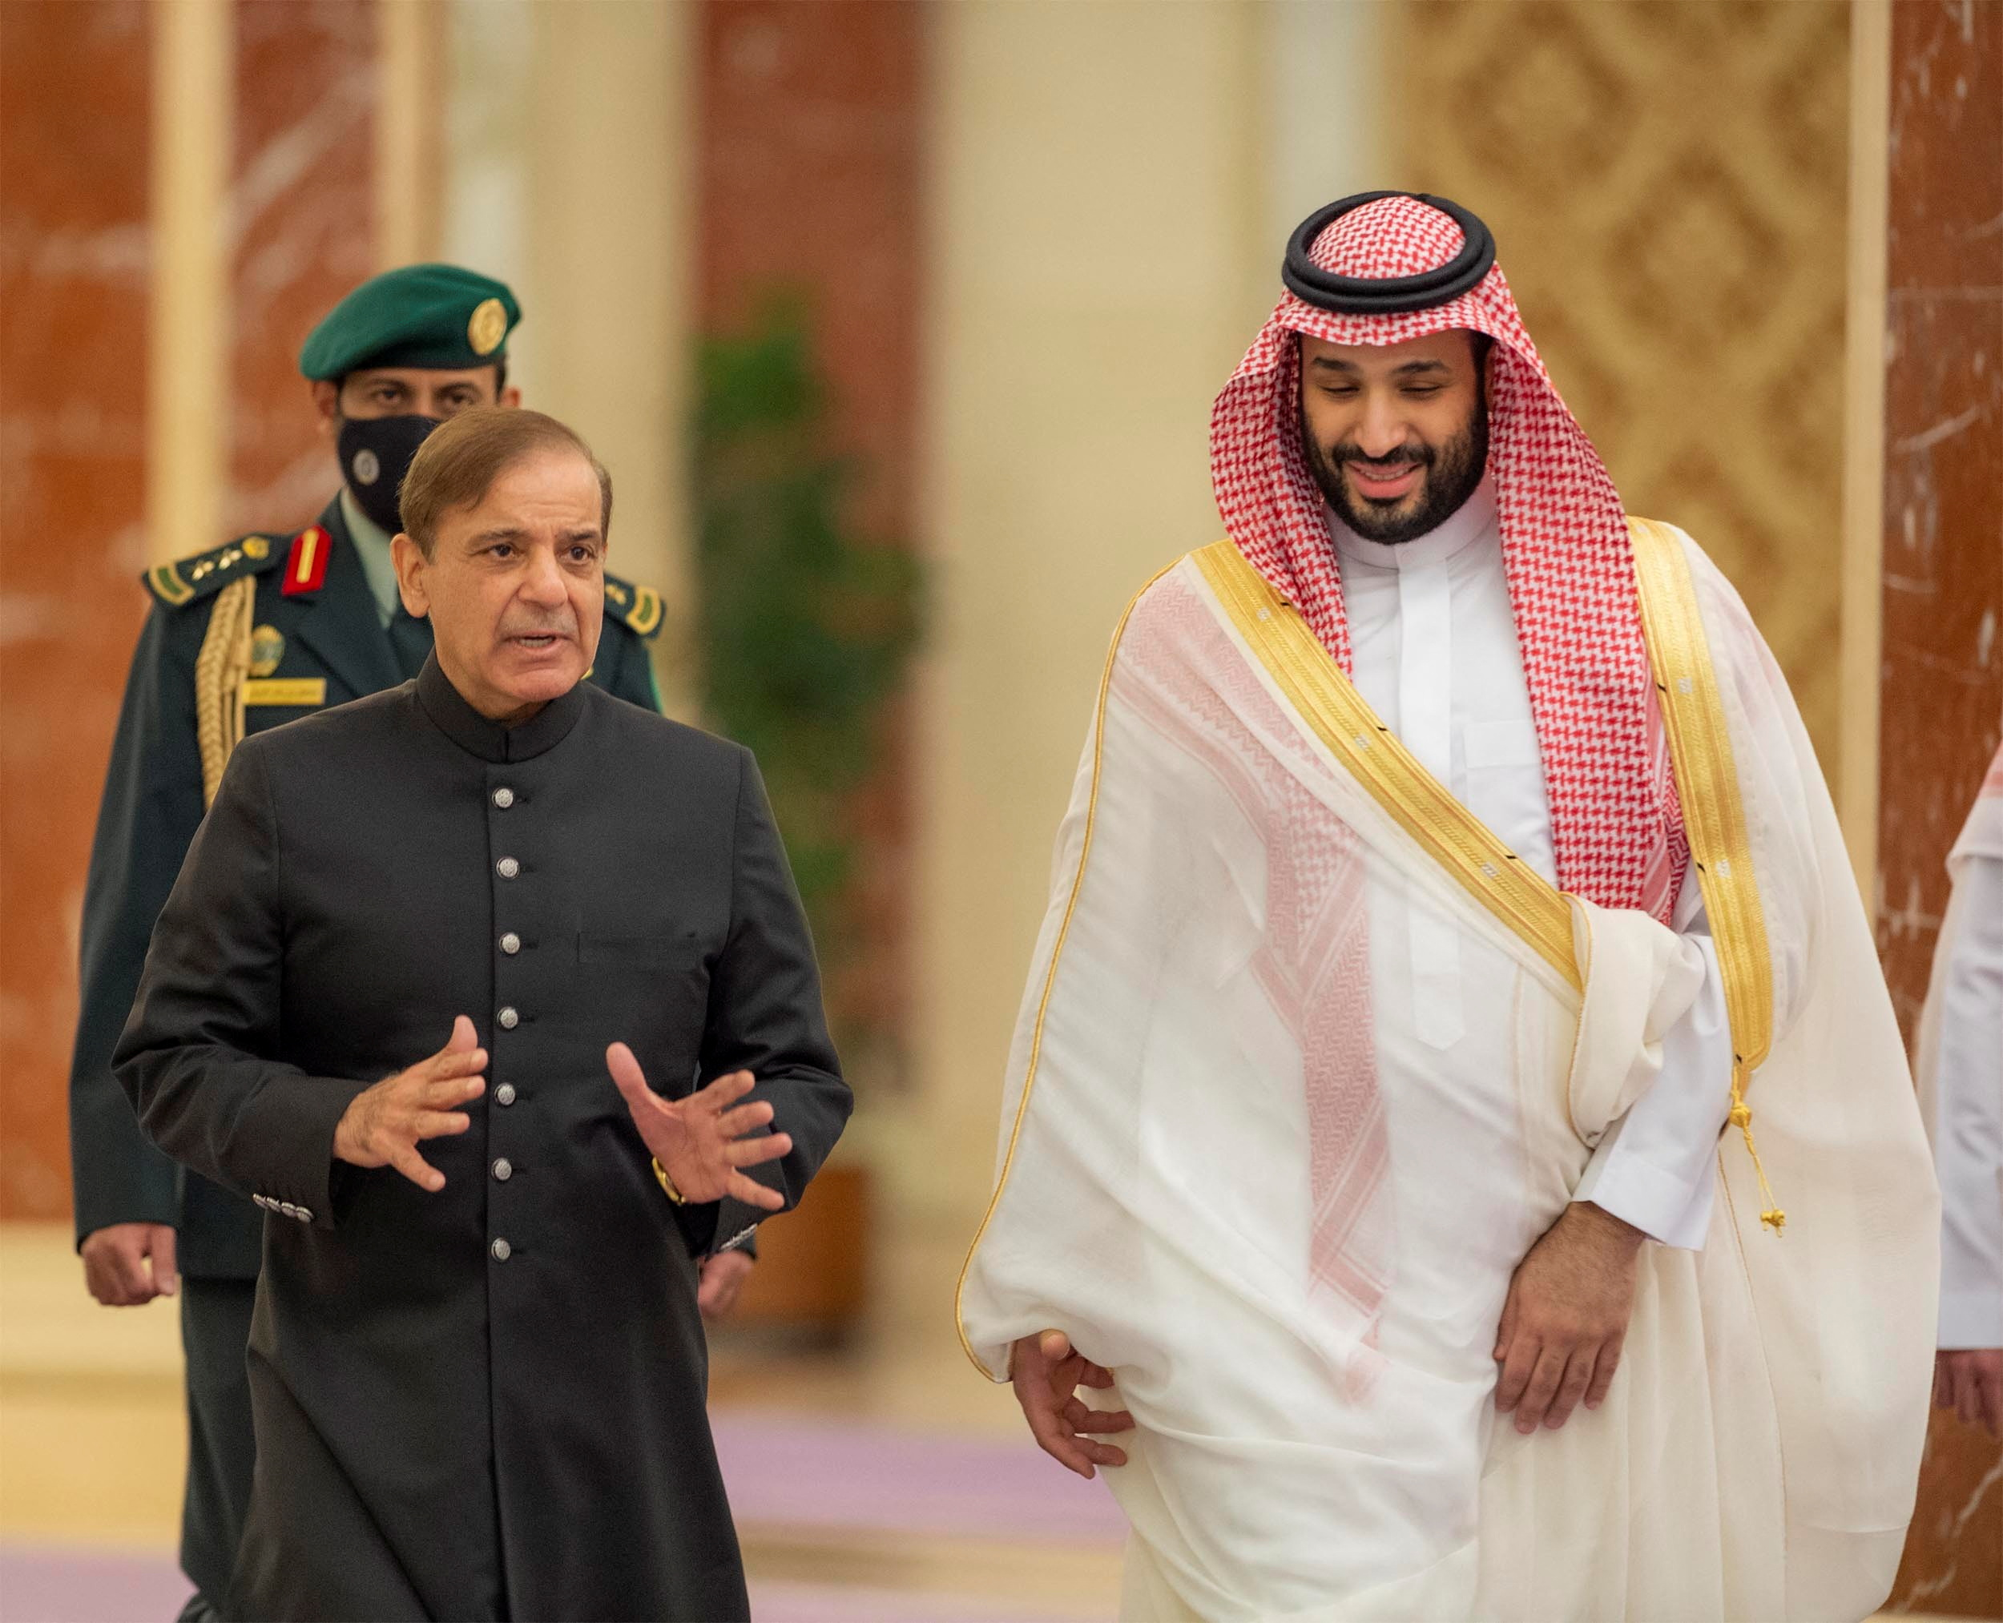
CORDIAL RELATIONS WITH MUSLIM COUNTRIES
PAKISTAN HAS ALWAYS SHOWN KEEN INTEREST IN DEVELOPING
CORDIAL AND FRIENDLY RELATIONS WITH ALL OTHER MUSLIM
COUNTRIES . PAKISTAN IS ONE OF THE
MOST ACTIVE AND POWERFUL LEADER
OF ORGANIZATION OF ISLAMIC COUNTRIES
( OIC ). PAKISTAN ALSO PLAY VARIUOS ROLES
IN PROMOTING PEACE BETWEEN MUSLIM
COUNTRIES AND HELP EACHOTHER IN DEVELOPING TRADE ROUTES
FOR VARIOUS EX AND IMPORTS SUCH AS OIL , GAS , GOOD ETC.

Slide 8
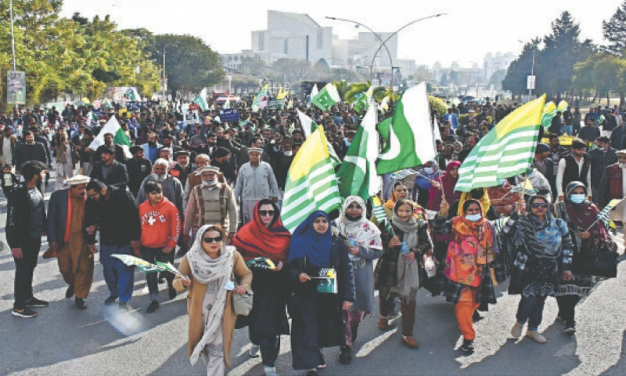
KASHMIR ISSUE
KASHMIR ISSUE IS ALSO ONE OF THE BIGGEST MATTER IN THE
FOREIGN POLICY OF PAKISTAN. PAKISTAN HAS ALWAYS STOOD AND
SUPPORTED KASHMIRIS FOR DEFENDING
THEIR RIGHT OF SELF – DETERMINATION
AGAINST THE CRUEL STANCES OF INDIA.
PAKISTAN HAS ALWAYS RAISED THE
ISSUE OF KASHMIR IN VARIOUS SUMMITS
I.E. SCO, UN, OIC, NAM ETC. PAKISTAN WILL ALWAYS SUPPORT THEM
AND WILL CONTINUE TO SUPPORT THEIR JUST CASE.

Slide 9
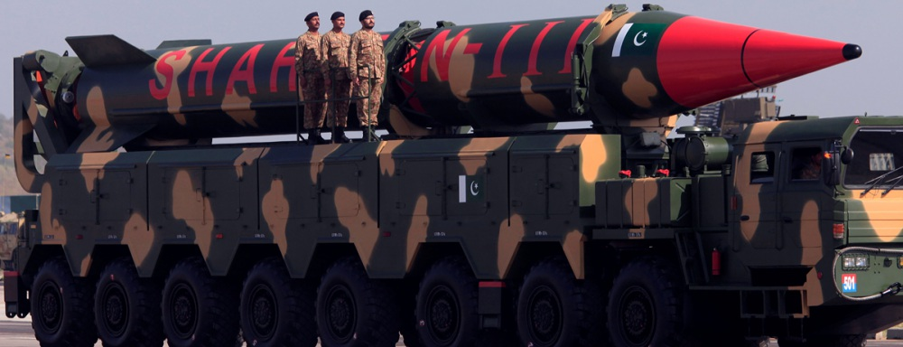
NUCLEAR DISARMAMENT
DISARMAMENT REFERS TO THE POLICY OF REDUCTION OR WITHDRAWAL
OF ARMS, WEAPONS, NUKES AND MILITARY FORCES FROM SOMEWHERE .
PAKISTAN HAS APPOINTED A POLICY OF
NUCLEAR DISARMAMENT IN CASE OF
ANY WAR AND WILL ALWAYS TRY TO
PROMOTE PEACE AND HARMONY ALL
OVER THE WORLD. PAKISTAN HAS ALSO
DECLARED THAT PAKISTAN WILL ALWAYS ACT AS A NON – NUCLEAR
STATE UNTIL ANYOTHER NATION WITH NUKES WAGE A WAR AGAINST IT.

Slide 10
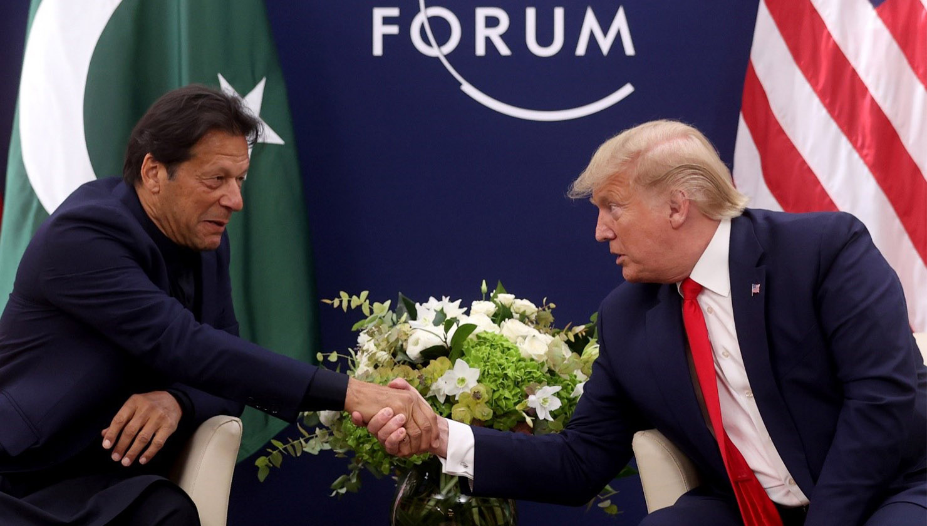
RELATIONS WITH SUPER POWER
PAKISTAN HAS A VERY SOPHISTICATED AND WELL – ESTABLISHED POLICY
TOWARDS HAVING GOOD RELATIONS WITH SUPERPOWERS . PAKISTAN IS
ALWAYS CONCERNED WITH SUPERPOWERS
FOR ALL INTERNATIONAL DEALINGS AND HAS
A VERY WELL ATTITUDE TOWARDS THEIR
POLICIES . CHINA IS THE BIGGEST ALLY OF
PAKISTAN AND THE BIGGEST TRADE PARTNER
IN WORLD . RUSSIA AND PAKISTAN HAVE
ADOPTED VARIOUS WEAPON POLICIES . UNITED STATES IS THE CHIEF
ADMINISTER IN THE POLITICS OF PAKISTAN AND DEFENDING AGAINST
TERRORISM .

Slide 11
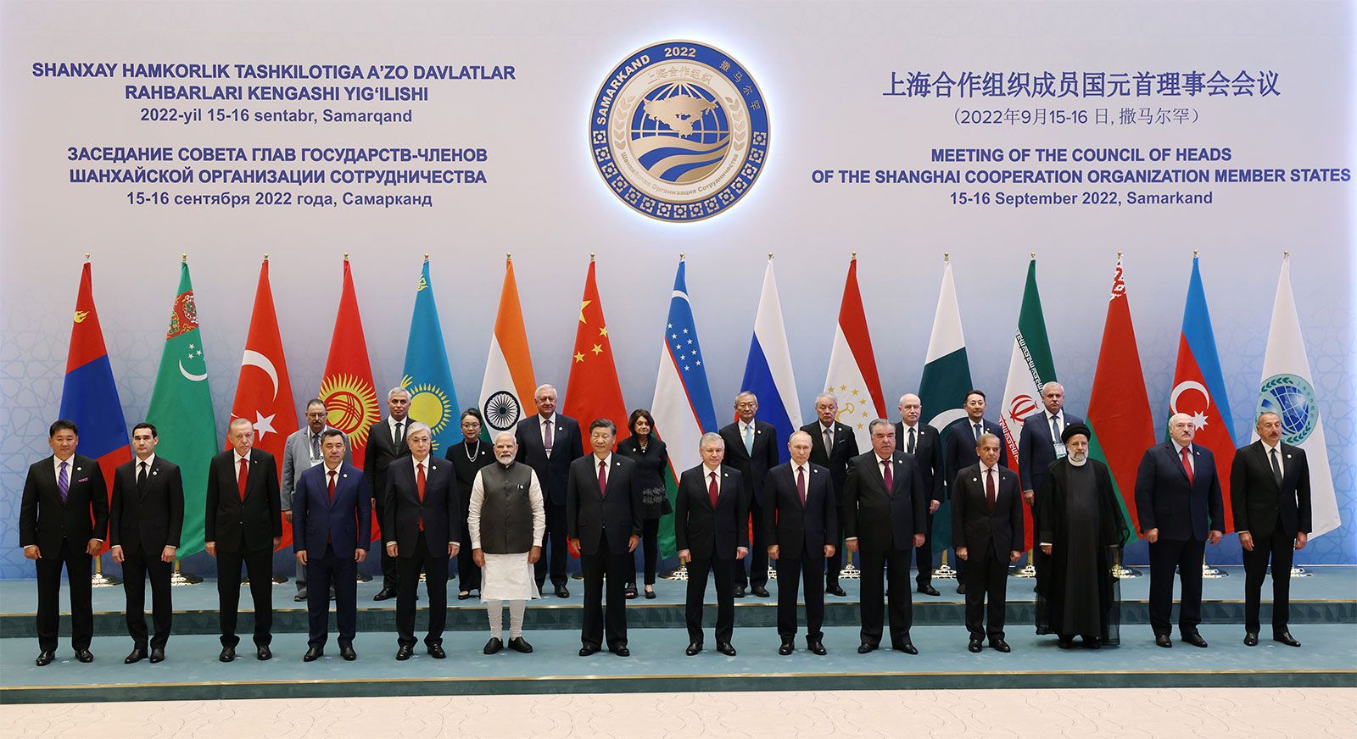
MEMBER OF ORGANIZATIONS
PAKISTAN IS AN INTEGRAL PART AND MEMBER OF VARIOUS IMPORTANT
ORGANIZATIONS WHICH ARE STRATEGIZED FOR DIFFERENT PURPOSES .
PAKISTAN IS MEMER OF UNITED NATIONS (UN) , NON – ALLIGNED
MOVEMENT (NAM) , SOUTH ASIAN ASSOCIATION
OF REGIONAL COORPORATION (SAARC) , SHANGHAI
COOPERATION ORGANIZATION (SCO) , ORGANIZATION
OF ISLAMIC COUNTRIES AND BRITISH COMMON
WEALTH (BCW) . PAKISTAN PLAYS AN IMPORTANT
ROLE IN THESE ORGANIZATIONS AND ALWAYS SUPPORTED THEMSELVES IN
VARIOUS FIELDS .

