Slide 1
FOREIGN POLICY OF PAKISTAN

Slide 2
WHAT IS FOREIGN POLICY?
Foreign Policy can be defined as a set of strategies a country uses to manage its interactions and relationships with other countries.
It aims at the establishment of friendly and cordial relations to protect national interests, security and economic prosperity on the international stage.
It includes diplomacy, trade, defense, human rights and cultural exchanges.

Slide 3
ACCORDING TO QUAID-E-AZAM :
“OUR FOREIGN POLICY IS ONE OF FRIENDLINESS AND GOODWILL TOWARDS ALL THE NATIONS OF THE WORLD . WE DO NOT CHERISH ANY AGGRESSIVE DESIGNS AGAINST ANY NATION OR COUNTRY . WE BELIEVE IN THE POLICY OF HONESTY AND FAIRPLAY IN ALL NATIONAL AND INTERNATIONAL DEALINGS AND ARE PREPARED TO CONTRIBUTE OUR UTMOST IN PROMOTING PEACE AND PROSPERITY AMONG THE NATIONS OF THE WORLD . PAKISTAN WILL NEVER BE FOUND LACKING IN EXTENDING ITS MATERIAL AND MORAL SUPPORT TO OPPRESS A SUPPRESS PEOPLE OF THE WORLD AND IN UPHOLDING THE PRINCIPLES OF THE UNITED NATION CHARTER ”

Slide 4
CONSTITUTION OF PAKISTAN:
The Constitution of Pakistan also lays down guidelines for the conduct of foreign policy of the country. Article 40 of the constitution provides that:
“The State shall endeavor to preserve and strengthen fraternal relations among Muslim countries based on Islamic unity, support the common interests of the peoples of Asia, Africa and Latin America, promote international peace and security, foster goodwill and friendly relations among all nations and encourage the settlement of international disputes by peaceful means.”

Slide 5
OBJECTIVES
Class | Group 1 | Group 2
 | 82 | 95
Class 2 | 76 | 88
Class 3 | 84 | 90
DEVELOPMENT OF FRIENDLY RELATIONS
ECONOMIC DEVELOPMENT
SECURITY OF NATIONAL INTEREST
DEFENSE OF IDEOLOGICAL FRONTIERS
NUCLEAR POLICY
UTILIZATION OF NATURAL RESOURCES
CONTROL OF TERRORISM
GEO – STRATEGIC INTEREST
PRESERVATION OF INDEPENDENCE

Slide 6
CORE PRINCIPLES
NON – INTERFERENCE
CORDIAL RELATIONS WITH MUSLIM COUNTRIES
NUCLEAR DISARMAMENT
RELATIONS WITH SUPERPOWERS
PRESERVATION OF INDEPENDENCE

Slide 7
NON - INTERFERENCE
Pakistan’s Foreign Policy refrains from intervening in the internal affairs of the other nations, respecting their sovereignty and independence.
It avoids imposing political ideologies or governance models on other countries.
It upholds the idea that each state has the right to manage its own political, social, and economic systems without external influence.

Slide 8
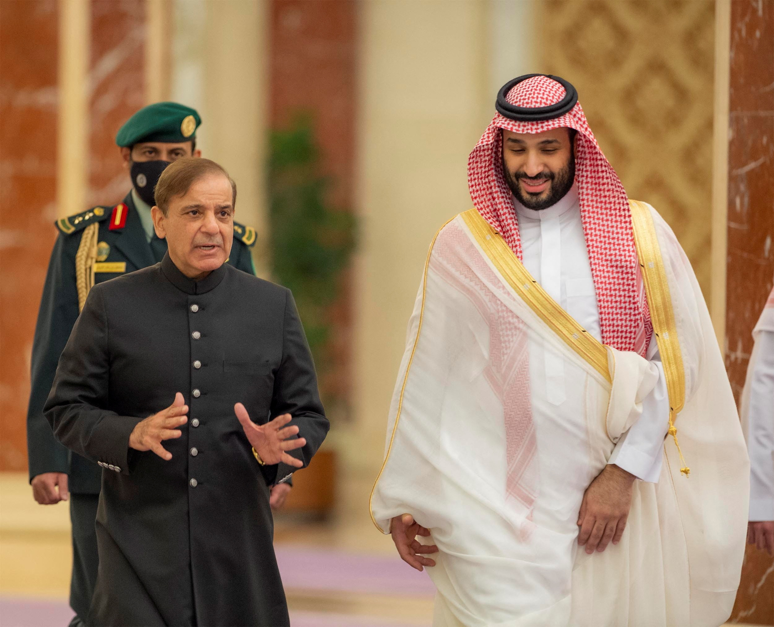
CORDIAL RELATIONS WITH MUSLIM COUNTRIES
Pakistan foreign policy promotes the development of strong friendly and genial relations with the Muslim countries.
It maintains strong diplomatic ties with Muslim
countries such as Saudi Arabia, Turkey, Qatar
focusing on trade, labor and energy partner-
-ships.
It supports Islamic values such as the Palestinian
right to self determination an opposition to Islamophobia globally.

Slide 9
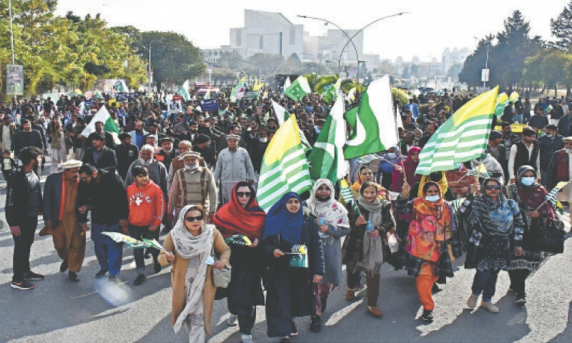
PRESERVATION OF STATE INDEPENDENCE
Pakistan’s foreign policy on state independence is rooted in its support for the right of self determination and opposition to foreign occupation.
It has advocated for the people of
Kashmir and Palestine and condemned
the Anti-Muslim polices of India and
Israel.
Pakistan emphasizes that both Kashmiris and Palestinians should be allowed independence free from occupation and external control.

Slide 10
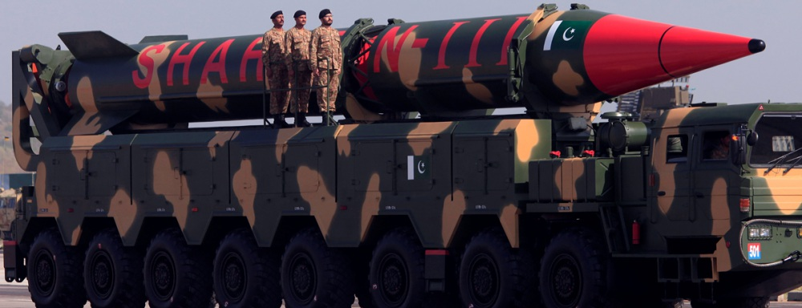
NUCLEAR DISARMAMENT
Pakistan’s policy advocates for the for non-proliferation and nuclear disarmament.
Pakistan developed nuclear capability primarily for self defense and deterrence, particularly in response to regional rival
India’s nuclear program.
It emphasizes responsible and restrained use of
nuclear weapons, maintaining them as a deterrent
rather than offensive tools.

Slide 11
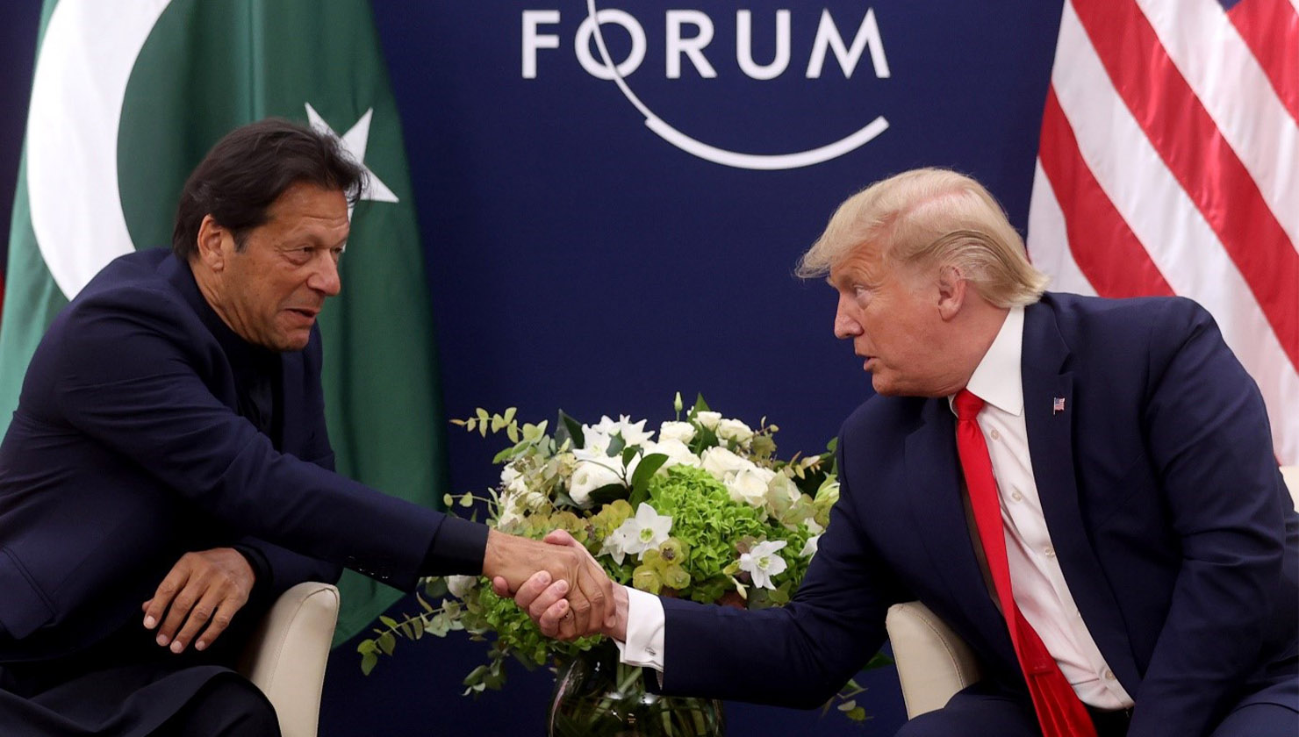
RELATIONS WITH SUPER POWERS
Pakistan’s foreign policy powers to develop congenial and friendly relations with all the big powers such as USA, China, Russia.
Its objective is to establish balanced relations with all the big powers to safeguard its national interests, security and
economic requirements.
Pakistan seeks economic cooperation and investme-
-nt opportunities with superpower to aid its
development.

Slide 12
SIGNIFICANT SUCCESSES AND FAILURES OF THE POLICY:
SUCCESSES:
Strategic partnership with China (CPEC):
The China-Pakistan Economic Corridor is one of the flagship projects under China’s Belt and Road initiative. This partnership has increased Pakistan’s global standing and provided a powerful economic and strategic ally in China.
2. Influence in the Islamic world:
Pakistan is a major member of Organization of Islamic Cooperation. Its stances on issues like Palestine, Kashmir, and Islamophobia has garnered respect from the Islamic world, helping Pakistan to maintain strong diplomatic and cultural relations with various Islamic countries.

Slide 13
3. Increased engagement with Russia:
Pakistan’s improved relations with Russia have diversified its foreign policy beyond traditional alliances, creating new economic and defense cooperation opportunities.
4. Strengthening Ties with Turkey and Malaysia:
Pakistan has reinforced its ties with Turkey and Malaysia, building on shared cultural, historical, and religious values. This relationship has translated into growing cooperation in trade, defense, and diplomatic backing on international issues.
FAILURES:
1. Strained ties with US and India:
While Pakistan has historically been a close ally of the US, recent shifts in US foreign policy towards stronger ties with India have strained the relationship. Additionally, challenges related to counter-terrorism have created friction. Relations with India remain hostile due to territorial disputes and political tensions, limiting economic and cultural exchanges.

Slide 14
2. Diplomatic isolation over regional issues:
Pakistan's regional policies, particularly concerning Afghanistan and its internal handling of various groups, have contributed to diplomatic isolation. Neighboring countries and other regional players often view Pakistan with caution due to perceived interference and its stance on various conflicts, which has limited its influence in broader regional cooperation efforts.
3. Economic Struggles:
Pakistan has faced persistent economic difficulties, with high levels of debt, low foreign reserves, and reliance on external aid. Economic instability has hampered its ability to conduct a more assertive foreign policy, as financial dependence often leads to external pressures that shape Pakistan’s international decisions.
4. Unresolved conflict over Kashmir:
The Kashmir issue remains a central conflict in Pakistan-India relations, with little diplomatic progress made in recent years. The unresolved conflict has led to military standoffs, high defense spending, and an inability to build trade or cultural ties that could stabilize the region.

Slide 15
Lack of Integration into Major Trade Agreements:
Pakistan has not been able to integrate effectively into major international trade agreements, such as regional free trade zones or economic partnerships like ASEAN. This has limited its ability to benefit from global trade networks and increase exports.
CONCLUSION:
Pakistan’s foreign policy reflects a complex balance of strategic alliances, regional stability efforts, and advocacy for Muslim solidarity, driven by the goals of security, economic development, and diplomatic influence. While Pakistan has achieved notable successes, such as its robust partnership with China, its respected role within the Islamic world, and its contributions to UN peacekeeping, it continues to face challenges. Issues such as strained relations with India, economic dependencies, and a need for greater global integration highlight areas for growth.
Moving forward, Pakistan’s foreign policy can be strengthened by fostering economic diplomacy, building regional partnerships, and enhancing its role in global forums. A stable, adaptable foreign policy will be crucial for Pakistan to secure its interests, address internal and external challenges, and contribute positively to regional and global stability.

