Slide 1
A Multi-Model Approach to Life Expectancy Prediction: Balancing Interpretability and Accuracy with Multiple Linear Regression, Random Forests and XGBoost
Authors:
1. Okello Andrew Peters 2024/HD05/21944U
2. Nalikka Joan Deborah
2024/HD05/26060U
Presented by – Andrew & Joan
Affiliation: Makerere University
Uganda

Slide 2
Introduction
This study contributes to Sustainable Development Goal 3 (Good Health and Well-being) by providing predictive insights into factors affecting life expectancy, enabling policymakers to make data-driven decisions for improving health outcomes Life expectancy is a critical health indicator, shaped by a wide range of factors such as socioeconomic status, healthcare access, and environmental conditions. Accurately predicting life expectancy is essential for shaping policies aimed at reducing health disparities and improving public health outcomes. However, existing predictive models face significant challenges: while linear models, such as Multiple Linear Regression (MLR), offer valuable interpretability, they often fail to capture the complex, non-linear relationships inherent in life expectancy data. On the other hand, ensemble methods like Random Forest and XGBoost enhance predictive accuracy but sacrifice interpretability.

Slide 3
Background
Life expectancy serves as a key indicator of health and wellbeing, directly aligning with SDG 3, which aims to ensure healthy lives and promote well-being for all at all ages. Life expectancy is a vital indicator of the overall health and wellbeing of populations worldwide, reflecting the effectiveness of healthcare systems, socioeconomic conditions, and environmental factors. It is shaped by a complex interplay of elements, including economic conditions, healthcare access, and lifestyle behaviors, which vary significantly across countries and regions. Understanding these factors is crucial for governments and international organizations seeking to design policies that improve public health outcomes and address health disparities. The dataset used in this study provides a comprehensive view of life expectancy trends across various countries from 2000 to 2015. It includes key indicators such as adult mortality rates, infant deaths, access to healthcare services (e.g., immunization rates and healthcare expenditures), economic factors (e.g., GDP), and lifestyle behaviors (e.g., alcohol consumption)
Notes:
The dataset can be found here.

Slide 4
Literature Review
Research consistently shows that socioeconomic status (SES) plays a significant role in determining life expectancy. Lower SES often correlates with poorer health outcomes, higher mortality rates, and limited access to quality healthcare. Studies indicate that as much as 30-55% of health outcomes can be attributed to social determinants such as income, education, and housing.
[1] One example is a study that used a hybrid Genetic Algorithm-Support Vector Machine (GA-SVM) model to predict life expectancy following thoracic surgeries for cancer patients [1].
Some researchers have integrated machine learning into multivariate regression techniques, using datasets with multiple socioeconomic and healthcare indicators to analyze life expectancy trends across continents [2].
Notes:
The dataset can be found here.

Slide 5
Gaps in Related work
Generalizability Across Diverse Populations and Conditions
Limited Focus on Emerging Economies.
3. Role of Environmental Factors.
4. Dynamic Interactions Between Variables.
5. Data Limitations in Developing Countries
6. Over fitting in Linear Regression Models

Slide 6
Problem Statement
Life expectancy prediction involves complex relationships among socioeconomic, healthcare, and environmental factors. Traditional models like Linear Regression (LR) are interpretable but prone to overfitting, while ensemble methods like Random Forests and XGBoost improve accuracy but lack transparency. This study tackles these challenges using a multi-model approach to balance interpretability and accuracy. By integrating LR, Random Forest, and XGBoost, and employing LIME and SHAP for explainability, it enhances model transparency while addressing overfitting. The research aims to uncover key determinants of life expectancy and provide actionable insights, especially for underrepresented regions like emerging economies

Slide 7
Significance of the Project
The significance of this study lies in its potential to utilize a multi-model approach that addresses the overfitting issue in linear regression while also demystifying the black-box nature of models like Random Forests and XGBoost. This is achieved by employing libraries such as LIME to explain how these models generate their outputs.

Slide 8
ML Research Objective
This project aims to develop a multi-model approach to predict life expectancy by utilizing Linear Regression, Random Forest model and XGBoost.
Linear Regression will provide a baseline, interpretable model that highlights direct relationships between variables such as GDP, healthcare expenditure, and immunization rates with life expectancy.
Random Forest and XGBoost will complement this by capturing complex, non-linear interactions between variables, improving predictive accuracy, and ranking the importance of each feature.

Slide 9
Research Questions
1. How do socioeconomic, healthcare, and environmental factors contribute to predicting life expectancy, and can a linear regression model effectively capture these relationships?
2. Can Random Forests improve the predictive accuracy of life expectancy models by capturing non-linear relationships between healthcare, demographic, and socioeconomic factors?
3. Which factors are most important in predicting life expectancy, and how do their contributions vary between linear regression and Random Forest models?

Slide 10
Dataset Description
The Global Health Observatory (GHO) data repository under World Health Organization (WHO) keeps track of the health status as well as many other related factors for all countries The datasets are made available to public for the purpose of health data analysis. The dataset related to life expectancy, health factors for 193 countries has been collected from the same WHO data repository website and its corresponding economic data was collected from United Nation website. Among all categories of health-related factors only those critical factors were chosen which are more representative.

Slide 11
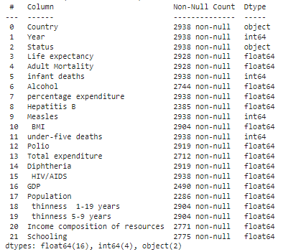
Dataset Features and Shape
The Dataset has 2938 records and 22 features

Slide 12
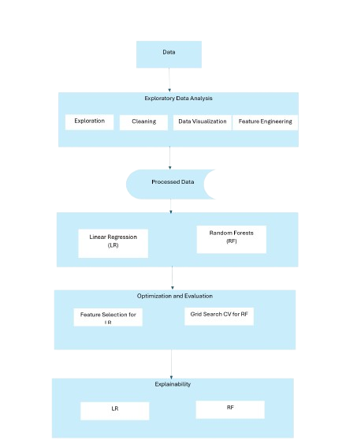
Methodology

Slide 13
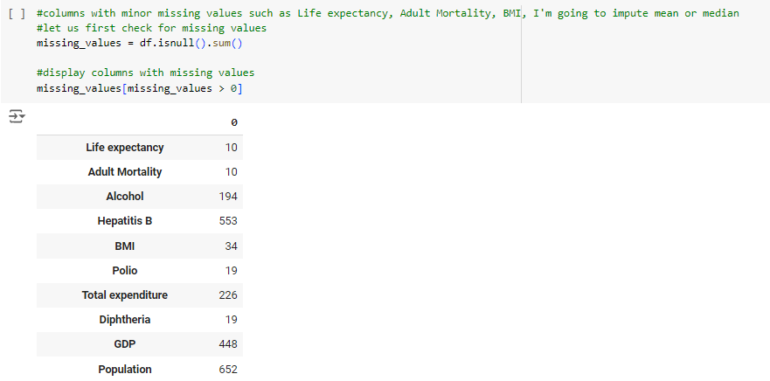
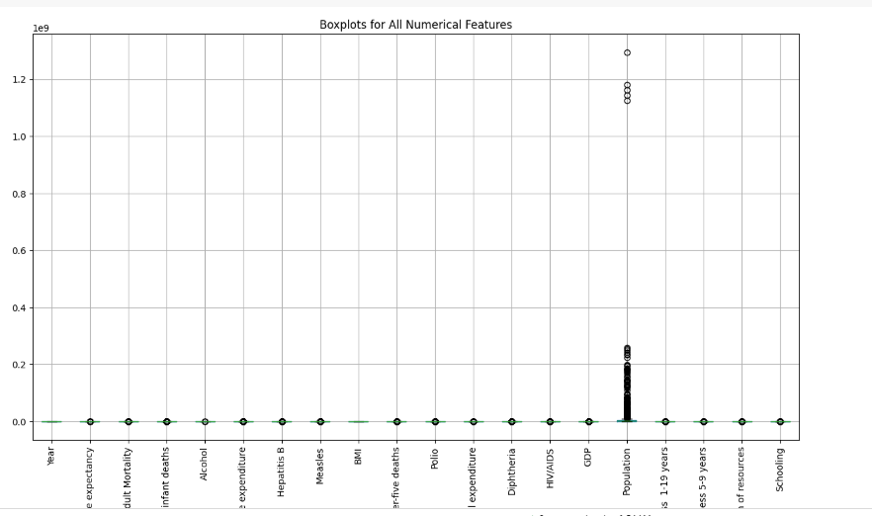
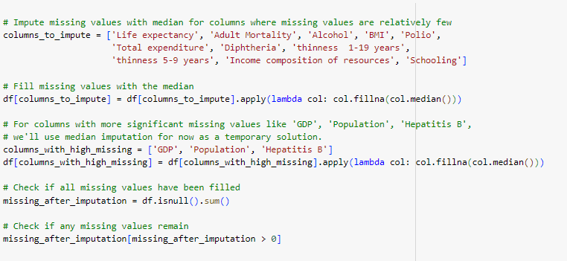
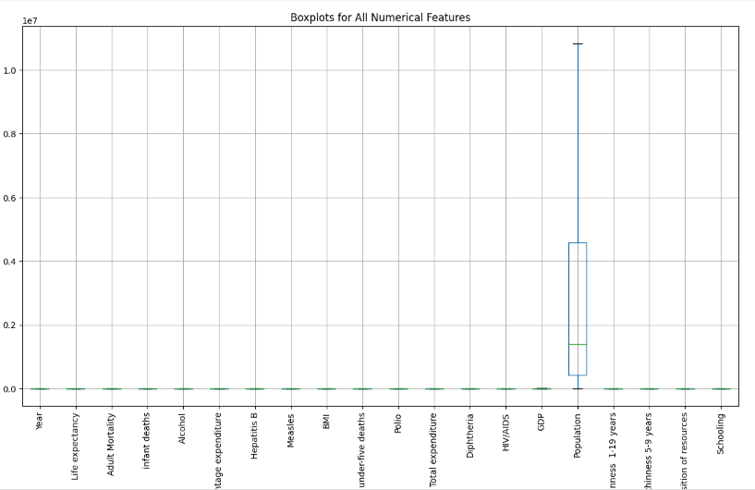
Data Cleaning and Preprocessing

Slide 14
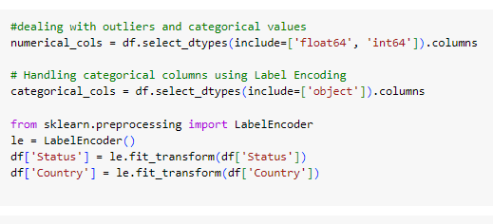
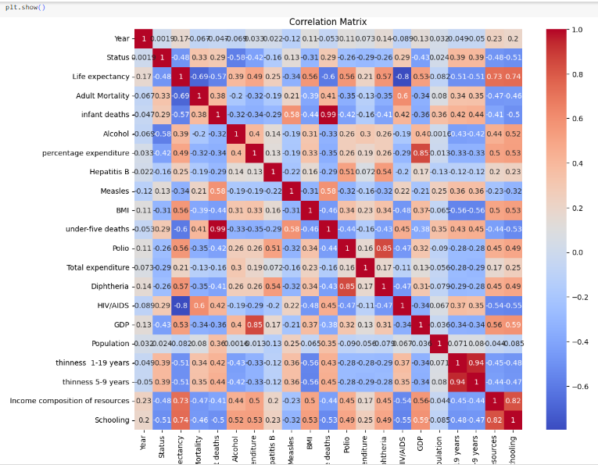
Data Cleaning and Preprocessing…

Slide 15
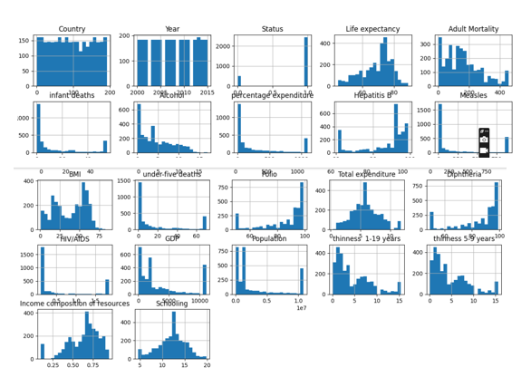
Univariate Analysis Visuals

Slide 16
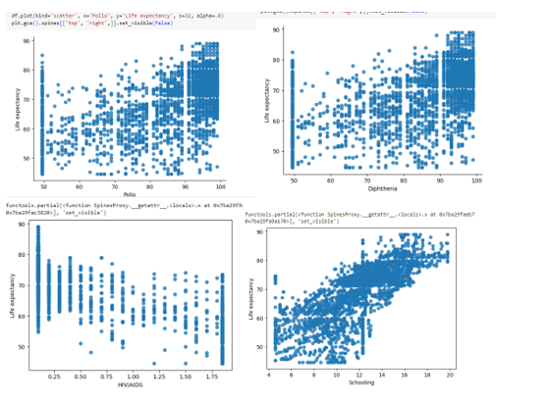
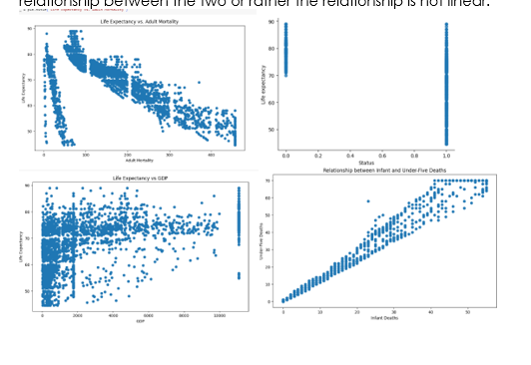
Bivariate Analysis Visuals

Slide 17
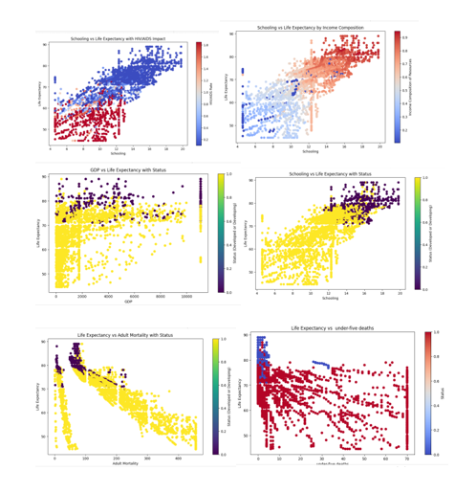
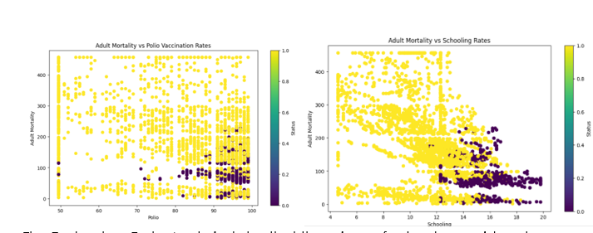
Multivariate Analysis Visuals

Slide 18
Model Results
Model | R Squared | Mean Squared Error
Linear Regression (lr) | 0.8595 | 12.1511
Random Forest Regressor | 0.967 | 2.84
XGBRegressor | 0.967 | 2.84
Notes:
Link: https://sorry.vse.cz/~berka/challenge/PAST/

Slide 19
Conclusion
This study employed a multi-model approach combining Multiple Linear Regression, Random Forests, and XGBoost to predict life expectancy based on socioeconomic, health, and environmental data. This study supports SDG 3, offering actionable insights for reducing health disparities and improving global well-being:
1. The study successfully demonstrated the influence of critical factors like GDP, healthcare access, and mortality indicators on life expectancy. However, the exclusion of environmental variables and non-communicable diseases (NCDs) limits the scope of actionable insights.
2. The focus on global datasets provided a broad perspective but lacked region-specific insights, particularly for emerging economies, which may face unique determinants of life expectancy.
3. Though SHAP and LIME were applied for interpretability, the models’ capacity to dynamically capture interactions between predictors over time remains an area for enhancement

Slide 20
Future Work
To address these limitations and expand upon the research gaps, the following directions are recommended:
Incorporate Environmental and Climate Factors Integrate variables such as air pollution levels, climate metrics, and ecological degradation to assess their impact on health and life expectancy, especially in vulnerable regions such as sub-Saharan Africa.
Including Non-Communicable Diseases (NCDs) Extend the model’s scope to include predictors related to NCDs, such as cardiovascular diseases and diabetes, which significantly affect life expectancy in developing regions.
Modeling Interactions and Longitudinal Data Develop advanced models capable of capturing dynamic interactions among variables over time. Incorporating recurrent neural networks (RNNs) or time-series analysis can better predict long-term trends. 4.
Policy Translation Framework Establish a clear methodology to translate predictive insights into actionable policy recommendations, focusing on reducing health disparities and improving resource allocation in underserved regions

Slide 21
References
1. https://www.mdpi.com/2076-3417/12/21/10927
2. https://www.enjoyalgorithms.com/blog/life-expectancy-prediction-using-linear-regression

