Slide 1
Software Testing

Slide 2
Overview
Definition of Software Testing
Problems with Testing
Benefits of Testing
Effective Methods for Testing

Slide 3
Definition of Software Testing
Software testing is the process of executing a software system to determine whether it matches its specification and executes in its intended environment.

Slide 4
“Program testing can be a very effective way to show the presence of bugs, but it is hopelessly inadequate for showing their absence” [Dijkstra, 1972]

Slide 5

Why Test?
Q: If all software is released to customers with faults, why should we spend so much time, effort, and money on testing?

Slide 6
Cost of Delaying the Release of a Software Product
Timing is another important factor to consider.
New products: The first to the market often sells better than superior products that are released later.

Slide 7
Beta Testing
Customers test for free!
Seems to give you test cases representative of customer use.
Helps to determine what is most important to the customers.
Can do more configuration (environment) testing than in your testing lab.

Slide 8
Problems with Beta Testing
Most beta testers are “techies” who have a higher tolerance of bugs. They do not represent the average customer.
Beta testers usually won’t report: usability problems, bugs they don’t understand and bugs that seem obvious.
Takes much more time and effort to handle a user reported bug.

Slide 9
Cutting Testing Costs can Increase other Costs
Customer support can be very expensive. Less bugs = less calls.
Customers will look for more reliable solutions.
Software organizations must perform cost benefit analysis’ to determine how much to spend on testing.

Slide 10
Problems with Testing
Since it is impossible to find every fault in a software system, bugs will be found by customers after the product is released.

Slide 11
Another Problem
In many software companies, testers are ill-equipped to test software. For example: My last co-op firm (which will remain unnamed).
Testing done almost entirely by untrained co-ops.
Testers were responsible for creating black-box test plans without being given formal specifications.
Testers were not provided with tools to automate test plans.

Slide 12
Reasons that Bugs Escape Testing
User executed untested code.
User executed statements in a different order than was tested.
User entered an untested combination of inputs.
User’s operating environment was not tested.

Slide 13
Why Can’t Every Bug be Found?
Too many possible paths.
Too many possible inputs.
Too many possible user environments.

Slide 14
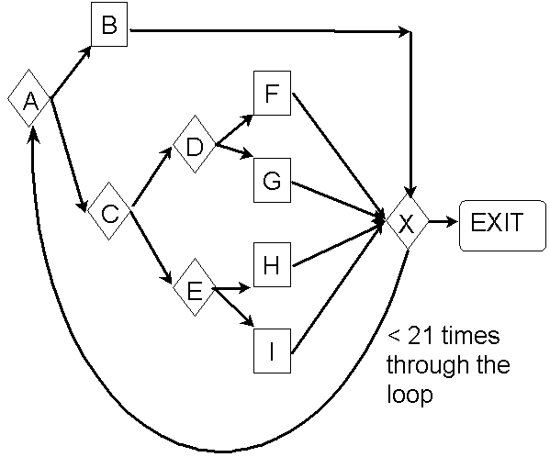
Too Many Possible Paths

Slide 15
Too Many Possible Inputs
Programs take input in a variety of ways: mouse, keyboard, and other devices.
Must test Valid and Invalid inputs.
Most importantly, there are an infinite amount of sequences of inputs to be tested.

Slide 16
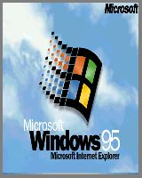
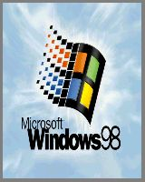


Too Many Possible User Environments
Difficult to replicate the user’s combination of hardware, peripherals, OS, and applications.
Impossible to replicate a thousand-node network to test networking software.

Slide 17

How is Testing Done

Slide 18
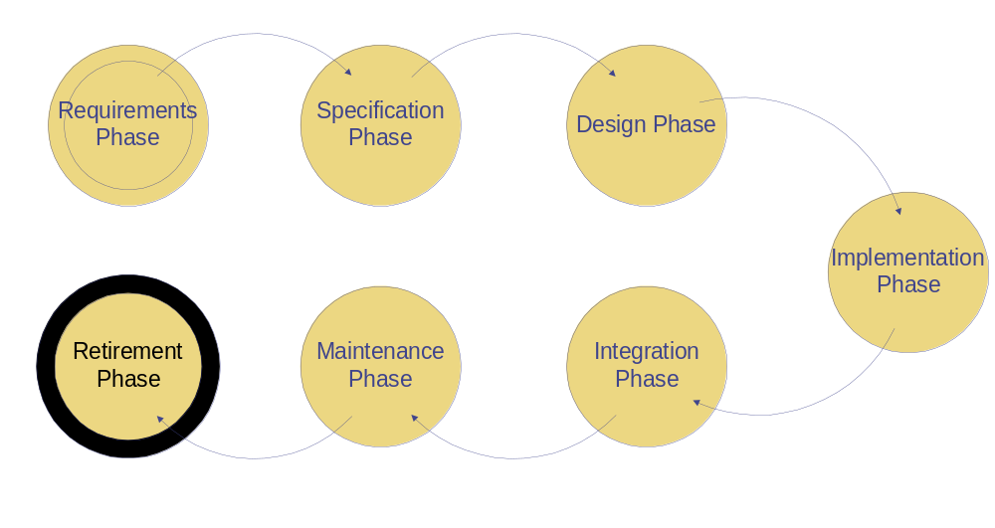
Phases of the Software Process

Slide 19
Why No Testing Phase?
Testing must be done at every phase.
Testing of a phase must be build upon and checked against the results of the previous phase.
Non-execution based testing is done in early phases (before executable code is produced).
Execution and non-execution based testing can be done in later phases.

Slide 20
Nonexecution-Based Testing
Walkthroughs
Inspections
Walkthroughs are shorter and more informal than inspections.
Goal of both is to record faults, not to correct them.

Slide 21
Execution-Based Testing
Utility
Reliability
Robustness
Performance
Correctness

Slide 22
Black-Box / White-Box Testing
Black-box tests are driven by the program’s specification
White-box tests are driven by the program’s implementation
Program
Specification
Black-box tests
White-box tests

Slide 23
Test Automation
If a manual test costs $X to run the first time, it will cost $X to run every time thereafter.
An automated test can cost 3 to 30 times $X the first time, but will cost about $0 after that.

Slide 24
Any Questions?

Slide 25
Too Many Possible Paths
There are 5 paths from A to X without passing through the loop.
There are 5²⁰ paths from A to X after passing through the loop 20 times.
There are 5 + 5² + 5³ +…+ 5²⁰ = 100 trillion possible paths in this program.
If you could test a path per second it would take more than 3 million years!

Slide 26
Black Box Testing
Checks that the product conforms to specifications
Cannot determine how much code has been tested
Program
Omissions detected by black-box tests

Slide 27
White Box Testing
Allows tester to be sure every statement has been tested.
Difficult to discover missing functionality.
Program
Commissions detected by White-box tests

