Slide 1


TECHNICAL PROPOSAL
Proposal No:
mm 202x
www.vietsol.com.vn

Slide 2



CONTACTS
Company: Nitto Denko Corporation
Address: Factory RBF-E/F, Zone RBF, no. 108, Huu Nghi road, VSIP Bac Ninh Integrated Township and Industrial Park, Tu Son ward, Bac Ninh province, Vietnam
Company: VIETSOL COMPANY LIMITED
Business Registration Address: The 12th Floor, Licogi 13 Building, No 164 Khuat Duy Tien Street, Thanh Xuan Ward, Ha Noi, Viet Nam
Office Address: 5th Floor, Everygolf Building, 63 Co Linh, Long Bien Ward, Ha Noi, Vietnam
Contacts
Contacts
Name: Lê Quang Hùng (Mr.) Title: Deputy Country IT Manager in charge of Vietnam
Phone: (+84) 931 531 664 Email: hung.lequang@nitto.com
Name: Lê Quang Sơn
Position: CCO
Phone: +84 914 836 868
E-Mail: Sonlq@vietsol.com.vn

Slide 3

AGENDA
SYSTEM REQUIREMENT
EDGE AI BOX SOLUTION
SOLUTION SYSTEM ARCHITECT
PROJECT TIMELINE
COMMERCIAL

Slide 4

SYSTEM REQUIREMENT
This proposal addresses the need for an Edge AI box solution for manufacturing application. The surveillance system will provide real-time detection and behavior analytics at the edge, ensuring low-latency, high accuracy and secure data handling.
Items ​ | Content​
Scope ​ | A complete turnkey system integrating AI Vision technology and Edge Box processing. The system is designed to detect safety violations in Nitto Denko manufacturing environments The Edge AI box will be installed in new Nitto Denko manufacturing in Hung Yen, Vietnam In the first phase of the project, the AI model is developed to detect: Environmental Safety: Fire, Smoke, and Fall detection, and Po-ke-te-na-shi safety requirement Basic PPE compliance: Safety Helmet, Safety Shoes Security: Restricted zone monitoring and intrusion detection. In the second phase, additional model will be integrated to existing Edge AI box solution, to detect: Specialized PPE compliance: Goggles, Mask, Gloves, Apron, High-Altitude: Safety Harness with Hook attached, also at Height
Defined area for surveillance | The Edge AI box with Camera surveillance will cover: 3 Floors, 1 Mezzanine, 1 Outdoor Area, and 1 Rooftop. All devices powered via PoE (Power over Ethernet).
Hardware specification | Edge AI Box: Industrial-grade fanless design with dedicated NPU (Neural Processing Unit) for low-latency processing.
Model accuracy | Latency? Accuracy target?
CMS | Storage: Centralized recording on NAS with data retention (CCTV data from 3 months to 1 year). Alerts: Real-time notifications sent directly to Microsoft Teams. Integration: integration to existing CMS system (Digital Watchdog from Nitto Denko)

Slide 5
SYSTEM REQUIREMENT
SOLUTION SYSTEM ARCHITECT
EDGE AI BOX SOLUTION
PROJECT TIMELINE
COMMERCIAL

Slide 6
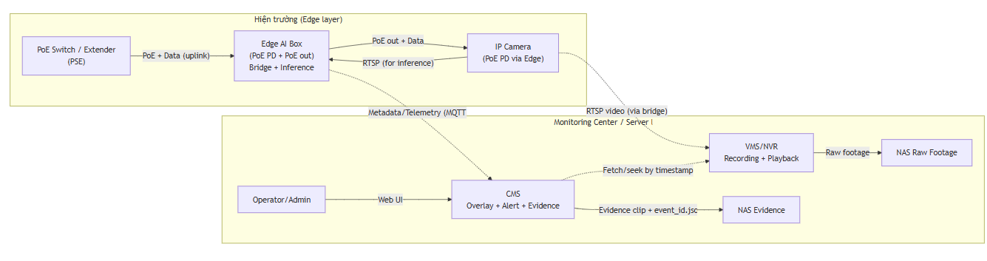
SYSTEM ARCHITECT
Digital
WatchDog
NOTE: To integrated Vietsol Edge AI solution to an existing CMS system, Digital WatchDog CMS API is requested
The Edge AI solution can support to integrate the bounding box for AI detection, and CAN NOT interfere to back-end architect and provide the statistical report of violation (in case the current customer’s CMS solution does not include the necessary feature)
The notification will be sent to Microsoft Teams

Slide 7
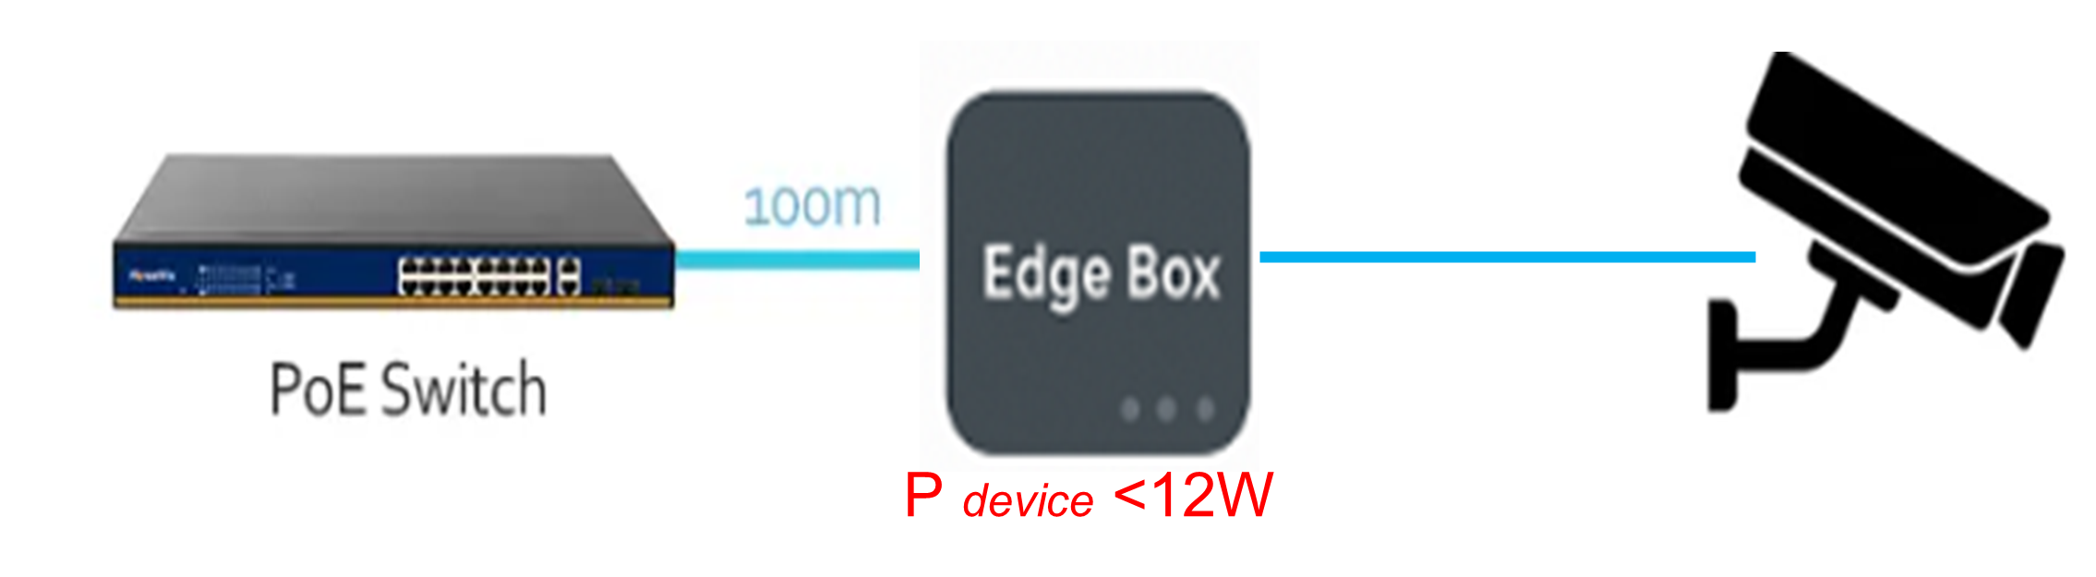
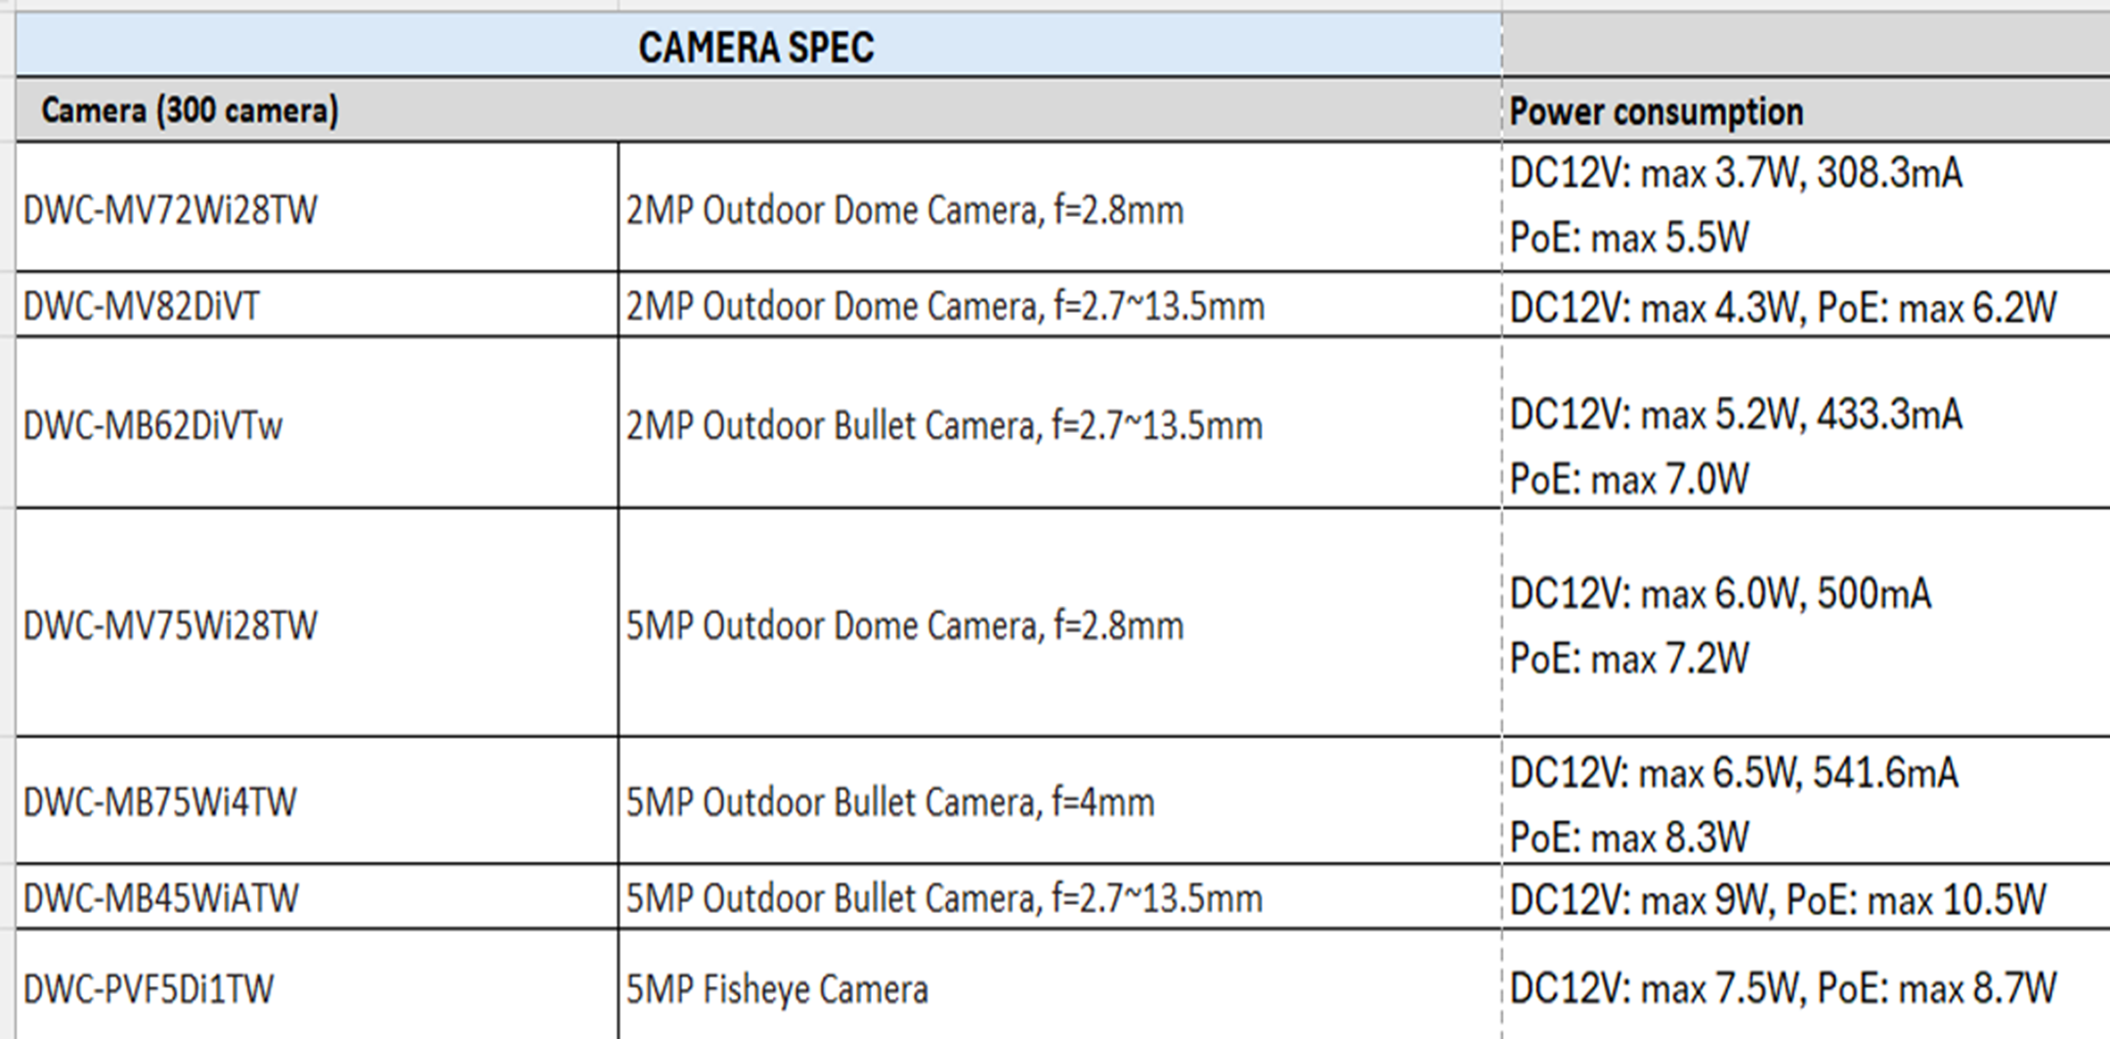
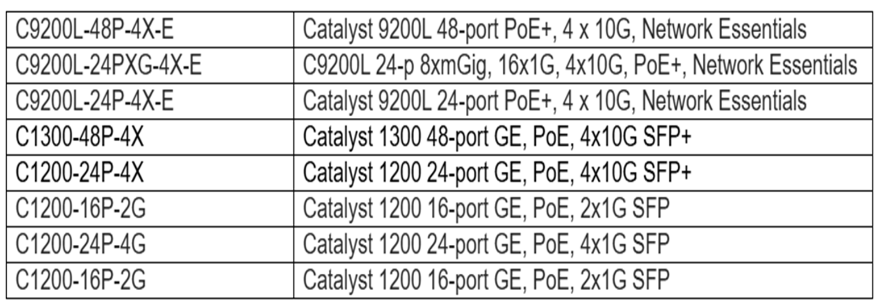
SYSTEM ARCHITECT
PoE Switch proposal:
Propose to switch all ‘’PoE 15W’’ device to “POE+ 30W’’ device
Reason: to get enough “power budget’’ for Edge device & IP Camera
For Outdoor surveillance using IP CAM ‘’DWC-MB45WIATW, max 10.5W’’, propose to setup PoE++ 60W
Reason: to get enough ‘’power budget’’ for Edge device and 1 specific IP Cam
Quantity: 1-2 PoE Switch (POE++)

Slide 8
SYSTEM REQUIREMENT
SOLUTION SYSTEM ARCHITECT
EDGE AI BOX SOLUTION
PROJECT TIMELINE
COMMERCIAL

Slide 9
GIẢI PHÁP KỸ THUẬT CỦA VIETSOL
Basic Specifications | NPU | 6-20 TOPS
 | RAM | 4GB LPDDR4
 | Storage | 32GB eMMC
 | Power | PoE Input: 1x RJ45 IEEE 802.3at (PoE+) as minimum PoE Output: 1x RJ45 ports providing IEEE 802.3af (PoE)
 | Power consumption | Max 12W
 | OS | Embedded Linux.
 | Software support | - Support the privatization deployment of ultra-large-scale parametric models under the Transformer architecture, such as - It supports traditional network architecture such as CNN, RNN, and LSTM. Support a variety of deep learning frameworks, including TensorFlow, TensorFlow Lite, PyTorch, Caffe, ONNX and Darknet. It also supports the development of custom operators
 | Size
 | Environment | -30°C to +60°C Storage Conditions: -30°C to +60°C Humidity: 10-95%RH
Interface Specifications | Network | Dual Gigabit Ethernet (1x POE in, 1x POE out through PHY/PSE)
 | IP Video input | 1 (Via PoE Switch)
 | Decoding format | H.265+/H.265/H.264+/H.264
 | USB | 2x USB 3.0
 | Serial interface optional | 2 x Digital Input (Dry Contact): Optically isolated for PLC triggers. 2 x Digital Output (Dry Contact): For machine-stop or alarm signaling
Box image
(HW Box styling-Nghiem’team
Size & logo)

Slide 10
VIETSOL EDGE BOX SOLUTION
Scope of Deliverables
Deliverables | Edge AI box Customer technical documents (Drawings + Manual) Service update AI model for 12 months
Nitto Denko’s resonsibility | Provide real data input from Nito Denko Manufacturing for specific Use Cases AI model training Provide Digital WatchDog API & SDK documentation for CMS integration Support to confirm data labelling (if needed) Support infrastructure, space & facility during the time Vietsol perform Edge Box installation

Slide 11
SYSTEM REQUIREMENT
EDGE AI BOX SOLUTION
SOLUTION SYSTEM ARCHITECT
PROJECT TIMELINE
COMMERCIAL

Slide 12
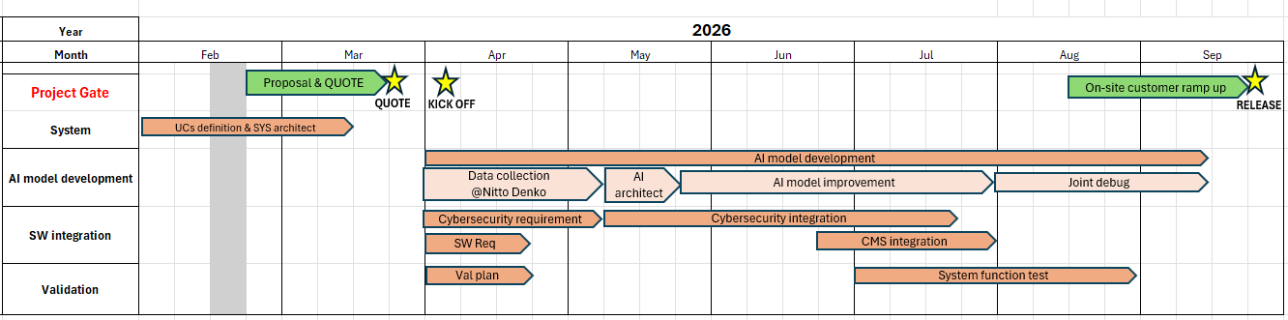
THỜI GIAN DỰ ÁN
In case the official project kick off happens in Apr. 2026, the Vietsol Edge AI box to be installed at Nitto Denko new manufacturing from Aug.2026

Slide 13
SYSTEM REQUIREMENT
EDGE AI BOX SOLUTION
SOLUTION SYSTEM ARCHITECT
PROJECT TIMELINE
COMMERCIAL

Slide 14
COMMERCIAL
Input provided

Slide 15
COMMERCIALS
Pricing Standards
All prices provided in the quotation are net prices in US dollar (USD), NET price, excluding any taxes (WHT, VAT,…)
Work shall begin after the client has confirmed the acceptance of this quotation, the correspondent Purchase Order has been received, and all technical details are clarified.
Cost was calculated for full project scope. Cost should be revised if Phong Phu selects some parts only.
Project deviation shall be agreed by Phong Phu and VIETSOL in advance in the agreed form of a Project Variation Request (PVR). Any project deviation shall be agreed between both parties in advance, taking into account timing and costs
The exchange rate applicable on the actual day of the PO shall be used.
In the event of the project's premature closure by Phong Phu, all costs will be charged on a pro-rated basis.
If the project timeline is extended due to unforeseen events or issues from Phong Phu, Vietsol will apply an extension cost based on the actual hours deployed by Vietsol during the extended period.
Any extra activities cost that is beyond scope if work that agreed in this quotation will be charged separately
VIETSOL’s General Terms and Conditions will apply to this quotation.
Payment plan of Development cost:
The 1st Payment: TT 40% of total price when PO releases
The 2nd Payment: TT 40% of total price when B sample releases
The 3rd Payment: TT 20% total price remain after Customer (Phong Phu) Approval milestone

Slide 16
PRICE AND COMMERCIAL CONDITIONS
Invoices and Payment Terms
Unless there is a dispute in the contents of the invoice Customer shall make payment of the invoice within thirty (30) days from the date of the receipt of invoice. In the event that Customer disputes the invoice provided by Services Provider, Customer shall provide Services Provider reasons for disputing the amount within fifteen (15) days after receipt of applicable invoice. In the foresaid situation Parties shall promptly seek to resolve the dispute by mutual discussion. If no dispute, substantiated in writing, is made by Customer within a period of fifteen (15) days of having received that invoice about any inaccuracy or any defect in the invoice, such invoice shall be deemed to have been accepted as correct by Customer. Any such dispute shall not relieve Customer from paying any undisputed portion of the invoice when due. Any invoice remaining unpaid after the aforesaid period of thirty (30) days shall be treated as a debt owed by Customer to Services Provider and Services Provider shall be, without prejudice to any other remedies that it may have in this regard, entitled to recover it as such with an accrued interest at the interest rate of 15% per annum, which will be charged to and payable by Customer, until the recovery is made in full with interest. Without prejudice to the other rights available, Services Provider also reserves the right to withhold the provision of Services till such time all the payments due to it under this Agreement have been made by Customer and any such withholding by Services Provider shall not be treated as breach by it of the provisions of this Agreement.​
The right to claim of a higher damage caused by default remains unaffected​
If a project is cancelled for reasons not attributable to us, we will charge the agreed-upon price up to that point, costs for irrevocable commitments, and appropriate compensation for losses incurred, capped at the agreed project price.
Our liability is limited to the project price or the remuneration paid at the time of loss and does not extend to incidental or consequential damages. Legal liabilities remain unaffected.
Legal actions or claims against us are time-barred one year after project acceptance, except where legal time limits apply.
This offer remains binding for us until July 9th , 2025. This validity applies equally to all agreement options mentioned therein. Errors and omission within this offer are excepted.

Slide 17





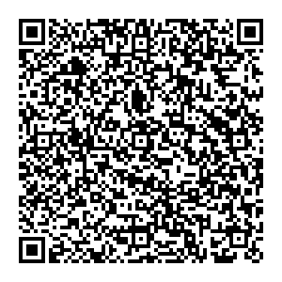

5th Floor, Everygolf Building, 63 Co Linh, Thach Ban, Long Bien, Ha Noi, Vietnam
(+84) 888 255 522
www.vietsol.com.vn
bod@vietsol.com.vn
END

