Slide 1
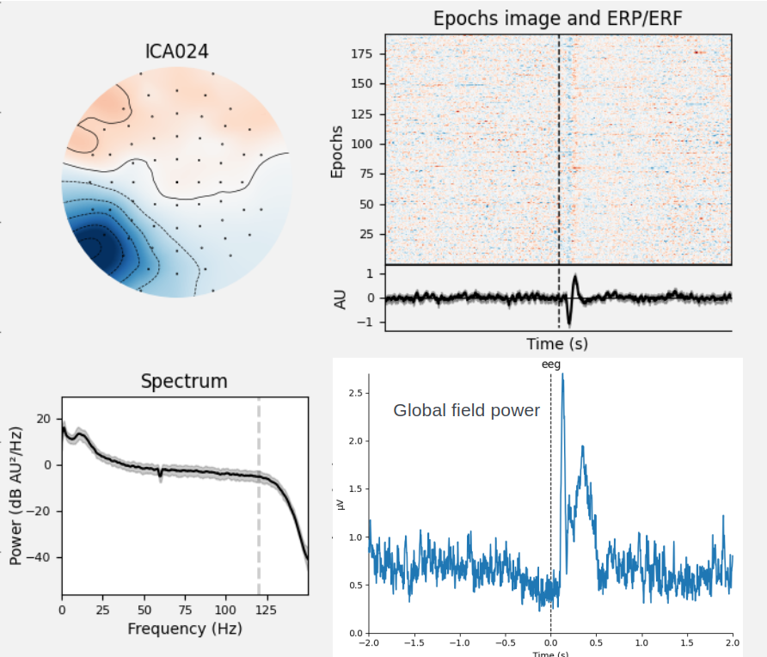
(Zebra) Signal processing and Analysis of human brain potentials Milestone 3
Identification of canonical neural events during continuous gameplay of an 8-bit style video game
- Bring into more suitable format for mbp - Remove superfluous events - Filter breaks (avg. 2 breaks of length 15s) - Reference to average - Bandpass filter (1-40 Hz), Notch (60 Hz) - Epoching [-0.2, 1] - Baseline correction (-0.2, 0) - Autoreject epochs (7.8%) - ICA (avg. 3 EOG ICs) - Autoreject and interpolate epochs (0.8%) - Time-frequency analysis

