Slide 1
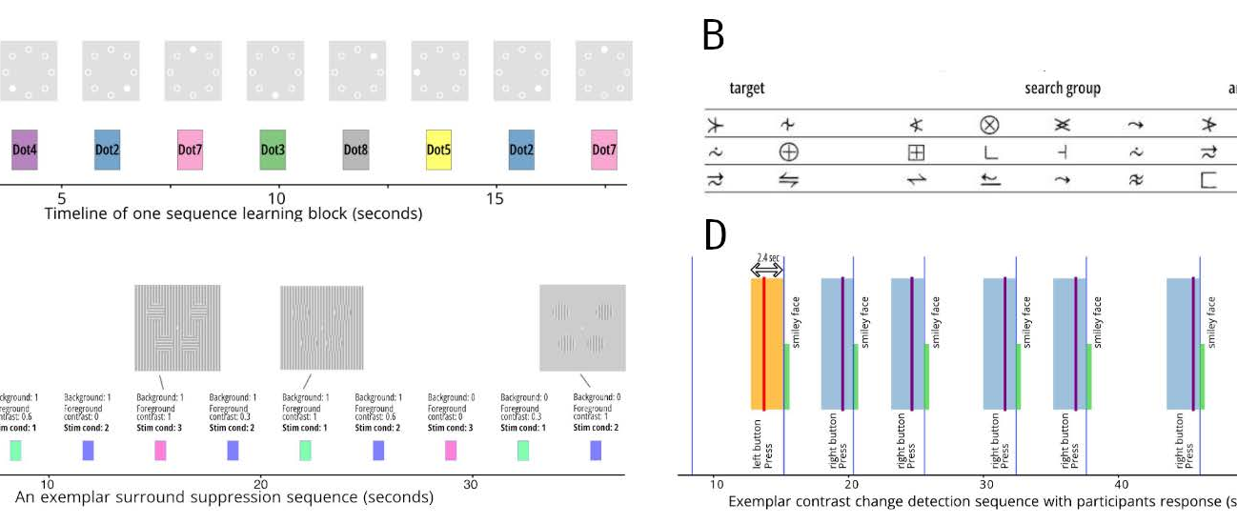
Insights from a very large EEG+Eyetracking dataset
Masters Thesis Introduction
Okan
Mazlum

Slide 2
The Healthy Brain Network (HBN) dataset
Spans 11 Releases from 2017 to 2024

Slide 3
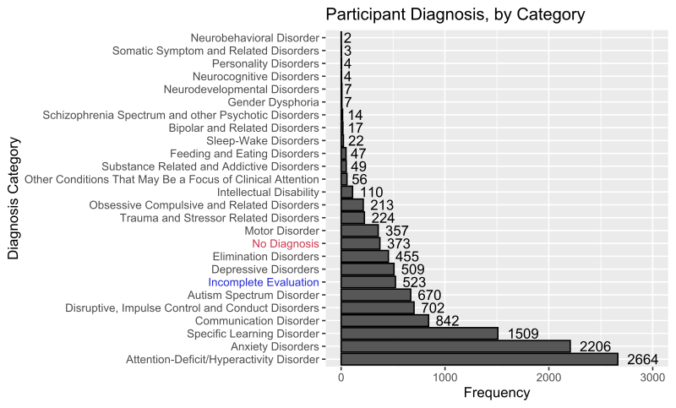
The Healthy Brain Network (HBN) dataset
Spans 11 Releases from 2017 to 2024
EEG + ET from 4000+ subjects aged 5-21

Slide 4
The Healthy Brain Network (HBN) dataset
Spans 11 Releases from 2017 to 2024
EEG + ET from 4000+ subjects aged 5-21
Contains 6 paradigms
Resting State
Surround Suppression
Contrast Change
Sequence Learning
Symbol Search
Naturalistic Viewing

Slide 5
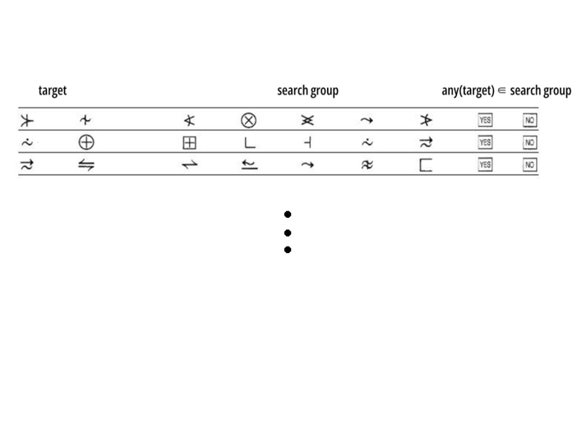
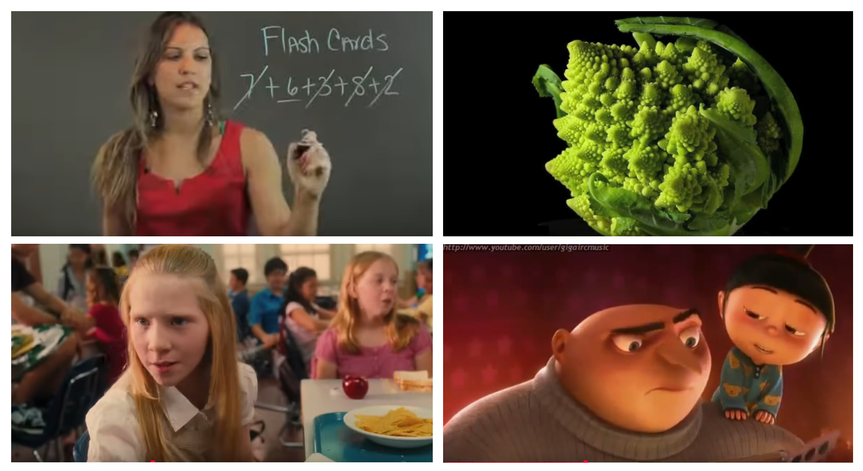
Free-view Paradigms
Symbol Search Naturalistic Viewing

Slide 6
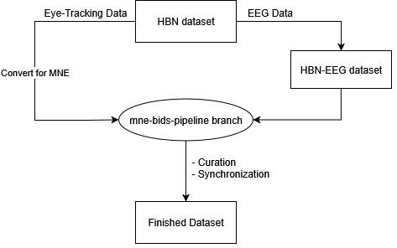
Data Preparation

Slide 7
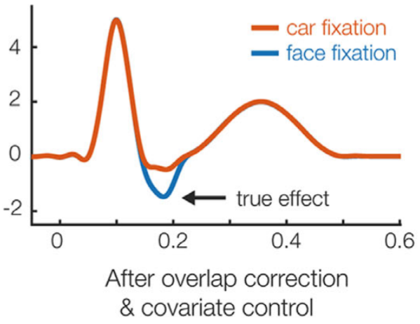
Motivation
The relationship between EEG + ET
Traditionally, EEG experiments minimize eye movements
Interest lies in event-related potentials (ERPs)
(simulated data)

Slide 8
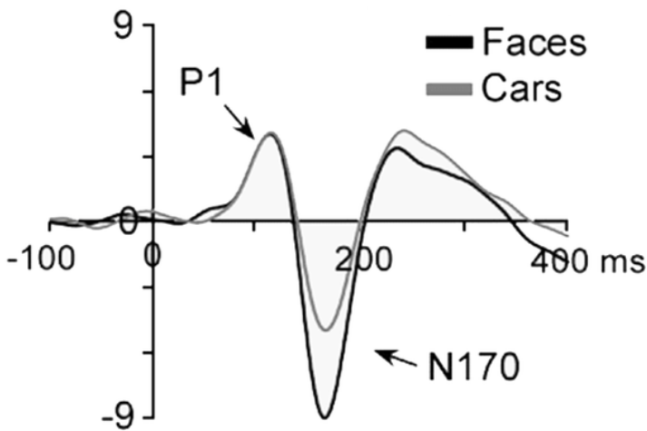
Motivation
The relationship between EEG + ET
Traditionally, EEG experiments minimize eye movements
Interest lies in event-related potentials (ERPs)
Eye movements do produce a meaningful neural response
Fixation-related potentials (FRPs)
(simulated data)

Slide 9
Challenges of creating FRPs
Synchronization of EEG + Eye-Tracking

Slide 10
Challenges of creating FRPs
Synchronization of EEG + Eye-Tracking
Ocular artifacts

Slide 11
Challenges of creating FRPs
Synchronization of EEG + Eye-Tracking
Ocular artifacts
Temporal overlap

Slide 12
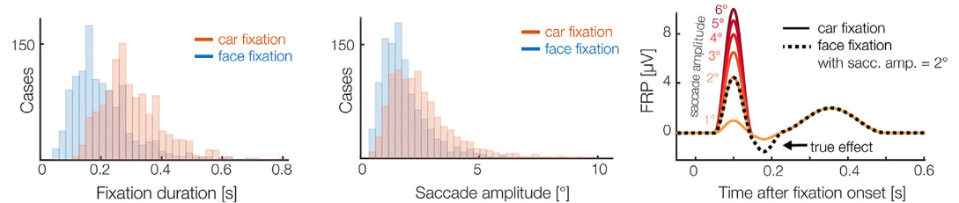
Challenges of creating FRPs
Synchronization of EEG + Eye-Tracking
Ocular artifacts
Temporal overlap
Confounding Low-Level Covariates

Slide 13
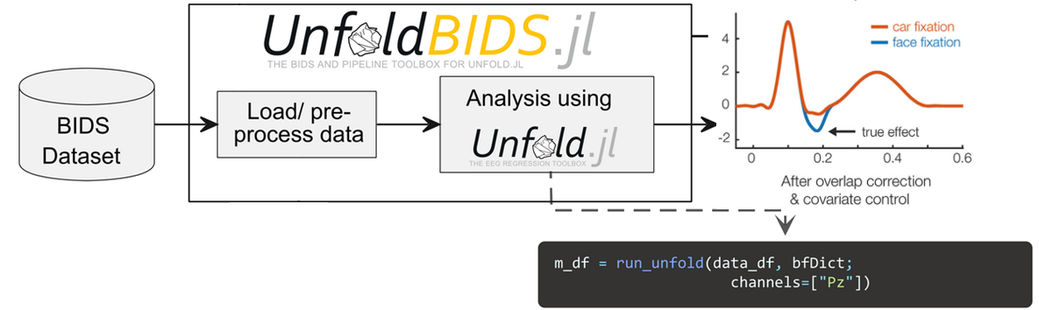
Data processing and analysis

Slide 14

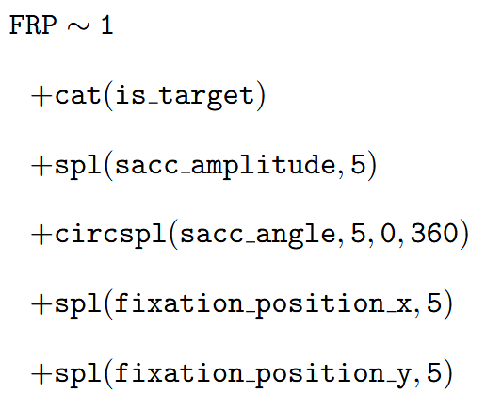
Regression Model
Symbol Search formula
Stimulus-onset
Intercept term
Category addressing fixation length for (non)targets
Nonlinear effect of saccade amplitude
Nonlinear effect of saccade angle
Nonlinear effect of fixation position

Slide 15
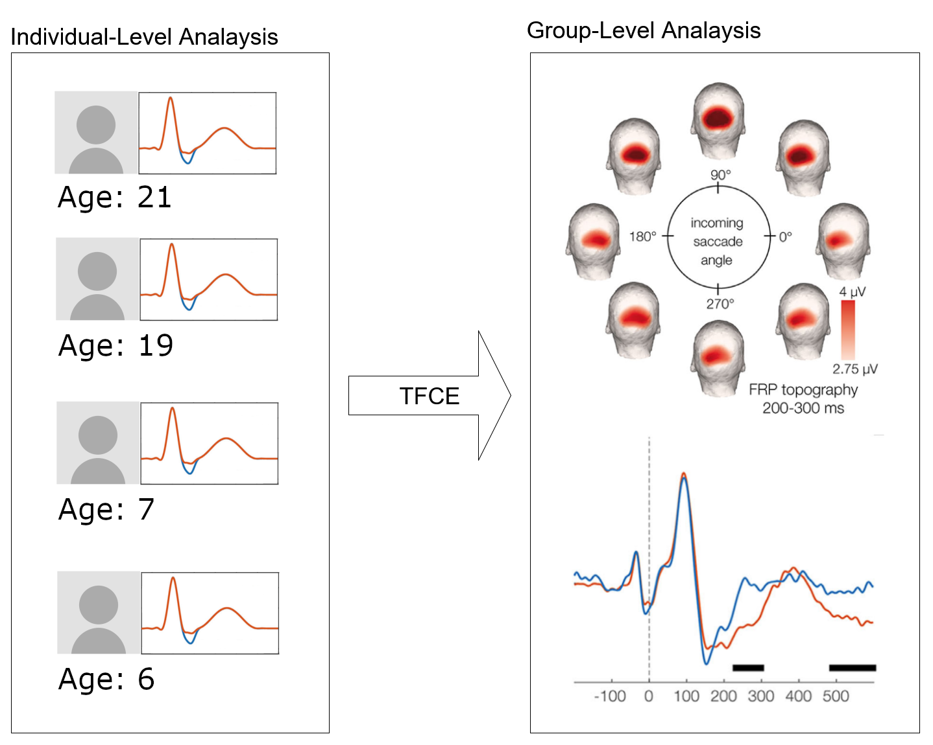
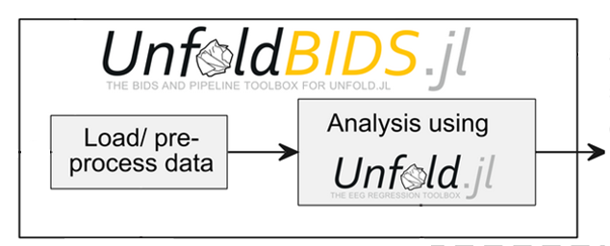
Research Goal

Slide 16
(Image) Sources
Dimigen O, Ehinger BV. Regression-based analysis of combined EEG and eye-tracking data: Theory and applications. J Vis. 2021 Jan 4;21(1):3. doi: 10.1167/jov.21.1.3. PMID: 33410892; PMCID: PMC7804566.
Figures modified
Alexander, L., Escalera, J., Ai, L. et al. An open resource for transdiagnostic research in pediatric mental health and learning disorders. Sci Data 4, 170181 (2017). https://doi.org/10.1038/sdata.2017.181
Seyed Yahya Shirazi, Alexandre Franco, Maurício Scopel Hoffmann, Nathalia B. Esper, Dung Truong, Arnaud Delorme, Michael P. Milham, Scott Makeig bioRxiv 2024.10.03.615261; doi: https://doi.org/10.1101/2024.10.03.615261
Figures modified
Langer, N., Ho, E., Alexander, L. et al. A resource for assessing information processing in the developing brain using EEG and eye tracking. Sci Data 4, 170040 (2017). https://doi.org/10.1038/sdata.2017.40
Kuefner, Dana & de Heering, Adélaïde & Jacques, Corentin & Palmero-Soler, Ernesto & Rossion, Bruno. (2010). Early Visually Evoked Electrophysiological Responses Over the Human Brain (P1, N170) Show Stable Patterns of Face-Sensitivity from 4 years to Adulthood. Frontiers in Human Neuroscience. 3. 67. 10.3389/neuro.09.067.2009.
Figures modified

Slide 17
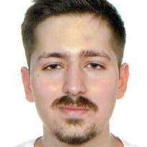
Institute for Visualization and Interactive Systems
Okan Mazlum
e-mail
st156392@stud.uni-stuttgart.de
University of Stuttgart
Department of Computational Cognitive Science
Pfaffenwaldring 5a, 70569 Stuttgart

