Slide 1
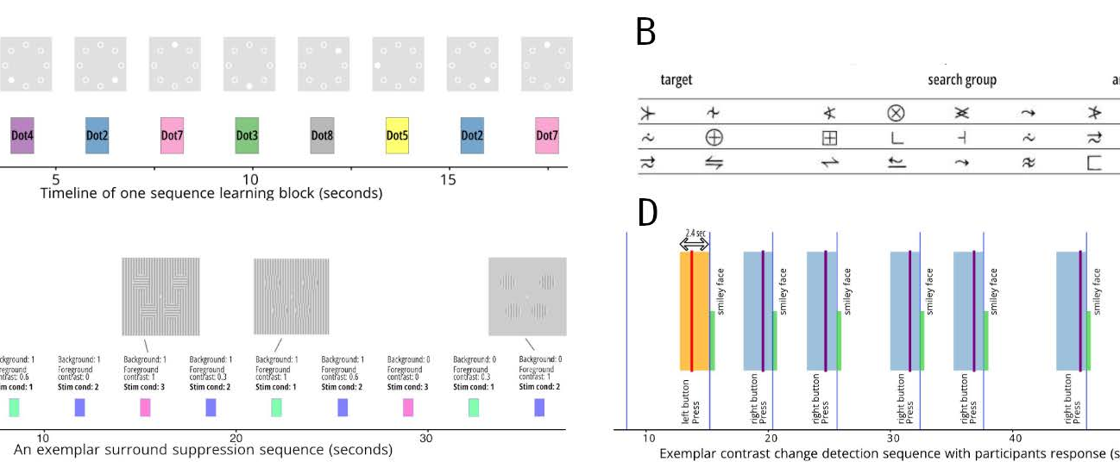
Insights from a very large EEG+Eyetracking dataset
Masters Thesis Defense
Okan
Mazlum

Slide 2
Structure
The Dataset
Intro to FRPs
Research Questions
Dataset Preparation
Subject Curation
Analysis Results
Takeaways

Slide 3
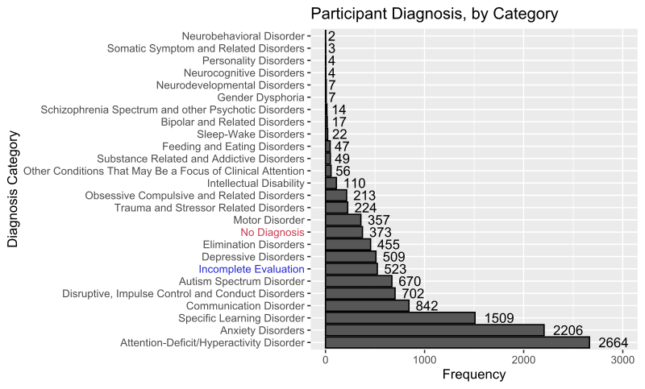
The Healthy Brain Network (HBN) dataset
Ongoing initiative to capture data from at least 10,000 adolescents
Currently 11 Releases with 4000+ subjects aged 5-21

Slide 4
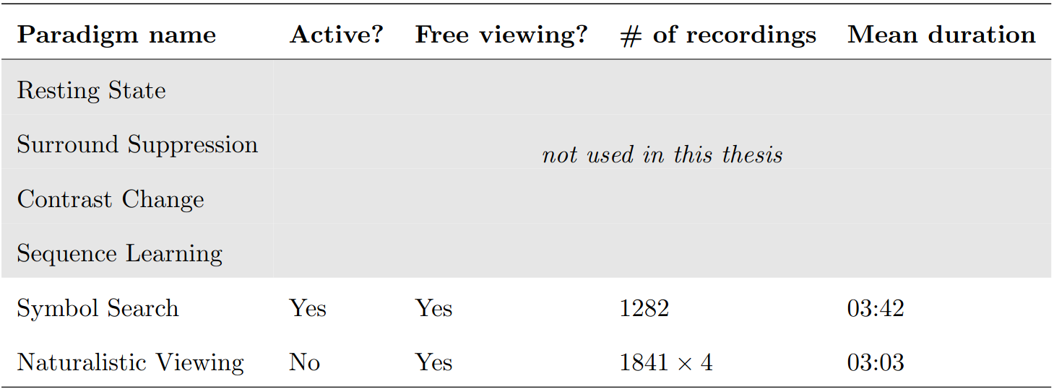
The Healthy Brain Network (HBN) dataset

Slide 5
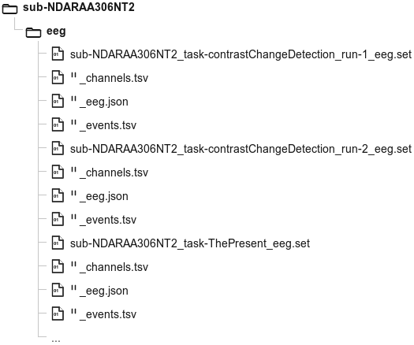
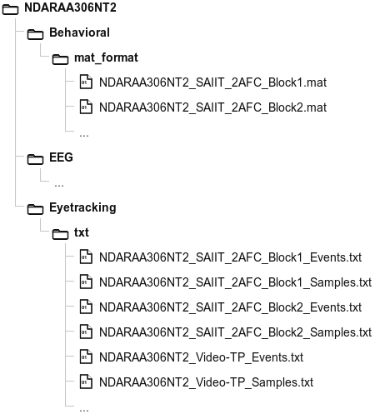
The Healthy Brain Network (HBN) dataset
HBN-EEG
HBN

Slide 6
Structure
The Dataset
Intro to FRPs
Research Questions
Dataset Preparation
Subject Curation
Analysis Results
Takeaways

Slide 7
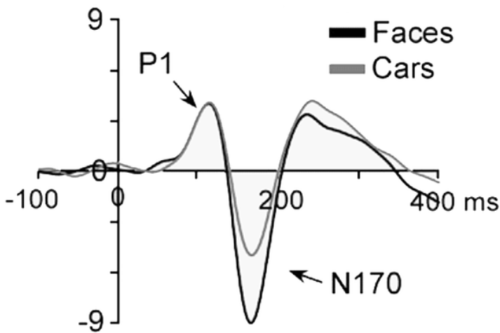
FRPs
The relationship between EEG + ET
Traditionally, EEG experiments minimize eye movements
Interest lies in event-related potentials (ERPs)

Slide 8
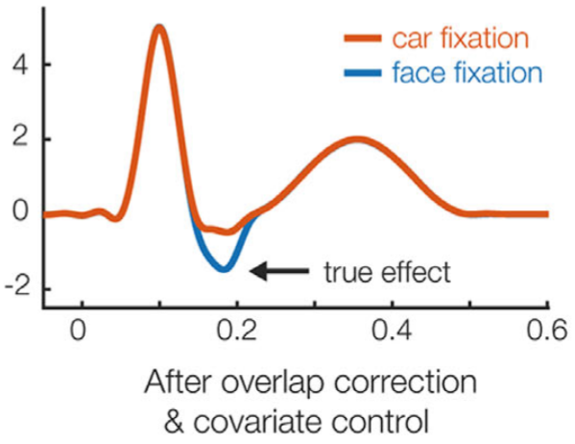
FRPs
The relationship between EEG + ET
Traditionally, EEG experiments minimize eye movements
Interest lies in event-related potentials (ERPs)
Eye movements do produce a meaningful neural response
Fixation-related potentials (FRPs)
(simulated data)

Slide 9
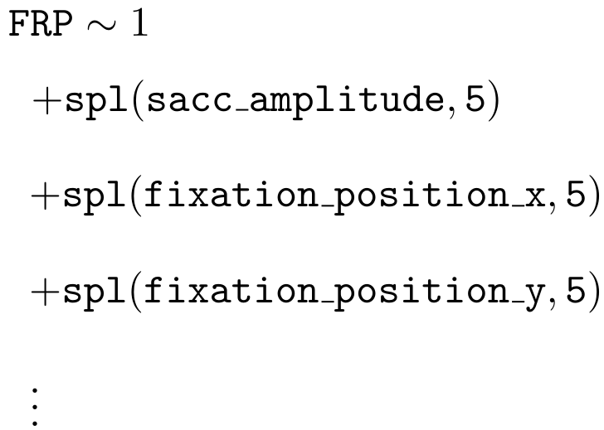
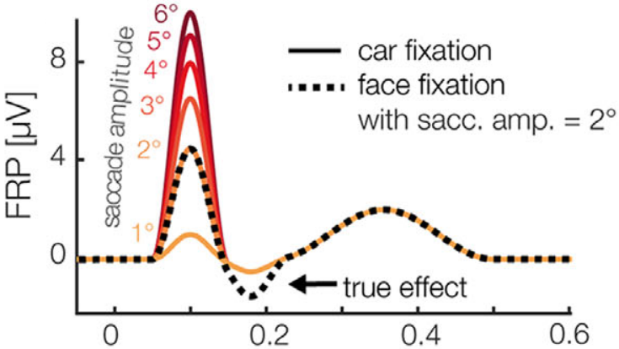
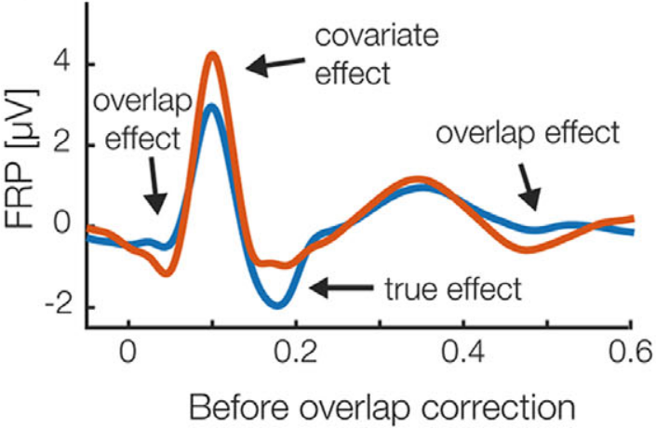
Regression Model
Symbol Search formula
Intercept term
Nonlinear effect of saccade amplitude
Nonlinear effect of fixation position

Slide 10
Structure
The Dataset
Intro to FRPs
Research Questions
Dataset Preparation
Subject Curation
Analysis Results
Takeaways

Slide 11
Research Questions
Can HBN-EEG and eye-tracking data be transformed into a unified, usable resource?

Slide 12
Research Questions
Can HBN-EEG and eye-tracking data be transformed into a unified, usable resource?
Can the scale and diversity of HBN provide new insight through FRP analysis?

Slide 13
Structure
The Dataset
Intro to FRPs
Research Questions
Dataset Preparation
Subject Curation
Analysis Results
Takeaways

Slide 14
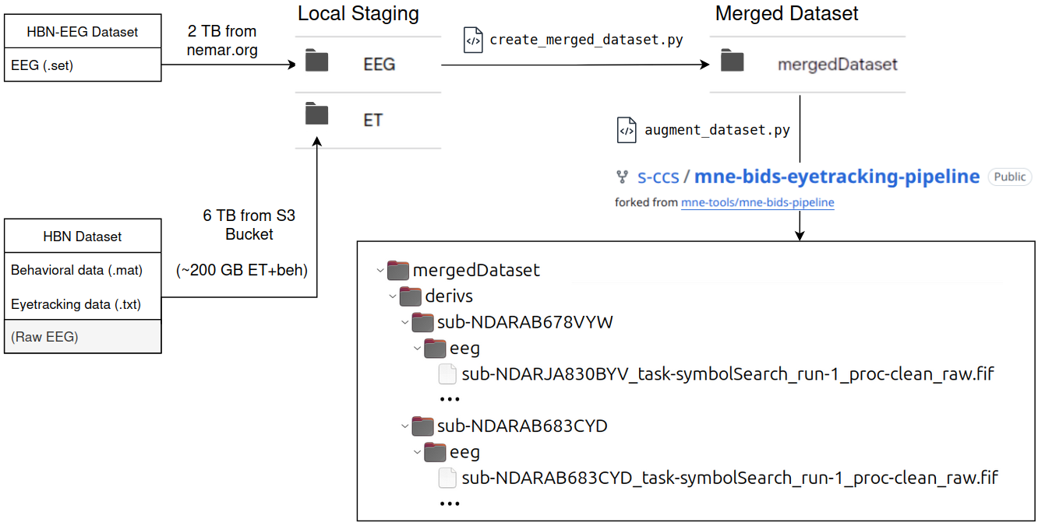
Dataset Preparation

Slide 15

Dataset Preparation

Slide 16

Dataset Preparation

Slide 17

Dataset Preparation
Combine root-level metadata and quality tables

Slide 18
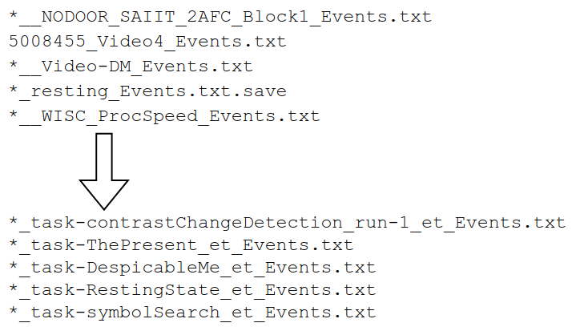
Dataset Preparation
Combine root-level metadata and quality tables
Map ET recordings to correct tasks

Slide 19
Dataset Preparation
Combine root-level metadata and quality tables
Map ET recordings to correct tasks
Fix *_channels.tsv (units → uV, type → EEG / MISC)

Slide 20
Dataset Preparation
Combine root-level metadata and quality tables
Map ET recordings to correct tasks
Fix *_channels.tsv (units → uV, type → EEG / MISC)
Handle and log unexpected edge cases

Slide 21
Dataset Preparation

Slide 22

Dataset Preparation
Add status column to all *_channels.tsv files (good / bad)

Slide 23
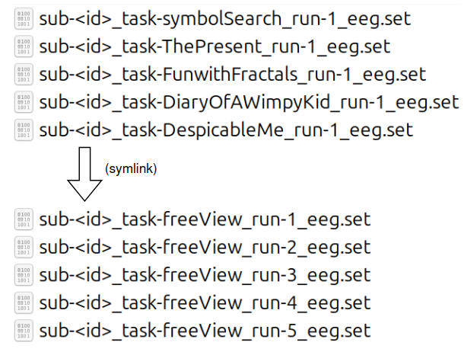
Dataset Preparation
Add status column to all *_channels.tsv files (good / bad)
Add synthetic tasks
freeView = Symbol Search + Naturalistic Viewing
allTasks = all tasks of the subject

Slide 24
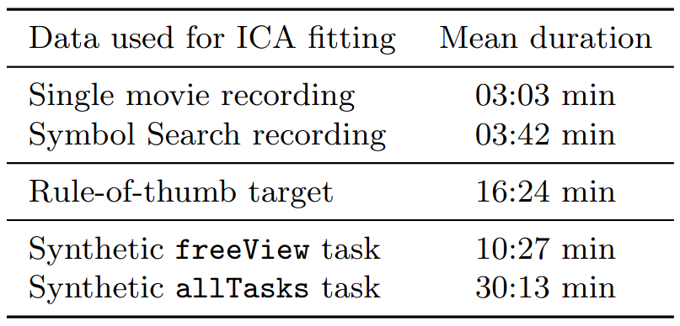
Dataset Preparation
Add status column to all *_channels.tsv files (good / bad)
Add synthetic tasks
freeView = Symbol Search + Naturalistic Viewing
allTasks = all tasks of the subject

Slide 25
Dataset Preparation

Slide 26

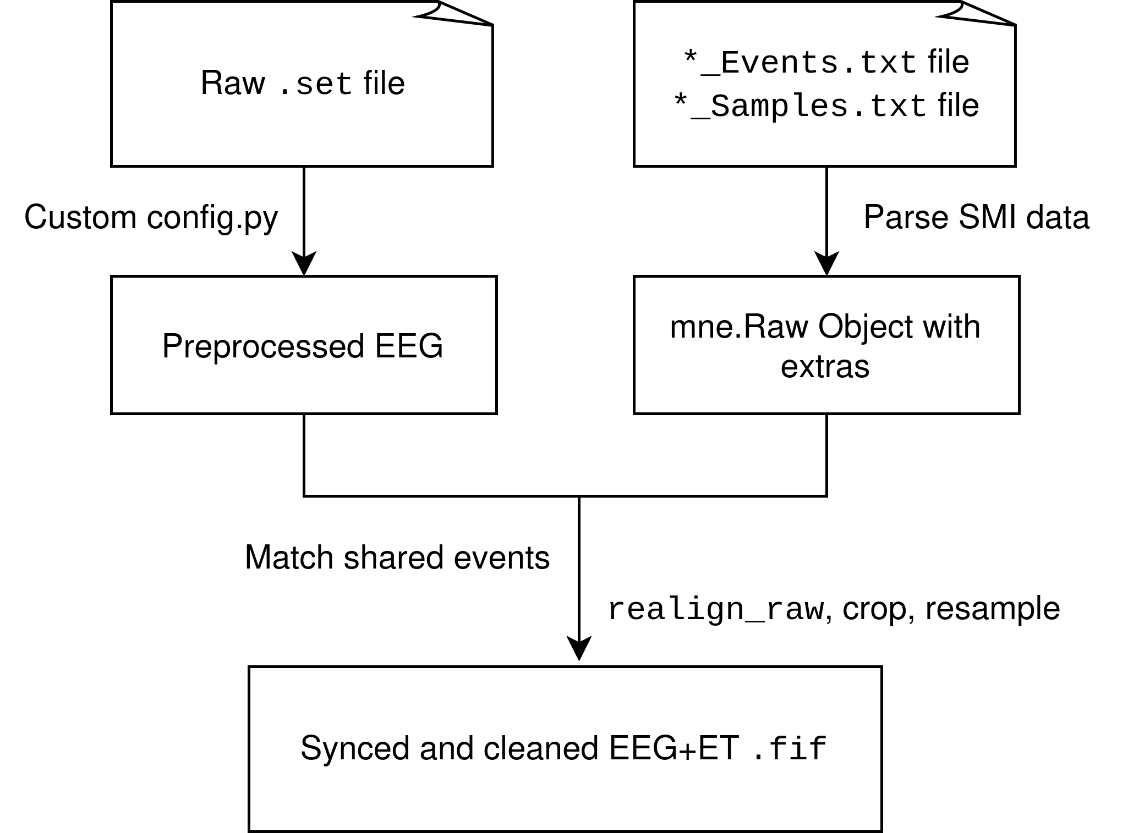

Dataset Preparation

Slide 27
Dataset Preparation
EEG preprocessing (tailored to free viewing)

Slide 28
Dataset Preparation
EEG preprocessing (tailored to free viewing)
Custom SMI eye-tracking parser

Slide 29
Dataset Preparation
EEG preprocessing (tailored to free viewing)
Custom SMI eye-tracking parser
Robust matching of shared events

Slide 30

Dataset Preparation

Slide 31
Structure
The Dataset
Intro to FRPs
Research Questions
Dataset Preparation
Subject Curation
Analysis Results
Takeaways

Slide 32
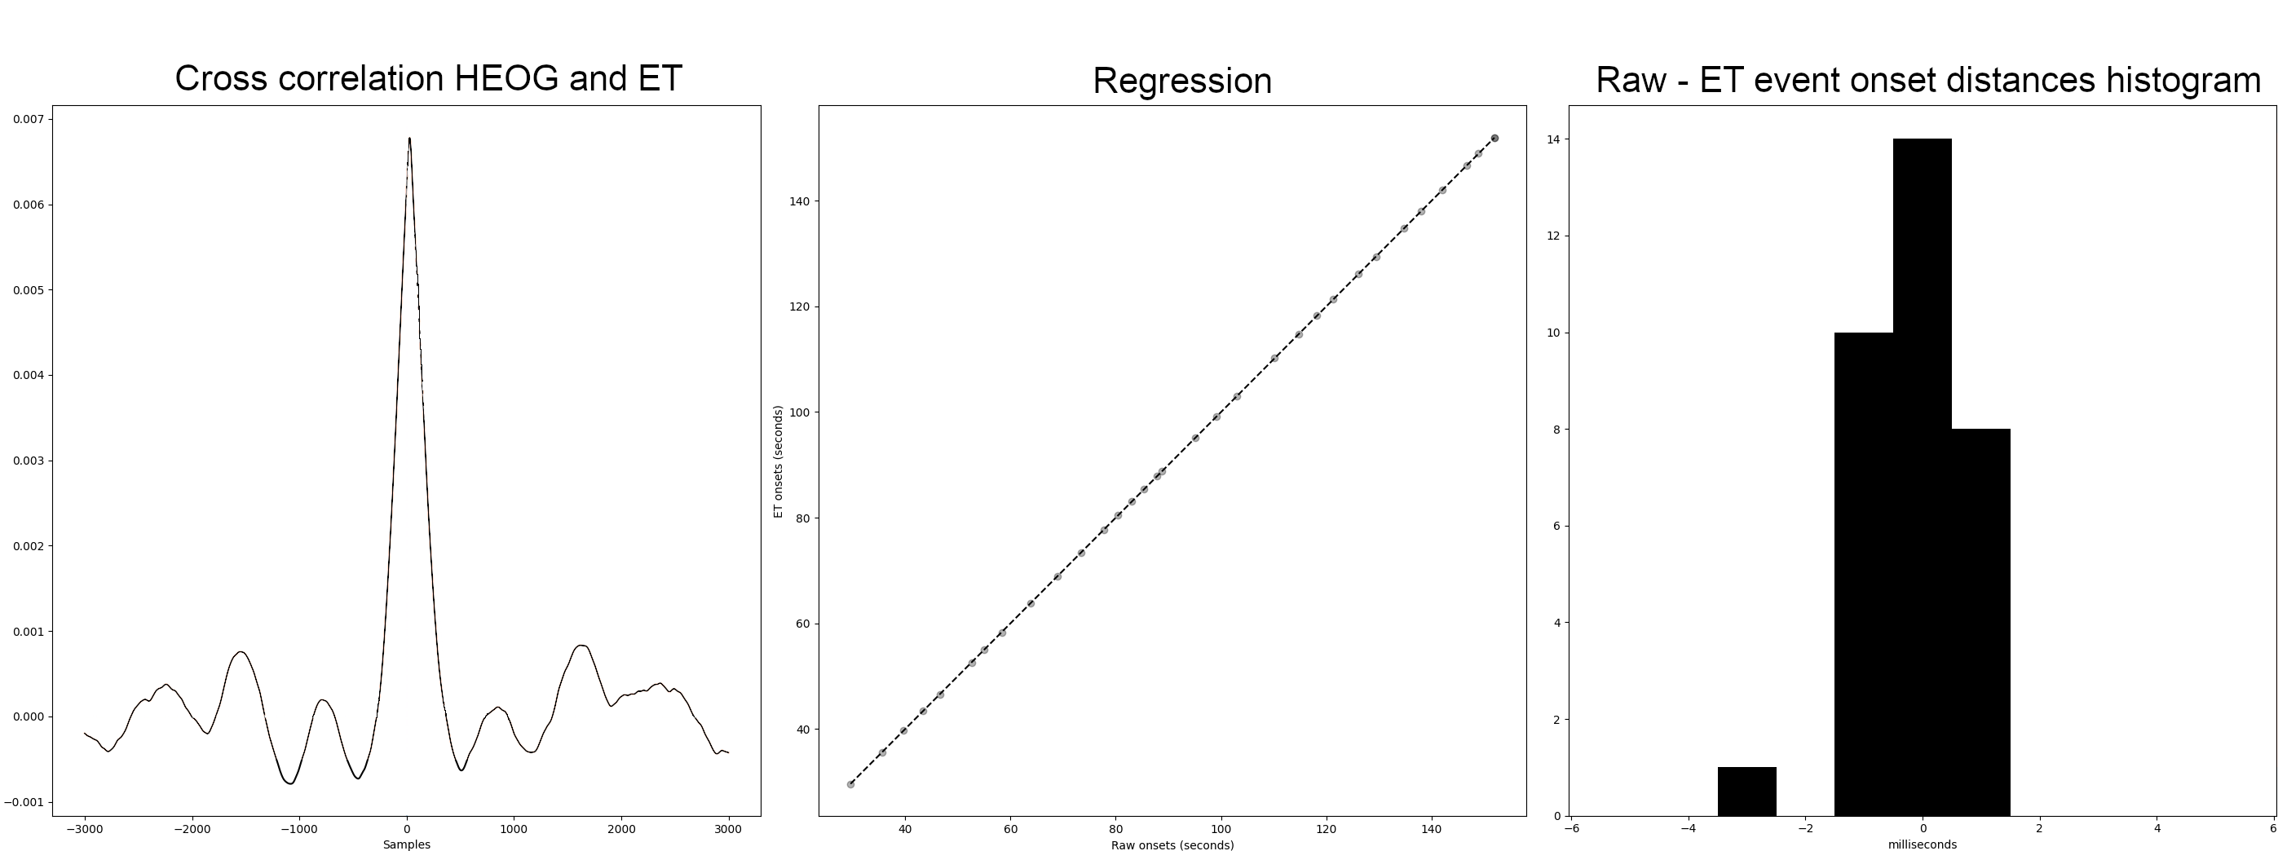
Subject Curation

Slide 33
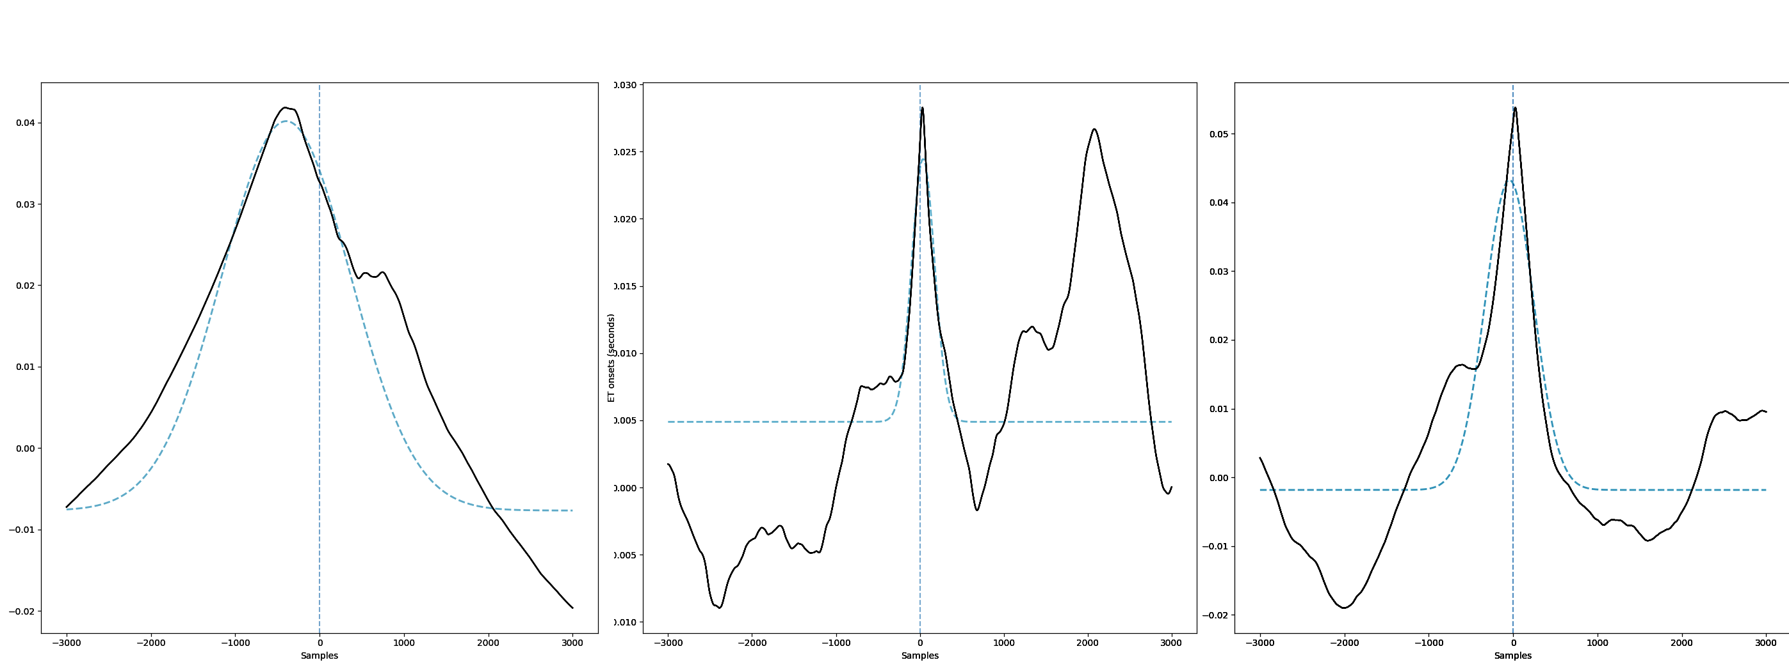
Subject Curation

Slide 34
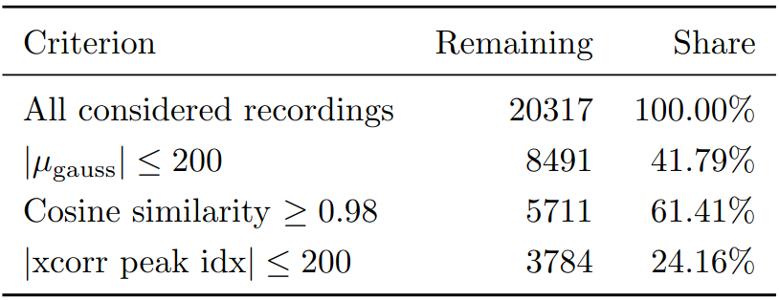
Subject Curation
Criteria for well synchronized recordings:

Slide 35
Subject Curation
Criteria for well synchronized recordings:
Thesis uses subset without symbol search recordings
876 subjects with 1355 recordings overall

Slide 36
Structure
The Dataset
Intro to FRPs
Research Questions
Dataset Preparation
Subject Curation
Analysis Results
Takeaways

Slide 37
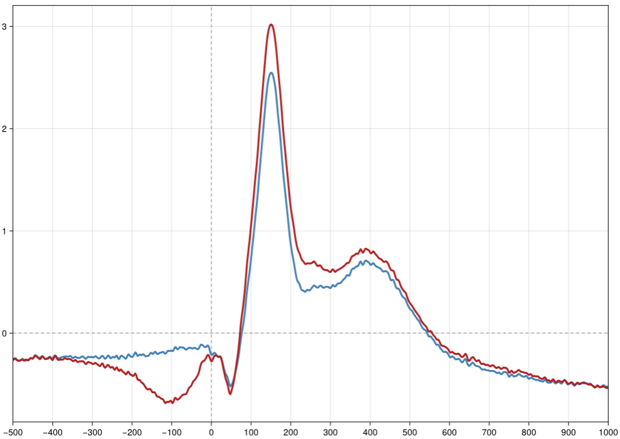
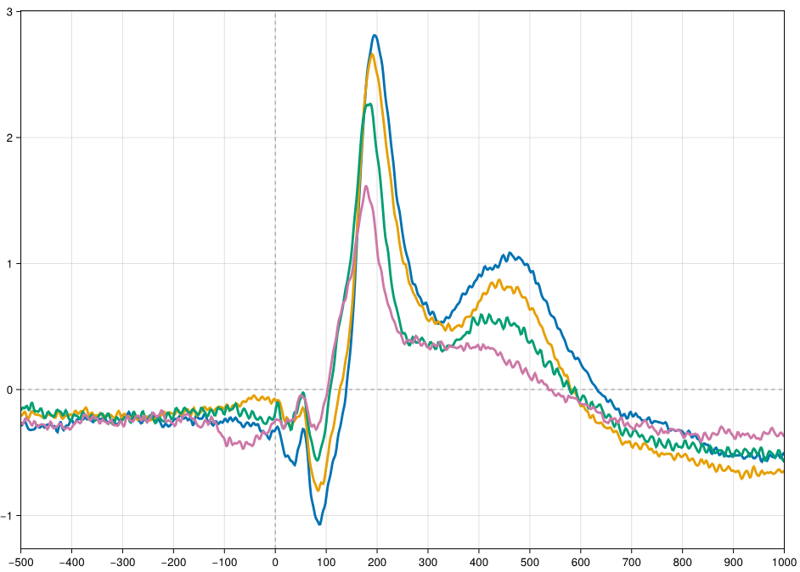
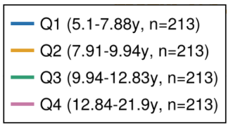
Analysis Results
Uncorrected FRPs (red is unprocessed)

Slide 38
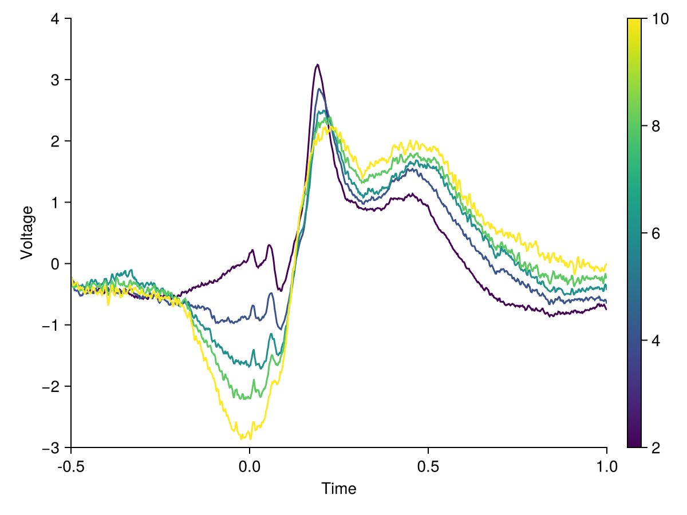
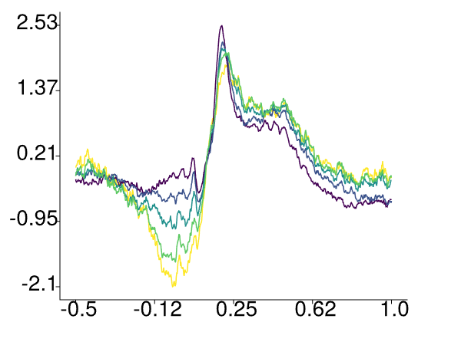
Analysis Results
Corrected FRPs (left only uses „well synchronized“ recordings)

Slide 39
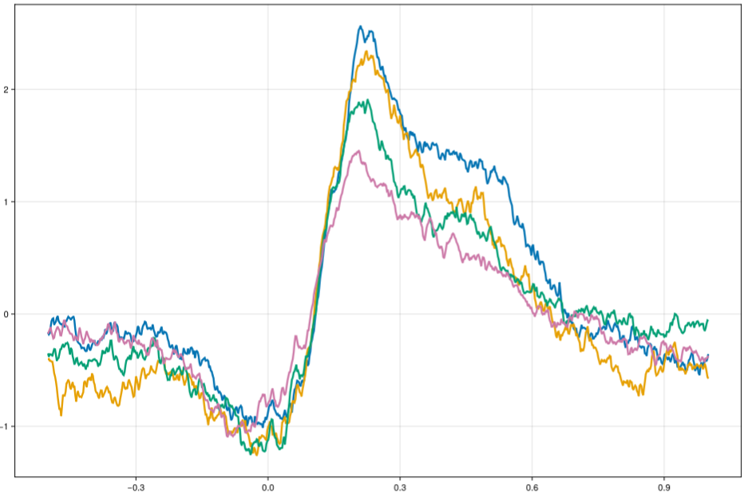
Analysis Results
Amplitude 8 split by age

Slide 40
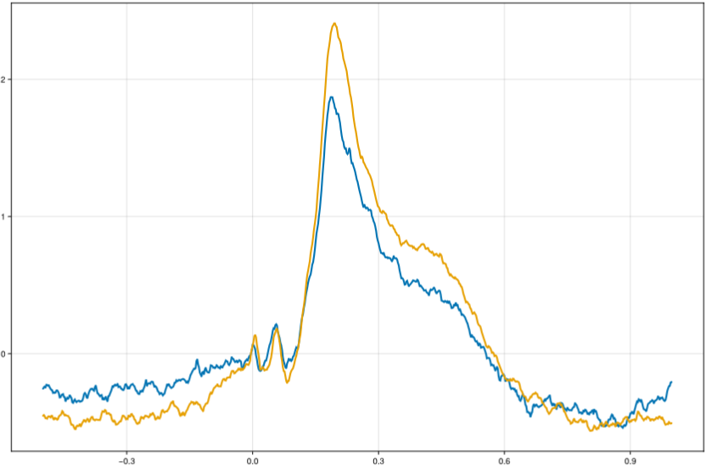
Analysis Results
Amplitude 8 split by age
Amplitude 2 split by sex (blue is female)

Slide 41
Structure
The Dataset
Intro to FRPs
Research Questions
Dataset Preparation
Subject Curation
Analysis Results
Takeaways

Slide 42
Takeaways
HBN data can be unified into a usable EEG+ET dataset
Synchronization quality impacts results, but scale helps
FRP analysis yields interesting results, but preprocessing pipeline needs to be adjusted

Slide 43
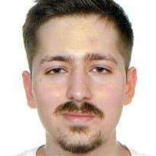
Institute for Visualization and Interactive Systems
Okan Mazlum
e-mail
st156392@stud.uni-stuttgart.de
University of Stuttgart
Department of Computational Cognitive Science
Pfaffenwaldring 5a, 70569 Stuttgart

Slide 44
Dataset Preparation – Unique challenges
20 Hz noise in some recordings → custom PSD spike detection

Slide 45
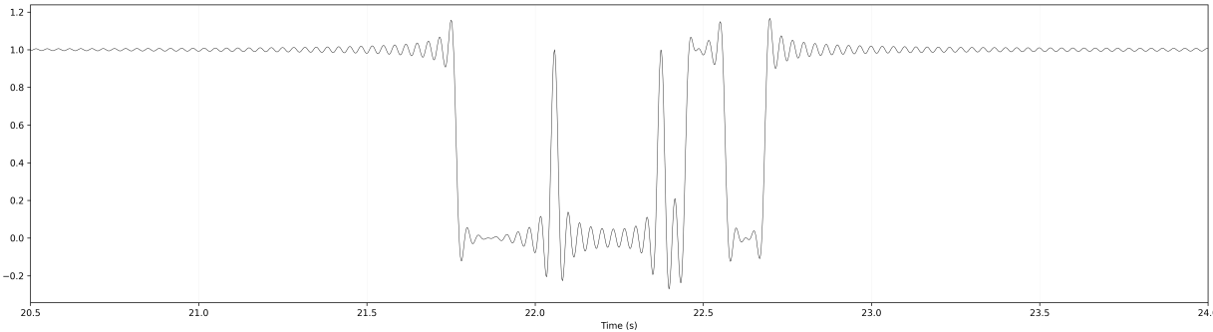
Dataset Preparation – Unique challenges
20 Hz noise in some recordings → custom PSD spike detection
Rounding for step-like ET channels

Slide 46
Dataset Preparation – Unique challenges
20 Hz noise in some recordings → custom PSD spike detection
Rounding for step-like ET channels
New config parameters for mne-bids-eyetracking-pipeline
Fallback EOG electrodes

Slide 47
Dataset Preparation – Unique challenges
20 Hz noise in some recordings → custom PSD spike detection
Rounding for step-like ET channels
New config parameters for mne-bids-eyetracking-pipeline
Fallback EOG electrodes
Use full recording for ICA Training

Slide 48
Dataset Preparation – Unique challenges
20 Hz noise in some recordings → custom PSD spike detection
Rounding for step-like ET channels
New config parameters for mne-bids-eyetracking-pipeline
Fallback EOG electrodes
Use full recording for ICA Training
Fixed raw.filter only being applied to first run in ICA

Slide 49
Dataset Preparation – Unique challenges
20 Hz noise in some recordings → custom PSD spike detection
Rounding for step-like ET channels
New config parameters for mne-bids-eyetracking-pipeline
Fallback EOG electrodes
Use full recording for ICA Training
Fixed raw.filter only being applied to first run in ICA
Many minor changes to make pipeline workable with multi-run dataset of this size

Slide 50
(Image) Sources
Dimigen O, Ehinger BV. Regression-based analysis of combined EEG and eye-tracking data: Theory and applications. J Vis. 2021 Jan 4;21(1):3. doi: 10.1167/jov.21.1.3. PMID: 33410892; PMCID: PMC7804566.
Figures modified
Alexander, L., Escalera, J., Ai, L. et al. An open resource for transdiagnostic research in pediatric mental health and learning disorders. Sci Data 4, 170181 (2017). https://doi.org/10.1038/sdata.2017.181
Seyed Yahya Shirazi, Alexandre Franco, Maurício Scopel Hoffmann, Nathalia B. Esper, Dung Truong, Arnaud Delorme, Michael P. Milham, Scott Makeig bioRxiv 2024.10.03.615261; doi: https://doi.org/10.1101/2024.10.03.615261
Figures modified
Langer, N., Ho, E., Alexander, L. et al. A resource for assessing information processing in the developing brain using EEG and eye tracking. Sci Data 4, 170040 (2017). https://doi.org/10.1038/sdata.2017.40
Kuefner, Dana & de Heering, Adélaïde & Jacques, Corentin & Palmero-Soler, Ernesto & Rossion, Bruno. (2010). Early Visually Evoked Electrophysiological Responses Over the Human Brain (P1, N170) Show Stable Patterns of Face-Sensitivity from 4 years to Adulthood. Frontiers in Human Neuroscience. 3. 67. 10.3389/neuro.09.067.2009.
Figures modified

