Slide 1
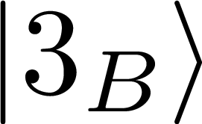
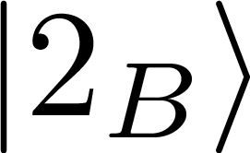
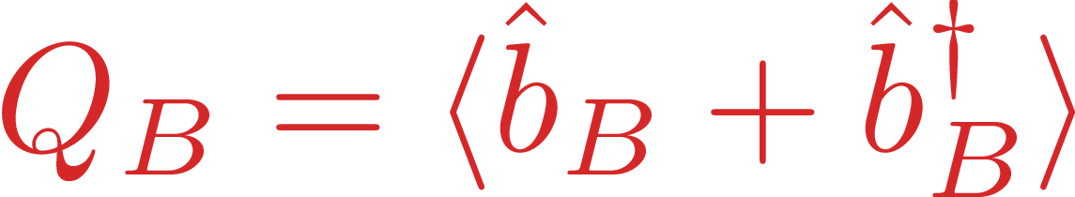
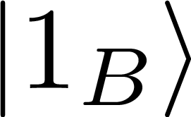
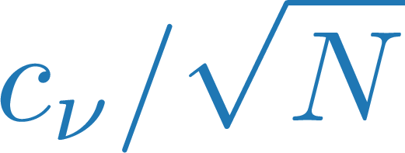
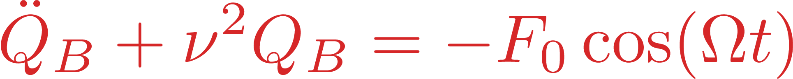
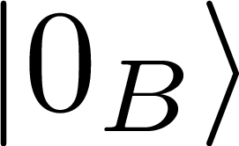

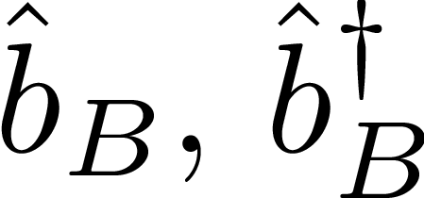
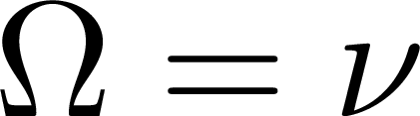
SE
MF
two-state
dynamics
driven oscillator
dynamics
UP
LP
bright vibrational mode
resonant Rabi driving:

Slide 2

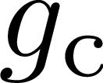



cavity
local
vibrational
modes
.
.
.

Slide 3




Excitation Number
Nonlinear
$$∞$$
…
Cluster Expansion
MF accurate
Higher Excitation Manifolds
2
$$n_{0}≪1$$
1
SE accurate
MF & SE agree
Number of Molecules
Linear
0
1
…
$$∞$$
$$N≫1$$
Quantum
Classical

Slide 4

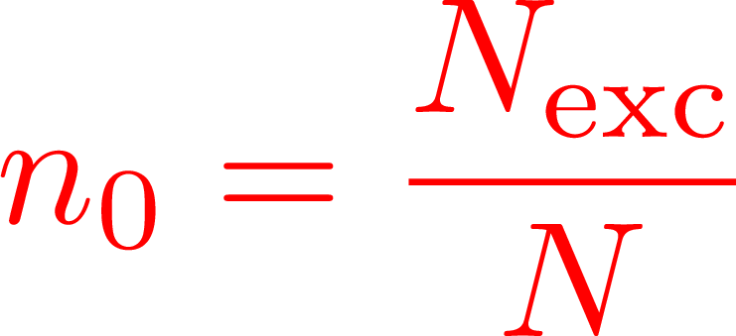




$$∞$$
Nonlinear
MF
1
SE
MF = SE
Linear
0
$$∞$$
$$N≫1$$
Quantum
Classical

