Slide 1
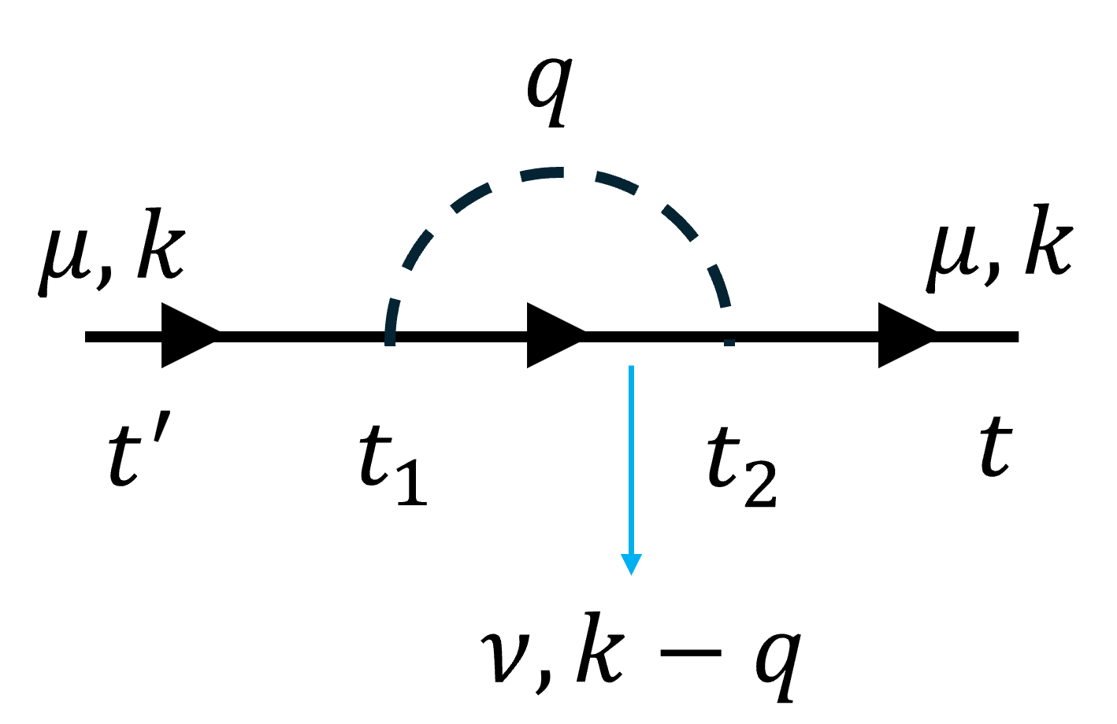
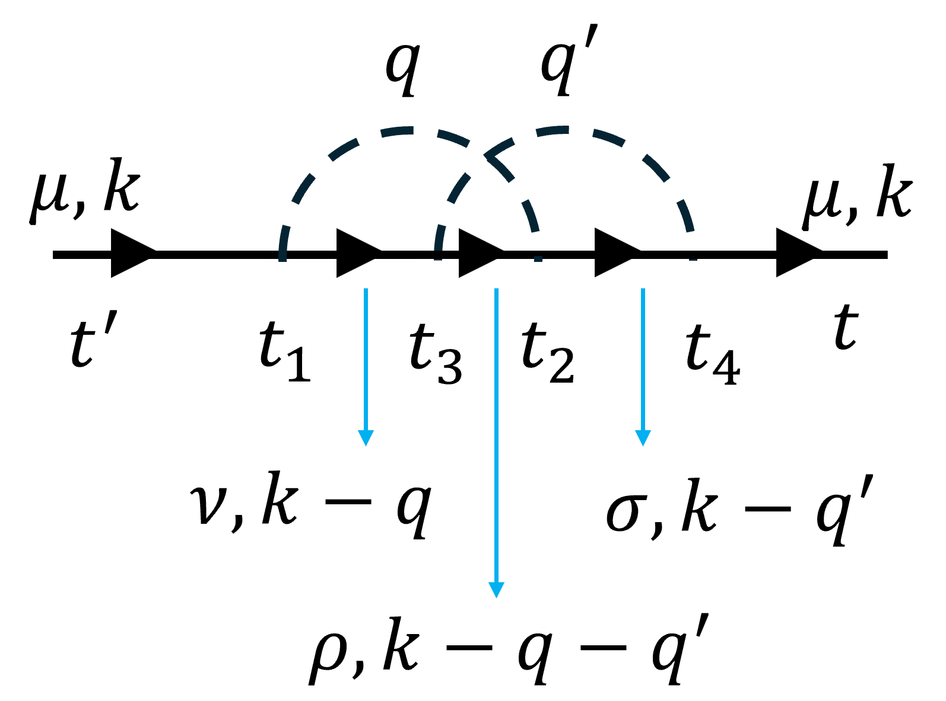
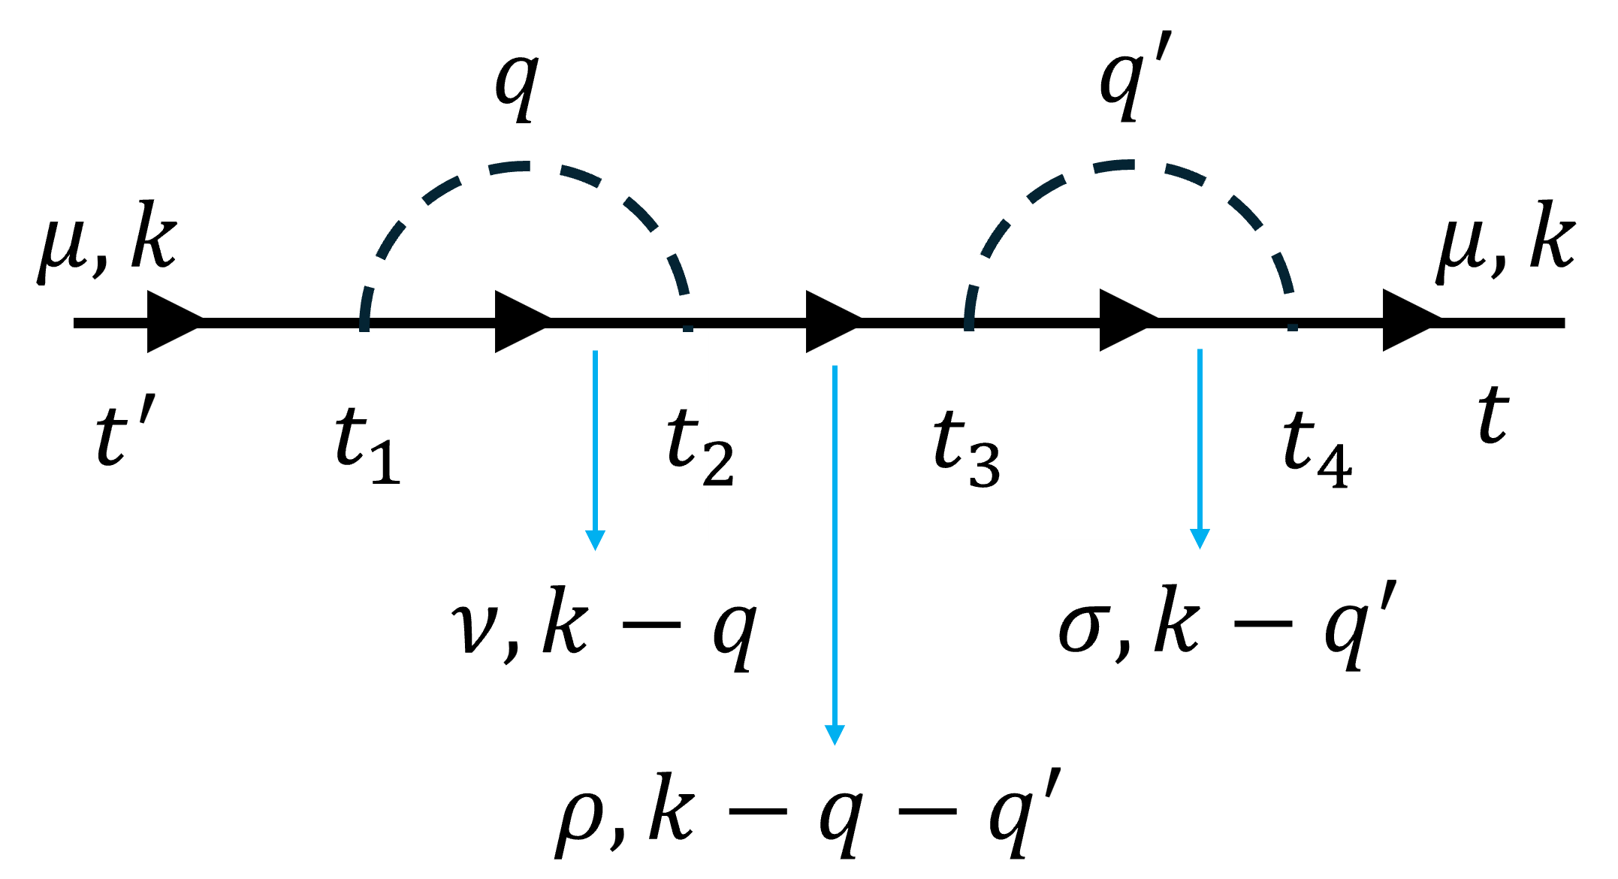
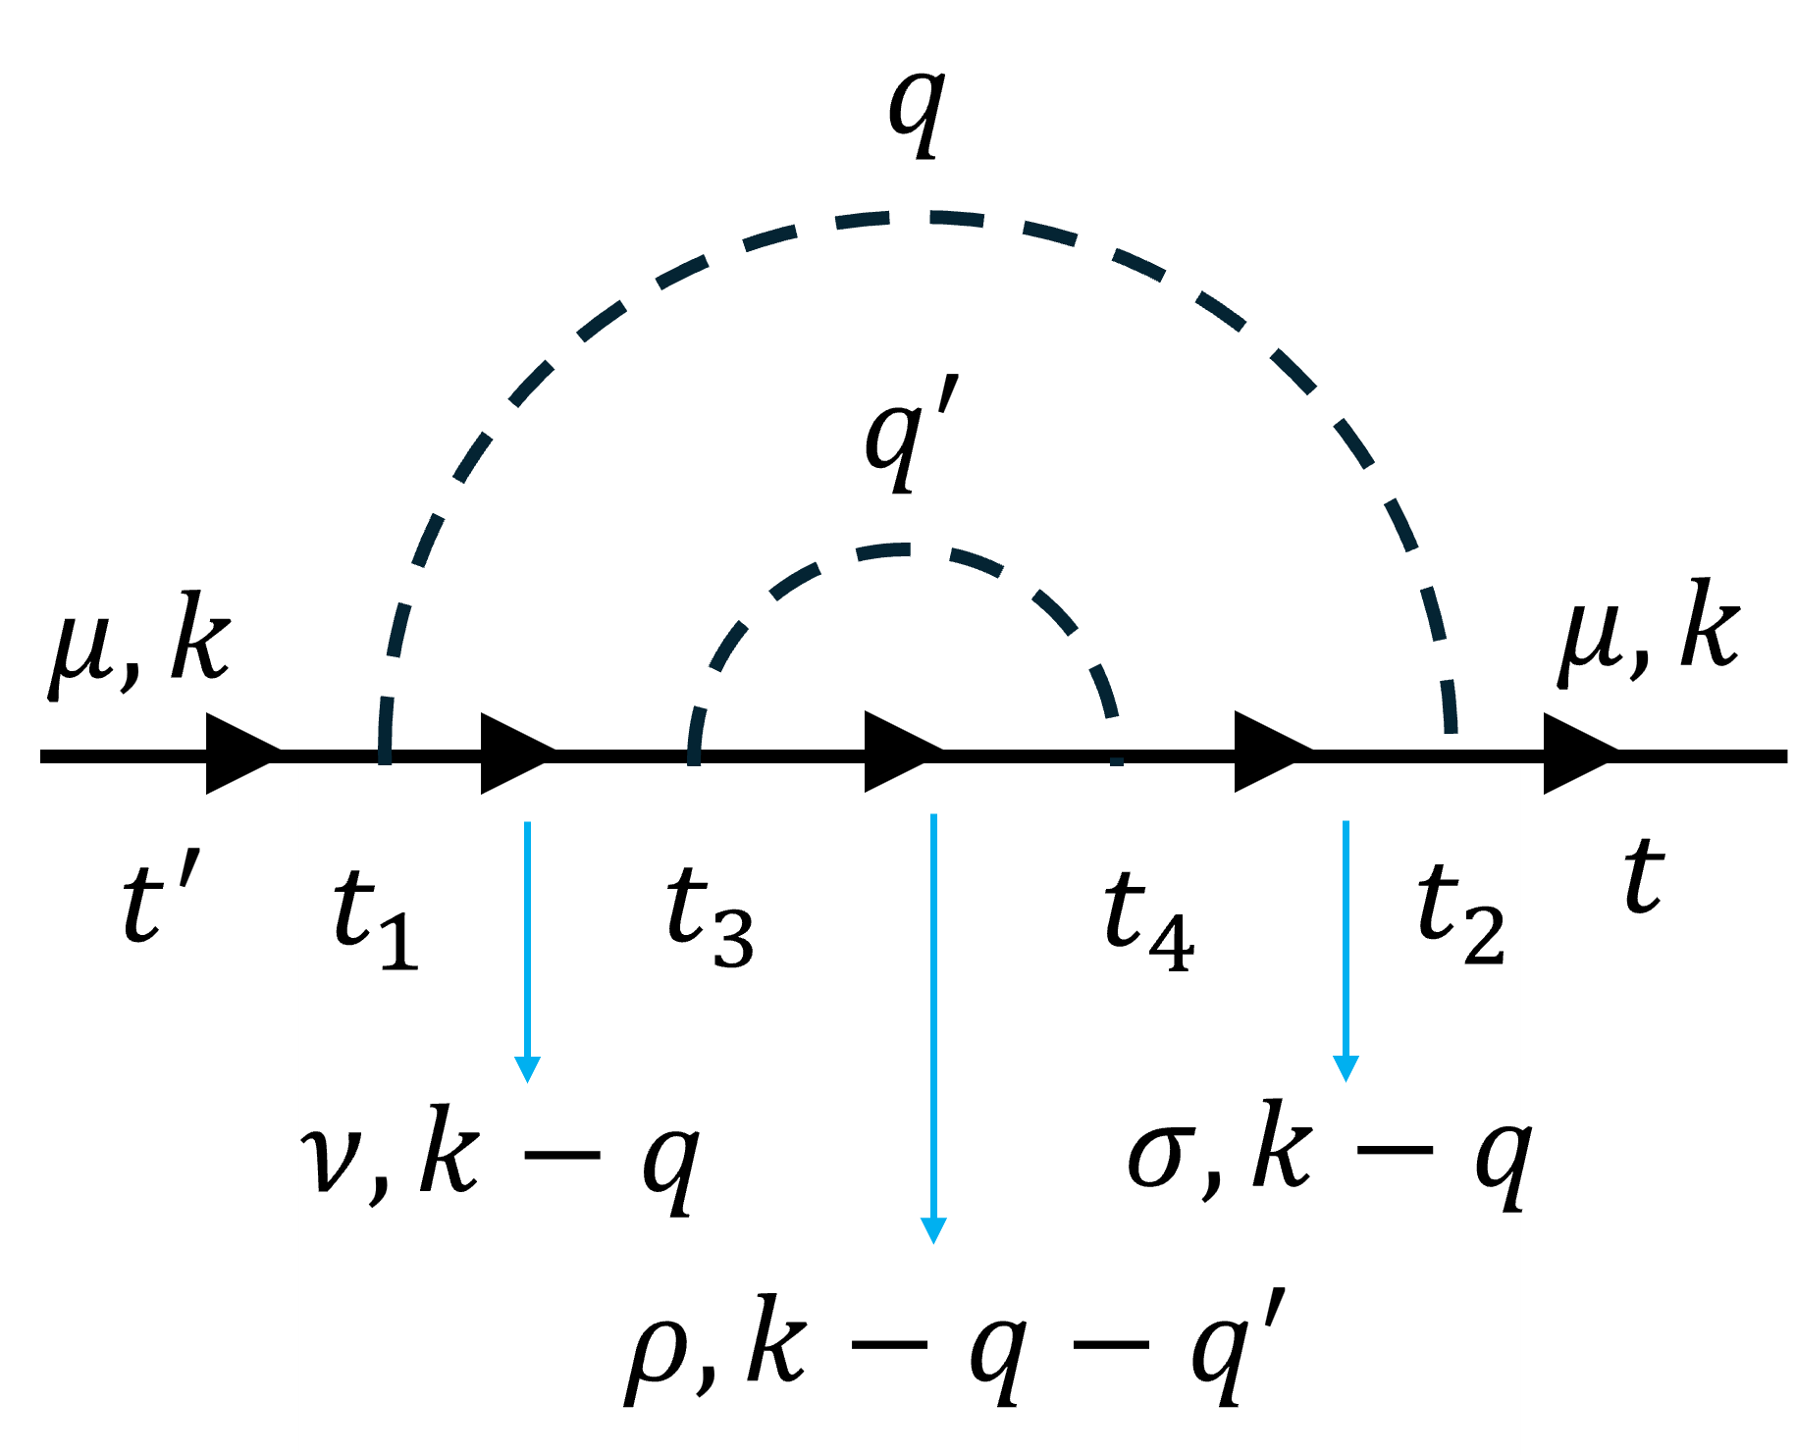
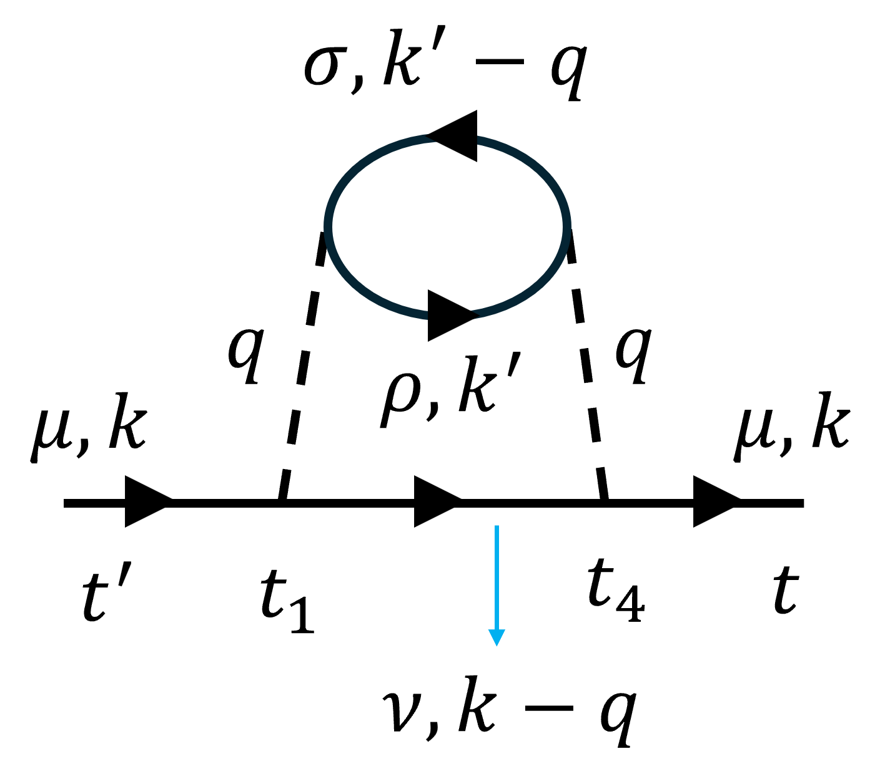









$$μ,k$$
$$q$$
$$t^{′}$$
$$t$$
$$t^{′}$$
$$t$$
$$+$$
$$+$$
$$+$$

Slide 2
















Diagram 0.
$$q$$
$$μ,k$$
$$μ,k$$
Uncombined:
$$t^{′}$$
$$t_{1}$$
$$t_{2}$$
$$t$$
$$ν,k−q$$
$$q$$
$$μ,k$$
$$μ,k$$
$$t^{′}$$
$$t_{1}$$
$$t_{2}$$
$$t$$
Combined:
$$ν,k−q$$

Slide 3


























Diagram 1.
$$q$$
$$q^{′}$$
$$μ,k$$
$$μ,k$$
Uncombined:
$$t^{′}$$
$$t_{1}$$
$$t_{2}$$
$$t$$
$$t_{3}$$
$$t_{4}$$
$$ν,k−q$$
$$σ,k−q^{′}$$
$$ρ,k−q−q^{′}$$
$$q$$
$$q^{′}$$
$$μ,k$$
$$μ,k$$
$$t^{′}$$
$$t_{1}$$
$$t_{2}$$
$$t_{3}$$
$$t_{4}$$
$$t$$
Combined:
$$ν,k−q$$
$$σ,k−q^{′}$$
$$ρ,k−q−q^{′}$$

Slide 4


























$$q$$
$$q^{′}$$
Diagram 2.
$$μ,k$$
$$μ,k$$
$$t^{′}$$
$$t_{1}$$
$$t_{3}$$
$$t_{2}$$
$$t_{4}$$
$$t$$
Uncombined:
$$ν,k−q$$
$$σ,k−q^{′}$$
$$ρ,k−q−q^{′}$$
$$q$$
$$q^{′}$$
$$μ,k$$
$$μ,k$$
$$t^{′}$$
$$t_{1}$$
$$t_{3}$$
$$t_{2}$$
$$t_{4}$$
$$t$$
Combined:
$$ν,k−q$$
$$σ,k−q^{′}$$
$$ρ,k−q−q^{′}$$

Slide 5


























$$q$$
Diagram 3.
$$q^{′}$$
Uncombined:
$$μ,k$$
$$μ,k$$
$$t^{′}$$
$$t_{1}$$
$$t_{3}$$
$$t_{4}$$
$$t_{2}$$
$$t$$
$$q$$
$$ν,k−q$$
$$σ,k−q$$
$$ρ,k−q−q^{′}$$
$$q^{′}$$
$$μ,k$$
$$μ,k$$
$$t^{′}$$
$$t_{1}$$
$$t_{3}$$
$$t_{4}$$
$$t_{2}$$
$$t$$
Combined:
$$ν,k−q$$
$$σ,k−q$$
$$ρ,k−q−q^{′}$$

Slide 6






















$${σ,k}^{′}−q$$
Diagram 4.
Uncombined:
$$q$$
$$q$$
$${ρ,k}^{′}$$
$$μ,k$$
$$μ,k$$
$$t^{′}$$
$$t_{1}$$
$$t_{4}$$
$$t$$
$$ν,k−q$$
$${σ,k}^{′}−q$$
$$q$$
$$q$$
$${ρ,k}^{′}$$
$$μ,k$$
$$μ,k$$
Combined:
$$t^{′}$$
$$t_{1}$$
$$t_{4}$$
$$t$$
$$ν,k−q$$

