Slide 1
Track II
M P I
M P I
M P I
M P I
M P I
Advanced Distributed-Memory Programming
Hands ON Exercises
2024 IHPCSS
Andrew KirbY

Slide 2
Bridges2 Setup
Connecting ssh <username>@bridges2.psc.edu
Exercises cp –r /jet/home/akirby/IHPCSS2024-mpi/exercises ~/.
Modules
1) allocations/1.0 2) psc.allocations.user/1.0 3) intel-mpi/2021.10.0
module load intel-mpi
Interactive Reservations
./interactive8-day1.sh
./interactive8-day2.sh
Slides(pptx): https://github.com/ackirby88/IHPCSS2024-mpi

Slide 3
Lecture Slides
Slides (pptx)/Code on Github git clone https://github.com/ackirby88/IHPCSS2024-mpi

Slide 4
Exercise.1 Derived Data Types
A[4][4]
Four Programs
ddt.1.contiguous
ddt.2.vector
ddt.3.indexed
ddt.4.struct
1.0 | 2.0 | 3.0 | 4.0
5.0 | 6.0 | 7.0 | 8.0
9.0 | 10.0 | 11.0 | 12.0
13.0 | 14.0 | 15.0 | 16.0
4

Slide 5
Exercise.1 Derived Data Types
ddt.1.contiguous
int MPI_Type_contiguous(
int count,
MPI_Datatype oldtype,
MPI_Datatype *newtype);
Rank 0 B[4] =
1.0 | 2.0 | 3.0 | 4.0
A[4][4]
Rank 1 B[4] =
5.0 | 6.0 | 7.0 | 8.0
1.0 | 2.0 | 3.0 | 4.0
5.0 | 6.0 | 7.0 | 8.0
9.0 | 10.0 | 11.0 | 12.0
13.0 | 14.0 | 15.0 | 16.0
1.0 | 2.0 | 3.0 | 4.0
5.0 | 6.0 | 7.0 | 8.0
9.0 | 10.0 | 11.0 | 12.0
13.0 | 14.0 | 15.0 | 16.0
Rank 2 B[4] =
9.0 | 10.0 | 11.0 | 12.0
Rank 3 B[4] =
13.0 | 14.0 | 15.0 | 16.0
5
Rank 0

Slide 6
Exercise.1 Derived Data Types
ddt.2.vector
int MPI_Type_vector(
int count,
int blocklen,
int stride,
MPI_Datatype oldtype,
MPI_Datatype *newtype);
Rank 0 B[4] =
1.0 | 5.0 | 9.0 | 13.0
A[4][4]
Rank 1 B[4] =
2.0 | 6.0 | 10.0 | 14.0
1.0 | 2.0 | 3.0 | 4.0
5.0 | 6.0 | 7.0 | 8.0
9.0 | 10.0 | 11.0 | 12.0
13.0 | 14.0 | 15.0 | 16.0
1.0 | 2.0 | 3.0 | 4.0
5.0 | 6.0 | 7.0 | 8.0
9.0 | 10.0 | 11.0 | 12.0
13.0 | 14.0 | 15.0 | 16.0
1.0 | 2.0 | 3.0 | 4.0
5.0 | 6.0 | 7.0 | 8.0
9.0 | 10.0 | 11.0 | 12.0
13.0 | 14.0 | 15.0 | 16.0
1.0 | 2.0 | 3.0 | 4.0
5.0 | 6.0 | 7.0 | 8.0
9.0 | 10.0 | 11.0 | 12.0
13.0 | 14.0 | 15.0 | 16.0
Rank 2 B[4] =
3.0 | 7.0 | 11.0 | 15.0
Rank 3 B[4] =
4.0 | 8.0 | 12.0 | 16.0
6
Rank 0

Slide 7
Exercise.1 Derived Data Types
ddt.3.indexed
int MPI_Type_indexed(
int count,
int *array_of_blocklens,
int *array_of_displacements,
MPI_Datatype oldtype,
MPI_Datatype *newtype);
Rank 0
A[16]
1 | 2 | 3 | 4 | 5 | 6 | 7 | 8 | 9 | 10 | 11 | 12 | 13 | 14 | 15 | 16
Block Count
Block Lengths
Displacements
Rank 0 B[6] =
6 | 7 | 8 | 9
13 | 14
Rank 2 B[6] =
6 | 7 | 8 | 9
13 | 14
Rank 1 B[6] =
6 | 7 | 8 | 9
13 | 14
Rank 3 B[6] =
6 | 7 | 8 | 9
13 | 14
7

Slide 8
Exercise.1 Derived Data Types
ddt.4.struct
int MPI_Type_create_struct(
int count,
int *array_of_blocklens,
MPI_Aint *array_of_displacements,
MPI_Datatype *array_of_types,
MPI_Datatype *newtype);
typedef struct {
float x, y, z, velocity;
int n, type;
} Particle;
Particle particles[NELEM];
f | f | f | f | i | i
… … … … … …
f | f | f | f | i | i
particles[NELEM];

Slide 9

Exercise.1 Derived Data Types
Four Programs
ddt.1.contiguous
ddt.2.vector
ddt.3.indexed
ddt.4.struct
Step 1: cp -r /jet/home/akirby/IHPCSS2024-mpi/exercises ~/.
Step 2: cd exercises/Exercise.1-DerivedDataTypes/{c or f90}
Step 3: Complete the “TODO” tasks in each of the programs.
SOLUTIONS: cd exercises/Exercise.1-DerivedDataTypes/.soln
5
Min
4
Min
3
Min
2
Min
1
Min
5
Min
4
Min
3
Min
2
Min
1
Min
5
Min
4
Min
3
Min
2
Min
1
Min
5
Min
4
Min
3
Min
2
Min
1
Min
9

Slide 10

Exercise.2 Cartesian Virtual Topologies
Step 1: cd exercises/Exercise.2-CartesianTopology/{c or f90}
Step 2: Complete the “TODO” tasks in stencil_cart_shift.{c or f90}
$$−Δu\left(x,y\right)=f$$
[0][0]
[0][1]
[0][2]
rx
[1][0]
[1][1]
[1][2]
ry
[2][0]
[2][1]
[2][2]
4 Neighbors
Typical Communication Pattern
10

Slide 11
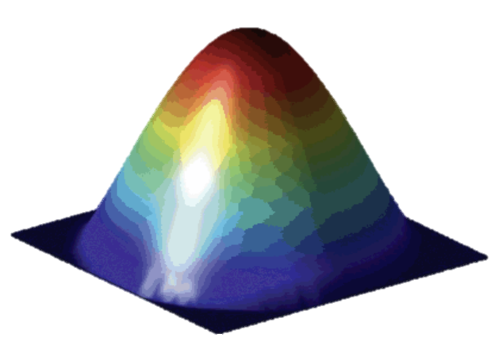

Exercise.2 Cartesian Virtual Topologies
Step 1: cd exercises/Exercise.2-CartesianTopology/{c or f90}
Step 2: Complete the “TODO” tasks in stencil_cart_shift.{c or f90}
$$−Δu\left(x,y\right)=f$$
bx
by
11

Slide 12
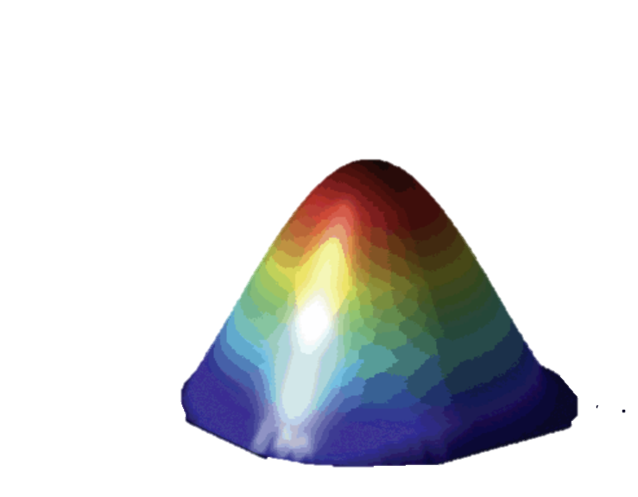
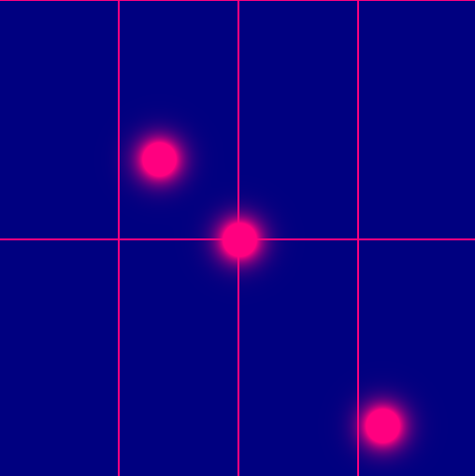
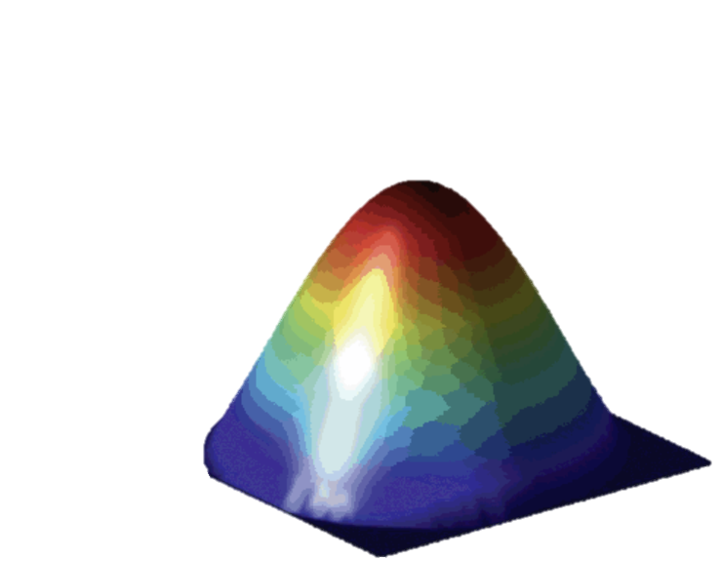

Exercise.2 Cartesian Virtual Topologies
Step 1: cd exercises/Exercise.2-CartesianTopology/{c or f90}
Step 2: Complete the “TODO” tasks in stencil_cart_shift.{c or f90}
20 Minutes
5
10
Time
15
20
SOLUTIONS: cd exercises/Exercise.2-CartesianTopology/.soln
$$−Δu\left(x,y\right)=f$$
12

Slide 13
Exercise.3 Distributed Graph Topologies
Makes a new communicator to which topology information has been attached.
0
2
1
3
0
2
0
2
1
3
1
3
MPI Process 0
MPI Process 1
MPI Process 2
MPI Process 3
Every MPI process may specify 0, 1 or more edges. The edges specified do not have to contain the MPI process that passes them.
13

Slide 14
Exercise.3 Distributed Graph Topologies
Step 1: cd exercises/Exercise.3-GraphTopology/{c or f90}
Step 2: Complete the “TODO” tasks in mpi_dist_graph_create.{c or f90}
0
2
0
2
1
3
1
3
MPI Process 0
MPI Process 1
MPI Process 2
MPI Process 3
20 Minutes
Look at the new rank reordering.
Does it make sense? Why?*
* May not reorder due to MPI Vendor implementation.
0
2
1
3
14

Slide 15

Exercise.4 Neighborhood Collectives
Step 1: cd exercises/Exercise.4-NeighborhoodCollectives/{c or f90}
Step 2: Complete the “TODO” tasks in stencil_mpi_carttopo_neighcolls.{c or f90}
$$−Δu\left(x,y\right)=f$$
4 Neighbors
Typical Communication Pattern
15

Slide 16
Exercise.4 Neighborhood Collectives
MPI_Ineighbor_alltoallv
Step 1: cd exercises/Exercise.4-NeighborhoodCollectives/{c or f90}
Step 2: Complete the “TODO” tasks in stencil_mpi_carttopo_neighcolls.{c or f90}
bx
Pack Send Buffer (green cells)
West, East, North, South
Recall Neighbor Ordering (X-, X+, Y-, Y+)
North
15 Minutes
Counts[4] = {?, ?, ?, ?}
West
East
by
Displacements[4] = {?, ?, ?, ?}
South
sbuf
0 | 1 | 2 | 3 | 4 | 5 | 6 | 7 | 8 | 9 | 10 | 11 | 12 | 13 | 14 | 15 | 16 | 17 | 18 | 19 | 20 | 21 | 22 | 23 | 24 | 25 | 26 | 27
0 | 1 | 2 | 3 | 4 | 5 | 6 | 7 | 8 | 9 | 10 | 11 | 12 | 13 | 14 | 15 | 16 | 17 | 18 | 19 | 20 | 21 | 22 | 23 | 24 | 25 | 26 | 27
0 | 1 | 2 | 3 | 4 | 5 | 6 | 7 | 8 | 9 | 10 | 11 | 12 | 13 | 14 | 15 | 16 | 17 | 18 | 19 | 20 | 21 | 22 | 23 | 24 | 25 | 26 | 27
0 | 1 | 2 | 3 | 4 | 5 | 6 | 7 | 8 | 9 | 10 | 11 | 12 | 13 | 14 | 15 | 16 | 17 | 18 | 19 | 20 | 21 | 22 | 23 | 24 | 25 | 26 | 27
0 | 1 | 2 | 3 | 4 | 5 | 6 | 7 | 8 | 9 | 10 | 11 | 12 | 13 | 14 | 15 | 16 | 17 | 18 | 19 | 20 | 21 | 22 | 23 | 24 | 25 | 26 | 27
16
West
East
North
South

Slide 17
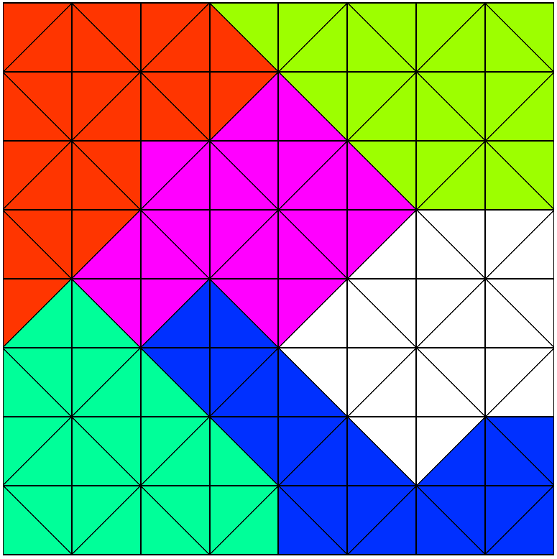
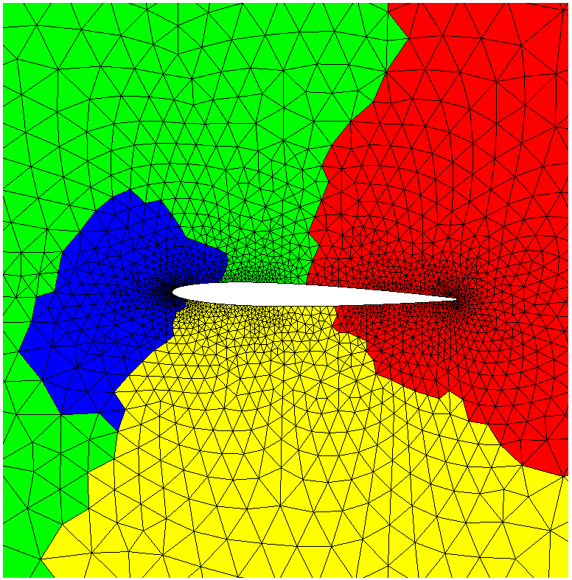
Exercise.5 Graph Partitioning with Metis
Step 1: cd exercises/Exercise.5-METIS/c
Step 2: Execute the Demos Programs in
Build METIS (./build-metis.sh)
cd demo.1.box
>> make; ./MetisDemo
cd demo.2.mesh
>> make; ./MetisDemo <MeshID> <nparts>
Step 3: Visualize the partitioned meshes (*.vtu) in VisIt/Paraview.
Step 4: Examine the source codes for METIS API calls.
17

