Slide 1
TIES4560
TASK5
Group 02
Tiina Tuomisto
Md Tanjimuddin
Elahe Hajihashemi Varnousfaderani

Slide 2
Azure Cloud
Task4 deployment: Restaurant

Slide 3

Preparations:
Create an account (free)
Download Azure Toolkit for Eclipse by dragging Install- file to Eclipse’s workspace from website:
https://docs.microsoft.com/en-us/azure/developer/java/toolkit-for-eclipse/installation
Appears: new window with chosen components > click “Confirm”
Now you can use the toolkit in Eclipse

Slide 4
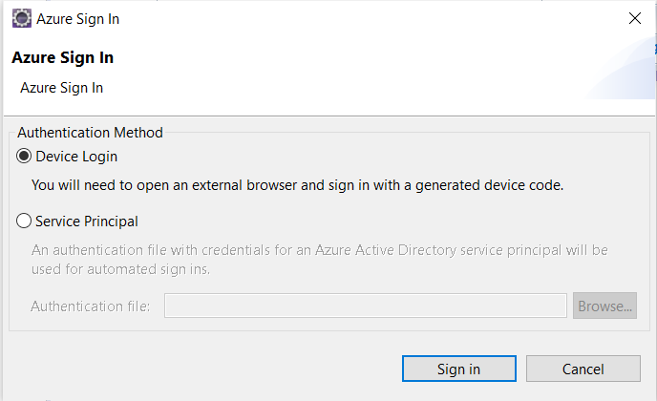

Deploying: Eclipse part 1
In Eclipse: Tools>Azure>Sign in…
Device login >Sign in > Opens new window

Slide 5
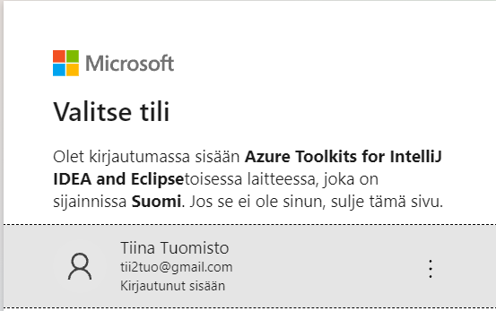
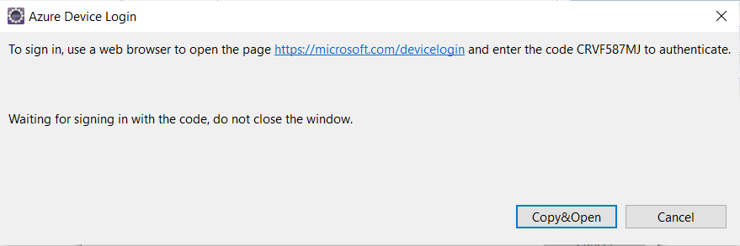
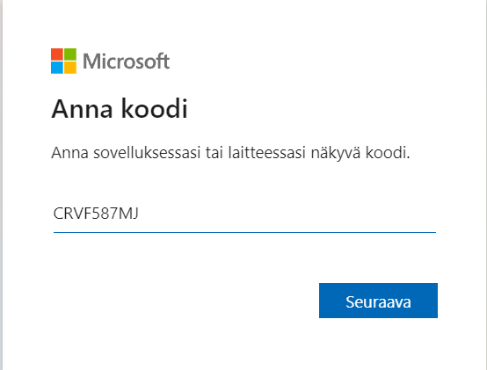
Deploying Eclipse part 2
New window: a code
Copy&Open > Opens Microsoft-page to Brower >
paste the given code >Choose your microsoft account
Name
email
xxxxxx
xxxxxxxxxxxx

Slide 6
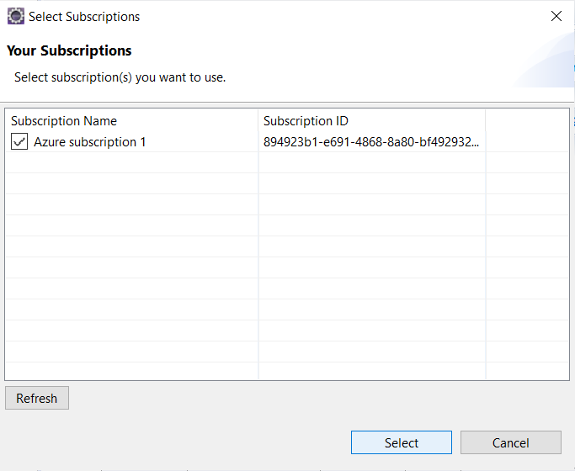
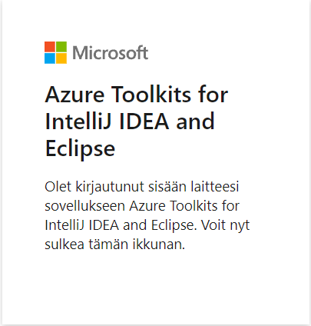
Deploying: Eclipse part 3
Identification is now complete > return to Eclipse:
New window is now open > Select

Slide 7
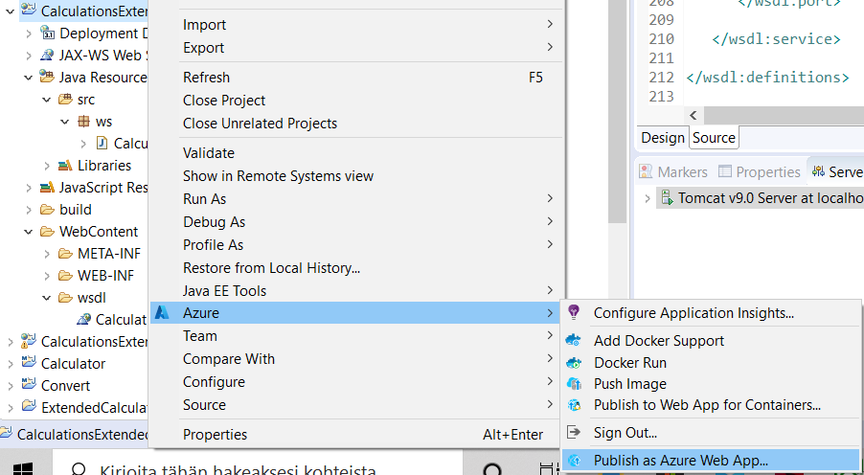
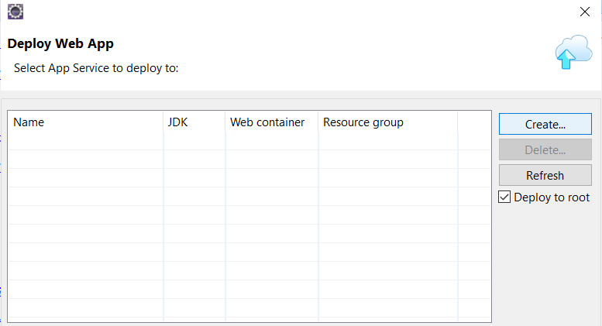
Depoying: Eclipse part 4
Right click the project you want to deploy: Azure>Publish as Azure Web App…
Click Create

Slide 8
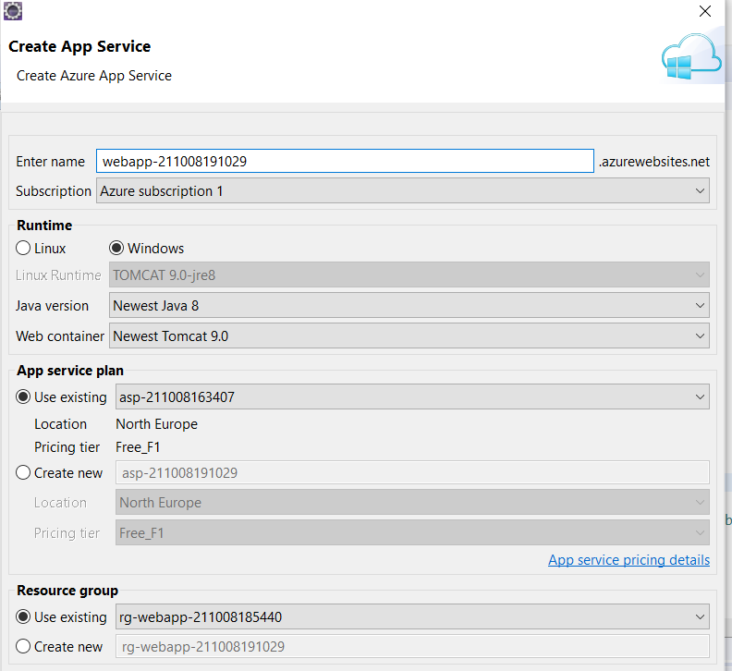
Deploying: Eclipse part 5
wsrestaurant
Give the app a name:
Will become part of url
Choose Runtime
Create new App service plan: choose North Europe, Free_F1
Create new Resource group
Click “Create”

Slide 9
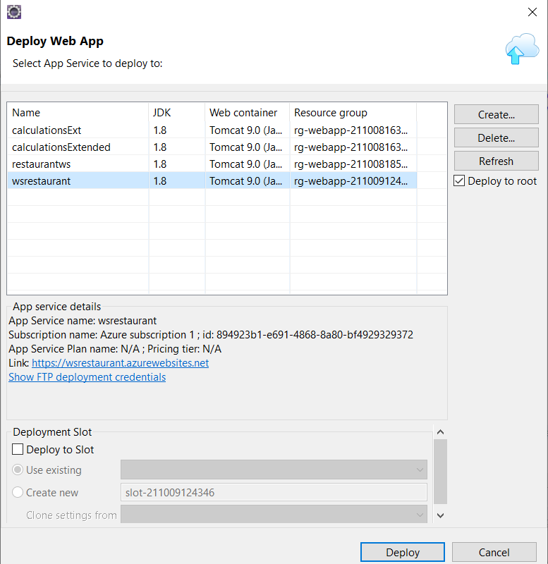
Deploying: Eclipse part 6
Choose the App service you want to deploy
Click “Deploy”

Slide 10
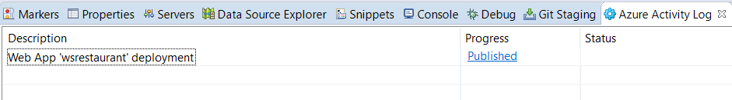
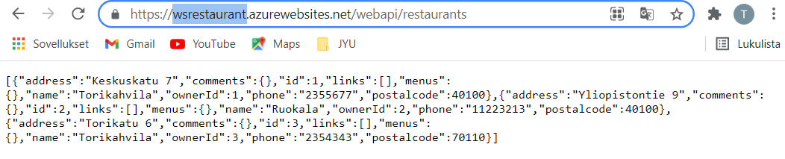
Deploying: Eclipse part 7, Published
Web app published
Click “Published” for url:
https://wsrestaurant.azurewebsites.net/webapi/restaurants

Slide 11
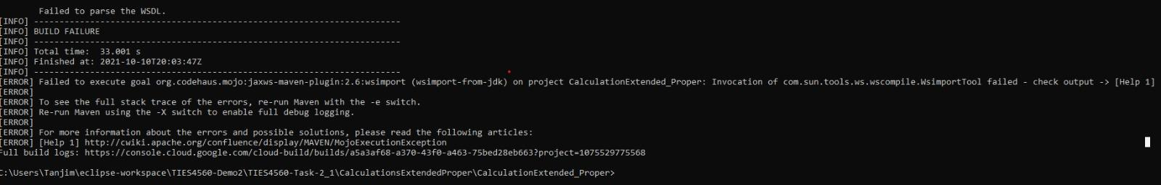
Difficulties during task5:
Deploying task2:
Cannot find wsdl: javax.xml.ws.WebServiceException: Failed to access the WSDL at:

Slide 12
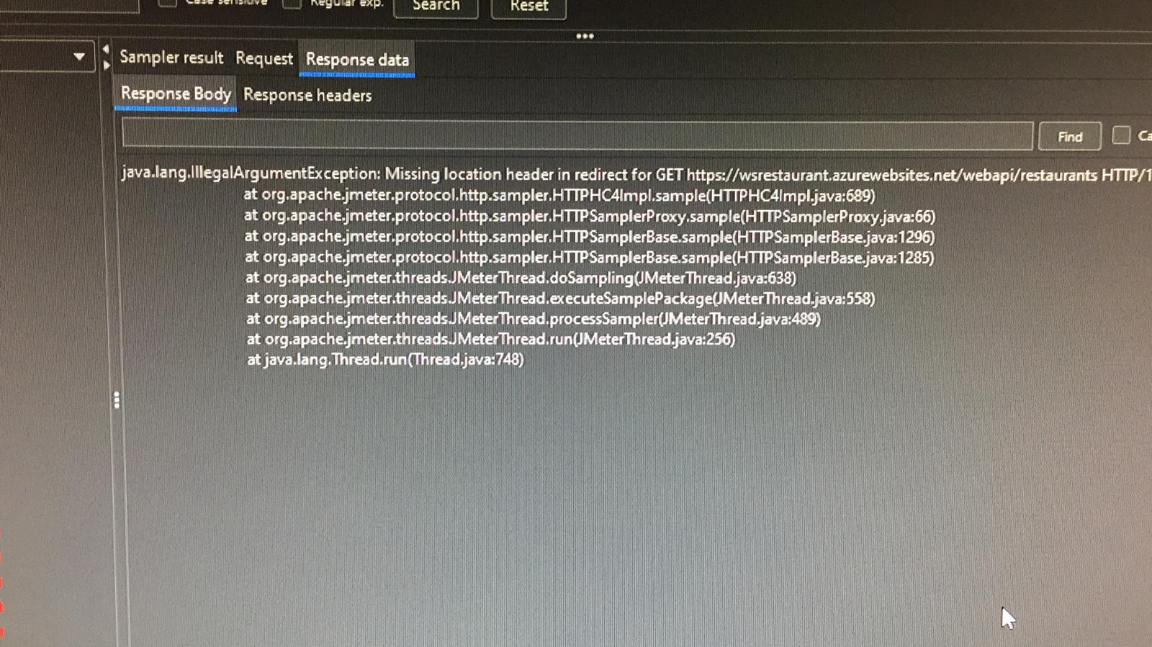
Applying JMeter for REST API testing

Slide 13
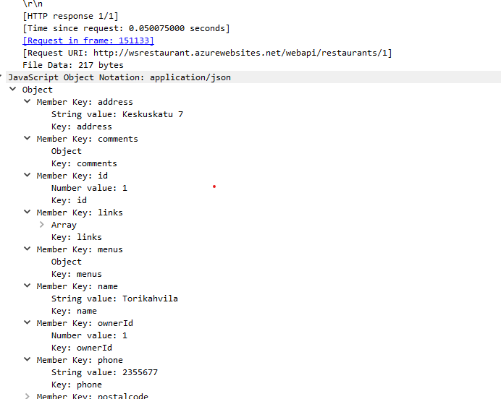
REST api testing

