Slide 1
TIES4560 Task 5 Individual tasks
Tiina Tuomisto 11.10.2021

Slide 2
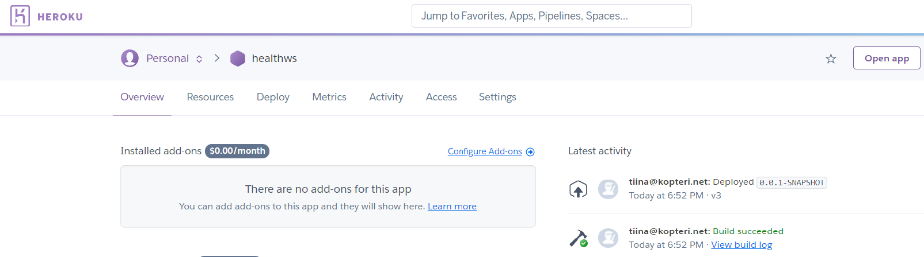
Task5-1 Application deployment to a Cloud

Slide 3
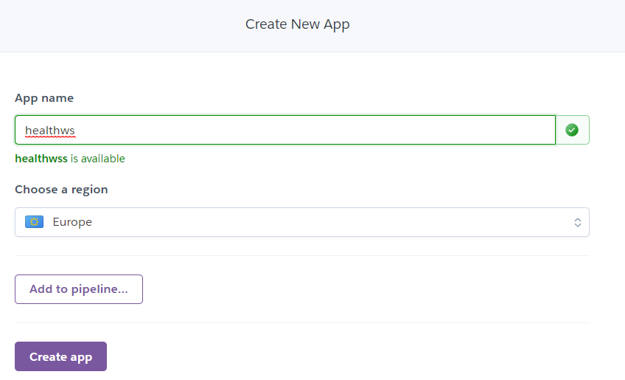
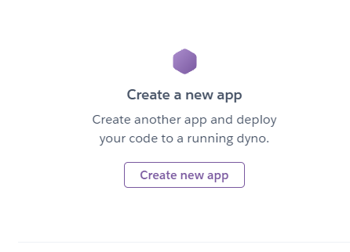
Deploying: Heroku
Create an account to Heroku
Create a new app: name it accordingly
2)
1)

Slide 4
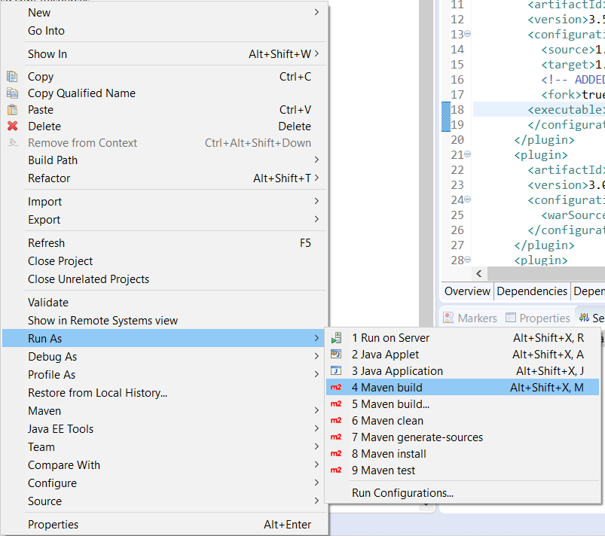
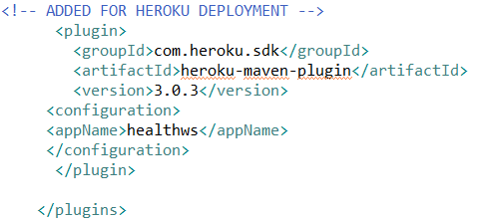
Deploying: Eclipse part 1
1) Add to pom.xml:
Heroku Maven plugin
Appname: healthws (same name as in Heroku)
2) Right click project:
Run As > Maven build
2)
1)

Slide 5
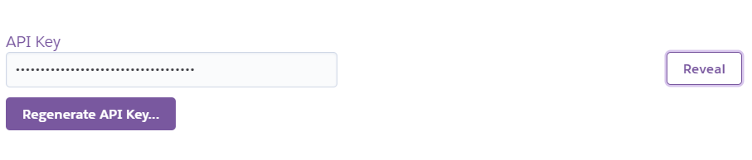
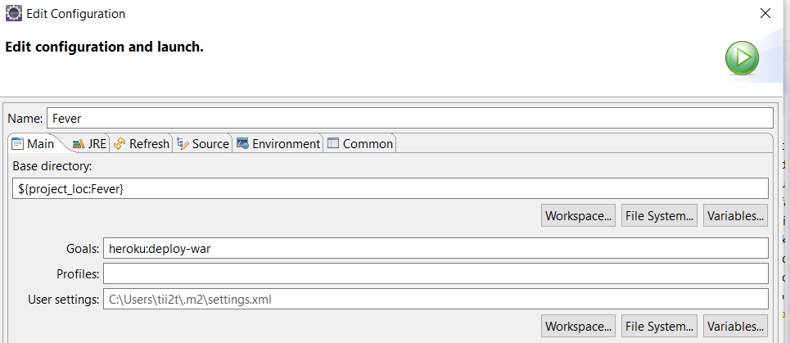
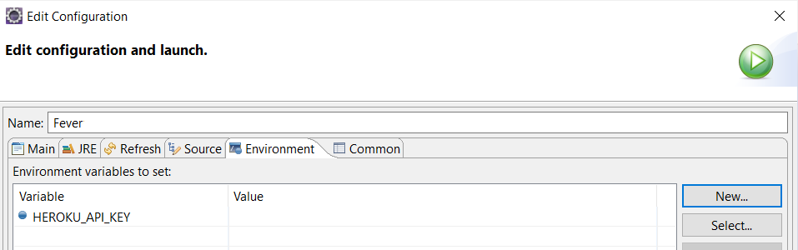
Deploying: Eclipse part 2
3) Edit configuration and launch
Main: Goals: heroku:deploy-war
Environment:
New…>
HEROKU_API_KEY
Value: API Key from Heroku
4) Run
3.2)
3.1)
3.2)
xxx-xxx-xxx-xxx-xxxx

Slide 6
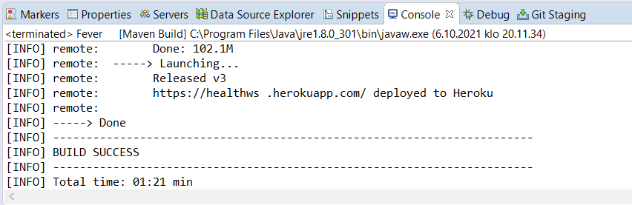
Deploying: Eclipse part 3
5) The app has been depoyed to Heroku: Build success
6) Url: https://healthws.herokuapp.com/

Slide 7
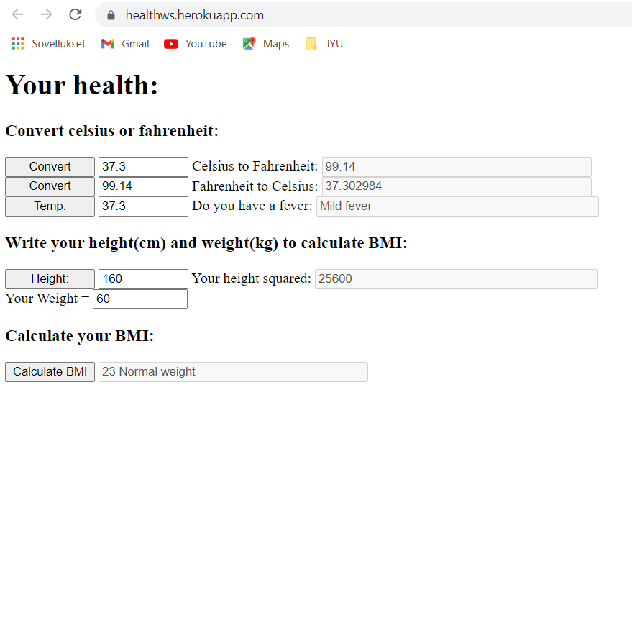

Slide 8
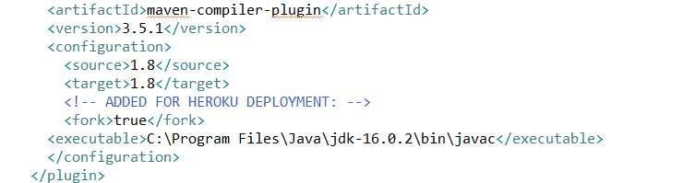
Problems:
” No compiler is provided in this environment. Perhaps you are running on a JRE rather than a JDK?”
FIX:

Slide 9
References:
https://devcenter.heroku.com/articles/deploying-java-applications-to-heroku-from-eclipse-or-intellij-idea (Deployment with Eclipse)
https://github.com/heroku/heroku-maven-plugin (Heroku Maven plugin)
https://roufid.com/no-compiler-is-provided-in-this-environment/ (Error: No compiler is provided in this environment)

Slide 10



Task5-2 Cloud Services: IoT data managment

Slide 11
In general
Services that help you manage data from IoT devices
Services:
Google Cloud: IoT Core
IBM: Internet of Things Platform
Microsoft Azure: Azure IoT Hub

Slide 12
Google Cloud: IoT Core
Manage, connect and consume data from devices
Can be combined with other services on Google Cloud e.g. to visualize and analyze data → improved operational efficiency and problem anticipation
Scalable (no up-front software installation)
REST APIs to automatically manage deployment, registration and operation of devices. Also to update and retrieve device properties and states (even when devices not connected)
Secure way to connect devices:
MQTT, HTTP –protocols

Slide 13
IoT Core: features part 1
Device manager:
Establishing device identity
Authentication of device when connecting
Maintains logical configuration of device
Remotely controls device from cloud
End-to-end security:
Possible to enable end-to-end security using asymmetric key authentication- can be used to verify device ownership
Single global system:
Connect devices/gateways to Google Cloud with MQTT or HTTP and manage devices as a single global system
Retains data for seven days

Slide 14
IoT Core: features part 2
Role-level access control:
Apply to control user access to data and devices
Offline operation and support for devices:
Use gateway to perform tasks on behalf of device: connecting to the Internet, authenticating credentials etc.

Slide 15
IoT Core: Pricing
Priced per MB of data exchanged by IoT devices with service
Free tier: until 250 MB (after creating account)
Tier | Price (per MB) | Data volume (per month)
Free | $0.00 | <250MB
Standard | $0.0045 | 250MB to 250GB
 | $0.0020 | 250GB to 5TB
 | $0.00045 | >5TB

Slide 16
IoT core: Getting Started
Requirements:
Google Cloud account
Google Cloud Shell or Cloud SDK and Node.js
Create a registery for devices:
Generate a device key-pair
Add a device : device ID and public key
Connect device to Cloud Iot Core

Slide 17
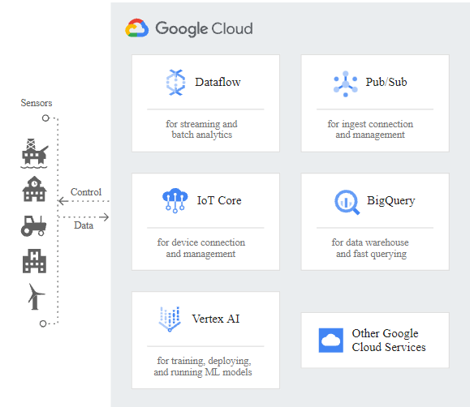
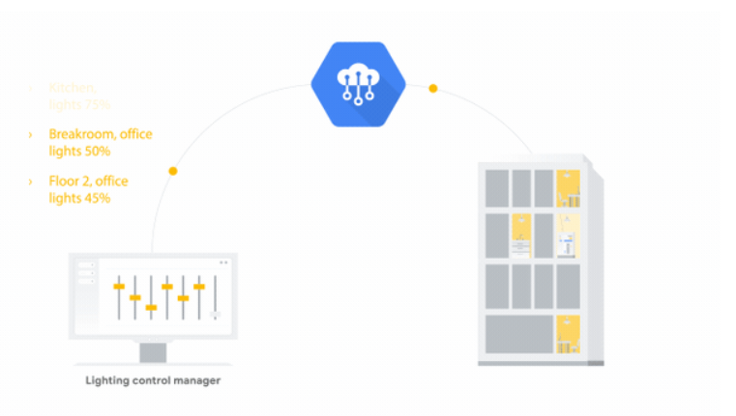
IoT Core Example:
Pic 2. Example of usage. Ref: https://cloud.google.com/blog/products/iot-devices/introducing-cloud-iot-core-commands-increased-flexibility-to-control-your-fleet-of-embedded-devices
Pic 1. Workings of IoT Core. Ref: https://cloud.google.com/solutions/iot

Slide 18
IBM: Internet of Things Platform
Communicate and collect data from connected devices
Monitor and analyze data
Manage data storage/integrate data
Trigger automatic actions: alerts, emails etc.
Build and connect own apps
Risk and security management
Access control for users and apps
Secure connectivity: MQTT

Slide 19
Internet of Things Platform: pricing
Plan | Pricing (€) per Plan | Features
Lite | Free | <500 registered devices <200 MB data Services deleted after 30 days of inactivity
Capacity Level 1 | 2108.25 | <5000 devices <1 million analytics events
Capacity Level 2 | 6746.40 | <25 000 devices <5 million analytics events

Slide 20
How to get started
Create IBM account and Watson IoT Platform instance
Device requirements:
Must be able to communicate by using MQTT or HTTP protocols
Register device and provide automatically generated token or create your own token
Now you can connect the device to Watson IoT Platform by setting your device for MQTT messaging and authenticating device with authentication token and device info
Extend data analytics features by creating/connecting own apps to consume device data

Slide 21
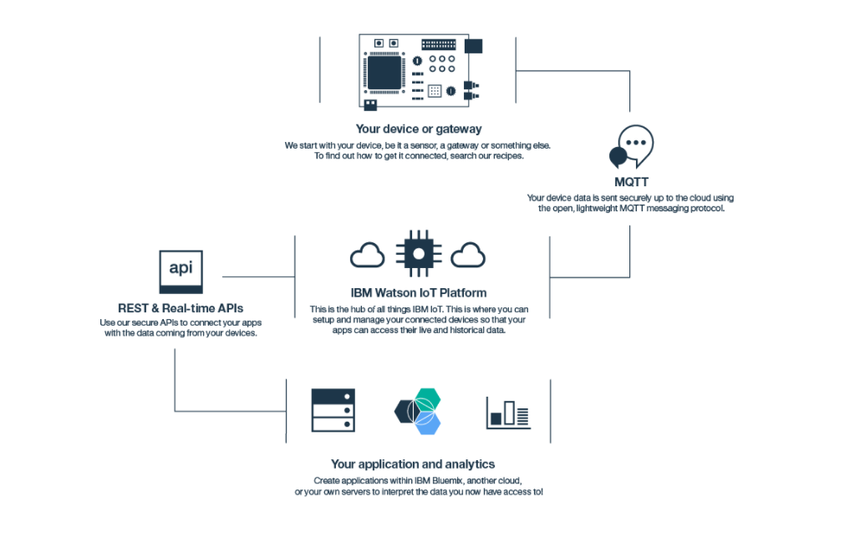
Internet Of Things Platform in general:
Pic 3. Workings of the platform. Ref: https://cloud.ibm.com/catalog/services/internet-of-things-platform#about

Slide 22
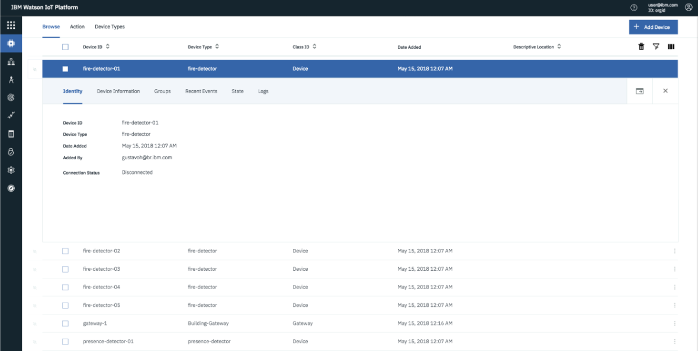
Internet Of Things Platform in general:
Pic 4. Devices registered to platform. Ref: https://cloud.ibm.com/catalog/services/internet-of-things-platform#about

Slide 23
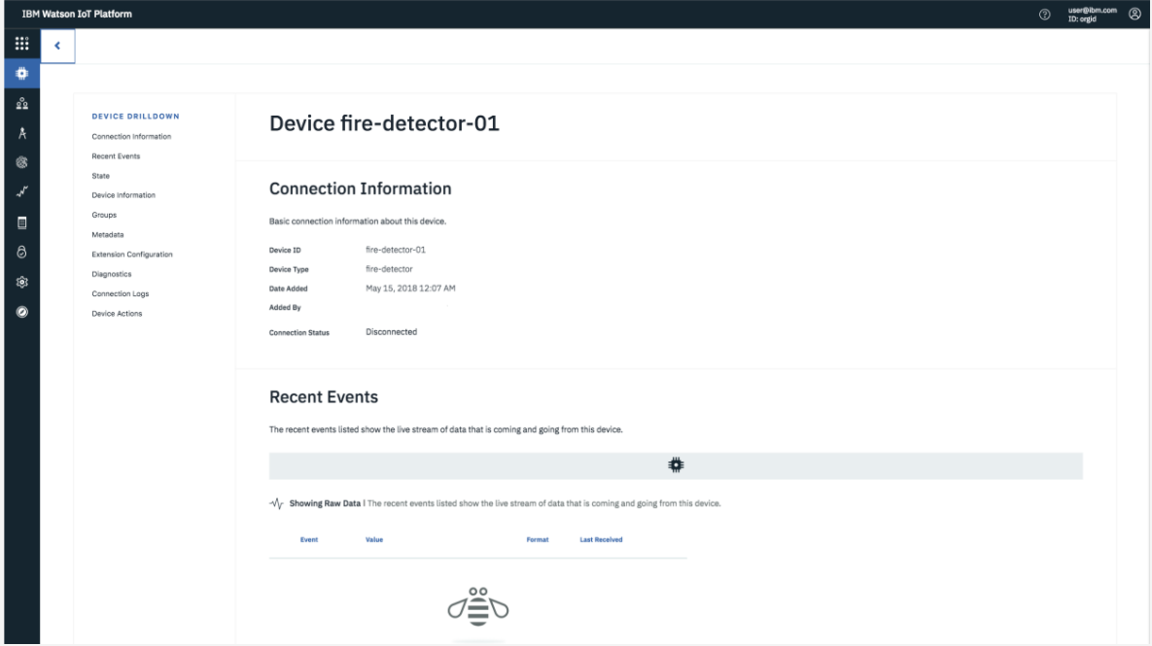
Internet Of Things Platform in general:
Pic 5. Spesific device connected. Ref: https://cloud.ibm.com/catalog/services/internet-of-things-platform#about

Slide 24
Azure: Azure IoT Hub
Connect, monitor and manage IoT devices:
Telemetry data to get the state of device
Reliable communication between IoT app and the devices
Send commands/notifications to connected devices
Track message delivery: ACK –receipts
Individual identities and credentials for each device
HTTP, MQTT
Flexible: IoT apps can run partially/entirely on-premises
Device Update –platform: distribute/manage updates to sensors/gateways etc.
Compatible with other Azure IoT services, e.g Azure IoT Edge, Azure Defender for IoT

Slide 25
Usage:
Two tiers:
Basic:
Collecting and analyzing data
Uni-directional communication: Devices → Cloud
Standard:
Control devices remotely
Bi-directional communication: Devices ←→Cloud
More compatible services
Free tier offered: limits messaging

Slide 26
Azure IoT Hub: Pricing
Basic tier | Price per unit (€/per month) | Number of messages a day per unit
B1 | 8.433 | 400 000
B2 | 42.165 | 6 000 000
B3 | 421.65 | 300 000 000
Standard tier | Price per unit (€/per month) | Number of messages a day per unit
Free | Free | 8 000
S1 | 21.083 | 400 000
S2 | 210.825 | 6 000 000
S3 | 2 108.25 | 300 000 000

Slide 27
Getting started:
Create an account on Azure Microsoft
Create IoT hub: choose region, name, tier and pricing etc.
Connect device to hub: deviceID, authentication type, generate keys etc.
→ IoT hub identity registry stores device identities to enable secure access to IoT hub
(device ID, keys as security credentials)

Slide 28
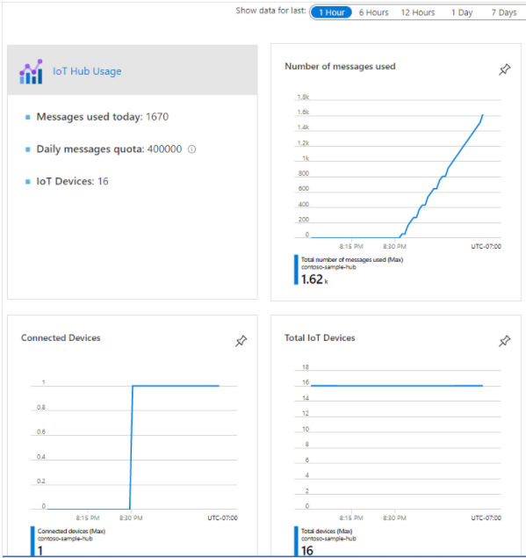
IoT Hub
Pic 6.IoT Hub usage. Ref: https://docs.microsoft.com/en-us/azure/iot-hub/monitor-iot-hub

Slide 29
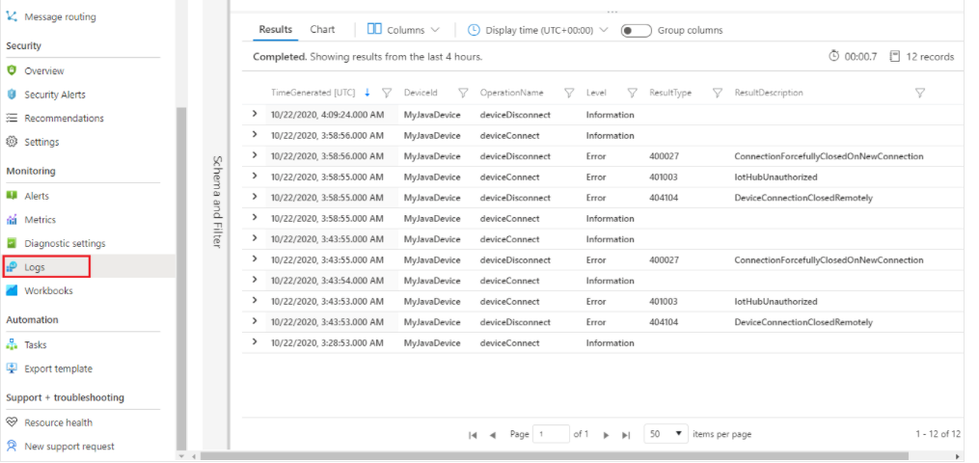
IoT Hub
Pic 7.IoT Hub Logs. Ref: https://docs.microsoft.com/en-us/azure/iot-hub/monitor-iot-hub

Slide 30
References:
https://cloud.google.com/iot-core (Google Cloud: IoT Core)
https://docs.microsoft.com/en-us/azure/iot-hub/iot-hub-scaling?branch=release-iotbasic#message-throughput (Azure choosing the right IoT Hub tier)
https://azure.microsoft.com/en-us/pricing/details/iot-hub/ (Azure IoT Hub pricing)
https://docs.microsoft.com/en-us/azure/iot-hub/monitor-iot-hub (Azure Monitoring data)
https://docs.microsoft.com/en-us/azure/iot-hub/iot-hub-create-through-portal (creating Hub)
https://azure.microsoft.com/en-us/services/iot-hub/#overview (Azure IoT Hub)
https://cloud.ibm.com/catalog/services/internet-of-things-platform (IBM IoT Platform)
https://cloud.ibm.com/catalog/services/internet-of-things-platform#about (IBM IoT pictures)
https://cloud.ibm.com/docs/IoT?topic=IoT-getting-started (IBM IoT getting tutorial)
https://cloud.google.com/blog/products/iot-devices/introducing-cloud-iot-core-commands-increased-flexibility-to-control-your-fleet-of-embedded-devices (IoT Core commands + pic2)
https://cloud.google.com/architecture/iot-overview#ingestion (Technical overview IoT Core)
https://cloud.google.com/iot/pricing (Billing IoT Core Cloud)

