Slide 1
TIES4560 TASK6-1
Tiina Tuomisto
15.10.2021

Slide 2
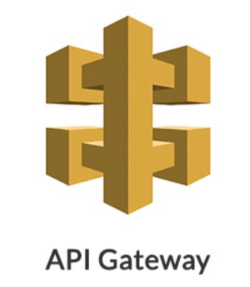
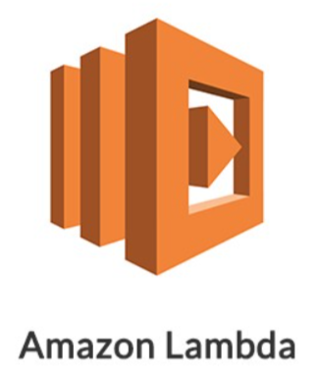
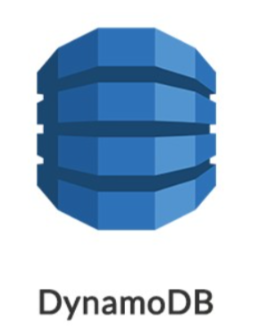

In general
Add, delete, get and update medicine information
After 5 minutes all the medicines in the database are logged
Done with Amazon Web Services (aws):
API Gateway
Lambda
DynamoDB
CloudWatch

Slide 3
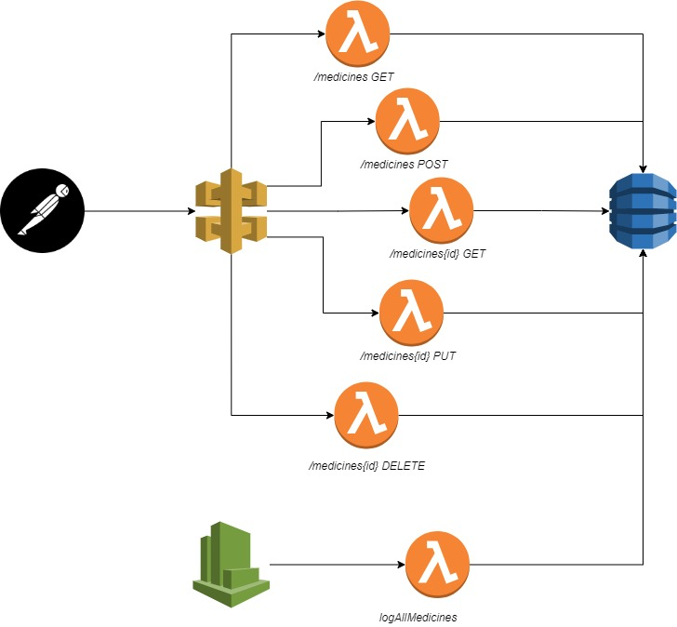
Use Case

Slide 4
Medicines
Path | Method | Parameter | Response | Failure
/medicines | GET |  | 200 OK | 404 Not Found
/medicines | POST | Info in body | 201 Created | 400 Bad request
/medicines/{id} | GET |  | 200 OK | 404 Not Found
/medicines/{id} | PUT | Info in body | 200 OK | 400 Bad request
/medicines/{id} | DELETE |  | 200 OK | 404 Not Found

Slide 5
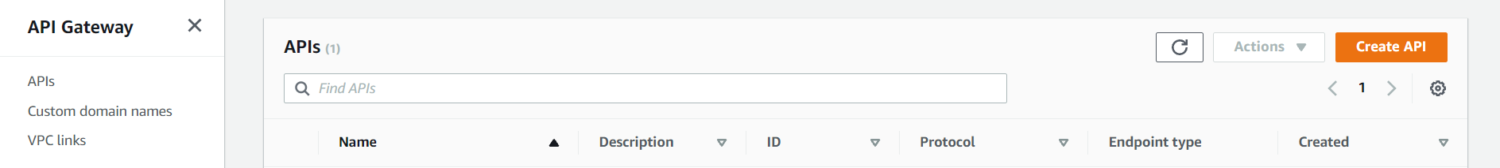
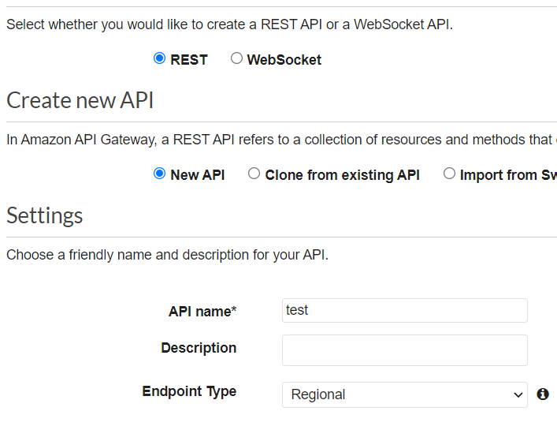
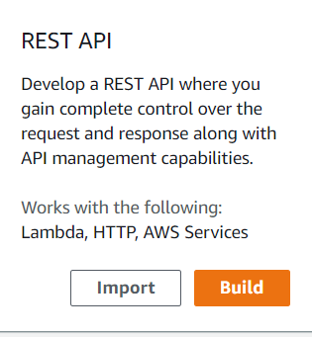
Creating API Gateway
Search: ”API Gateway” in aws and click ”Create API”
Choose ”REST API” and click ”Build”
Name your API
Click ”Create API”
You can now create:
Resources
Methods

Slide 6
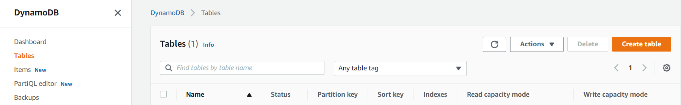
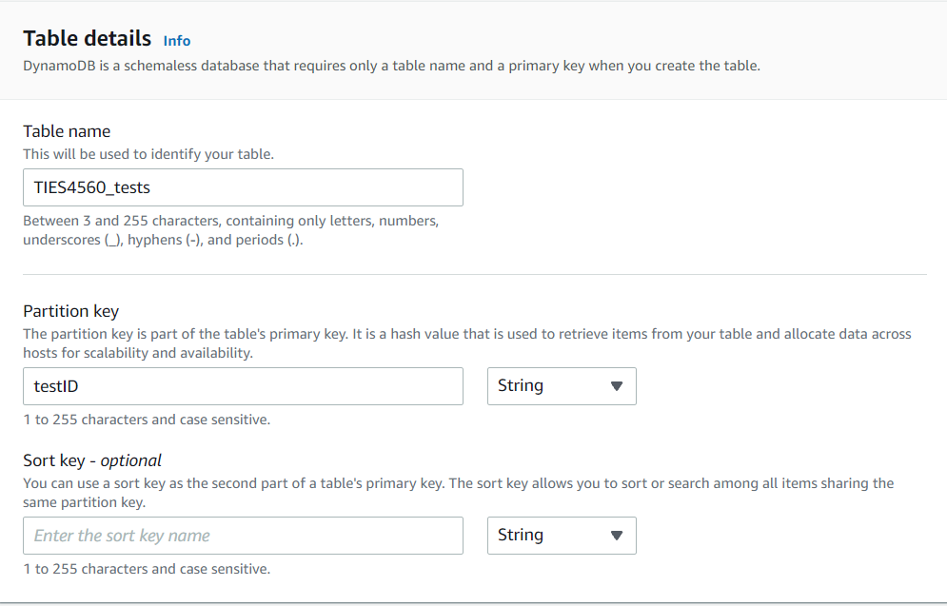

Creating dynamoDB
Search: ”dynamoDB” in aws and click ”Create table”
Name your table
Give a partition key
Settings: use Default settings
Click ”Create table”

Slide 7
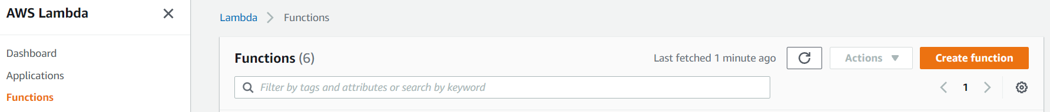
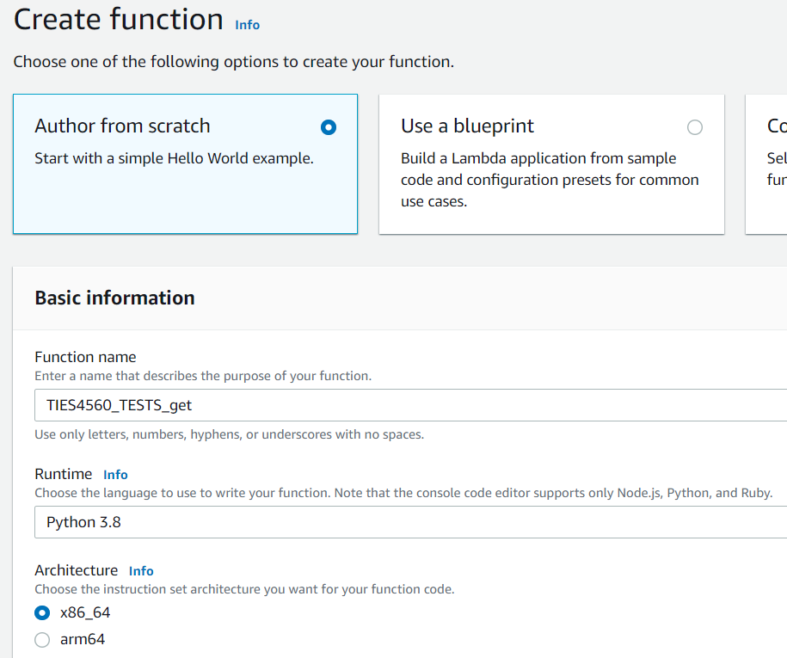
Creating Lambda functions part 1
Search: ”Lambda” in aws and click ”Create function”
Choose: Author from scratch
Give the function a name accordingly
Choose runtime

Slide 8
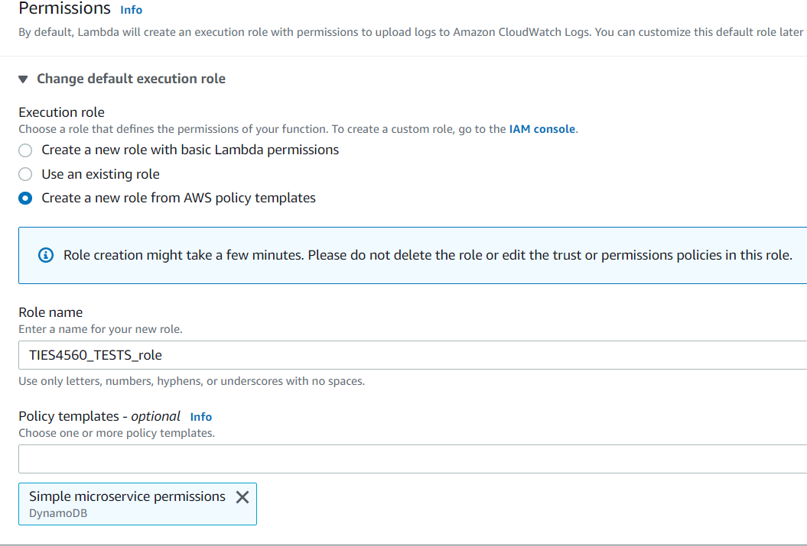
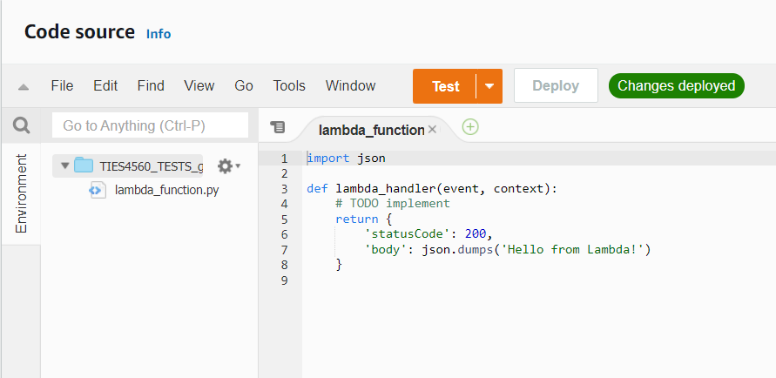
Creating Lambda functions part 2
Create new role with templates
Name your new role
Choose a policy: ”Simple microservice permissions”
Click ”Create Function”
Now we can add our code → Click ”Deploy” when ready

Slide 9
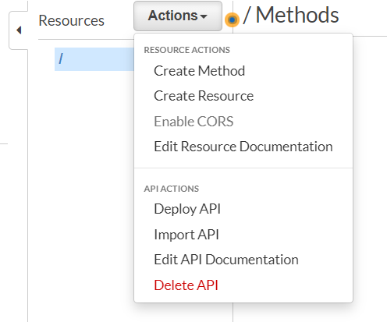
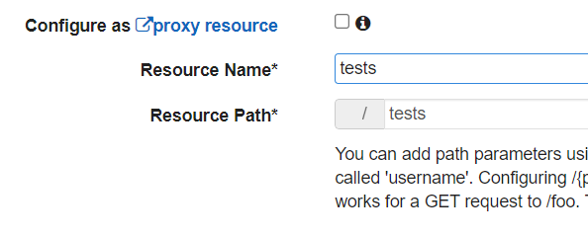
In API Gateway: Creating Resouce
Open your gateway > Actions > Create Resource
Name your Resouce>Create Resource

Slide 10
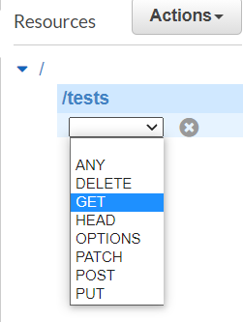
In API Gateway: Creating Methods
Actions > Create Method
Choose the method

Slide 11
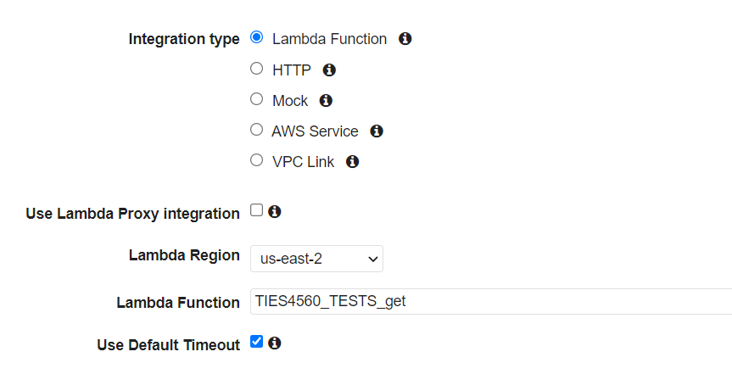
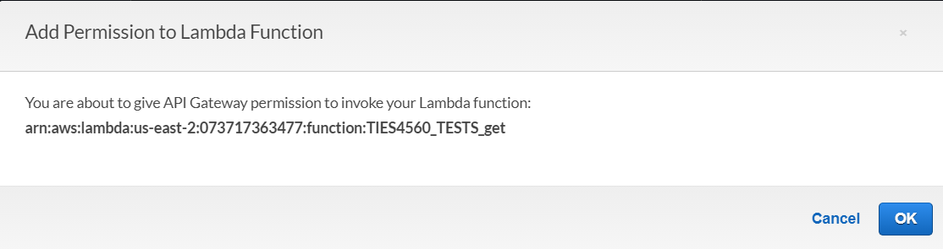
In API Gateway: Creating Methods
Actions > Create Method
Choose the method
Choose Lambda Function
Click ”Save”
Pop-up:
Click ”Ok”

Slide 12
Lambda: Creating other functions
Happens in the same fashion as previously
Exceptions:
When creating a Lambda Function: choose the previously created Permission:
”Use existing role” > choose the previously created role

Slide 13
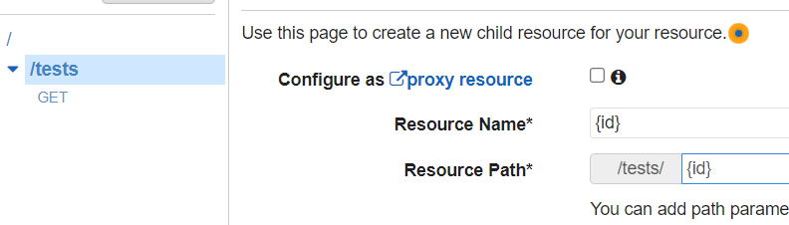
API Gateway: creating methods with pathparam
To create a pathparam:
API Gateway > Click on resource >Actions > Create Resource
Resource Name: {pathname}
Resource Path: {pathname}
Create Resouce

Slide 14
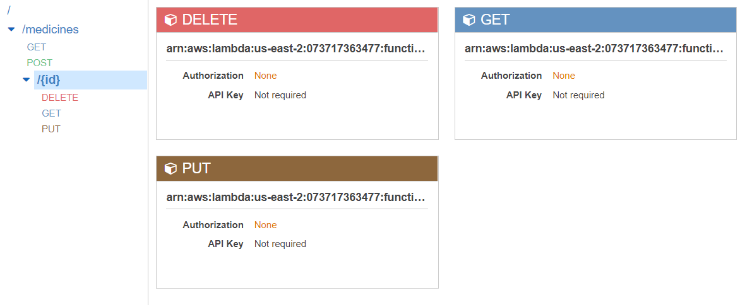
API Gateway: creating methods with pathparam
You can now create different methods for the path in the similar fashion as before
Exception:
How to access pathparam in the code in Lambda!
For GET and DELETE: pathparam
For PUT: pathparam + body

Slide 15
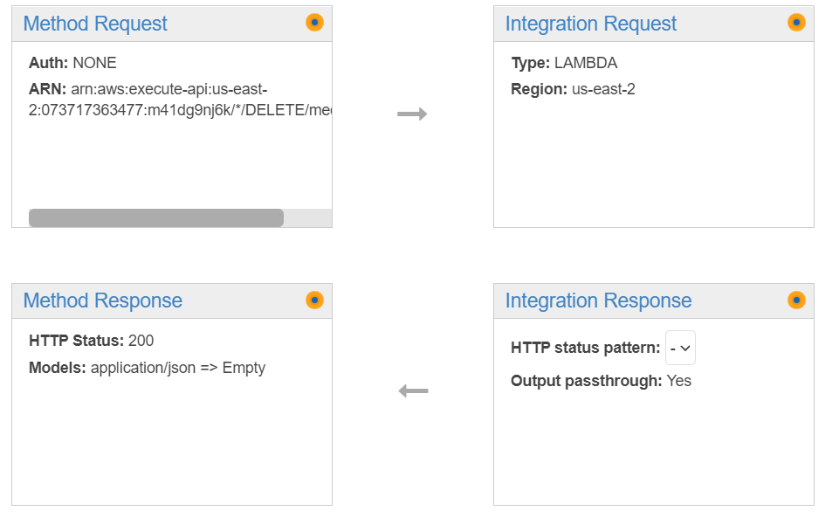

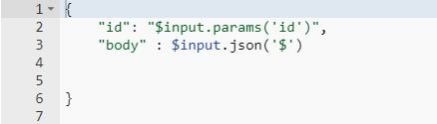
API Gateway: creating methods with pathparam
Choose method: DELETE, GET, PUT
Choose ”Integration Request”
Scroll to: ”Mapping Templates”
Write Content-Type: ”application/json”
Write to body
For Delete and Get:
For Put:

Slide 16
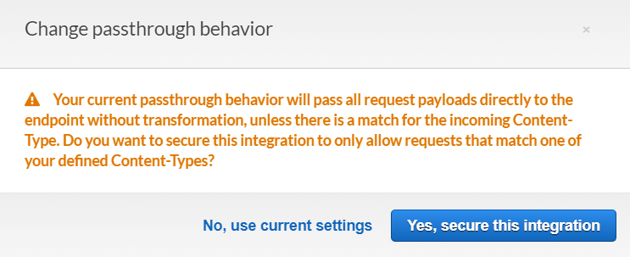
API Gateway: creating methods with pathparam
Save the changes
Pop-Up: Click ”Yes, Secure this integration”
Now you can access the pathparameter and body in the spesific Lambda functions

Slide 17
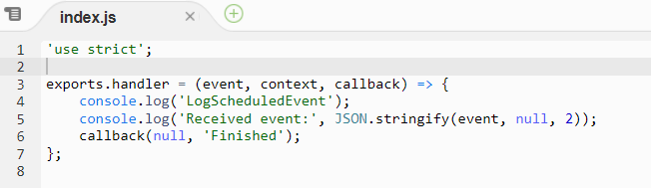
CloudWatch part 1
Create a Lambda Function like before:
Exception: In Permissions choose ”Create a new role with basic Lambda permissions”
Edit the code how you wish, for example:

Slide 18
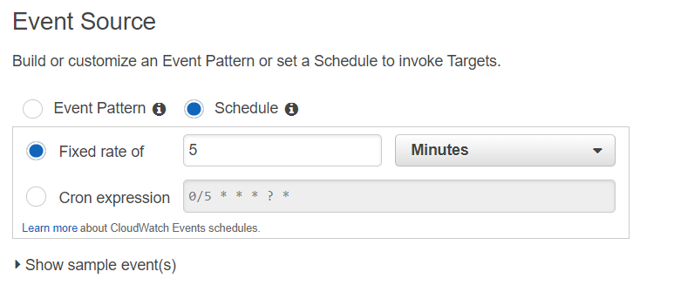
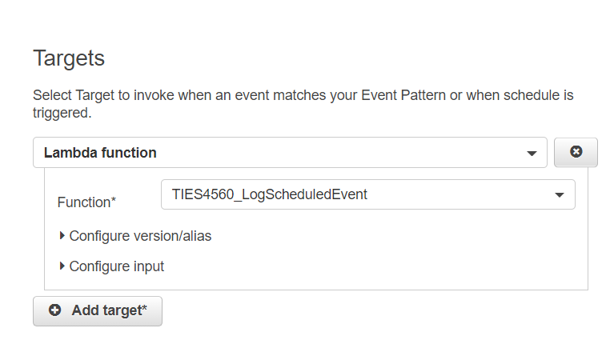
CloudWatch part 2
Go to CloudWatch
In navigation pane: Events>Rules>Create rule
In Event Source choose ”Schedule” and write in the ”Fixed rate of” to execute the created lambda function: in this case executed every 5 Minutes
Choose the Target:
Lambda function
Choose the just created labda function
Click ”Configure details”

Slide 19

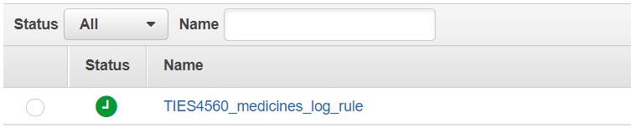
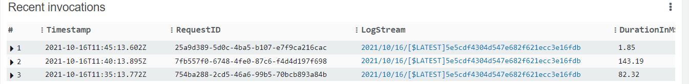
CloudWatch part 2
Name your rule
Click ”Create rule” → Rule now created
Rule tested after 5 minutes:
Go to Lambda>Functions>Choose log-function>Monitor>Logs

Slide 20
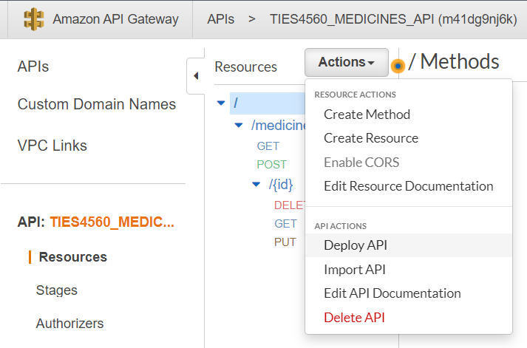
Lastly deploy your API
Go to API Gateway
Resources>Actions>Deploy API:
Choose Deployment stage or
Create a new stage: name it
Click ”Deploy”
https://m41dg9nj6k.execute-api.us-east-2.amazonaws.com/api/medicines
Now you can test your API in Postman

Slide 21
Thank you!

