Slide 1
CHLORINE AND ITS COMPOUNDS
MORE ON HALOGENS

Slide 2
Halogens are in group 7 of the periodic table, on the right.
7
H
He
Li
Be
B
C
N
O
F
F
Ne
Na
Mg
Al
Si
P
S
Cl
Cl
Ar
K
Ca
Sc
Ti
V
Cr
Mn
Fe
Co
Ni
Cu
Zn
Ga
Ge
As
Se
Br
Br
Kr
Rb
Sr
Y
Zr
Nb
Mo
Tc
Ru
Rh
Pd
Ag
Cd
In
Sn
Sb
Te
I
I
Xe
Cs
Ba
La
Hf
Ta
W
Re
Os
Ir
Pt
Au
Hg
Tl
Pb
Bi
Po
At
At
Rn
Fr
Ra
Ac
Rf
Db
Sg
Bh
Hs
Mt
Ds
Rg
?
?
?
?
?
?
?
Notes:
2

Slide 3
Electron structure
All halogens have 7 electrons in their outer shell.
This means that:
fluorine
2,7
They can easily obtain a full outer shell by gaining 1 electron.
chlorine
2,8,7
They all gain an electron in reactions to form negative ions with a -1 charge.
They have similar chemical properties.
bromine
2,8,8,7
Notes:
3

Slide 4
Chlorine has a symbol ^{35.5} Cl because it is made up of
two isotopes ³⁷ Cl and ³⁵ Cl. It has an electronic
arrangement of 2:8:7, hence justifying its position in
group (VII).
Laboratory preparation
In order to convert hydrogen chloride to chlorine, it is necessary to remove hydrogen. Removal of hydrogen is oxidation. A powerful oxidizing agent such as manganese (IV) oxide converts hydrogen chloride (HCl) to chlorine (Cl₂)
The most common laboratory method for preparation of Chlorine is to heat of Manganese Dioxide with concentrated Hydrochloric Acid.

Slide 5

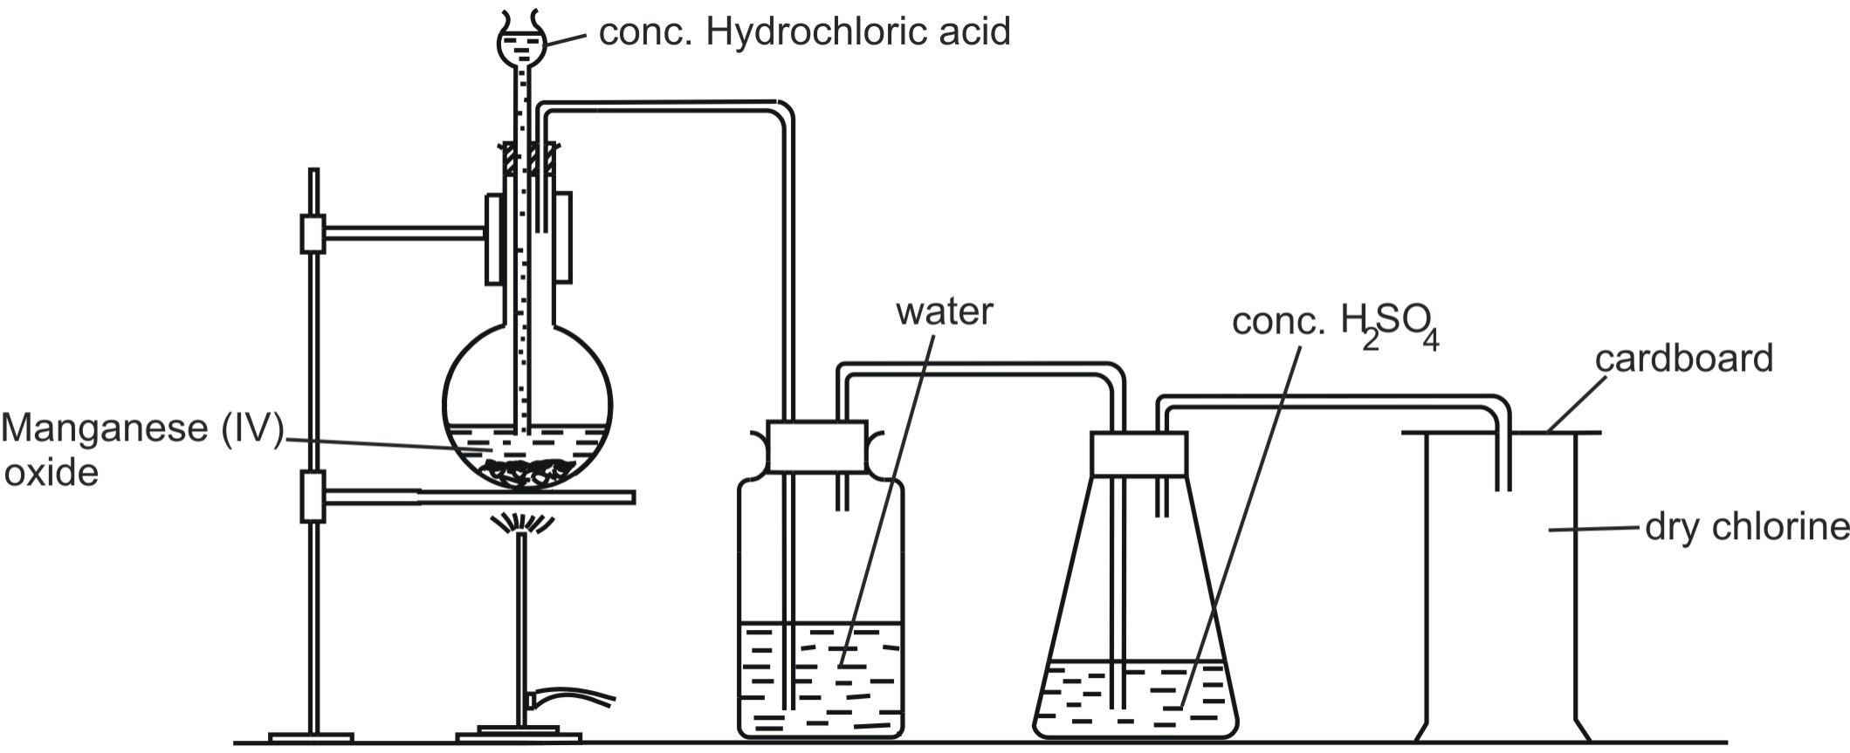

Slide 6
The gas is bubbled through water to remove any traces of hydrochloric gas that may be present and then it is dried by bubbling it through concentrated sulphuric acid.
Chlorine may also be prepared by dropping cold concentrated Hydrochloric Acid on crystals of Potassium Permanganate.

Slide 7
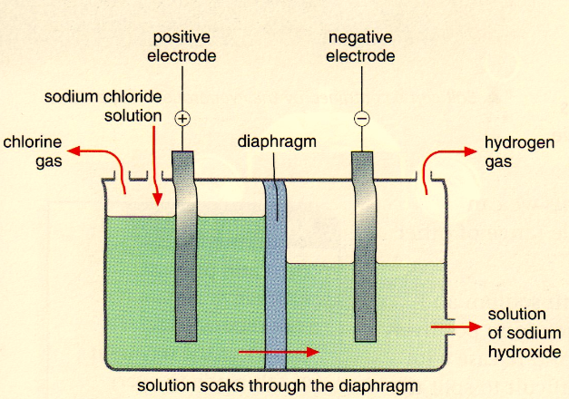
MANUFACTURE OF CHLORINE
Chlorine is manufactured industrially as a by-product in the manufacture of Caustic Soda by the electrolysis of brine.

Slide 8
The membrane cell has titanium anode and a nickel cathode. Titanium is chosen because it is not attacked by chlorine. The anode and the cathode compartments are separated by an ion exchange membrane. The membrane is selective; it allows Na⁺ ions, H⁺ and OH⁻ ions to flow but not Cl⁻ ions. These ions cannot flow backwards, so products are kept separate and cannot react with each other.
At anode, the Cl⁻ ions are discharged more readily than OH⁻ ions because they are in higher concentration and are hence preferred.

Slide 9

A pale green gas is seen coming off at the anode
At cathode, it is the H⁺ ions that accept electrons, as sodium is more reactive than hydrogen
Bubbles of hydrogen are seen at the cathode
The remaining ions of Na⁺ and OH⁻ join up and come off as sodium hydroxide, NaOH.

Slide 10
Products and uses
Product | Uses
Chlorine | Poisonous greenish yellow gas Used for making; PVC, solvents for dry cleaning, paints and dye stuffs, bleaches, weed killers, pesticides, killing bacteria in swimming pools and in domestic water treatment.
Hydrogen | Colourless flammable gas Used for making: Margarine, nylon, hydrochloric acid
Sodium hydroxide | Alkaline and corrosive substance Used for making; Soap, detergents, textiles, textiles and paper.

Slide 11
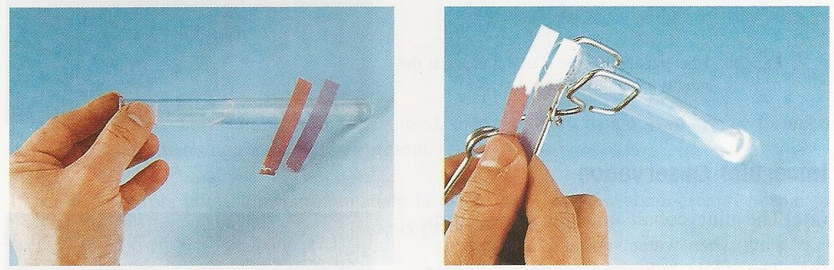
Test for Chlorine (Cl₂)
Observations :Chlorine turns damp blue litmus paper red, then white.
Conclusion : Chlorine gas is acidic and a bleach.

Slide 12
Properties of chlorine
(2) Is green-yellow in colour.
(3) Has a pungent choking smell and is poisonous. It is twice as dense as air.
(4) Will put out a lit splint.

Slide 13

Reactions
1. Chlorine is a highly reactive element, and undergoes reaction with a wide variety of other elements and compounds.
2. Chlorine is a good bleaching agent, due to its oxidising properties.
3. Chlorine is soluble in water (which solution is called Chlorine Water) and this loses its yellow colour on standing in sunlight, due to the formation of a mixture of Hypochlorous Acid and Hydrochloric Acid.

Slide 14

4.Chlorine gas supports the vigorous combustion of many elements to form their chlorides. For example, Sulphur and Phosphorus burn in the gas.

Slide 15

Bleaching Action
If chlorine is passed through water, it forms two acids, hydrochloric acid.
Hypochlorous acid (the second acid) is the source of oxygen and is responsible for the bleaching of chlorine.
It is important to wash bleached clothes thoroughly to remove hydrochloric acid formed after the process.

Slide 16
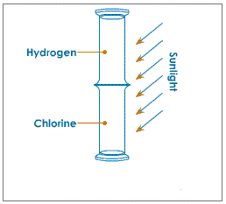
Reaction of Chlorine with Hydrogen
A mixture of Chlorine and Hydrogen explodes when exposed to sunlight to give Hydrogen Chloride. In the dark, no reaction occurs, so activation of the reaction by light energy is required.
Hydrogen and chlorine gas also combine directly in presence of sunlight. A jar of hydrogen is inverted and placed on a jar containing chlorine in the sun. Soon hydrogen chloride is formed

Slide 17
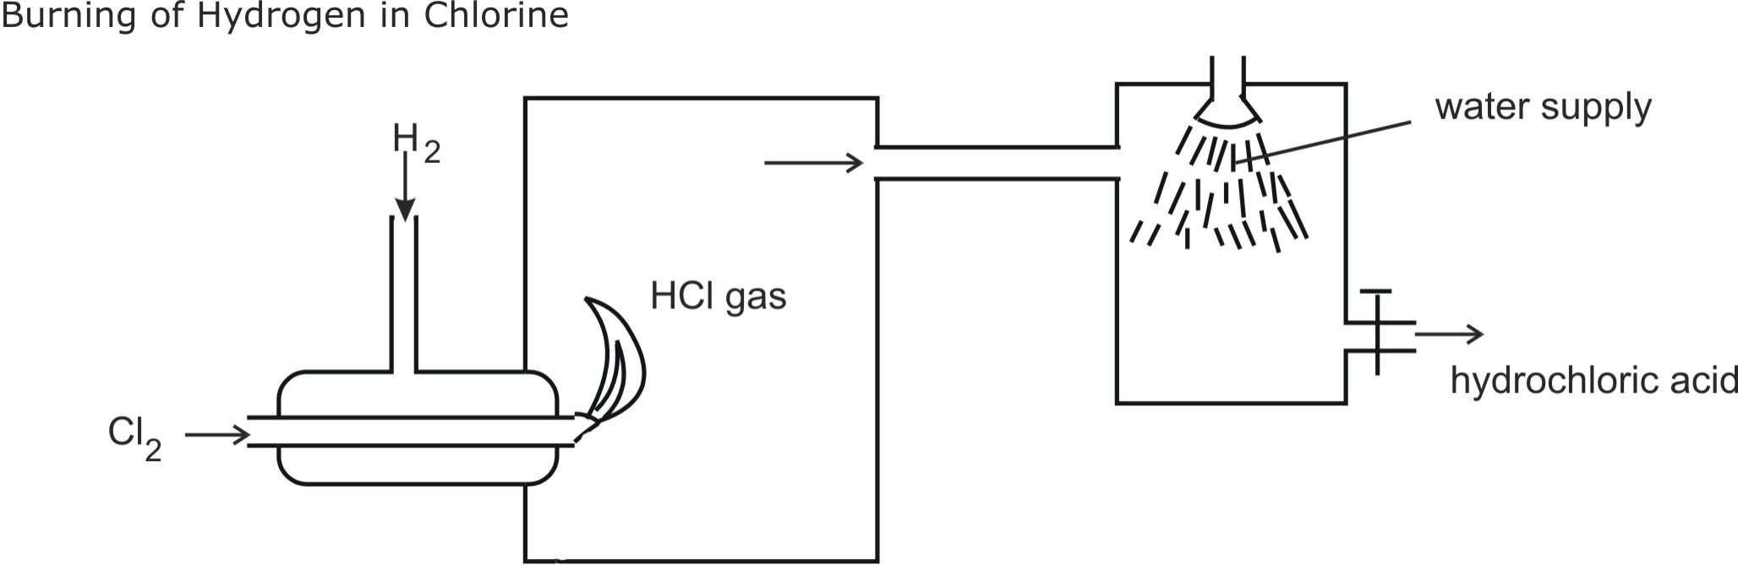
In diffused sunlight, the reaction slows down, and in the
dark it is very slow.
Hydrogen chloride is highly soluble in water. It dissolves to form hydrochloric acid. This reaction can be used to produce hydrochloric when the hydrogen chloride gas produced is dissolved in water as shown.

Slide 18

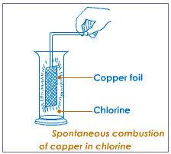

2. Reaction of Chlorine with Non-Metals
Chlorine combines directly with most non-metals (except with Nitrogen, Oxygen and Carbon, C).
3. Reaction of Chlorine with Metals
Thin foils of metals like sodium, copper, etc. when plunged into a jar of chlorine gas catch fire spontaneously to form their respective chlorides.

Slide 19
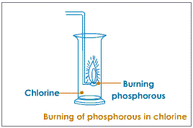
With yellow phosphorous
Yellow phosphorus first melts and then catches fire spontaneously when introduced into a jar of chlorine gas. It forms thick white fumes of phosphorus (III) chloride and phosphorus (V) chloride

Slide 20
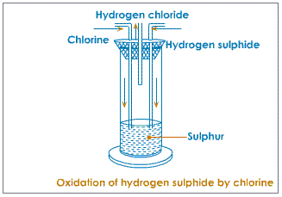

Reaction with hydrogen sulphide
On passing chlorine and hydrogen sulphide through separate vents in a upright combustion tube hydrogen sulphide gets oxidised to hydrogen chloride and sulphur. Hydrogen chloride comes out through the middle tube.

Slide 21
Displacement of the Halogens by Chlorine
Halogens are the most electronegative elements. Fluorine is the most electronegative, followed by chlorine then bromine and then iodine. The relative reactivity of the halogens, as described in group trends, can be shown by displacement reactions. These are similar to the metal displacement reactions.
For example, Bromine gas bubbled through a solution of potassium iodide in water will displace (take the place of) the less reactive iodine, forming iodine and potassium bromide.

Slide 22
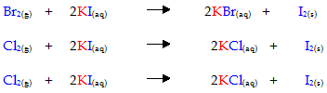

Slide 23
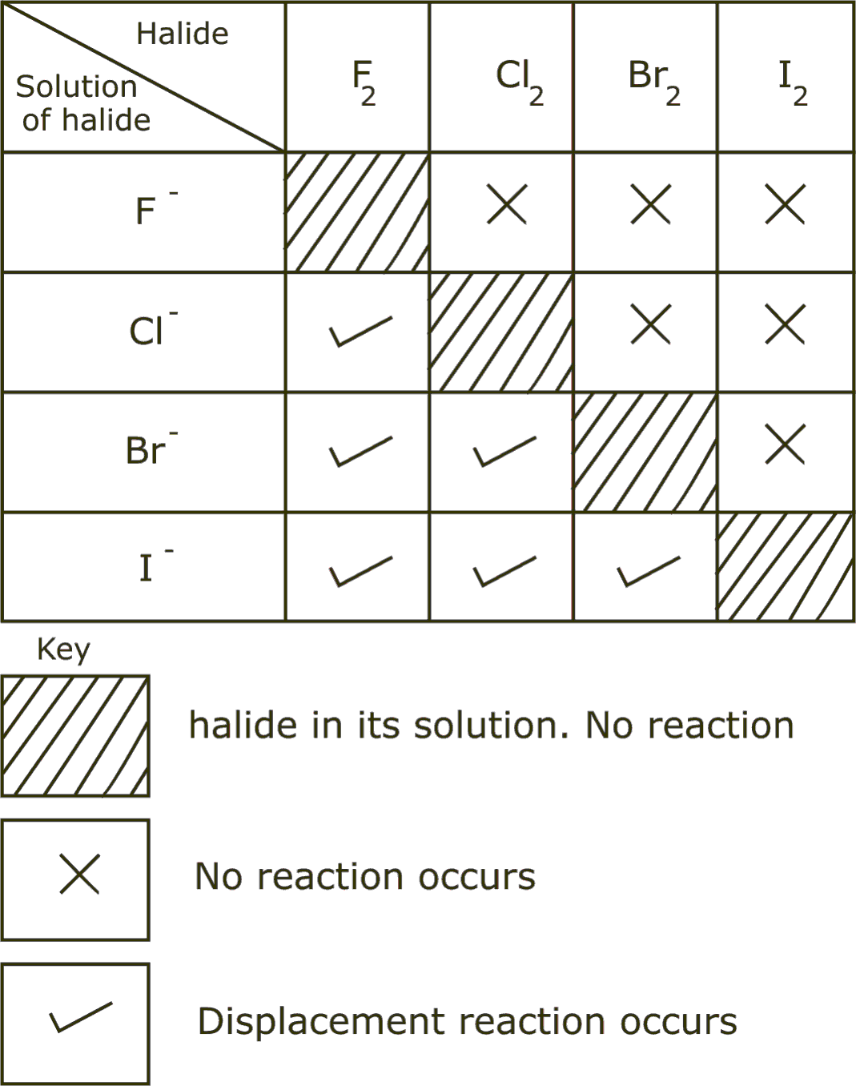
SUMMARY OF DISPLACEMENT REACTIONS

Slide 24
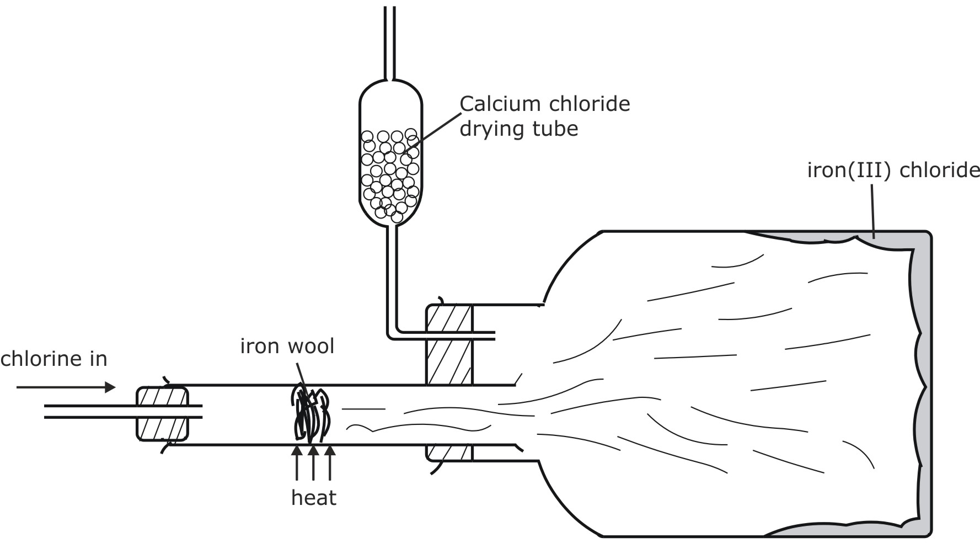
Oxidizing Reaction of Chlorine
Chlorine is a strong oxidising agent. Chlorine oxidises Iron (II) Chloride, FeCl₂, to the salt containing Iron in the higher oxidation state Iron (III) Chloride, FeCl₃. This is possible because Iron has a variable valency.

Slide 25


With alkalis
Alkalis, at different temperatures and at different levels of concentration, behave differently with chlorine.
(i) With cold dilute alkalis
Chlorine reacts with cold dilute alkalis to form their respective chlorides, hypochlorites and water.

Slide 26


(ii) With hot concentrated alkalis
Chlorine reacts with hot concentrated alkalis to form their respective chlorides, chlorates and water.

Slide 27
Uses Of Chlorine
For the manufacture of bleaching powder and liquid bleaches,
To bleach fabrics (e.g. linen and cotton), wood pulp and paper,
For the direct manufacture of Hydrochloric Acid by the direct combination of its elements,
In the manufacture Sodium Hypochlorite (i.e. domestic bleach), disinfectants, insecticides, plastics and Hydrochloric Acid,
As a disinfectant used to kill bacteria in the preparation of drinking water.
Chlorine is also important in the manufacture of paints, aerosol propellants and plastics.
Also used to make some explosives, poison gases and pesticides.

Slide 28
HYDROGEN CHLORIDE
Hydrogen chloride is an hydrogen compound of Chlorine. Chlorine is a highly reactive element and is mainly found in combined state. Its most important source is sodium chloride which is mainly found in large underground deposits, sea and lake such as lake Magadi.
Sodium chloride is the main source of chlorine which is used to make hydrogen chloride.

Slide 29
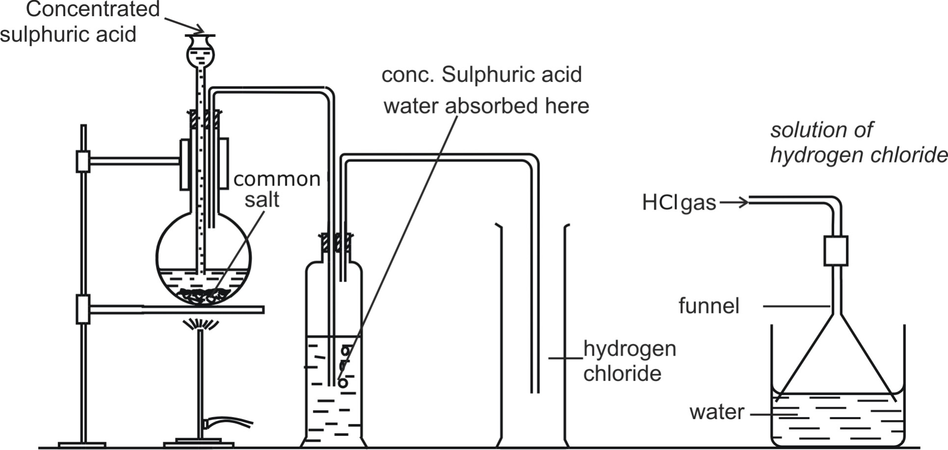
Preparation of hydrogen chloride
Hydrogen Chloride may be prepared in the laboratory by heating Concentrated
Sulphuric Acid, with Sodium Chloride.

Slide 30

PROPERTIES OF HYDROGEN CHLORIDE
Hydrogen chloride is a colourless fuming gas. The polar covalent gas Hydrogen Chloride is very soluble in Water. In aqueous solution, the molecule exists in ionic form, as the positively charged Hydrogen Ion, H⁺, and the negatively charged Chloride Ion, Cl⁻.
Its solution in water turns blue litmus paper red. Hydrogen chloride has no effect on dry litmus paper as no ions are present in dry gas.
The gas hydrogen chloride is made up of covalently bonded molecules. If the gas is dissolved in an organic solvent, such as methylbenzene, it does not show any of the properties of an acid.

Slide 31
For example, it does not conduct electricity or turn a piece of blue litmus paper red. However, when the gas is dissolved in water, a strongly acidic solution is produced. The acidic oxides of sulphur, phosphorus and carbon are the similar. They are covalent molecules when pure, but show acidic properties only when dissolved in water.

