Slide 1
NEX RESEARCH AND INNOVATION COHORT 2026
Turning Campus Weeds into
Productive Resources
Final Presentation — Problem, Solution, Cost & Impact
Group 8 — Next Gen Innovators | LASU Epe Campus

Slide 2

The Problem
A renewable resource, currently treated as waste
Routine campus maintenance
A Second Problem,
Same Solution
LASU Epe Campus generates a continuous, recurring supply of weed biomass through everyday grounds maintenance.
This biomass is currently discarded, left to rot, or burned — even though the species growing on campus can be converted into useful products.
The problem is not the presence of weeds. It is the absence of a system to capture the value already being produced.
Sachet "pure water" bags are one of Nigeria's most common plastic waste items — discarded daily, rarely recycled.
Our solution tackles both waste streams at once: campus weeds and discarded plastic sachets, combined into one material.

Slide 3
Our Solution
A weed-fibre composite waste bin — frame and panel design
Harvest &
Dry Weed
→
Extract
Fibre
→
Combine with
Recycled Plastic
→
Mould into
Composite Panels
→
Assemble on
Metal Frame
Why This Design
30:70
A fully molded, one-piece bin would need industrial moulding equipment we don't have. Our design instead uses a simple metal frame with flat, removable composite panels — achievable with basic fabrication tools.
Damaged panels can be individually replaced rather than discarding the whole bin, and the frame itself is reusable.
Speargrass : Recycled PET
(by mass)
Based on peer-reviewed Nigerian composite research

Slide 4
Why the Research Supports This
A published Nigerian study (Olusunmade, Bulus & Kashin — Acta Polytechnica) combined speargrass (Imperata cylindrica) with recycled sachet-water plastic.
Result: mat-form composites showed tensile strength 57.27% higher than recycled plastic alone, and 81.23% higher than particulate composites — with tensile modulus increasing by over 300%.
We are not guessing — we are replicating a validated method, using the same fibre and the same plastic, at small scale.
Both raw materials are already abundant on and around LASU Epe Campus, at no material cost to the team.

Slide 5
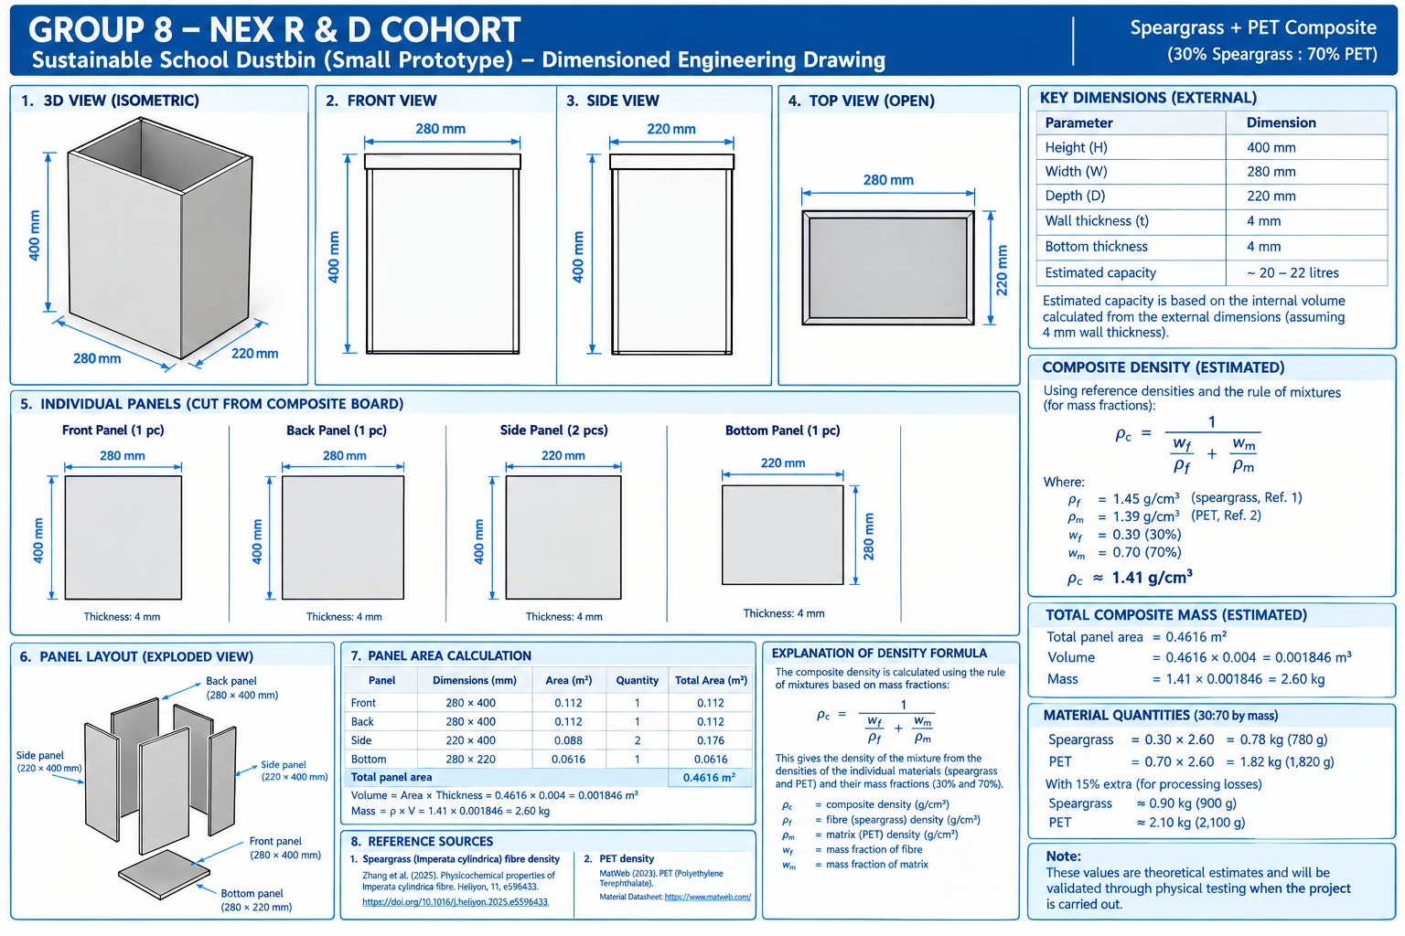
Prototype Design: Dimensioned Engineering Drawing
Small-scale prototype — Speargrass + PET composite (30:70)

Slide 6
Key Figures From Our Prototype Design
20-22 L
0.4616 m²
2.60 kg
Estimated bin capacity
Total panel area (5 panels)
Total composite mass
30:70
900 g
2,100 g
Speargrass : PET ratio (by mass)
Speargrass needed (incl. 15% buffer)
Recycled PET needed (incl. 15% buffer)
Theoretical estimates based on published fibre/PET density data — to be validated through physical testing.

Slide 7

Cost: Our Scale Prototyping Method
Standard industrial design practice — applied to our composite panels
Build small
test panel
→
Measure exact
material used
→
Calculate cost
per m²
→
Scale to
full bin size
Scales Cleanly
Does Not Scale Cleanly
Fibre weight, plastic weight, and frame steel length are directly proportional to bin size.
A small test panel gives us a reliable, real per-square-meter material cost.
Fabrication service fees (welding, compression moulding) may carry a fixed minimum charge.
We confirm these directly with vendors rather than assuming they shrink proportionally.

Slide 8

Cost: Benchmark Reference Data
Published research figures, used as a frame of reference while we finalize our own numbers
General natural fibre market cost
$0.20 - $2.10 / kg
Global range; our fibre is free (campus-sourced) — shows its worth if purchased
Agricultural-residue fibre cost
~$0.22 / kg
Closer match to our grass/weed fibre than general natural fibres
Wood-plastic composite production cost
~$0.53/kg (vs. $0.84/kg plastic alone)
Closest direct comparison — natural-filler composite costs less than plastic alone
Finished plastic bin — Nigerian retail price
NGN 6,290 - 12,600
Current market price for comparable bins — a ceiling reference for our prototype
Our own scaled-prototype figure, once finalized, is what we will present as our actual production cost.

Slide 9


Impact
Two Waste Streams Solved
Campus weed biomass and discarded sachet plastic both find productive use in one material.
Campus-Wide Potential
Our documented estimate of ~13.4 tonnes of dry weed biomass per year shows the campus can sustainably supply material for ongoing production, not just one prototype.
Beyond LASU Epe
This is a new sustainable composite material, not just a campus fix — with real potential as a market-ready alternative to conventional plastic products.

Slide 10
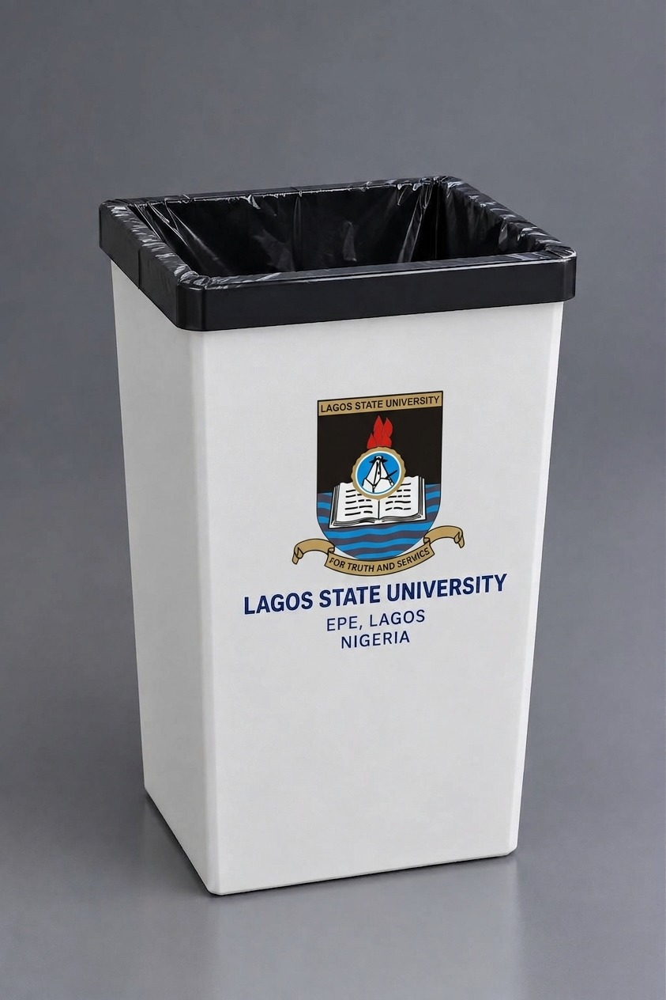
Product Vision: What This Could Become
A concept render — branded LASU Epe campus waste bin
A Real, Adoptable Product
This render shows how the final product could look and function on campus — not just a lab sample.
It complements our dimensioned engineering drawing: one proves it works on paper, the other shows what it looks like in the real world.
Our accompanying demo video walks through the full fabrication process, from harvesting the grass to the finished bin.

Slide 11
From Campus Waste to
Real-World Material
Thank you — Group 8: Next Gen Innovators

