Slide 1
Low-Cost Six-Stage Water Treatment Unit
Safe drinking water for LASU Epe: proof of concept, CAD design and simulation
Group 9 | NEX Research and Innovation Cohort 2026
Notes:
Good day everyone. We are Group 9 from the NEX Research and Innovation Cohort 2026. Today we will take you from the problem we found at LASU Epe, to the low-cost treatment unit we designed, to the CAD model and simulation, and finally the risks and next steps.

Slide 2
Why we changed our focus
We first looked at the lack of power at LASU Epe
No public grid power for about 5 years
The hostel gets 1 hour of light in the morning and 3 hours in the evening
A real fix needs capital beyond our 6-week project
5 years
without public grid power
1 h + 3 h
of hostel light, morning and evening
So we turned to a problem we can solve in scope: unsafe drinking water
Notes:
We first looked at the electricity problem. Epe has had no public grid power for about five years and the hostel only gets one hour of light in the morning and three in the evening. Fixing that needs capital beyond our six-week scope, so we turned to unsafe drinking water, a problem we can actually tackle.

Slide 3
What the borehole water tests show
pH 3.8 to 6.8
Lead 0.046 mg/L
Nickel 0.053 mg/L
HPI 515
Acidic. The safe range is 6.5 to 8.5 (mean 4.7)
About 4.6 times the 0.01 mg/L limit
Above the safe limit
Heavy metal index (MI 8.038) shows polluted, unsafe water
This is why the water needs treatment before it reaches the taps
Sources: Salami & Ayinde 2025; Salami, Abel & Olatunji 2025 (our Week 1 and 2 reports)
Notes:
Our Week 1 and Week 2 reports used published studies of the Epe borehole water. The water is very acidic, with a pH between 3.8 and 6.8 against a safe range of 6.5 to 8.5. Lead is about four and a half times the limit, nickel is above safe limits, and the pollution indices say the water is polluted and unsafe.

Slide 4
Where we started: filter options
Basic faucet filter
Week 3 recommendation
Short term: low-cost faucet filters (₦3,000 to ₦12,000)
Long term: rehabilitate the mini water works and test the water routinely
Ceramic faucet filter
Gravity multi-stage filter
Chlorine tablets (Aquatabs)
Our proof of concept goes further: one unit that deals with dirt, acidity, metals and bacteria together
Notes:
In Week 3 we compared four point-of-use options. We recommended low-cost faucet filters as the quick fix and, in the long term, rehabilitating the mini water works with routine testing. For our proof of concept we went further and designed one unit that deals with dirt, acidity, metals and bacteria together.

Slide 5
Our solution: six stages, no electricity
1
2
3
4
5
6
Settling drum
Limestone column
Sand and gravel filter
Activated carbon column
Chlorine disinfection
Covered storage with tap
Heavy dirt sinks out
Neutralises the acidity
Catches fine particles
Adsorbs metals and odours
Kills bacteria
Keeps clean water safe
Gravity-fed, no electricity | about 20 L/h | about 160 L a day for around 40 people | estimated cost ₦150,000 to ₦350,000
Notes:
Water moves through six stages by gravity. The settling drum removes heavy dirt, limestone raises the pH, the sand and gravel filter catches fine particles, activated carbon adsorbs metals and odours, chlorine kills bacteria, and the covered tank keeps the water safe until it is drawn from the tap. The unit gives about 20 litres an hour, roughly 160 litres in an eight-hour day for around 40 people, at an estimated cost of 150 to 350 thousand naira.

Slide 6
How it fits the campus water system
Borehole
Pump
Storage tank
Treatment unit (new)
Taps
Already there
The borehole pump and storage tank
Our plan
Add the treatment unit after the storage tank
Funding
We plan to seek funding to build and install it
Notes:
The campus already pumps borehole water into a storage tank before it reaches the taps. Our plan is to add the treatment unit into that line, after the storage tank, so the water is treated before it is used. We plan to seek funding for the build and installation.

Slide 7
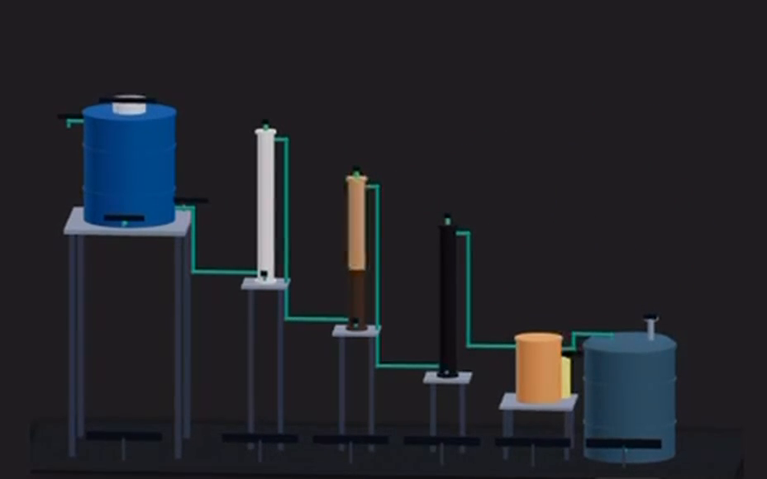
CAD design of the treatment unit
Stepped cascade: each stage sits lower than the last, so water flows by gravity
Blue settling drum on a raised stand
Three columns: limestone (white), sand and gravel (tan), activated carbon (black)
Chlorine unit (orange) and covered storage tank
Drum and tank sizes are assumed (about 200 L each) until confirmed.
Notes:
This is our CAD model, rotating so you can see every stage. It is a stepped cascade: the blue settling drum sits on a tall stand and each stage after it sits a little lower, so water flows downhill with no pump. Then you can see the white limestone column, the tan sand and gravel column, the black carbon column, the orange chlorine unit and the covered storage tank. The drum and tank sizes are still assumed at about 200 litres each until we confirm them.

Slide 8
Design specifications
Item | Specification
Flow rate | About 20 L/h, gravity-fed with no electricity
Daily output | About 160 L in an 8-hour day, enough for around 40 people
Treatment columns | Three 4-inch PVC columns, 1 m each (limestone, sand and gravel, activated carbon)
Settling drum and storage tank | About 200 L each (assumed sizes, to be confirmed)
Disinfection | Chlorine dosing before the covered storage tank, which has a tap
Monitoring | pH, turbidity and a microbial test
Estimated cost | About ₦150,000 to ₦350,000
Notes:
These are the key numbers for the unit. Flow is about 20 litres an hour with no electricity. The three columns are four-inch PVC pipes, one metre tall. The drum and tank sizes are assumptions we still need to confirm, and the cost is an estimate until we get supplier quotes.

Slide 9
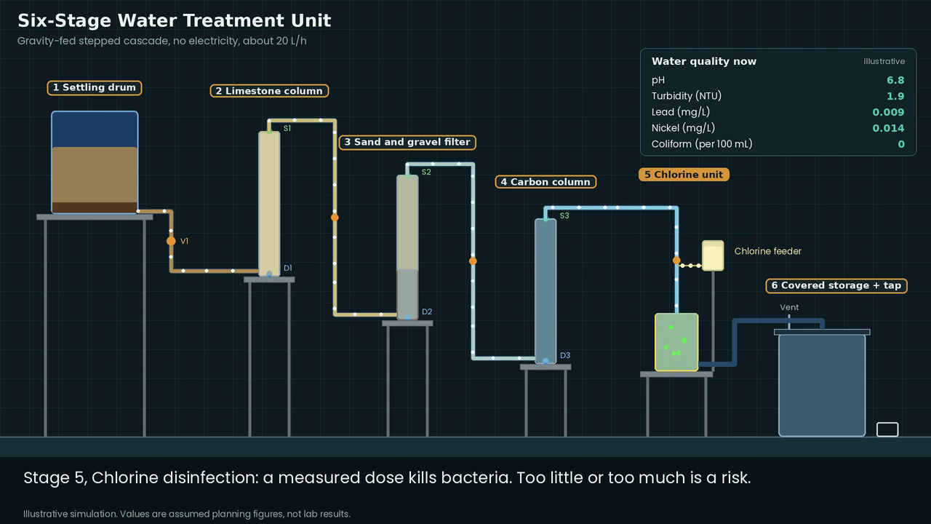
Simulation: how the water gets cleaner
pH: 4.7 to 6.8
after the limestone column
Turbidity: 25 to 1.9 NTU
settling, sand and carbon
Lead: 0.046 to 0.009 mg/L
carbon, 70% removal assumed
Coliform: 50 to 0 per 100 mL
after chlorine
Illustrative simulation using assumed removal rates. Lab tests will confirm real performance.
Notes:
This animation follows the water through all six stages. Muddy water enters the drum and the dirt sinks. The limestone raises the pH, the sand and carbon clear the water and take out metals, and chlorine kills the bacteria. The numbers on screen are assumed planning values, not lab results, and lab tests will confirm how the real unit performs.

Slide 10
Risks and how we manage them
Risk | Level | How we manage it
Carbon wears out and metals pass through | High | Lab-test the output and replace the carbon on a schedule
Wrong chlorine dose | High | Fix a measured dose and check it with a simple test kit
Water gets dirty again after treatment | High | Keep the tank covered, clean the tap, teach safe storage
Output not yet verified in a lab | High | Book lab tests for lead, nickel and coliform before use
Limestone is used up and pH drops | Medium | Test pH weekly and top up the limestone
Filters clog or flow is weak | Medium | Backwash or replace the sand layer, check the drum height
No one owns maintenance | Medium | Name a caretaker and set a maintenance budget
Notes:
These are the main risks. The biggest ones are the carbon wearing out so metals pass through, a wrong chlorine dose, and the water getting dirty again after treatment. We also have not yet verified the output in a lab. Each risk has a simple control, mostly testing and a maintenance schedule.

Slide 11
Funding and implementation
1
Get supplier quotes to firm up the budget
₦150,000 to ₦350,000
2
Seek funding for building and installation
Estimated build cost, to be firmed up with supplier quotes
Connect the unit to the borehole pump and storage tank system
3
4
Assign a caretaker and a maintenance budget
Full detail is in our implementation and funding report.
Notes:
We estimate the build cost at 150 to 350 thousand naira. That is an estimate until we get supplier quotes. We plan to seek funding, connect the unit to the existing borehole pump and tank system, and make sure someone is responsible for maintenance. Our implementation and funding report gives the detail.

Slide 12
Next steps
1
2
3
4
5
Book a lab
Get quotes
Finalise sizes
Build the prototype
Test every week
Test lead, nickel and coliform
Ask suppliers for prices
Confirm drum, tank and stand dimensions in CAD
Assemble the six stages
Log pH, metals and bacteria results
Long term: rehabilitate the mini water works and keep routine water testing
Notes:
Our next steps are to book a lab for lead, nickel and coliform tests, get supplier quotes, finalise the sizes in the CAD model, build the prototype, and then test the output every week. In the long term we recommend rehabilitating the mini water works and keeping routine testing in place.

Slide 13
Safe water for LASU Epe, with no electricity
Questions?
Group 9 | NEX Research and Innovation Cohort 2026
Notes:
That is our proof of concept: a low-cost, gravity-fed unit that treats the dirt, acidity, metals and bacteria in the borehole water. Our next step is lab testing and quotes. Thank you, we are happy to take questions.

