Slide 1




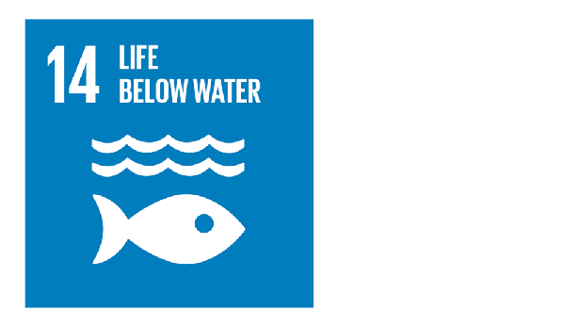
Coupling Spatio-Temporal Remote Sensing and Automated Internet of Things(IoT) in situ sensors to monitor, Forecast in Short-Term and Raise an Alarm on Cyanotoxins and Harmful Algal Blooms(CyanoHABs) along Lake Victoria for SDG:

Slide 2
Objectives
To monitor trends in HABs and Cyanotoxins from Satellite Images data in L. Victoria.
To Predict occurrence of cyanobacterial and Harmful algal blooms in the Selected Lake.
To associate Automated Internet of Things (IoT) in situ sensors, machine learning Applicable in near real-time to enhance the accuracy and speed for in situ data analysis.

Slide 3
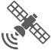



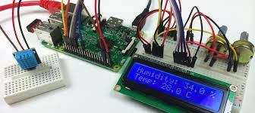



Spatiotemporal Phase
In-Situ Automated IoT Phase
GEE L8 OLI + MODIS_Aqua
Start
Raw Data Acquisition
Raw Img. Collections
Establish a secure connection via ssh
Client PC
Study Area Delineation
Upload in-situ data to microcontroller
Image Filtering
Raster pre-processing
- Radiometric corrections
- Surface Reflectance­­­ _{BOA}
Above Surface Temp
Lake Surface Temp.
NO
Spatio-temporal Image Fusion
In-Situ Data > Temp. Threshold
Image Analysis
Chl-a & Cyanotoxins Detected

Slide 4
