Slide 1




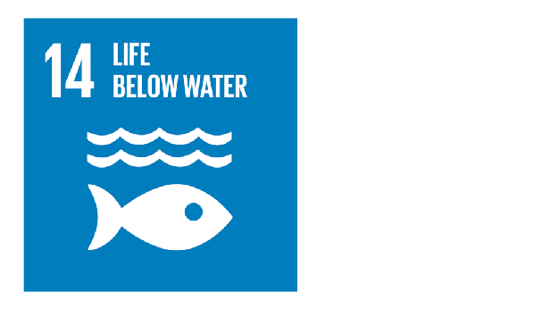
Coupling Spatio-Temporal Remote Sensing and Automated Internet of Things(IoT) in situ sensors to monitor, Forecast in Short-Term and Raise an Alarm on Cyanotoxins and Harmful Algal Blooms(CyanoHABs) along Lake Victoria for SDG:

Slide 2
Objectives
To monitor trends in HABs and Cyanotoxins from Satellite Images data in L. Victoria.
To Predict occurrence of cyanobacterial and Harmful algal blooms in the Selected Lake.
To associate Automated Internet of Things (IoT) in situ sensors, machine learning Applicable in near real-time to enhance the accuracy and speed for in situ data analysis.

Slide 3
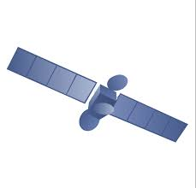



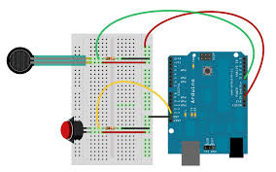
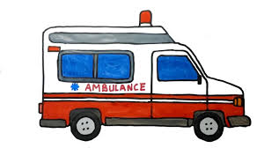
probabilistic prediction of blooms
-H20 temperature
-Nutrient Loading
-Chlorophyll-A conc.
-Fluorescence line height (FLH)

