Slide 1
Current Algebra of HK Model
Yuting Bai

Slide 2


(1)Current Algebra Description of Free Fermion
Particle Description
Fluid Description

Slide 3
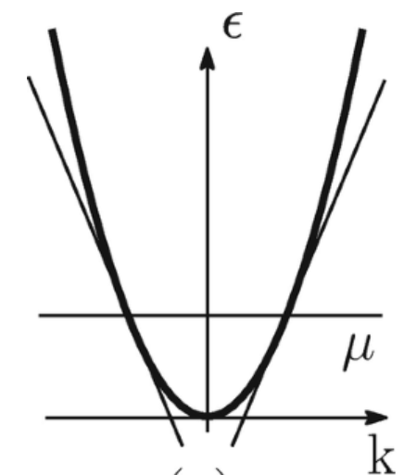
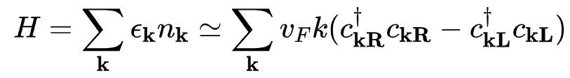
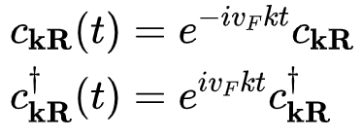
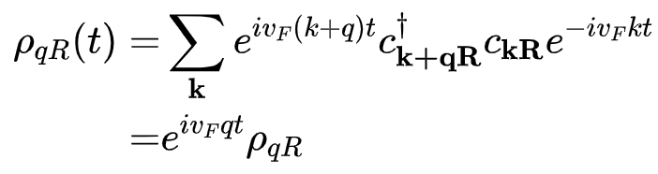
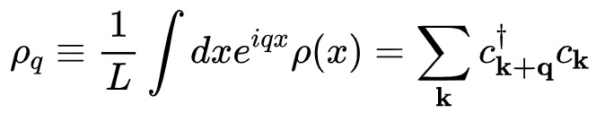
(1)Current Algebra of Free Fermion
For free fermion, we check the operator dynamics in the Heisenberg picture.
Particle
Current
Both of them acquire a U(1) phase under evolution!

Slide 4
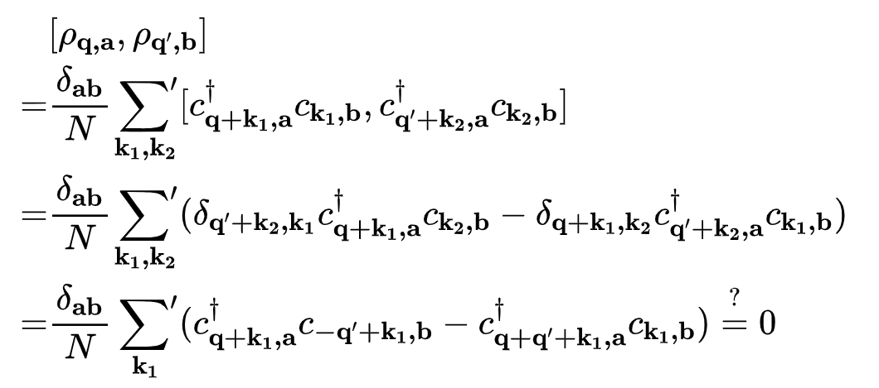

(1)Current Algebra of Free Fermion
Getting the Equation of Motion correct is not enough.
Does current operators $ρ_{q}$ obey boson’s commutation relation?
Do we fail?

Slide 5


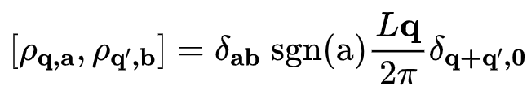
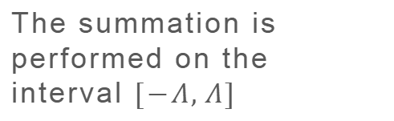
(1)Current Algebra of Free Fermion
The canonical commutation relation does not give you the right answer!
The summation is performed on the interval $[−Λ,Λ]$
The commutator of current operator is a c-number. It is boson!

Slide 6
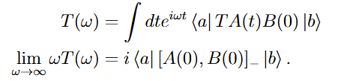
(2)Bjorken-Johnson-Low Prescription
The previous method works well for free fermion. Here we introduce a method that calculates the anomalous commutator directly from correlation function.
The matrix element of anomalous commutator depends on the high-frequency limit. This implies the robustness of anomalous commutator to interaction!

Slide 7
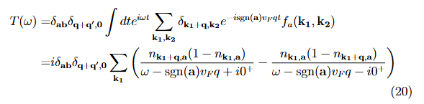
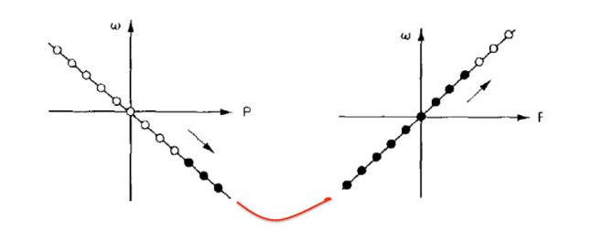

(2)Bjorken-Johnson-Low Prescription
One can show that BJL prescription reproduce the U(1) Kac Moody algebra for chiral fermion.
$$\lim_{ω→∞}{ωT(ω)}$$

Slide 8
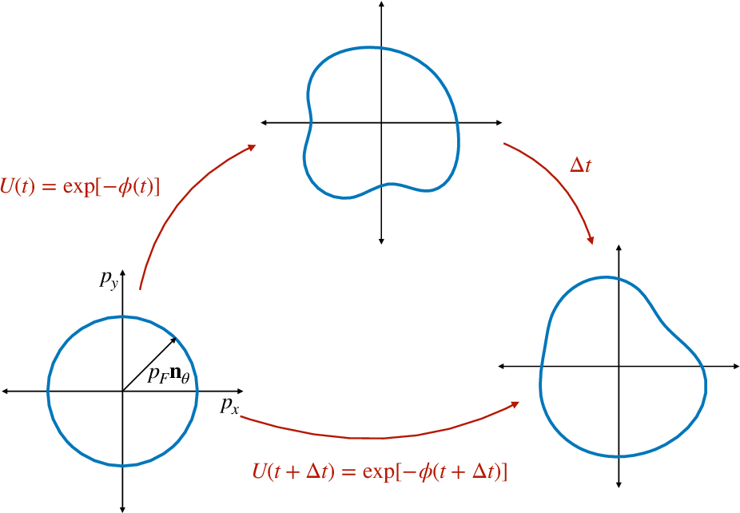
(4)Question
Could Interaction change the current algebra
If Luttinger Theorem holds, the dynamics of fermi surface is analogues to an imcompressible droplet. Thus, such violation might most easily found in system that violates it.
Delacrétaz, L. V., Du, Y. H., Mehta, U., & Son, D. T. (2022). Nonlinear bosonization of Fermi surfaces: The method of coadjoint orbits. Physical Review Research, 4(3), 033131.

Slide 9
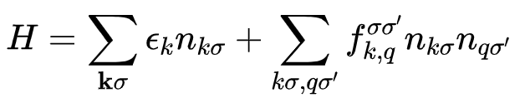
(5)Extra Symmetry of Fermi Liquid
The fermi liquid has O(4) symmetry.
A general interaction breaks this Z2 symmetry! While FL is stable against it?
Treat it perturbatively??
Are there stable fixed point that breaks Z2 symmetry?

Slide 10
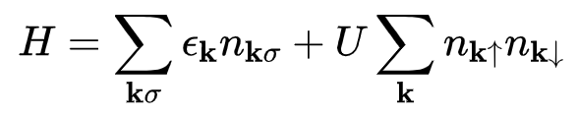

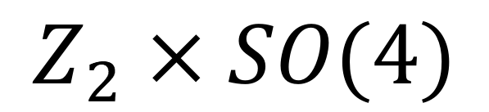

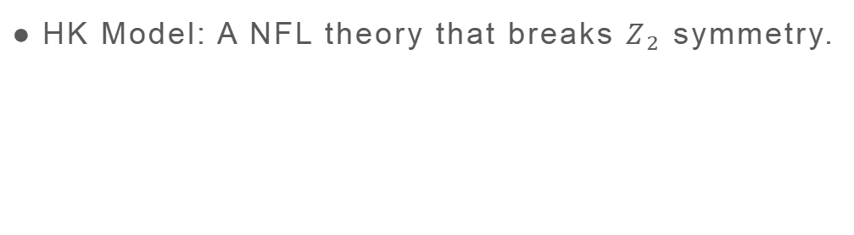
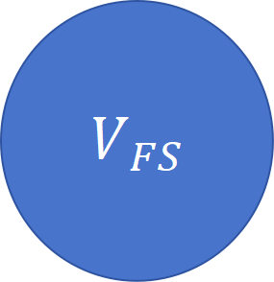
(3)HK Model
$$O(4)$$
HK Model: A NFL theory that breaks $Z_{2}$ symmetry.
$$Z_{2}×SO(4)$$
The HK model has Green function zero, which leads to violation of Luttinger Theorem.
Could one find a local solvable theory that has the similar correlation function with HK in the low-energy, long wavelength limit?
$$V_{FS}$$
$$N_{tot}$$

Slide 11

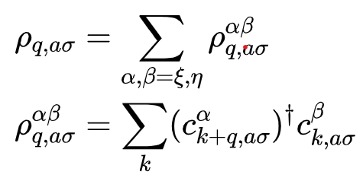
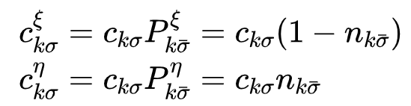
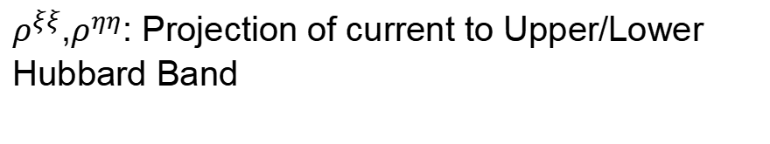
(4)Current Algebra for HK
In HK model, the eigenparticles are not bare fermions, but holon and doublon!
Instead of bare current, one should work with parton current
$ρ^{ξξ}$,$ρ^{ηη}$: Projection of current to Upper/Lower Hubbard Band
$ρ^{ξη}$,$ρ^{ηξ}$: Mixture of Upper/Lower Hubbard Band

Slide 12
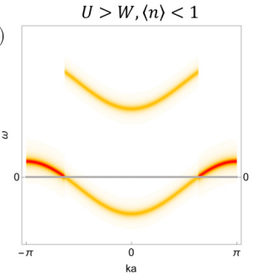
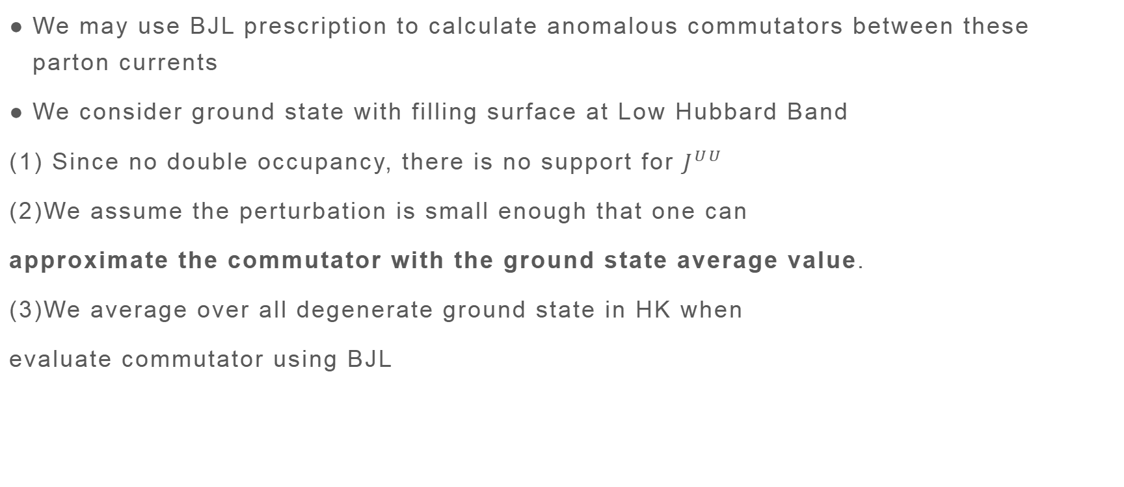
（4）Current Algebra of HK
We may use BJL prescription to calculate anomalous commutators between these parton currents
We consider ground state with filling surface at Low Hubbard Band
(1) Since no double occupancy, there is no support for $J^{UU}$
(2)We assume the perturbation is small enough that one can
approximate the commutator with the ground state average value.
(3)We average over all degenerate ground state in HK when
evaluate commutator using BJL

Slide 13
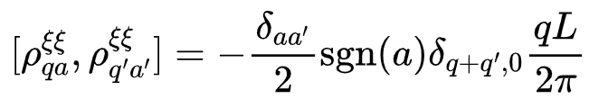
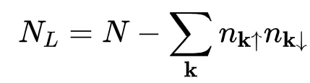
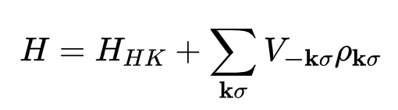
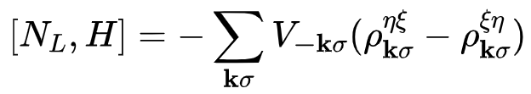


(4)Current Algebra of HK
We may start with projected density $ρ^{ξξ}$.
In general, the projected current $ρ^{ξξ}$ is not conserved subjected to an external field.
The Projected Charge
Add Onsite Potential
Must include $J^{LU}$ , $J^{UL}$ to satisfy conservation law!!

Slide 14
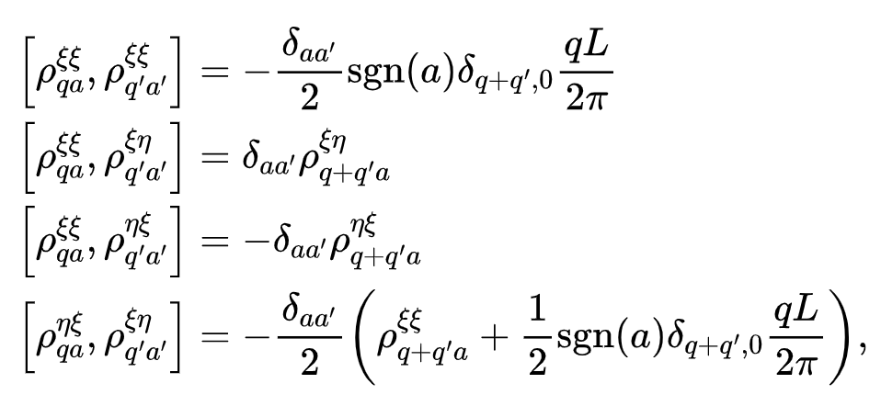
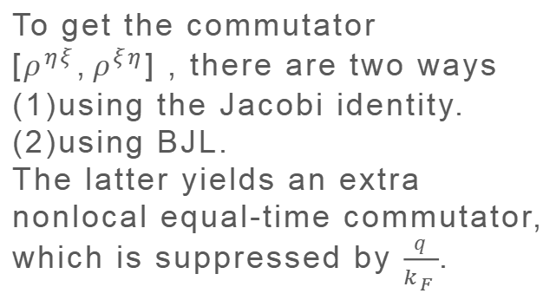
(4)Current Algebra of HK
To get the commutator $[ρ^{ηξ},ρ^{ξη}]$ , there are two ways
(1)using the Jacobi identity.
(2)using BJL.
The latter yields an extra nonlocal equal-time commutator, which is suppressed by $\frac{q}{k_{F}}$.
The 1st/4th line is derived from BJL prescription.
The 2nd/3rd line is fixed by conservation law.

Slide 15
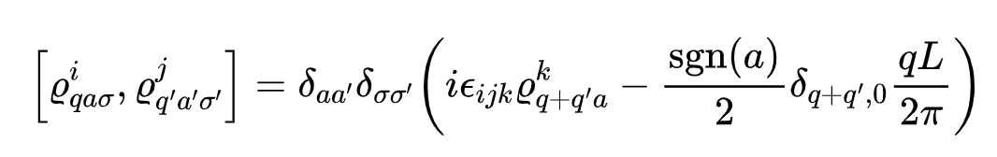
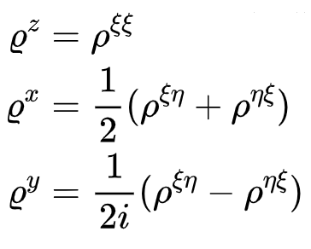
(4)Current Algebra of HK
The parton current in the charge sector is affine su(2) Lie algebra!

Slide 16
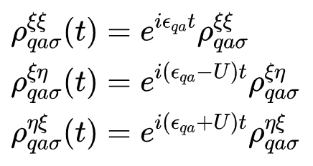

(5)Hamiltonian
Under the Heisenberg picture, the current operator only gain a phase under time evolution.

Slide 17
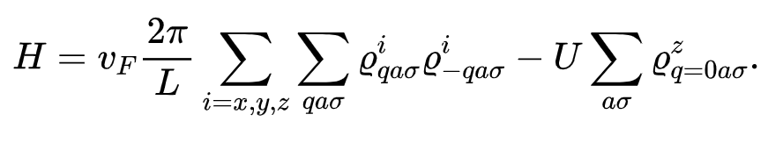
(5)Hamiltonian
We can use a LOCAL hamiltonian to generate the correct energy.
Jz commutes with J^2 if there is no anomaly. Schwinger term gives you kinetic energy vq.
Zeeman field that generates the energy difference U

Slide 18
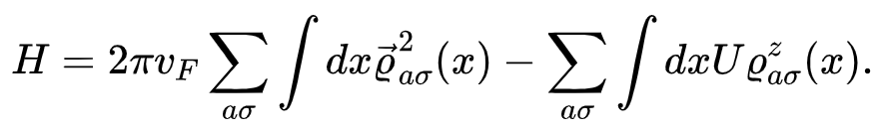
(5)Hamiltonian
We can use a LOCAL hamiltonian to generate the correct energy.

Slide 19
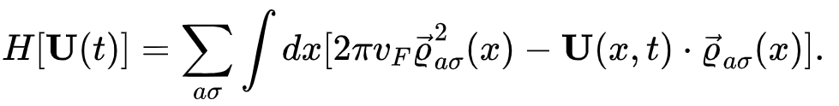
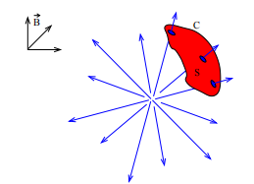
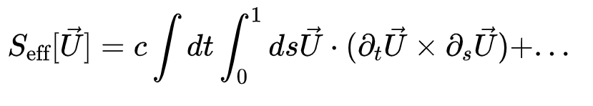
(6)Topology and Geometry Aspect
We could modify the second term.
Berry Phase
The effective action must e multi-valued function of U!
Relation with anomaly in LW Functional?

Slide 20



(6)Correlation function
We may compare correlation function from our Hamiltonian and the Kubo formalism
Kubo：Imaginary time-ordered correlation function
Current Algebra: Real time retarded correlation function
The difference is controlled by $\frac{q}{k_{F}}$ and $\frac{v_{F}q}{U}$.
In the limit $k_{F},U→∞$, the difference goes to zero.

Slide 21
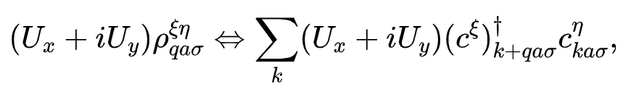
(7)New Interpretation for HK model
We show that a local model could restore the equation of motion and two-body correlation of band HK model at IR limit.
The local, well-defined excitation in HK model are particle-hole pair instead of single particle operators!
Maybe we could interpret the nonlocality of HK model as a result of rewriting local degree of freedom in nonlocal way.
Local SU(2) Object
Nonlocal particle-hole cloud

Slide 22
(11)To Do List
(1)Ambiguity of BJL Prescription
Replacing commutator with ground state expectation value might miss something
(2)Response: How to couple the Hamiltonian to gauge field
(3)Generalization to other model: MMHK, 1D Hubbard, higher dimension?
These terms have zero expectation value on GS, while necessary to close the algebra!

Slide 23
Thank You!

