Slide 1
Recommended location for opening a fashion store in Paris
Presentation

Slide 2
Introduction
Hierarchical model of the fashion industry
Couture (haute couture)
Chanel and Christian Dior
Designer
Dries Van Noten and Prada
Bridge or diffusion
Marc Jacobs and DKNY
Upper high street
Karen Millen and Jones New York
Mid-high street
Gap and Next
Lower high street
H&M and New Look
Budget
Primark and Cherokee

Slide 3
Business Problem
Lower high street brand label
Closure to French Restaurants, Cafés and Wine Bars
Opening a new store in Paris, France
Variety of other clothing stores
Narrowing down the best district options

Slide 4
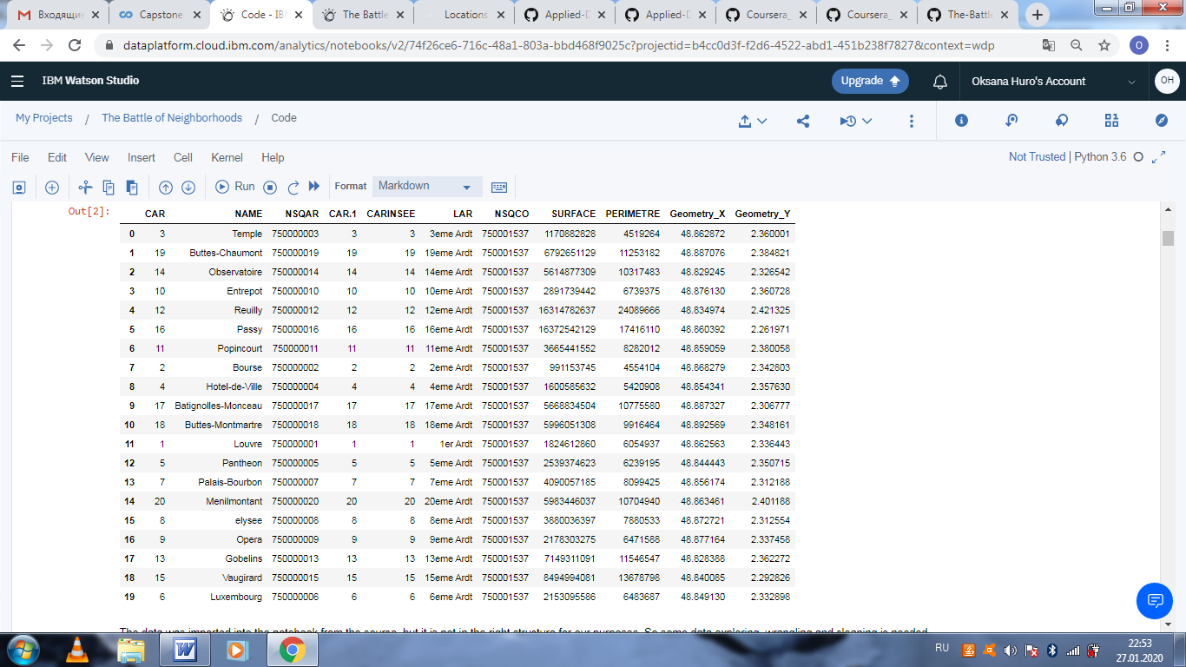
Data

Slide 5
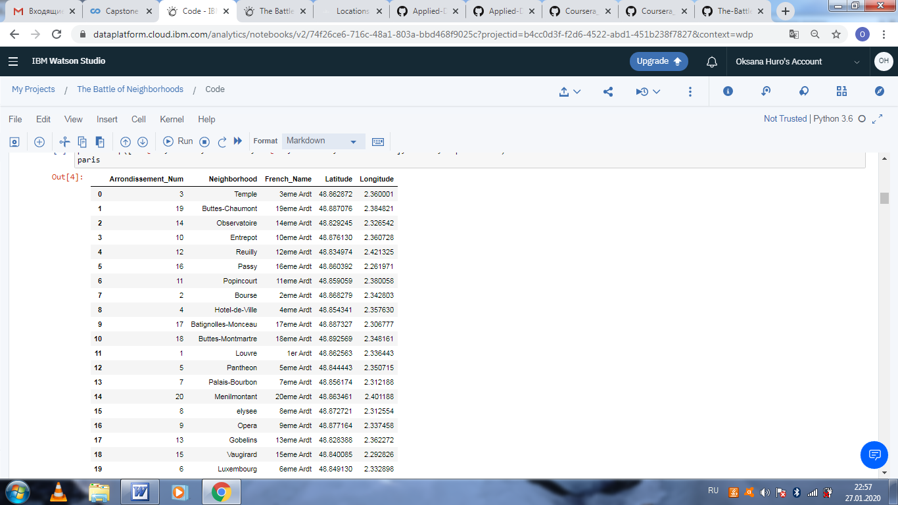
Cleaned Data

Slide 6
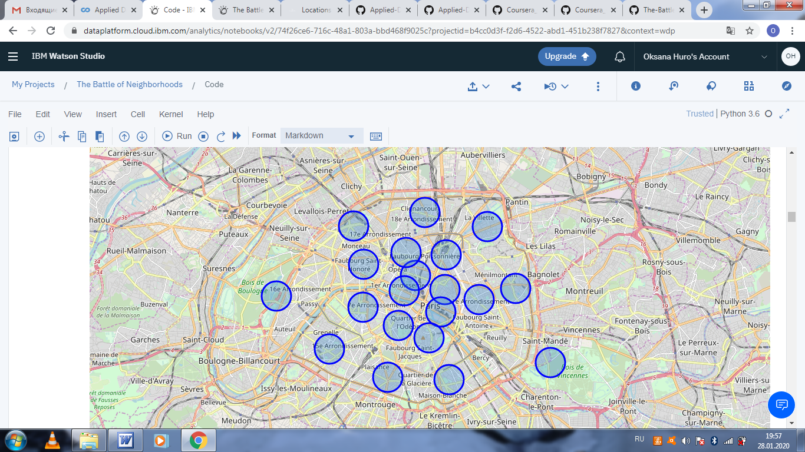
Map of Paris with the location of the neighborhoods

Slide 7
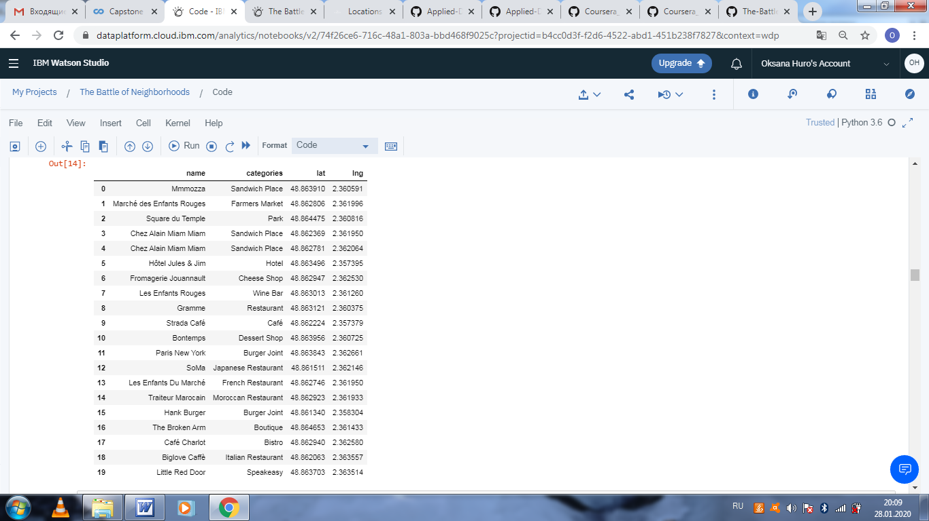
Top 100 venues of the neighborhood 3eme Ardt

Slide 8
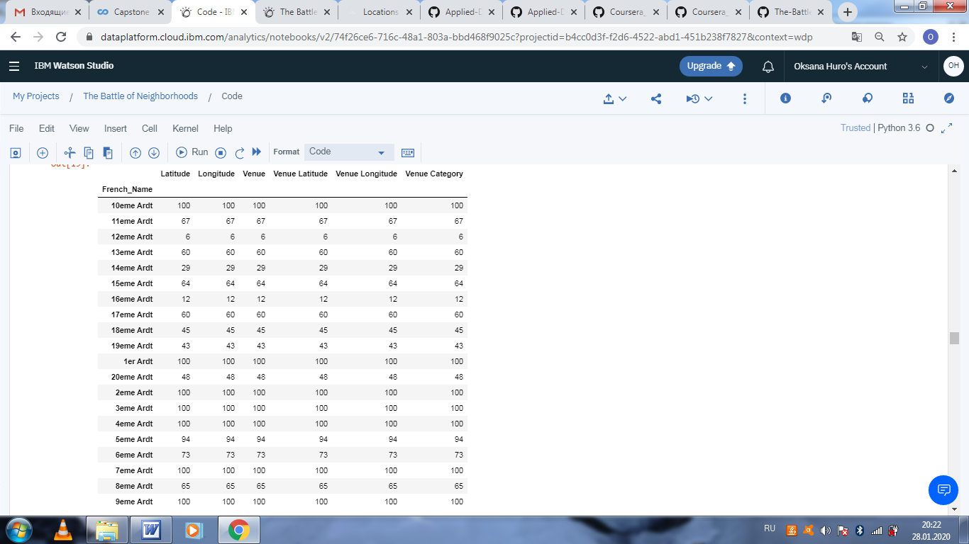
Unique venue categories

Slide 9
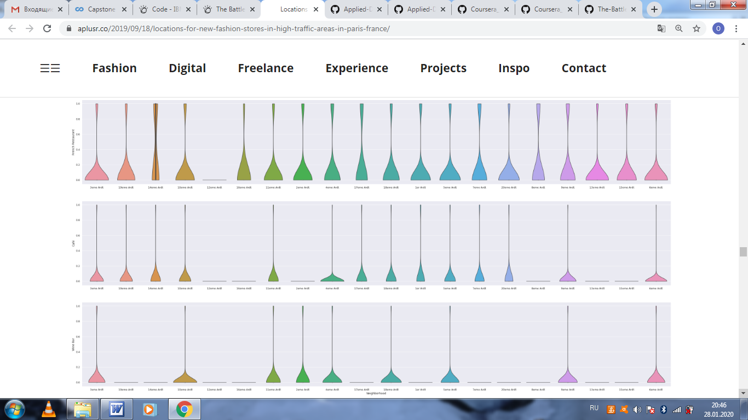
Frequency distribution for the top 3 venue categories for each neighborhood

Slide 10
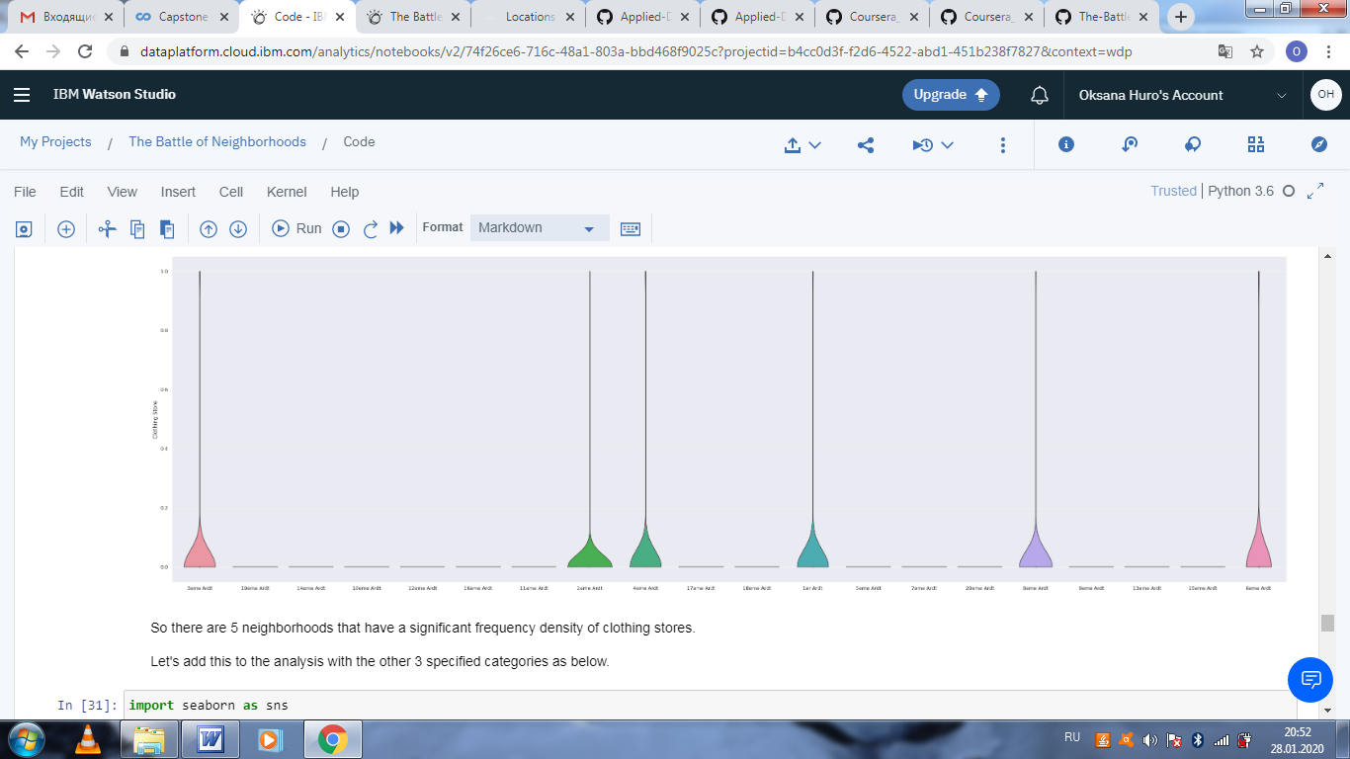
Frequency of Clothing stores for each neighborhood

Slide 11
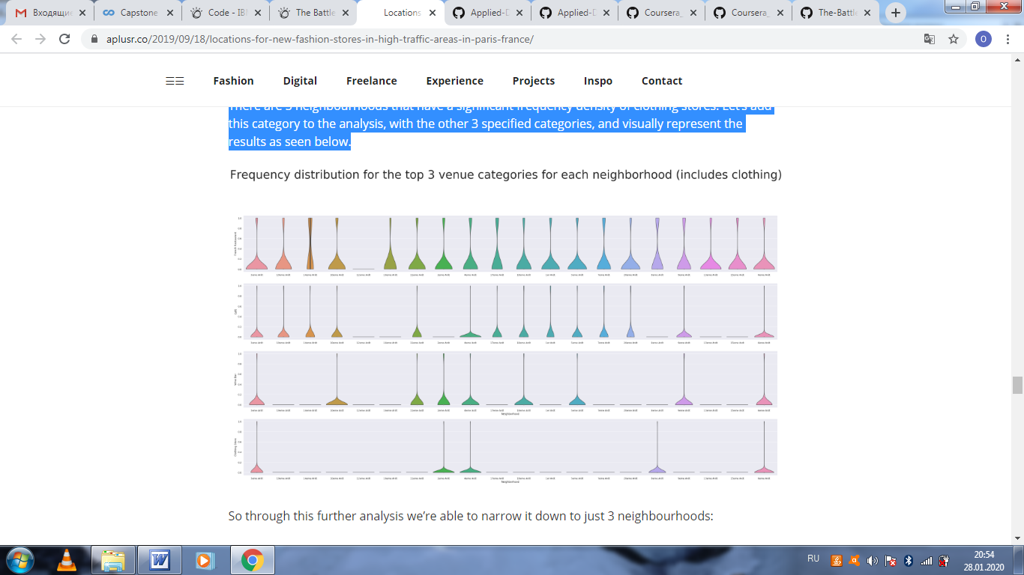
Frequency distribution for each neighborhood

Slide 12
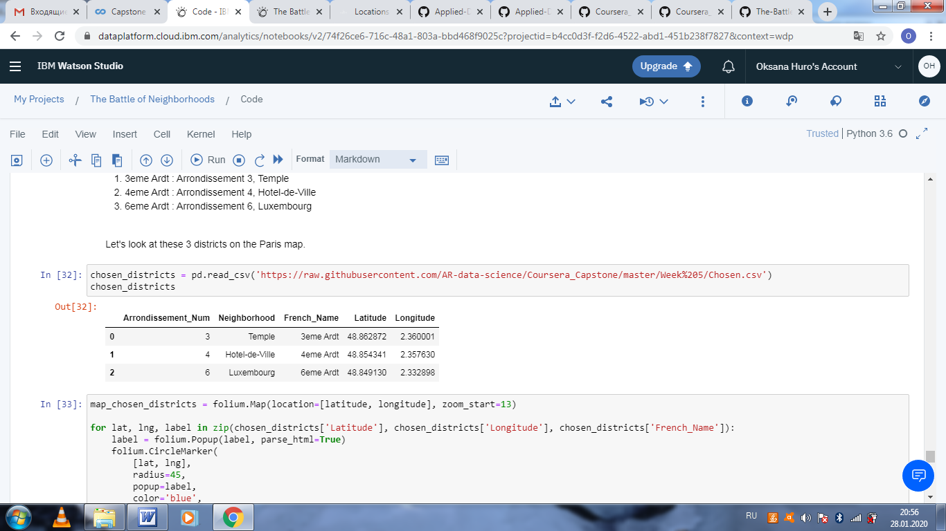
Prospective neighborhoods for new store locations

Slide 13
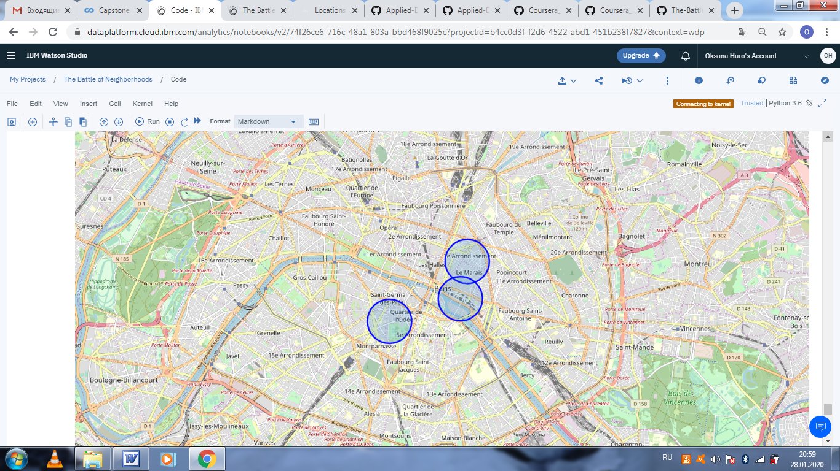
Prospective neighborhoods for new store locations on the map

Slide 14
Results, discussion and conclusion
Inferential analysis using the data, as well as domain knowledge of retail and marketing, allowed narrowing the search area down significantly from 20 potential districts to 3 that should suit the retail business.
The analysis and results are not an end point, but rather a starting point that will guide the next part of the process to find specific store locations.
Data has helped to provide a better strategy and data-driven decisions will lead to a better solution in the end.

