Slide 1
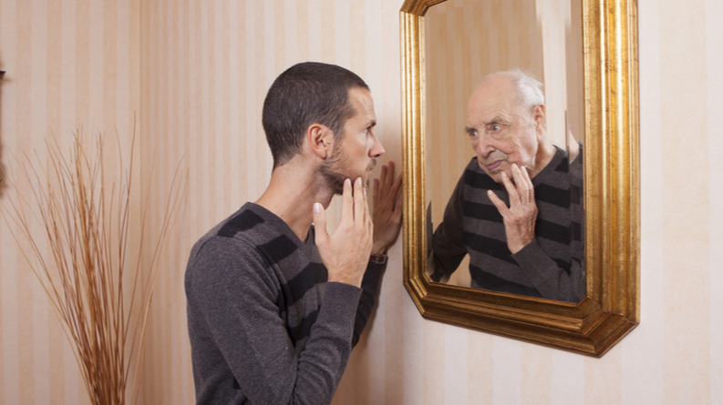

Age: Youths & Old age

Slide 2


Warm-up
Tongue Twisters
You are going to read once. Start by saying the tongue twister slowly, paying close attention to each word then increase your speed.
I wish to wish the wish you wish to wish, but if you wish the wish the witch wishes, I won’t wish the wish you wish to wish.

Slide 3

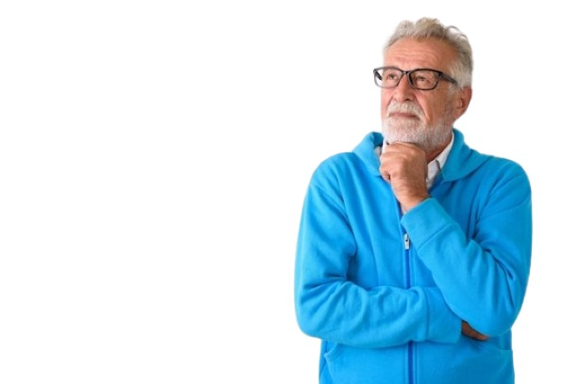
A. Questions
You are going to read, and talk about the following:
What do you least like (like most) about getting older?
How do/did you feel about your parents growing older?
Can you recall a special place you loved to visit when you were much younger? Do you still like to visit there now?

Slide 4

Questions
You are going to read, define and talk about the following:
Is there a song or piece of music from your younger years that still holds meaning for you? Do you listen to it occasionally?
What was the most exciting adventure or trip you took during your teenage years?
Can you share a story or memory about an older person who has inspired you?

Slide 5

B. Idioms and Expressions
1
2
2
1
You are going to read, match and talk about the following:
Young at heart
Pension
To be a spring chicken
To be a senior citizen
Centenarian
a. an elderly person, especially an old-age pensioner.
b. Regular payment to support retirees
c. This idiom refers to being young and full of energy.
d. a person who is a hundred or more years old.
e. This means to have a youthful outlook or attitude, regardless of one's actual age.

Slide 6

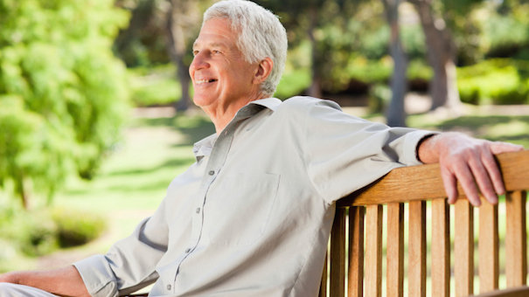
C. Scenarios
In pairs, what would you say in the following situations?
If your parents could no longer care for themselves, would you let them live with you or put them in a nursing home?
If people are still able to (and want to) work, should they have to retire when the reach a certain age?
If you could change one thing about how society views and treats the elderly, what would it be and why?

Slide 7
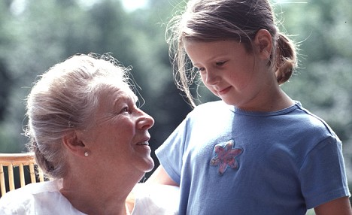
C. Scenarios
In pairs, what would you say in the following situations?
If you were to give a piece of advice about aging to young people, what would it be and why?
If you had the opportunity to age in reverse (like Benjamin Button), how do you think your life would be different?
If you could give a gift to someone who is much older, what would it be?

Slide 8

Breakout room
For today's activity, pair up with a partner(s) to discuss the following questions provided below. 💬 Ask your partner(s) the questions and explore their experiences. Connect with them, and later, share your findings with the group
Questions
What was a place you loved to go with your family when you were young? Do you visit similar places now? Do you think that, as an older person, you will defy all stereotypes and do something remarkable?

