Slide 1
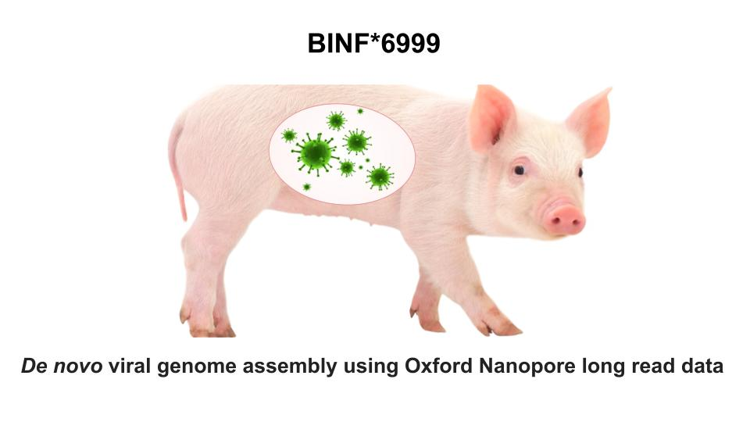
Genomics Unit - Lab meeting - May 21, 2024

Slide 2
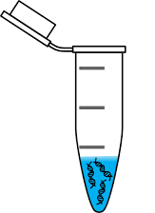
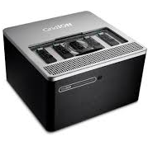


Aim and objectives
Intro: Long read de novo genome assemblers have been successfully used for animals, plants, bacteria;
Problem: de novo assembly of viral genomes remains challenging due to the generally smaller genome size and lower abundance in metagenomics data.
Aim: assess performance of long read de novo assemblers to reconstruct viral genomes from metagenomics data and to develop the best practices guidelines.
https://wepresent.wetransfer.com/stories/kent-rogowski-love-love

Slide 3
Outline
Simulated data sets
NanoSim
2 scenarios
1 M reads each
Empirical data sets
Metagenomic datasets sequenced in house
De novo asm
Canu 2.2
metaFlye 2.9
metaMDBG
Check # and completeness of reconstructed genomes

Slide 4
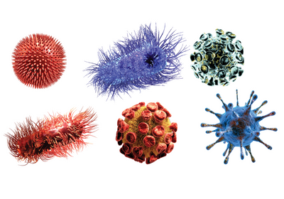
Simulated data sets
Scenario 1:
High genetic diversity of viruses;
7 distinct viral species with various relative abundance;
Hendra, FMDV, CSFV, PEDV, phages
Scenario 2:
(relatively) Low genetic diversity of viruses;
mixed infection of several strains of the same virus + 3 additional distinct viral species (4 strains of FMDV + Hendra + phages)

Slide 5

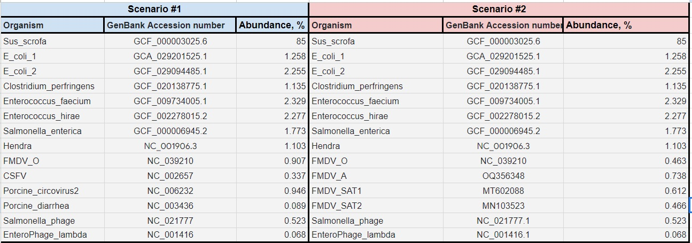




Simulated data sets
https://github.com/bcgsc/NanoSim
Composition and relative abundance info
2. Reference FASTAs
3. Basecall model/error profile
metagenome_ERR3152366_Log
- can specify min/max/med read length;
- generate chimeric reads;
- introduce random variation in abundance;

Slide 6
Simulated data sets
https://github.com/bcgsc/NanoSim
Composition and relative abundance info
2. Reference FASTAs
3. Basecall model/error profile
metagenome_ERR3152366_Log
Pre-trained metagenomic models are outdated => need to create our own model

Slide 7
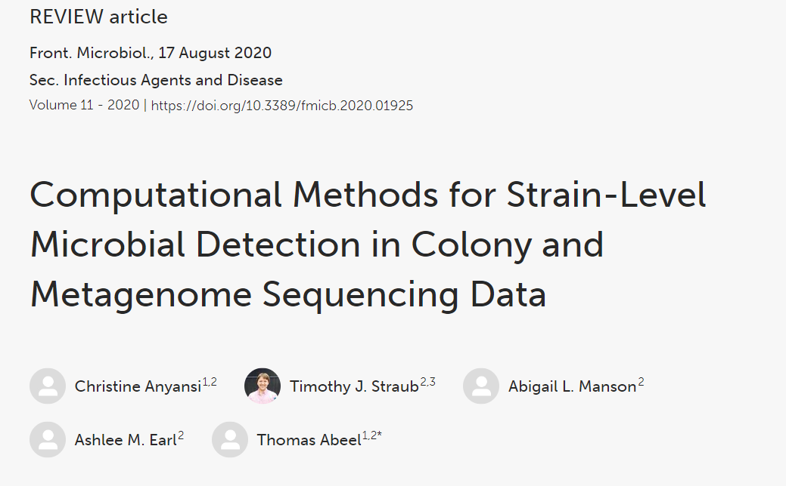
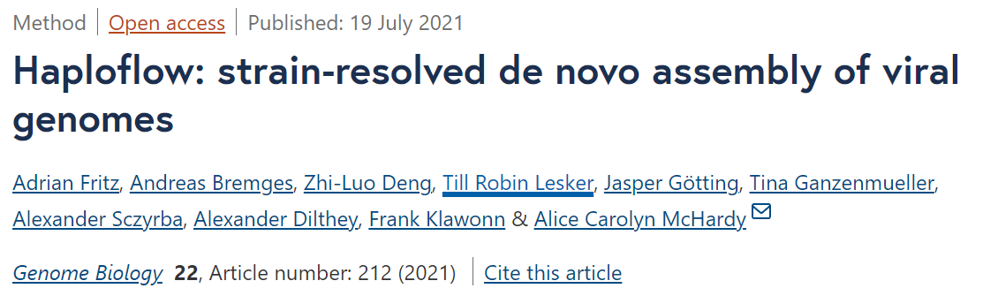
Simulated data sets: strain-level assembly
Scenario 2

Slide 8
Simulated data sets: strain-level assembly
Scenario 2
Perform assembly with and without a strain-level assembler

Slide 9
Outline
Simulated data sets
NanoSim
2 scenarios
1 M reads each
Train our own model
Empirical data sets
Metagenomic datasets sequenced in house
De novo asm
Canu 2.2
metaFlye 2.9
metaMDBG
HaploFlow
Check # and completeness of reconstructed genomes

