Slide 1

Test Report
Site https://www.olx.ua/uk/
Author: Oksana Zhyrak

Slide 2
Test report contain:
Estimation
Project information
Test objective
Test environment map
Test summary
Defects

Slide 3
Estimation
Task name | Estimation parameters (hours) | Estimated hours | Actual hours
Creation of Test plan | O=5 M=10 P=12 | 9.5 | 8
Creation of Checklist | O=10 M=12 P=15 | 12 | 14
Creation of Test cases | O=8 M=10 P=16 | 10.5 | 10
Execution of Checklist | O=7 M=10 P=15 | 10 | 8
Execution of Test Cases | O=5 M=9 P=15 | 10 | 5
Creation of Bug report | O=9 M=11 P=15 | 11 | 10
Creation of Test report | O=5 M=9 P=13 | 9 | 6
Total (hours) | 72 |  | 61
The Program Evaluation and Review Technique (PERT)
PERT estimate formula is:
(O + 4M +P) / 6;
O-optimistic estimation P-pessimistic estimation M-most likely estimation

Slide 4
Project information
Project Name | OLX
Name of Product | Site https://www.olx.ua/uk/
Product Description | Online marketplace
Project Description | <Mission of project> Conduct testing to verify the quality of this website <Project’s output product> Test report, test plan, test cases, checklist, bug reports
Project duration | Start date: 20.10.2022 End date: 25.11.2022

Slide 5
Product Description
OLX is one of the largest online businesses in Ukraine.
The base of the site includes almost 10.8 million ads and is replenished with more than 3 million new offers every month.
The OLX has the highest traffic in the country after Google, YouTube, and Facebook. Every second Ukrainian online user visits OLX at least once a month.
OLX improves people's lives by connecting them together for mutually beneficial deals. Sellers can easily make extra money by simply posting ads and selling items they no longer need or new items. Thus, they enable buyers to find valuable goods at reasonable prices.

Slide 6
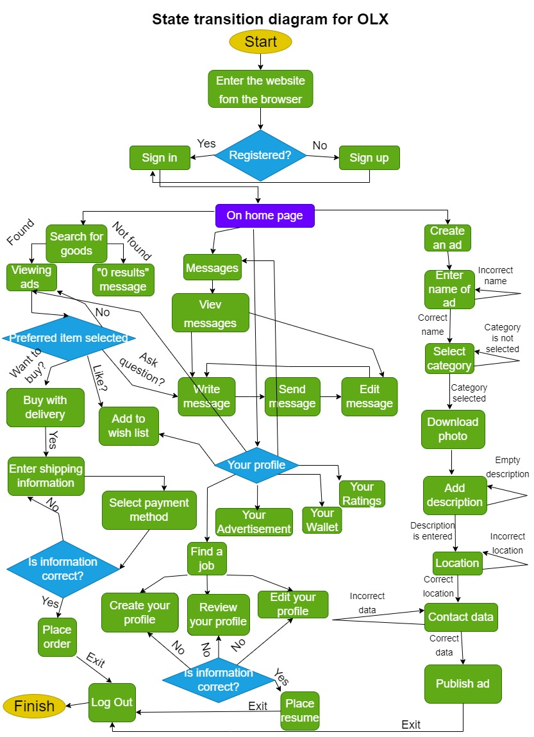
https://drive.google.com/file/d/1UfdBIAGOcUzeQE2sg7ZXIoKLELAQtuTK/view?usp=sharing

Slide 7
Test objective
Functionality | Registration/authorization form, Language switcher, Sending/viewing/editing messages, Search field, Adding/removing goods to the wish list, Profile categories, View/edit/save/submit an ad, Import image file, Different filter items, Currency filter, Sorting filter, Viewing ads information/picture/phone number/location, Social media links

Slide 8
Test objective
UI:
Web elements | Website layout
Buttons, Menu, Text, Images | Window breakpoints, Horizontal scrolling HTML/CSS, Links
Usability | User friendly Clear contents

Slide 9
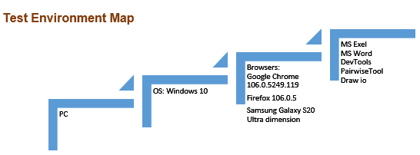
Test environment map

Slide 10
Test summary
The number of checklist items executed | 117
The number of test cases executed | 21
The number of checklist items passed | 105
The number of test cases passed | 20
The number of checklist items failed | 12
The number of test cases failed | 1

Slide 11
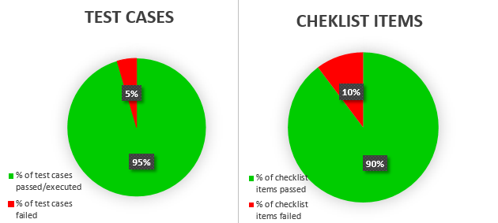
Test summary

Slide 12
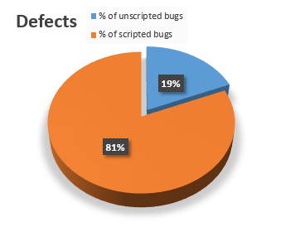
Defects
The total number of bugs – is 16.
13 of them were found according to the documentation and 3 – were without.

Slide 13
Defects
The status of 16 bugs is “Open”.
4 bugs are found by localization testing.
2 bugs are found by testing currency.
3 bugs are found by using DevTools.

Slide 14
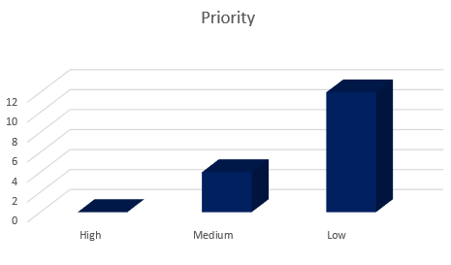
Defects
Priority | Quantity of defects
High | 0
Medium | 4
Low | 12

Slide 15
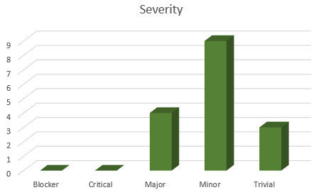
Defects
Severity | Quantity of defects
Blocker | 0
Critical | 0
Major | 4
Minor | 9
Trivial | 3

Slide 16
Thank you for your attention!

