Slide 1
UI/UX 勉強会

Slide 2
UI：User Interface
機械と人間のコミュニケーションの方法
UX：User Experience
システムから得られる体験,感動

Slide 3
直感的
簡単
レベルデザイン

Slide 4
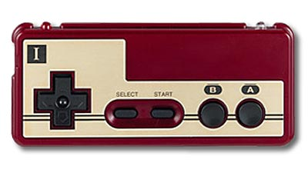
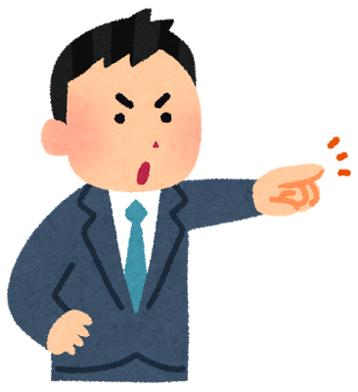
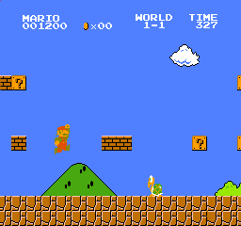
Push Left
Move Right

Slide 5
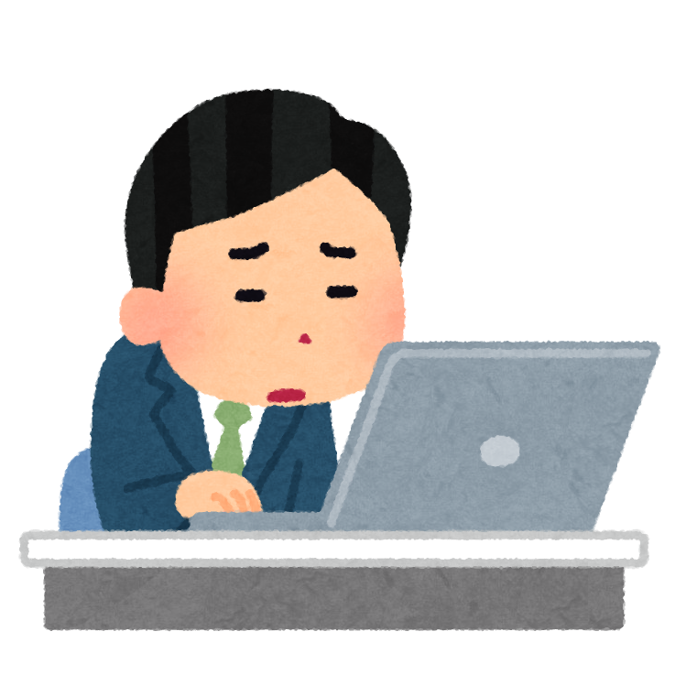
Ctrl + C
Copy
Drag & Drop
Move Item
Click
Select

Slide 6

Push Right
after 1min
Move Right

Slide 7

Very Complexity
Push That Keys
Ctrl + Alt + Shift + A + B + F1 + Tab

Slide 8
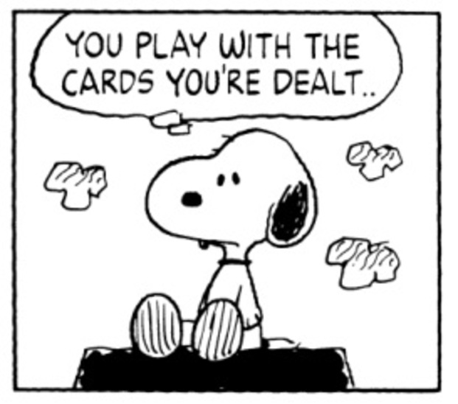
Ver Up
add operation
Ver Up
add operation
Ver Up
add operation

Slide 9

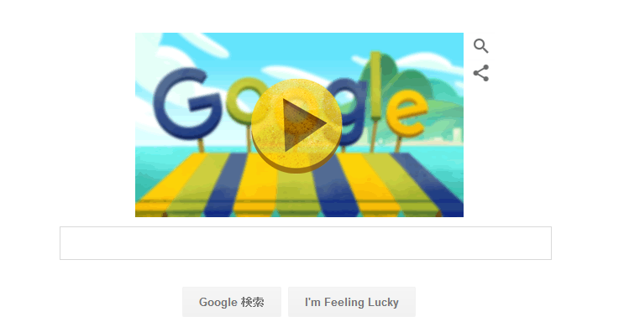
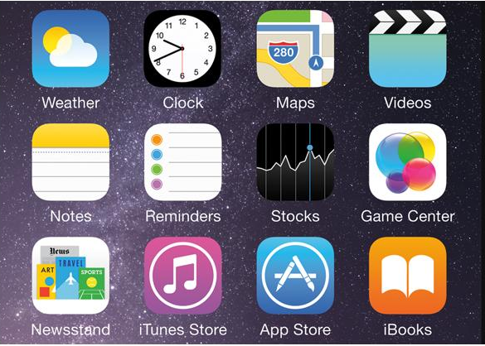
Twitter
Google
iPhone

Slide 10
Delete
Add
Delete
Add
Add
Delete

Slide 11
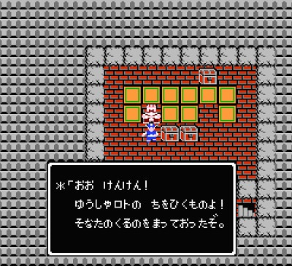
Level Design

Slide 12
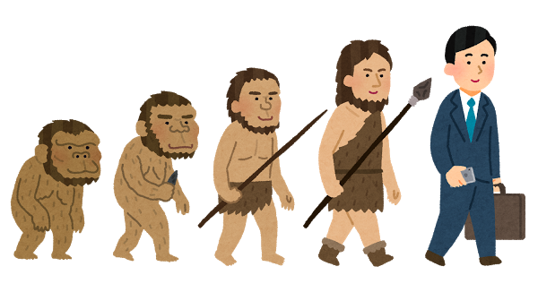
Good Design
Bad Design

Slide 13
UX
UX
UI

Slide 14


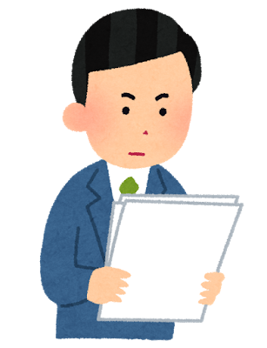
Use
When
Where
Who
What
Why
How

Slide 15
When
Leisure
Holyday
Event
Working

Slide 16
Where
Home
School
Station
Office

Slide 17
Who
User Difinition
Purpose
Frequency
Age
Sex
Emotion
Goal

Slide 18
What
Me
Bag
Animal
Cell Phone
PSP
Tool

Slide 19
Why
Lonely
Interesting
Cool
Convinient

Slide 20
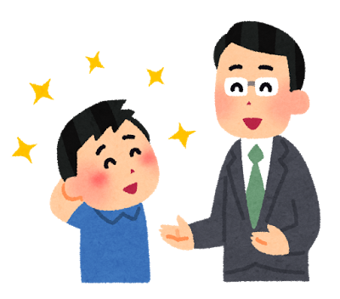
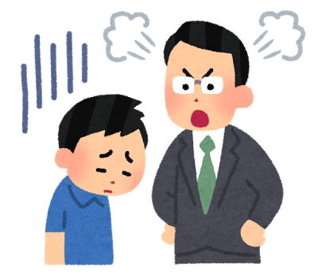
Ctrl + C
Copy
Ctrl + C
Copy
Ctrl + C
Cut

Slide 21

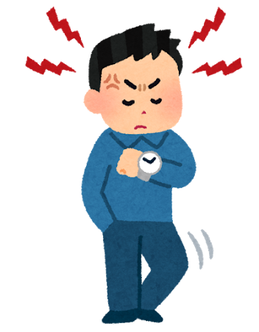
・・・・・
Frustration

Slide 22
Recommend Function
Tutoreal
Information
Redo / Undo
Bigineer
State
Command
What Happen?
Item Information
Mement

