Slide 1
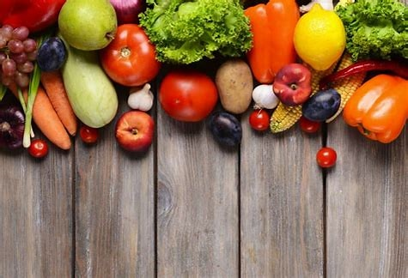
Nutrition ME
The Ultimate nutrition tracking website
-Krisha Desai
-Mehak Gurbaxani
-Erzhan Okumaliev
- Bach Le Xuan

Slide 2
DATA SCIENCE IN NUTRITION MANAGEMENT
Introduction: Individualised dietary management is necessary for health and well-being.
Data Science: Dietary regulation is revolutionised by the application of data analytics and nutrition science.
Relevance: Finding patterns in datasets helps support evidence-based dietary treatments.

Slide 3
Challenges
Traditional Methods: Standardised criteria and manual entry impede consistent tracking.
User Difficulty: Label interpretation and consistency maintenance are difficult.
Solutions in Data Science: Tracking is made easier with automation and customised recommendations.Sorting recipes according to user requirements.
Empowerment: Tailored advice improves dietary compliance and satisfaction.

Slide 4
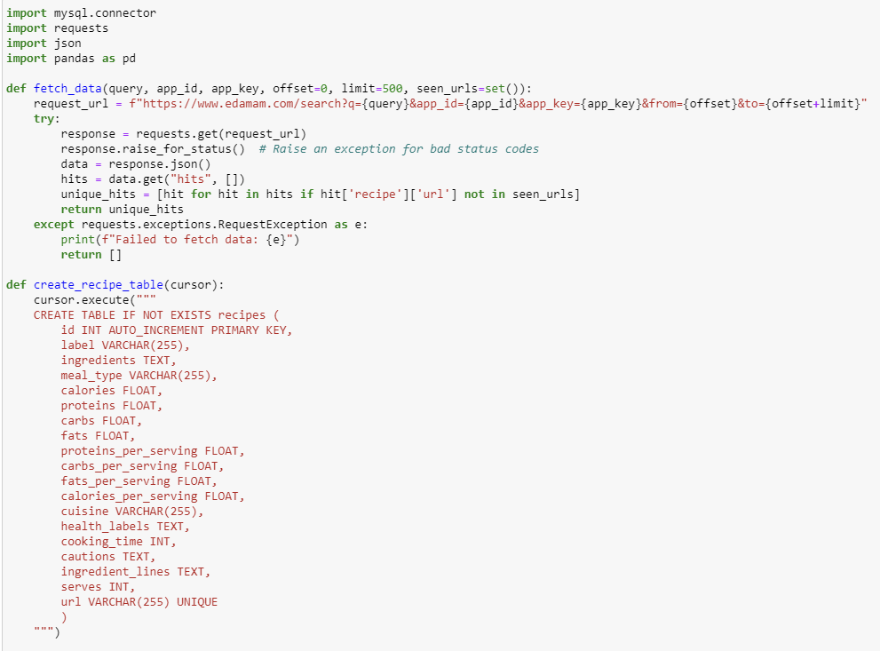
Database
Objective: Our project aims to create a comprehensive database of recipes using the Edamam API.
Data Extraction: We extract recipe data from the Edamam API, which provides a vast collection of recipes.
Why Edamam API?:
Advantages of Edamam API:

Slide 5
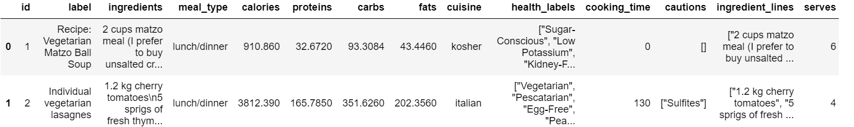
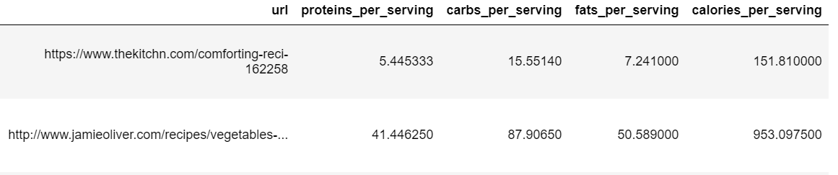
Dataset

Slide 6
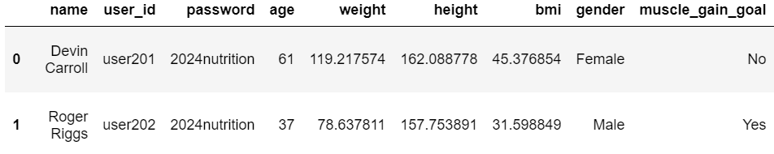
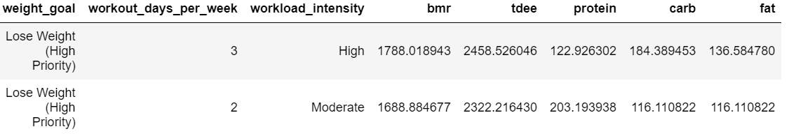
User data
Cata Generation:
User data was generated using the Faker library, providing realistic fake names for our database.
Data Extraction and Storage:
Data extraction from the Edamam API.
Storage in a CSV database.
Nutrition tracking starts as soon as a user starts using the application.
CSV Storage:
Recipe data stored in CSV format for backup and easy retrieval.
Nutrition Tracking:
Nutritional tracking starts when a user begins using the application, enabling personalized nutrition analysis and recommendations.

Slide 7
Nutrition ME
Three Primary Sections:
User Registration Page
The Dashboard
The Recipe Page
The website is developed with Streamlit, a Python web application toolkit, and machine learning techniques are used to provide recommendations based on user data.

Slide 8
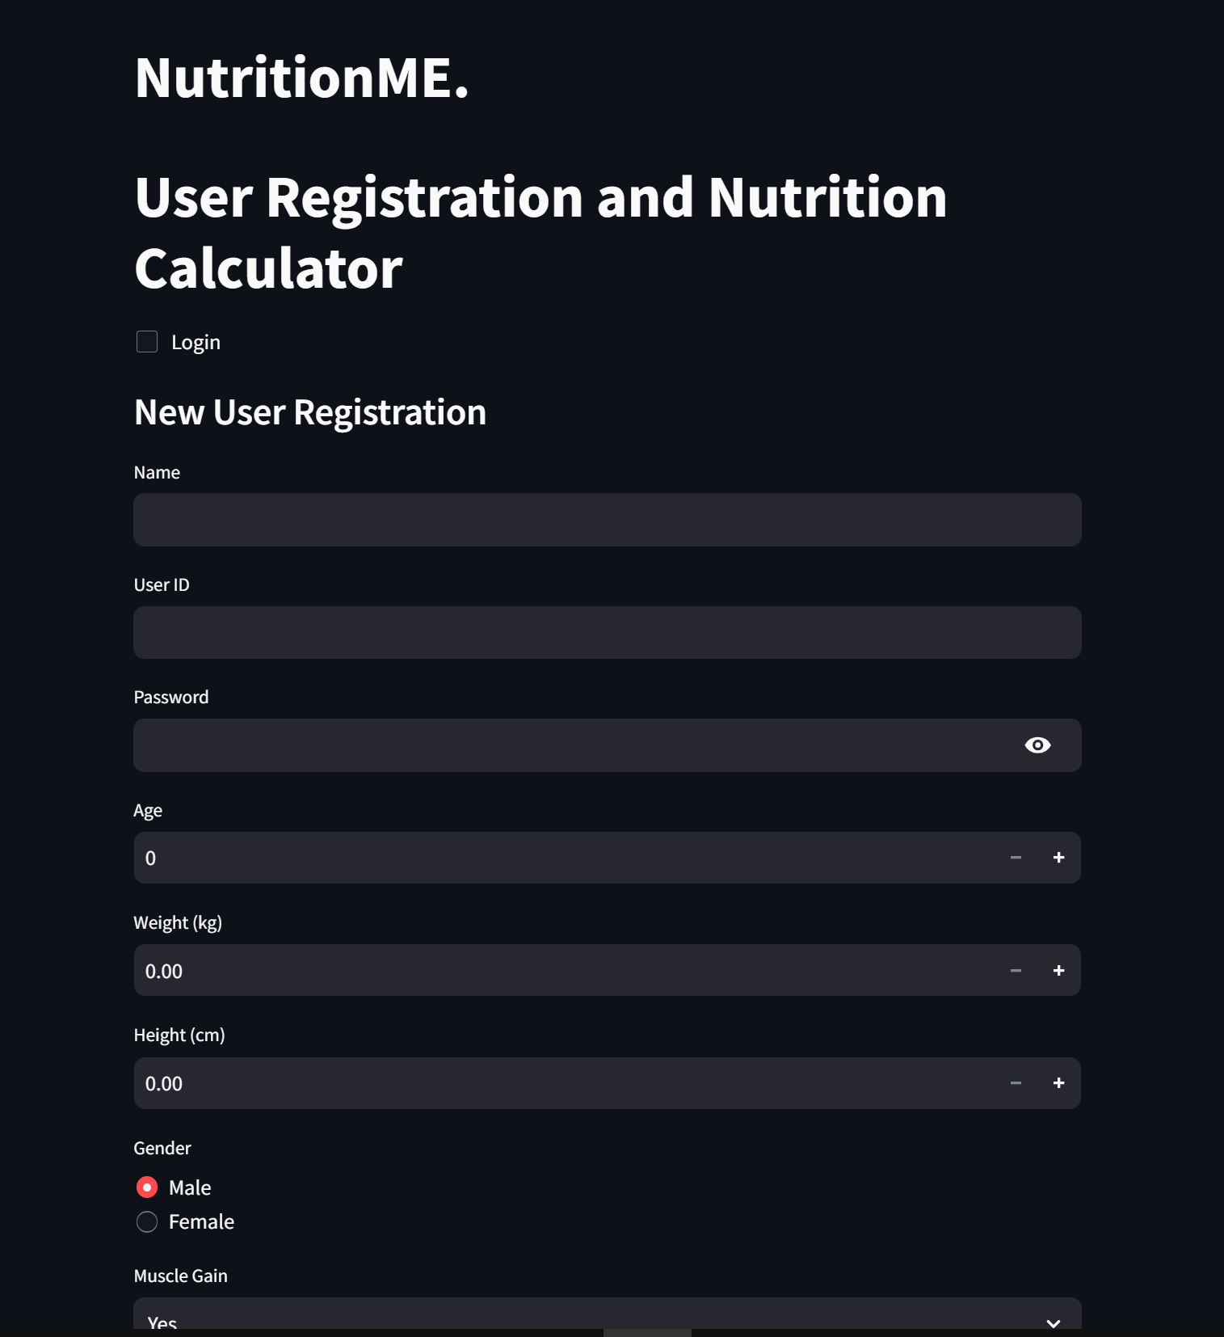
USER-REGISTRATION
PAGE

Slide 9
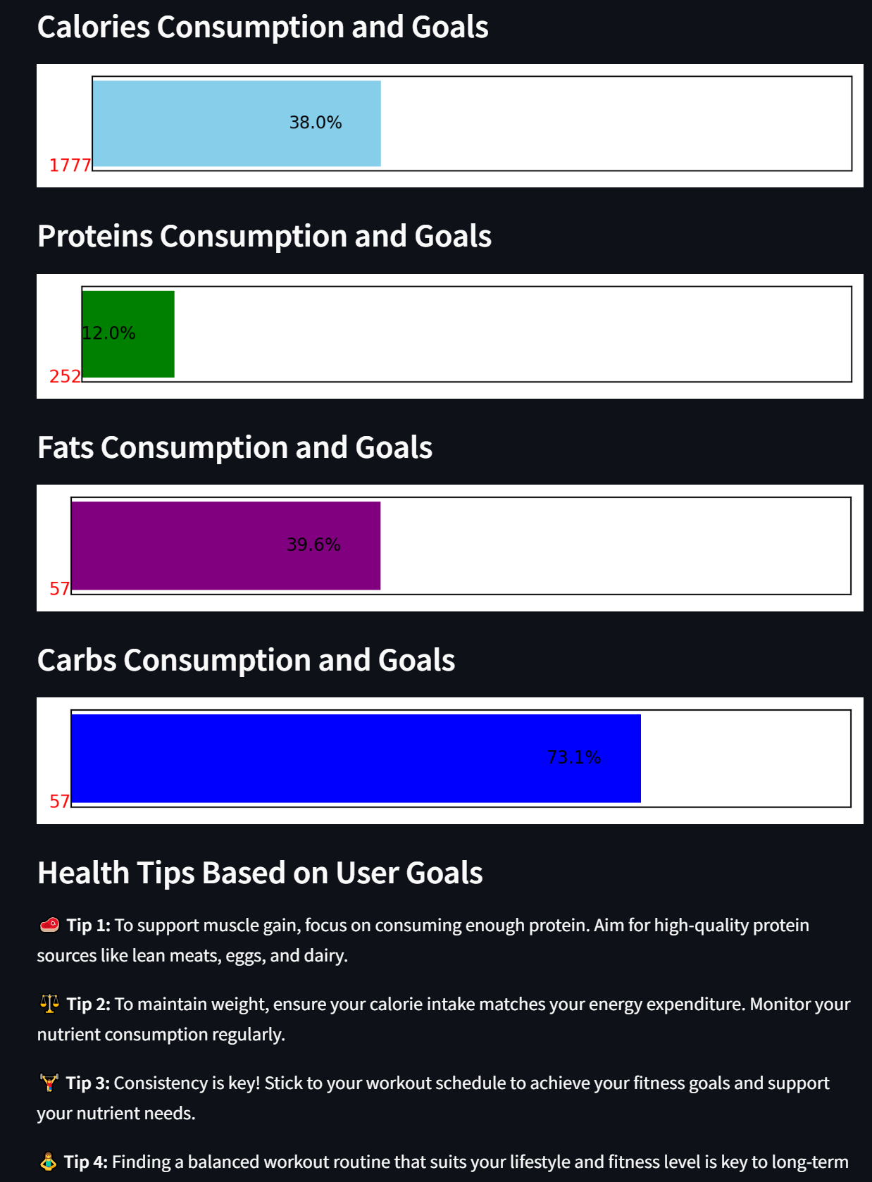
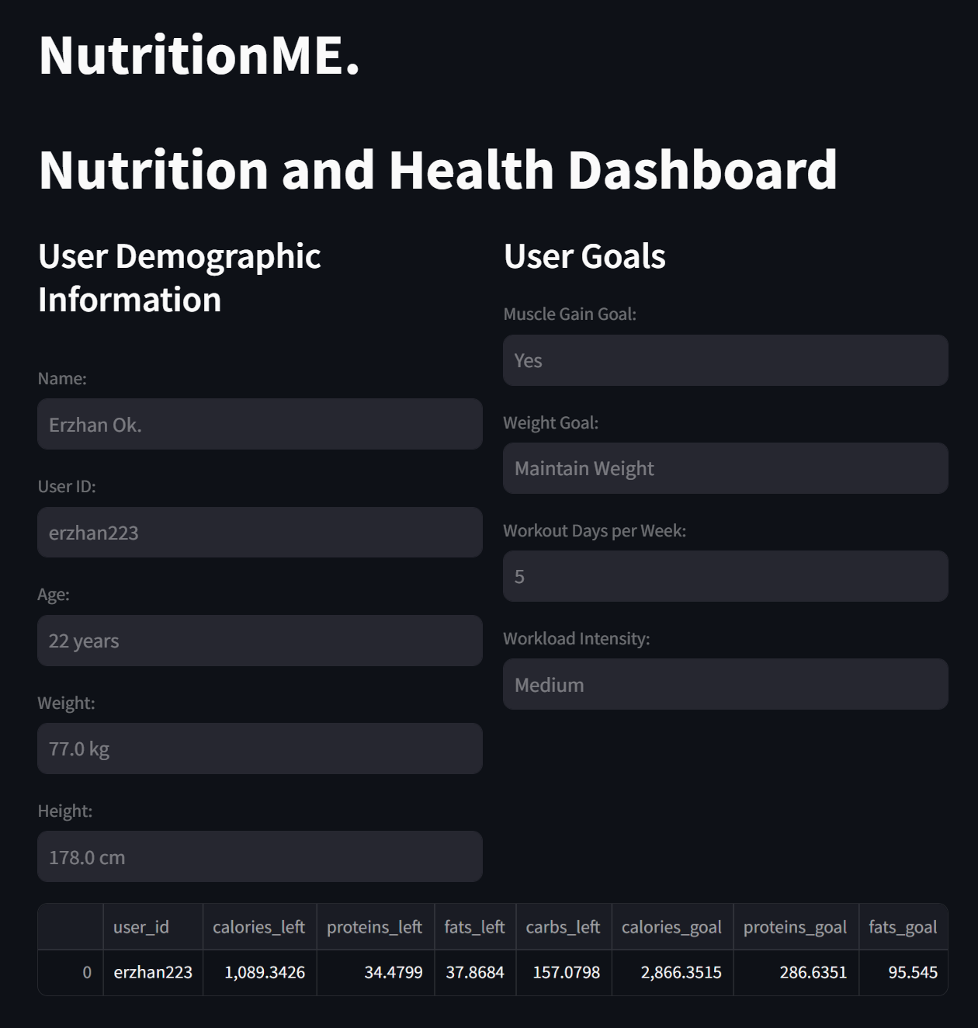
DASHBOARD

Slide 10
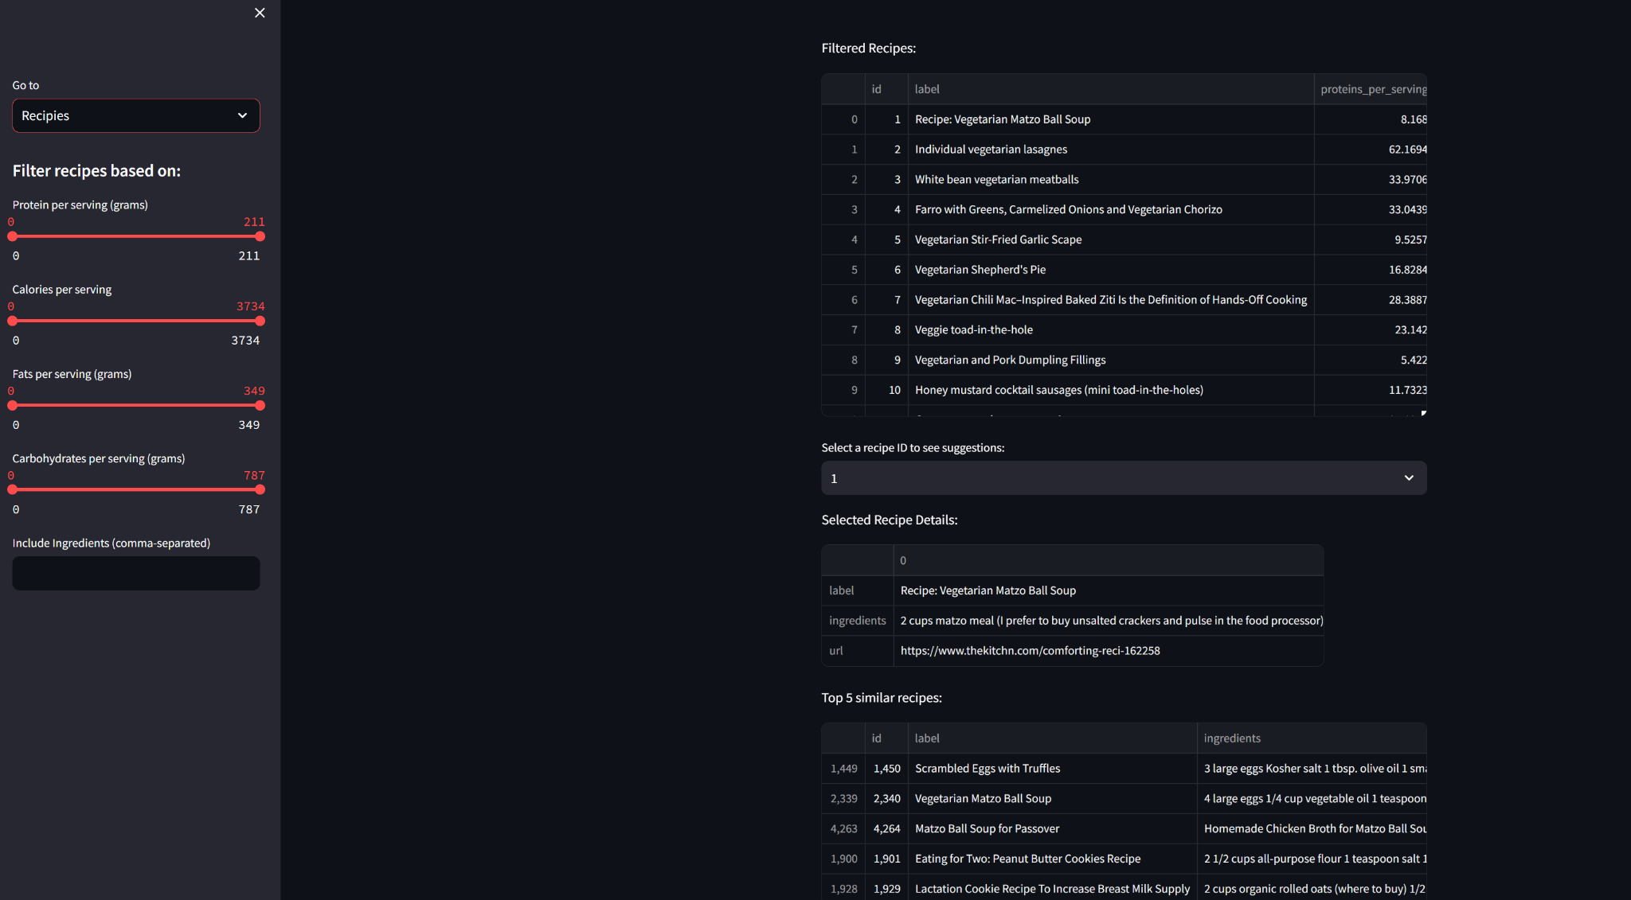
RECIPE
PAGE

Slide 11
Future Goal
Nutrition Me is more than simply a diet guidance app; it's a complete health and wellbeing companion. We envision a future in which people achieve their objectives through the seamless integration of personalised nutrition and workout regimens. This paper investigates how Nutrition Me will encourage user participation, enable recipe creation and customisation, and form a collaborative relationship with gyms, resulting in a truly symbiotic user experience.

Slide 12
Enhancing user interaction:
Recipe Rating and Review System: A strong rating and review system allows users to share their culinary experiences and influence the decisions of others. This generates a sense of community and allows users to curate delicious and effective meals.
Social Sharing: Include social media sharing features that allow users to share their meal creations and fitness achievements with friends and family. This instills a sense of responsibility and recognises individual paths.

Slide 13
Empowering Recipe Creation and Customisation:
Customisation Tools: Users can alter portion sizes, substitute items depending on allergies or preferences, and personalise recipes to meet their individual nutritional requirements. This creates a sense of ownership and control over meal plans.
My Recipe Creation: The app will have user-friendly recipe creation features. Users can enter their own recipes, including ingredients, instructions, and nutritional data. Users can share family favourites, cultural delicacies, and unique culinary creations with the community.

Slide 14
Collaboration with gyms and workout routines.
Gym Integration: The app will look into partnerships with gyms, allowing users to connect their accounts. This allows gyms to provide customised training programmes that supplement the user's nutritional goals and calorie expenditure data from Nutrition Me.
Workout Routines: Include a library of workout routines designed for various fitness goals (weight loss, muscle building, endurance). Users can choose routines based on their gym membership or preferred training style.

Slide 15
DEMO AND CONCLUSION!

