Slide 1
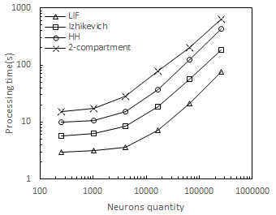
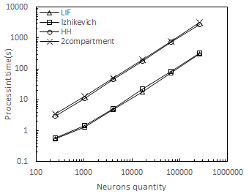
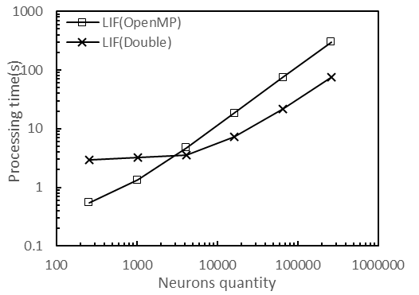
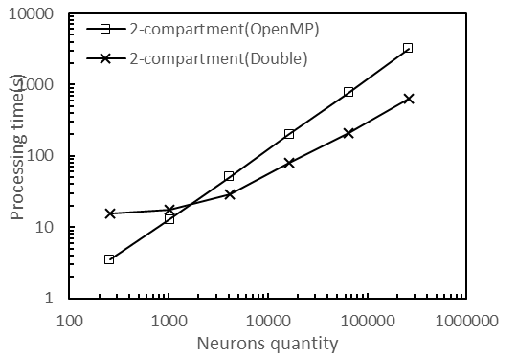
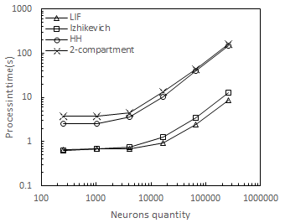
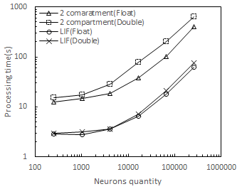
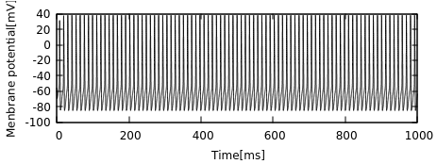
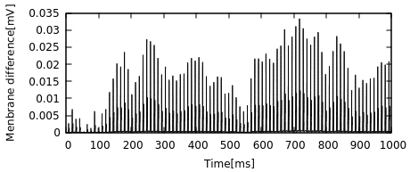
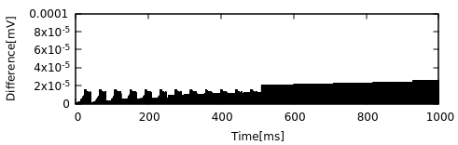
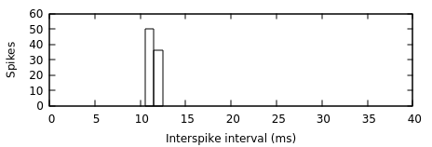
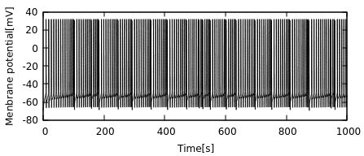
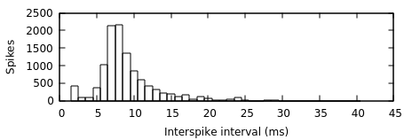
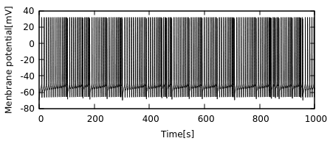

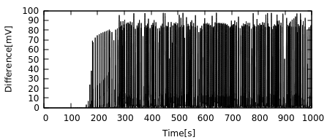
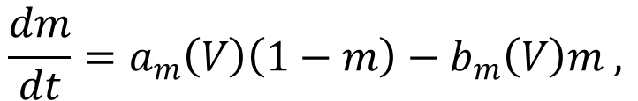
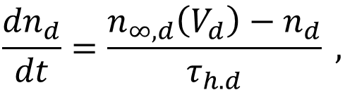

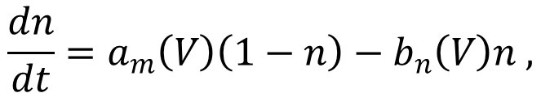
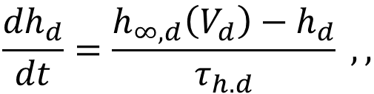

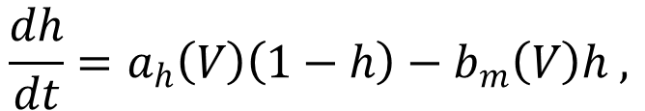
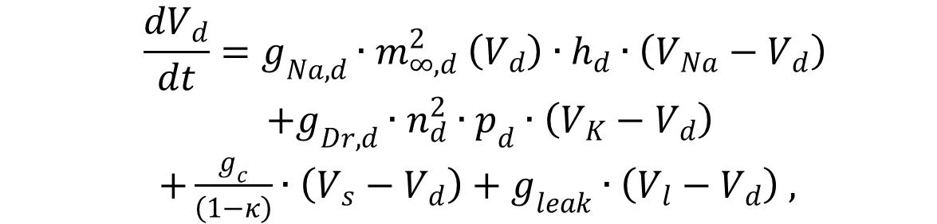
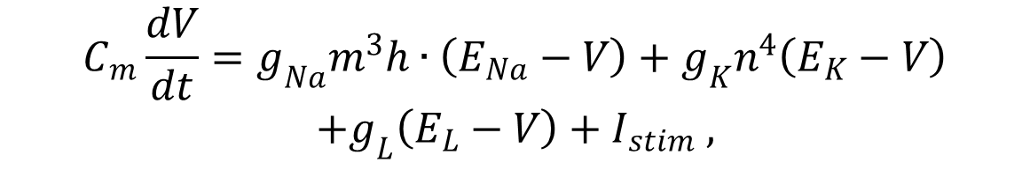
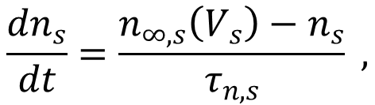

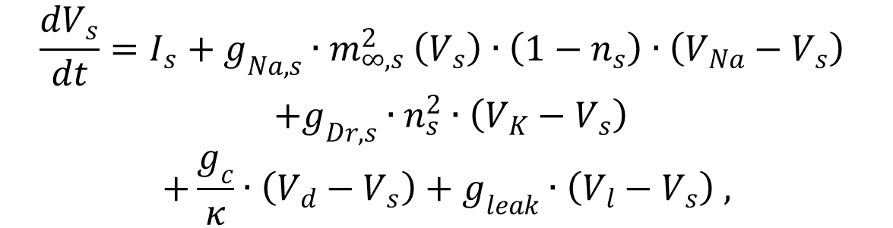
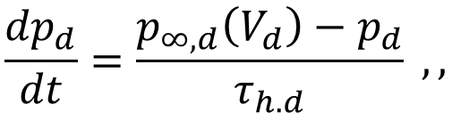
大規模スパイキングネットワークに対するGPUシミュレー ション法の計算速度と精度の評価
Evaluation of computing speed and accuracy of a GPU-simulation method
for large-scale spiking neural networks 奥野 舜(Shun Okuno) 樫森 与志喜(Yoshiki Kashimori) 藤田 一寿(Kazuhisa Fujita)
電気通信大学大学院 情報理工学研究科, 津山高専 情報工学科
2P-372
Abstract
Results
To understand the processing mechanisms of sensory information in the brain, it is necessary to simulate a huge size of network that consists of complicated neuronal model imitating the actual neurons. However, such a simulation requires a very long computation time, failing to perform computer simulation with a realistic time scale. In order to solve the problem of computation time, we focus on the reduction of computation time by GPGPU, providing an efficient method for simulation of huge number of neurons. In this paper, we develop a computational architecture of GPGPU, by which computation of neurons is performed in parallel. Using this architecture, we show that the GPGPU method significantly reduces the computation time of neural simulation. We also show that the simulations with single and double float precision give little significant difference in the results, independently of the neuron models used. These results suggest that the GPGPU calculation with single float precision is most efficient method for simulation of a huge size of neural network.
1. Computation time of four types of SNNs
CUDA
OpenMP
Introduction
Fig5. Computation time of four SNNs for CUDA (A) and Open MP (B) methods.
GPGPU
GPGPU is a computation method in which a high processing power of graphic processing unit (GPU) is utilized to perform general purpose computing (GP) . It has a high performance in parallel computing and high operational processing. We used a CUDA developed by Nvidia Comp. to perform a GPGPU calculation , which is a platform for parallel computing and achieve a high speed computation by a computing process shown in Fig. 1.
2. Comparison of computation time for two different methods
Memory
1.Copying data of processing
Memory of GPU
CPU
4.Copying result data
2.Control of processing
LIF model
2-comp-model
GPU
Machine specs
CPU : Intel® Xeon E5-2630 v2, 2.60GHz 12core
GPU : NVIDIA GeForce GTX1080
Operating System : Linux distribution Ubuntu 16.06
Programming language : C++(GCC/G++ 5.4.0) with OpenMP and CUDA toolkit 7.5
3.Processingon GPU core
CUDA Core
Fig1. Flow oｆ CUDA. Processing
Fig.6 Computation time of a LIF network (A) and a 2-compartment network (B) for CUDA and Open MP.
3. Effect of data-transfer process on computation time
What are our problems?
1. How is computation time affected by computational architectures and neuron models?
2. To what extent does date-transfer process affect computation time? 3. How much accuracy does computation with a single and double precision floating points yield in computation time?
Fig.7 Computation time of a LIF network and a 2-compartment network in the presence and absence of data-transfer process.
Method
4. Comparison of computation accuracy for a single and double precision floating points
(A) Computation time of two neuron models in both floating types
(C) Hodgkin-Huxley model
Spike pattern(single)
Parallelize
Parallelize
Spike pattern (Double)
Difference
Fig4. Flow of CUDA processing . The process is performed by data transfer between memory and graphic board, which differs fundamentally from the Open MP.
(B) LIF model
Interspike
Interval(ISI)
Single, double
Fig3. Flow of CPU. processing. (A) A single CPU unit. (B) Open MP.
Neuron model used
Izhikevich neuron model
(D) 2-compartment model
Result
$$\frac{dv}{dt}=0.04v^{2}+ 5v+140−u+I ,$$
Spike pattern (single)
$$\frac{du}{dt}=a\left(bv − u\right) ,$$
ISI(single)
Spikes data
Input
Neuron model
2-compartment model [1]
Spike pattern (Double)
Fig2. A spiking neural network model
$$\frac{dV_{s}}{dt}=I_{s}+g_{Na,s}{∙m}_{∞,s}^{2}\left(V_{s}\right)∙\left(1−n_{s}\right)∙\left(V_{Na}−V_{s}\right)$$
$$+g_{Dr,s}∙n_{s}^{2}∙\left(V_{K}−V_{s}\right)$$
$$+\frac{g_{c}}{κ}∙\left(V_{d}−V_{s}\right)+g_{leak}∙\left(V_{l}−V_{s}\right) ,$$
ISI(double)
Leaky integrated-and-fire model
Difference
$$τ\frac{dV\left(t\right)}{dt}=−V\left(t\right)+RI\left(t\right)$$
$$\frac{{dn}_{s}}{dt}=\frac{n_{∞,s}\left(V_{s}\right)−n_{s}}{τ_{n,s}} ,$$
Hodgkin-Huxley model
$$\frac{dV_{d}}{dt}=g_{Na,d}{∙m}_{∞,d}^{2}\left(V_{d}\right)∙h_{d}∙\left(V_{Na}−V_{d}\right)$$
$$+g_{Dr,d}∙n_{d}^{2}∙p_{d}∙\left(V_{K}−V_{d}\right)$$
$+\frac{g_{c}}{\left(1−κ\right)}∙\left(V_{s}−V_{d}\right)+g_{leak}∙\left(V_{l}−V_{d}\right) ,$
$$C_{m}\frac{dV}{dt}=g_{Na}m^{3}h∙\left(E_{Na}−V\right)+g_{K}n^{4}\left(E_{K}−V\right)$$
$$+g_{L}\left(E_{L}−V\right)+I_{stim} ,$$
Conclusions
$$\frac{dm}{dt}=a_{m}\left(V\right)\left(1−m\right)−b_{m}\left(V\right)m ,$$
$$\frac{{dh}_{d}}{dt}=\frac{h_{∞,d}\left(V_{d}\right)−h_{d}}{τ_{h.d}} ,,$$
GPU computation has the best performance for simulation of large-scale networks, whereas Open MP shows the best performance for simulation of smaller size of networks.
2. Data transfer process can be a key process for accelerating GPU computation.
Computational performance with single precision provides accuracy enough to study the dynamical property of a large-scale spiking neural network. In summary, GPU architecture with single precision would offer a powerful architecture for simulation of a large scale spiking network.
$$\frac{dh}{dt}=a_{h}\left(V\right)\left(1−h\right)−b_{m}\left(V\right)h ,$$
$$\frac{{dn}_{d}}{dt}=\frac{n_{∞,d}\left(V_{d}\right)−n_{d}}{τ_{h.d}} ,$$
$$\frac{dn}{dt}=a_{m}\left(V\right)\left(1−n\right)−b_{n}\left(V\right)n ,$$
$$\frac{{dp}_{d}}{dt}=\frac{p_{∞,d}\left(V_{d}\right)−p_{d}}{τ_{h.d}} ,,$$
References
[1] Doiron, B. et al.: Ghostbursting: A novel burst mechanism. J Comput Neurosci. 12, 5-25 (2002)
[2] Okuno et al. GPGPU-accelerated simulation and accuracy evaluation for various neuron models. IEICE Tech Report *** (2016)

