Slide 1
Planning

Slide 2
PasswordManager (SPA) project is aimed at managing Passwords and saving them for different accounts.
This project is intended to help users track and manage their passwords.
Application addresses the challenges of managing and securing online accounts by offering a centralized solution for password storage.
With the increasing number of services requiring unique passwords, many users resort to weak or reused passwords, compromising security.
This application provides encrypted storage and encourages people to use strong passwords when they are creating their account, allowing users to securely store, manage, and retrieve their passwords.

Slide 3
Key Features
Key features include User authentication with registration and login, encrypted password storage, a user-friendly interface for adding, viewing, editing, and deleting.

Slide 4
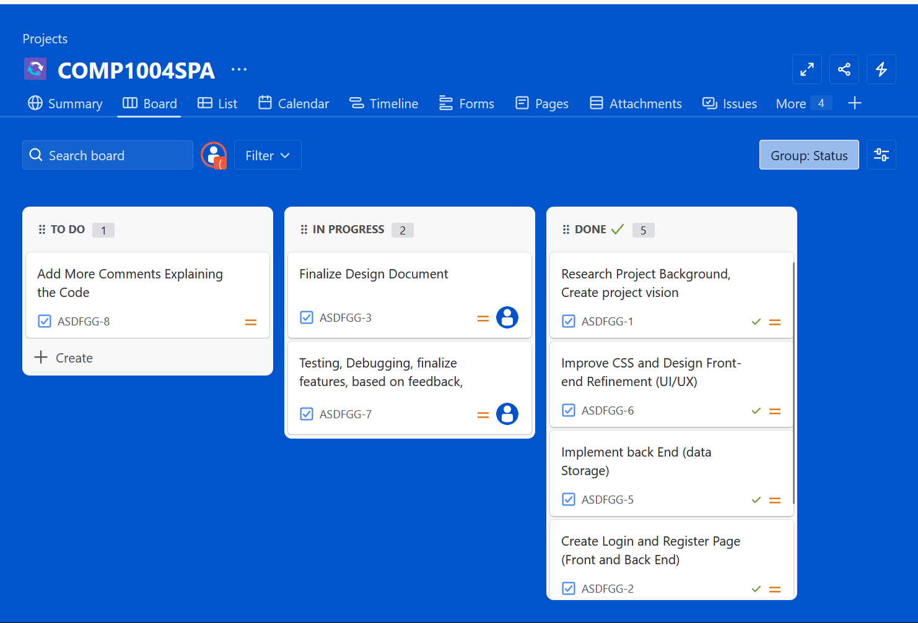
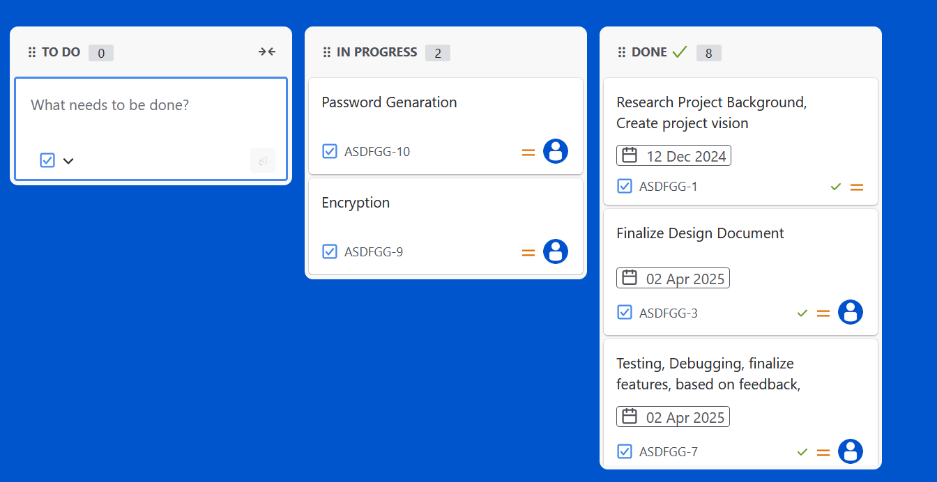
Sprint Plan Iterations

Slide 5
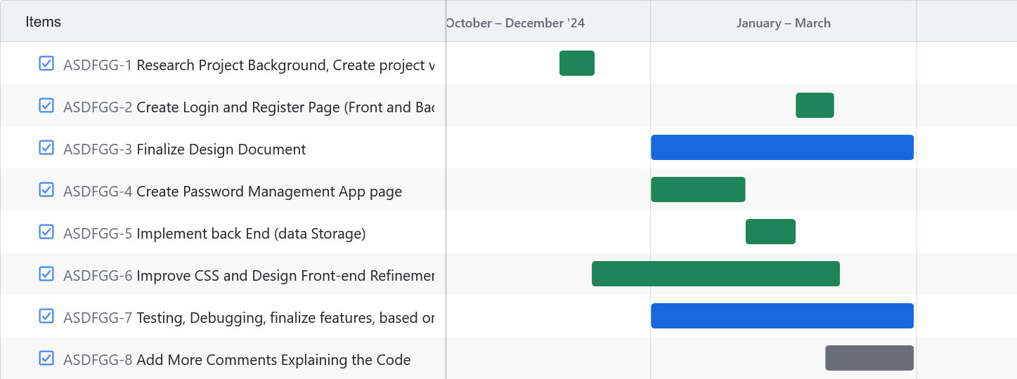
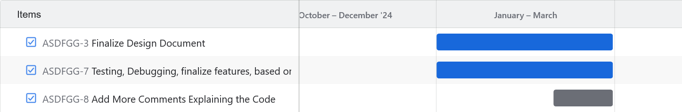
Iteration Timelines
Plan
Design
Develop
Test
Deploy

Slide 6
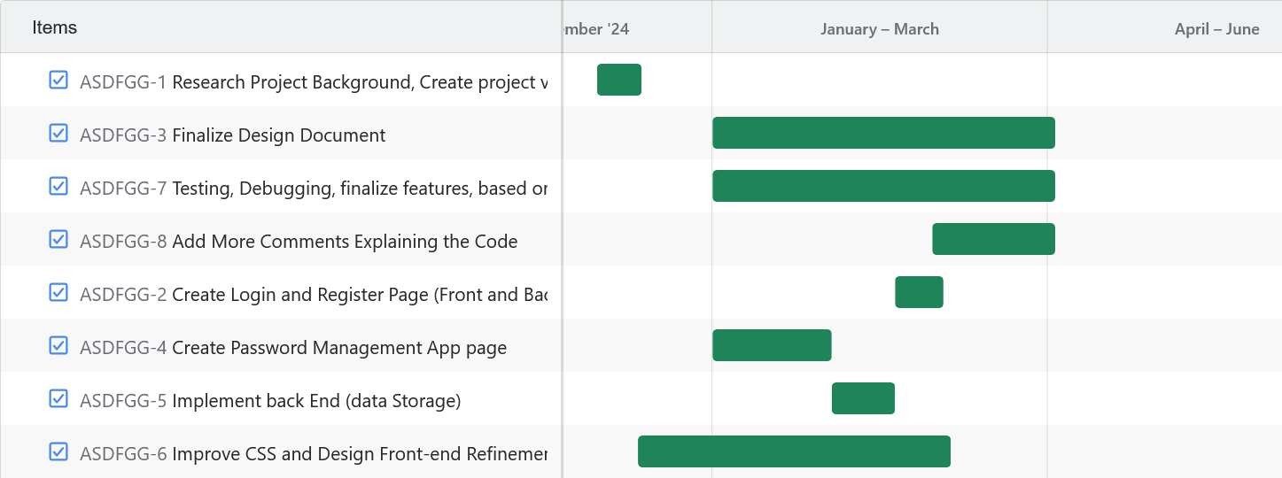
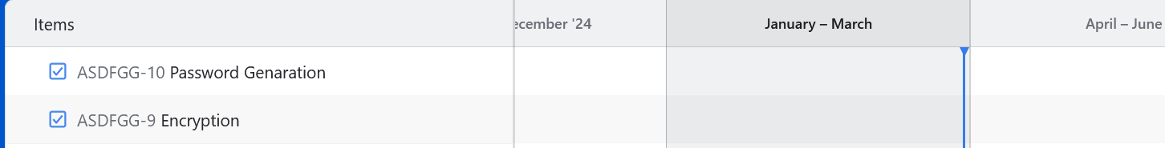
Iteration Timeline Progress
.
.
.

Slide 7
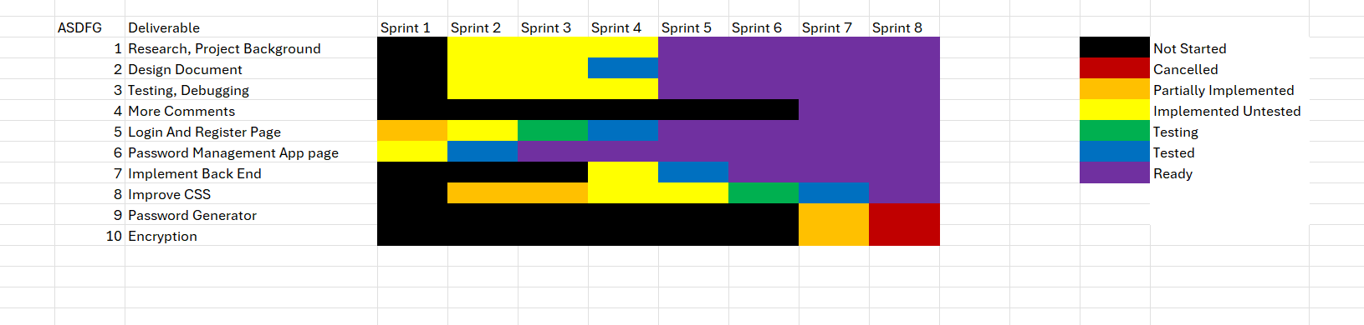
Sprint Table

Slide 8
Requirement Analysis and Design

Slide 9
I chose to observe the way the Websites are done in real world environment
For This I interviewed people to find the requirements and Based on the feedback received from the questionnaire and interviews, I have outlined the following finalized requirements
Registration and login functionality with secure data handling is a must as every user needs to have their own unique way of seeing their data its also protects the user from getting their passwords stolen
Implementation of strong encryption for storing user passwords is also another point as it’s a must have as Laws for protecting the data of the users is strict.
A clear interface for managing passwords is a must have
A password strength measuring for creating strong passwords will be included.
Lastly the project will be developed using an agile methodology

Slide 10
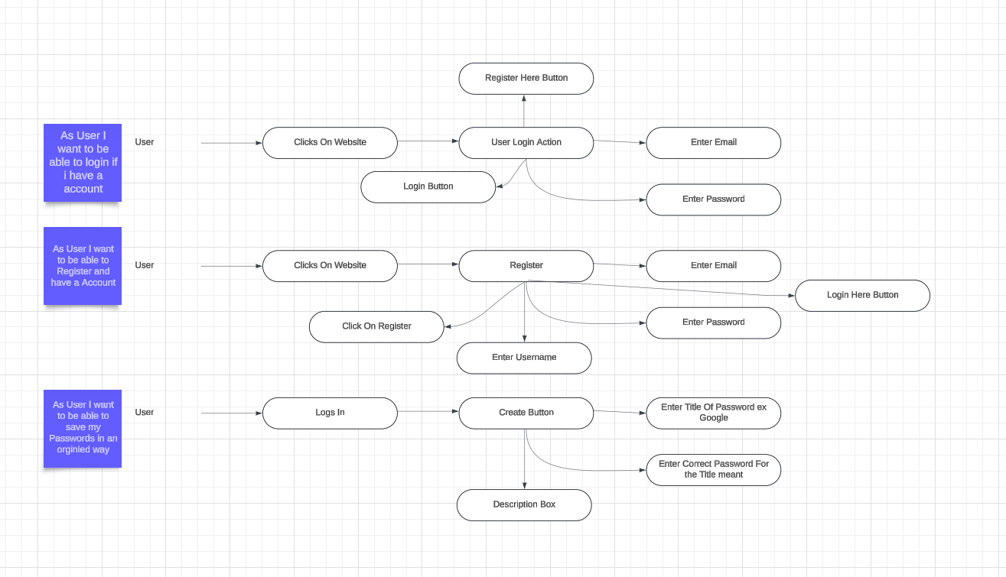
User Diagram

Slide 11
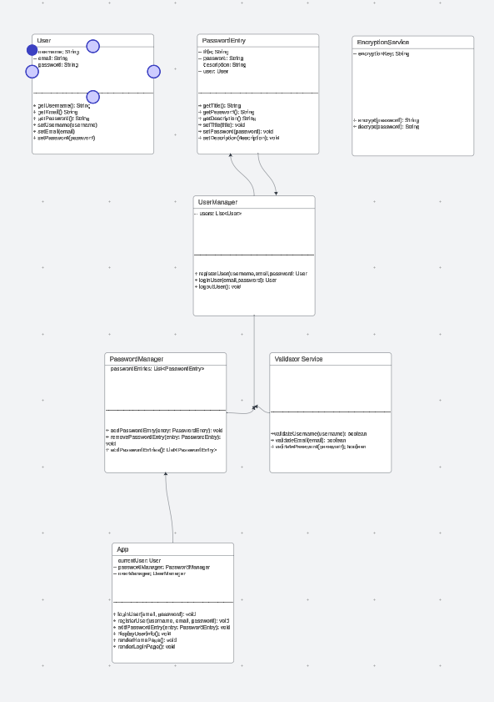
Class Diagram
Class Diagram Overview:
User class: Contains user-specific data such as email, username, and password.
Password Entry class: Contains details about individual passwords, including title, password, and description.
Encryption Service class: Handles encrypting and decrypting passwords to ensure sensitive data is secure.
User Manager class: Manages user-related operations like registration, authentication, and password entry management.
Password Manager class: Manages password entries, storing and retrieving them for a particular user.
Validator Service class: Ensures the correctness and security of inputs such as usernames, emails, and passwords.
App class: Manages the overall application workflow (e.g., logging in a user, rendering pages, etc.).

Slide 12
Breakdown of Interactions:
User -> Password Entry:
A User can have multiple Password Entry objects. This relationship is represented as a one-to-many relationship (one user, many password entries).
User Manager: User Manager is responsible for handling User objects (e.g., creating, authenticating, and logging out users).
It interacts with the User class to authenticate and register users.
Password Manager: Password Manager is responsible for managing the password entries for each user. It stores multiple Password Entry objects and provides functions like adding, removing, and retrieving entries.
Password Manager interacts with User Manager to ensure that password entries are associated with the correct user.
Encryption Service: Encryption Service provides security for the password entries by encrypting the password before storing it and decrypting it when retrieving it.
The Password Entry objects call the Encryption Service when a password is added or retrieved, ensuring passwords are never stored in plaintext.
Validator Service: Validator Service is responsible for validating user input, such as checking the validity of a username, email, and password (e.g., ensuring strong password rules or proper email format).
User Manager uses Validator Service to ensure inputs are valid when users register or update their profile.
App: App is the central controller of the application and interacts with the User Manager, Password Manager, and Encryption Service to manage the overall application flow.
The App class can log in users, register new users, add new password entries, and render various pages based on user interactions.

Slide 13
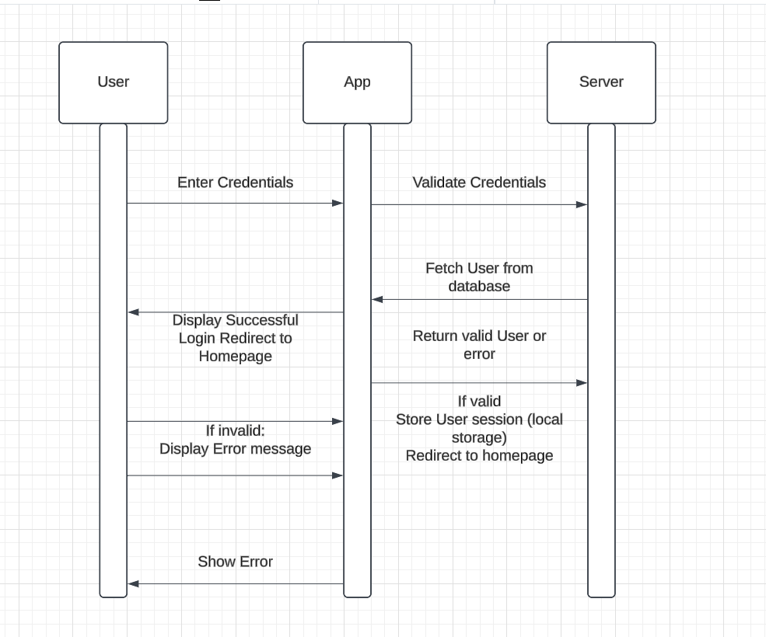
Sequence Diagram

Slide 14
Issues/challenges faced

Slide 15
Cybersecurity and Legal Issues
Due to the technological constraints, it was not possible to implement some of the security features.
This created a situation where, although the website could store passwords, it did so in an insecure manner, which violated key cybersecurity principles around data protection and user privacy.
A good cybersecurity framework would typically involve using encryption to secure passwords, implementing secure communication protocols like HTTPS, and ensuring proper user authentication.
Without these security features, the project was not able to meet the expectations of users typically expected of a password manager.
From a legal perspective, this causes issues as well, particularly concerning data protection laws like GDPR.

Slide 16
Technological Constraints
One of the most significant constraints was the limitation to only use Java, HTML, and CSS.
Initially, I had a bigger vision for the website, considering the use of TypeScript, React and server-side languages like Python and extensions for encryption and password generation.
However, the restriction to only Java, HTML, and CSS created challenges.
For example, encryption an important feature for securing stored password could not be properly implemented within the boundaries of these technologies.
Without encryption, the security of the password manager was compromised, as password are stored in plain text, making the system vulnerable to attacks.
Also, These Restrictions prevented us from using any frameworks that could have helped speed up development and provided stronger security features which most industry professional’s use.

Slide 17
Time Constraints and Project Adjustments
I had to make several difficult decisions regarding which features were feasible to implement in the given time.
I underestimated the required time to implement features within the limited technological constrains.
Some features, such as encrypted password storage had to be removed from the project due to time limitations.
Additionally, my personal time constraints played a significant role in the project’s progress. With a part-time job requiring me to work availability to leave time to the project was limited.
Balancing work and academic responsibilities made it challenging to meet project sprints and deadlines, which delayed some features or outright cancelled them
The confusion surrounding what technologies were allowed also added to the projects missing key features.
According to my interview previous year’s students had used a wider range of technologies during their sprint meetings, leading most students (me being included) to assume they could integrate those same tools.
Unfortunately, this assumption was incorrect, which caused confusion and further delayed progress.
.

Slide 18
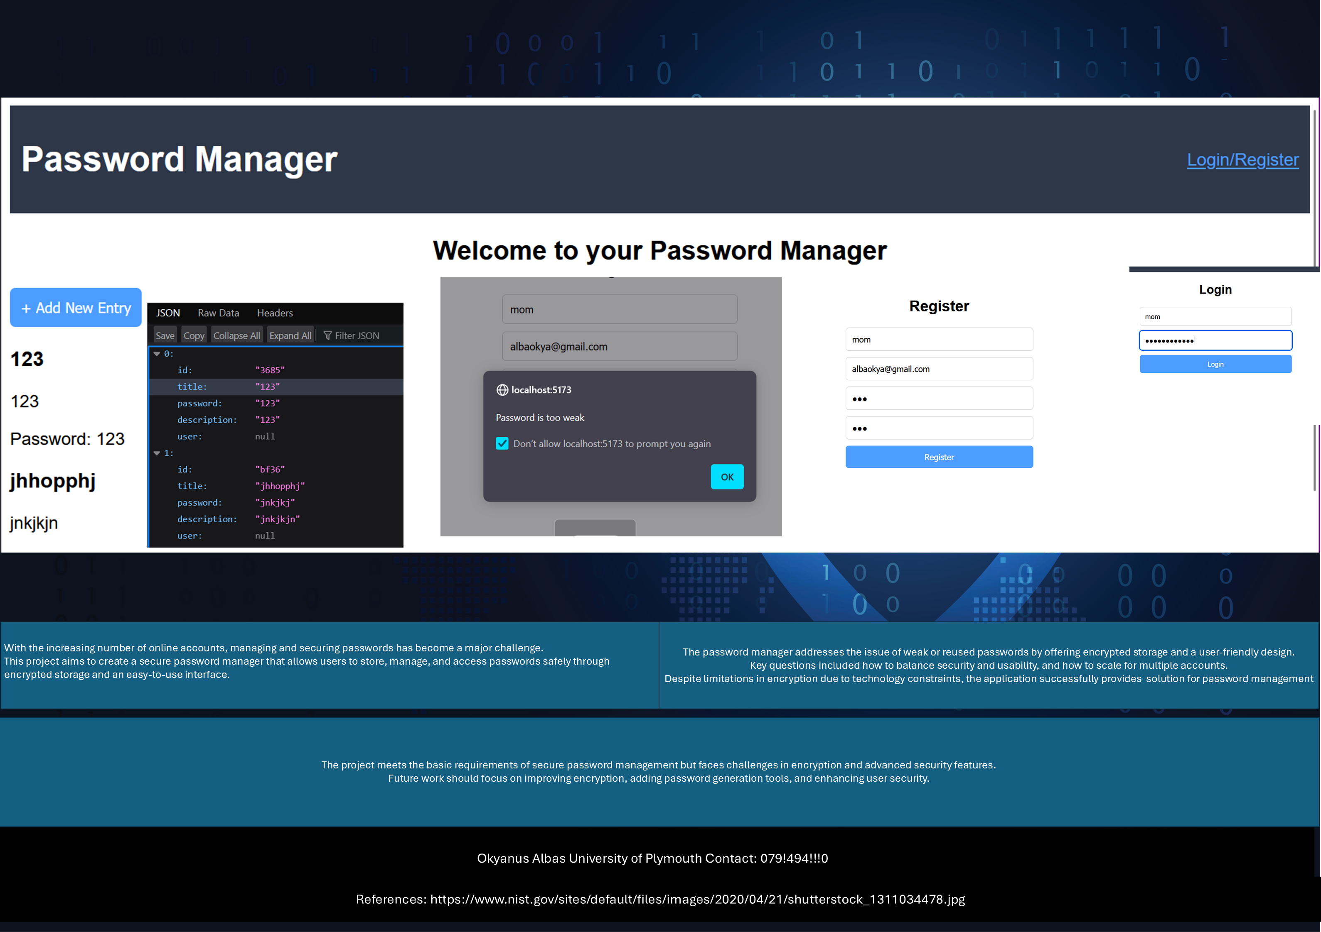

Slide 19

Questions ?

