Slide 1
COMP1004SPA Video Presentation

Slide 2
Introduction
This report presents the plan for my COMP1004 module project, which focuses on creating a single-page application (SPA) aimed at managing Passwords and saving them for different accounts. This project is intended to help users track and manage their passwords.
The report will outline the project vision and UML diagrams along with Prototype Demonstration. The presentation also discusses the challenges faced, the planning process, and how I approached the development of the application and several others.

Slide 3
Project Vision and Project Background
The PasswordManager application addresses the challenges of managing and securing online accounts by offering a centralized, secure solution for password storage. With the increasing number of services requiring unique passwords, many users resort to weak or reused passwords, compromising security. This application provides encrypted storage, strong authentication, and a password generation tool, allowing users to securely store, manage, and retrieve their passwords.
Key features include:
User authentication with registration and login.
Encrypted password storage.
Password generation for creating strong, random passwords.
A user-friendly interface for adding, viewing, editing, and deleting passwords.
Password categorization and search functionality for easy access.
Backup and recovery options to protect user data.
Targeting individuals seeking to enhance online security, the app aims to make password management both secure and convenient by ensuring compliance with industry-standard encryption. By addressing rising security threats and promoting good password hygiene, PasswordManager helps safeguard online identities and sensitive information. Feedback from staff and peers will refine the project to meet security and usability standards.

Slide 4
Sprints Carried Out to Date
Sprints | Task To Complete | TimeLine | Status
Sprint 1 | Research Project Background, Create project vision | Week 1 ((01/12/2024)- (06/12/2024)) | Completed
Sprint 2 | Create Login and Register Page (Front and Back End) | Week 2 ((06/12/2024)- (14/12/2024)) | Completed
Sprint 3 | Finalize Design Document | Week 3 ((07/01/2025)- (Current)) | Uncompleted
Sprint 4 | Create Password Management App page | Week 3 ((…)-(…)) | Uncompleted
Sprint 5 | Implement back End (data Storage) | Week 4 ((…)-(…)) | Uncompleted
Sprint 6 | Improve CSS and Design Front-end Refinement (UI/UX) | Week 5 ((…)-(…)) | Uncompleted
Sprint 7 | Testing, Debugging, finalize features, based on feedback, final presentation. | Week 6 ((…)-(…)) | Uncompleted

Slide 5
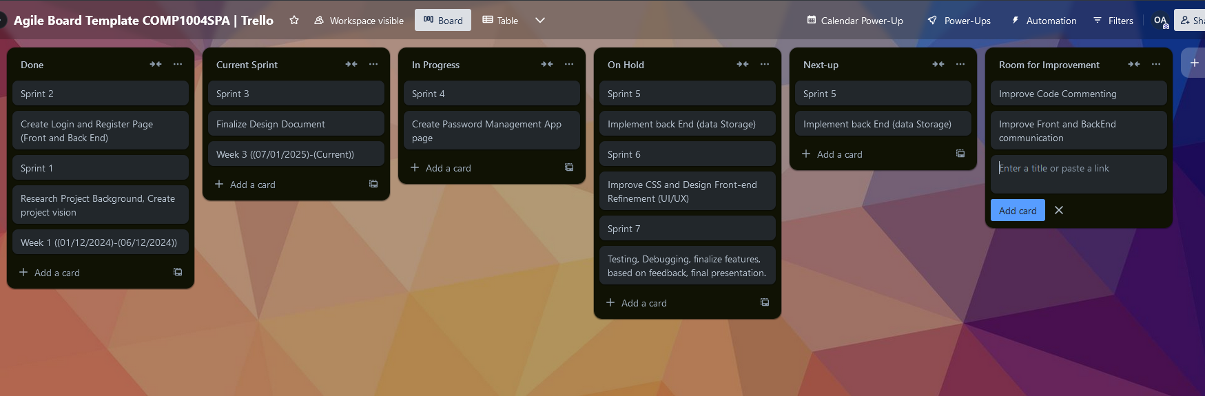

Slide 6
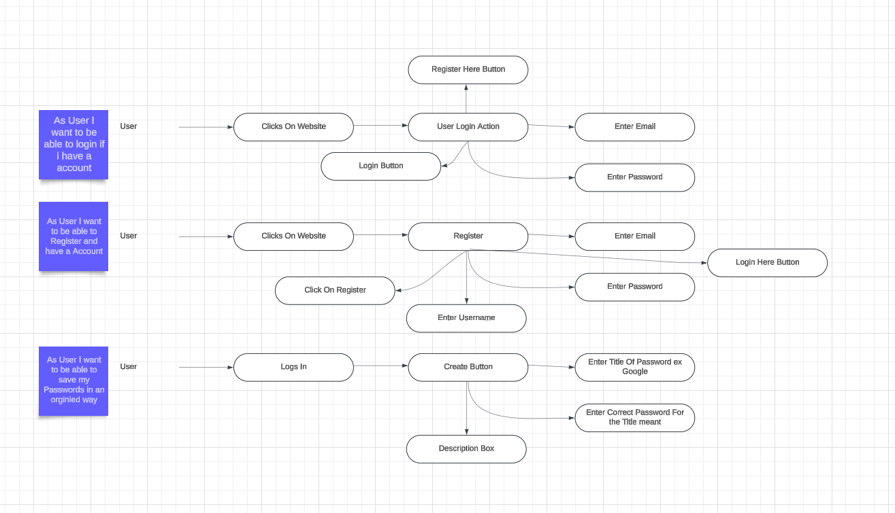
Use Case Diagram

Slide 7
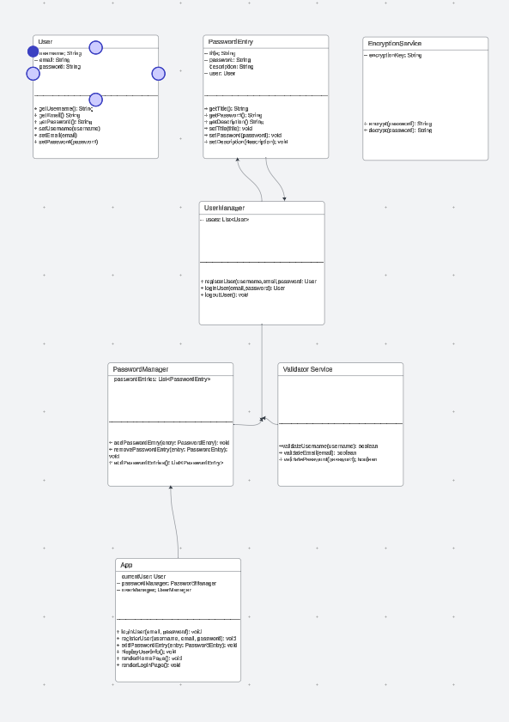
Class Diagram
User → PasswordEntry: A User can have multiple PasswordEntry objects. This relationship is represented as a one-to-many relationship (one user, many password entries).
UserManager: UserManager is responsible for handling User objects (e.g., creating, authenticating, and logging out users). It interacts with the User class to authenticate and register users.
PasswordManager: PasswordManager is responsible for managing the password entries for each user. It stores multiple PasswordEntry objects and provides functions like adding, removing, and retrieving entries.
PasswordManager interacts with UserManager to ensure that password entries are associated with the correct user.
EncryptionService: EncryptionService provides security for the password entries by encrypting the password before storing it and decrypting it when retrieving it. The PasswordEntry objects call the EncryptionService when a password is added or retrieved, ensuring passwords are never stored in plaintext.
ValidatorService: ValidatorService is responsible for validating user input, such as checking the validity of a username, email, and password (e.g., ensuring strong password rules or proper email format). UserManager uses ValidatorService to ensure inputs are valid when users register or update their profile.
App: App is the central controller of the application and interacts with the UserManager, PasswordManager, and EncryptionService to manage the overall application flow. The App class can log in users, register new users, add new password entries, and render various pages based on user interactions.

Slide 8
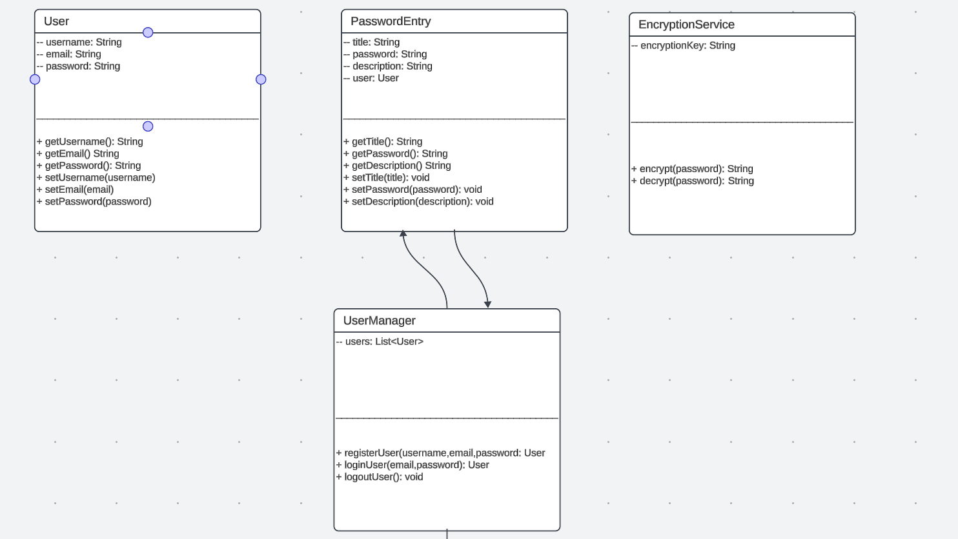
Class Diagram Zoomed

Slide 9
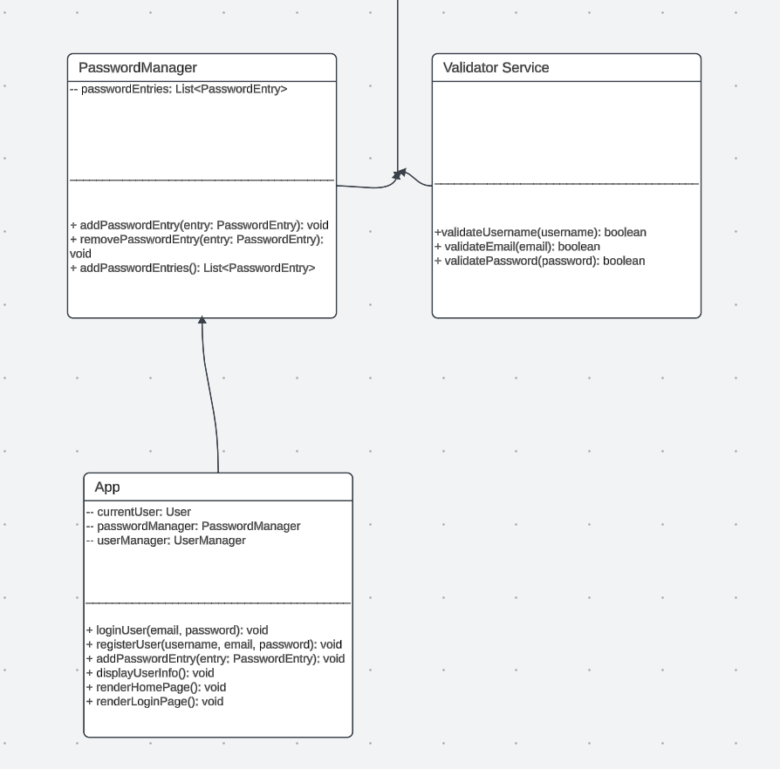

Slide 10
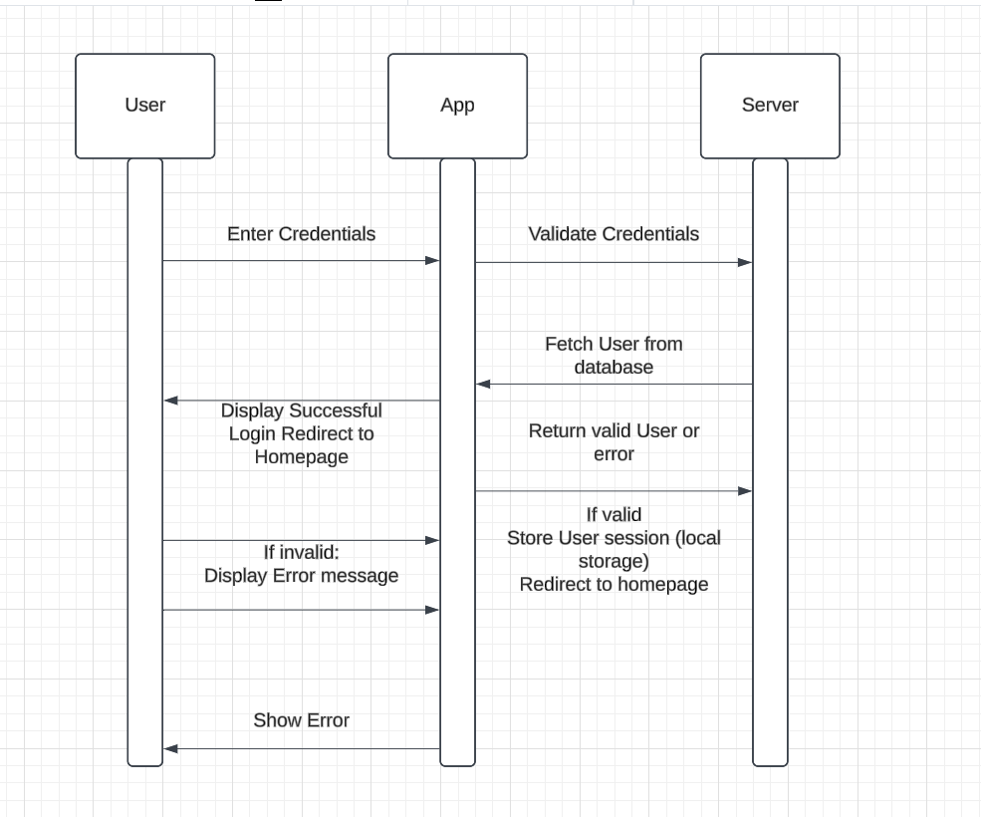
Sequence Diagram

Slide 11
An Initial Prototype Running (Demonstration)

Slide 12
Issues and Constraints
Challenges faced during development include:
Learning and implementing secure password encryption (Not implemented yet). Being Worked On
Ensuring the app works across multiple devices and browsers.
Time Management was a problem as I am juggling 2 jobs + University coursework so far it was the biggest constrain I have ever faced.
Money was another problem as my Student Finance isn’t approved yet I have to work to pay my university and Rent.
Coursework Restriction (Not Being able to use technologies other then html, JavaScript and CSS as coursework restricts what we can use as we are only allowed to use technologies we did in lecture. This is important because technologies we are not able to use might significantly reduce of development time.

