Slide 1

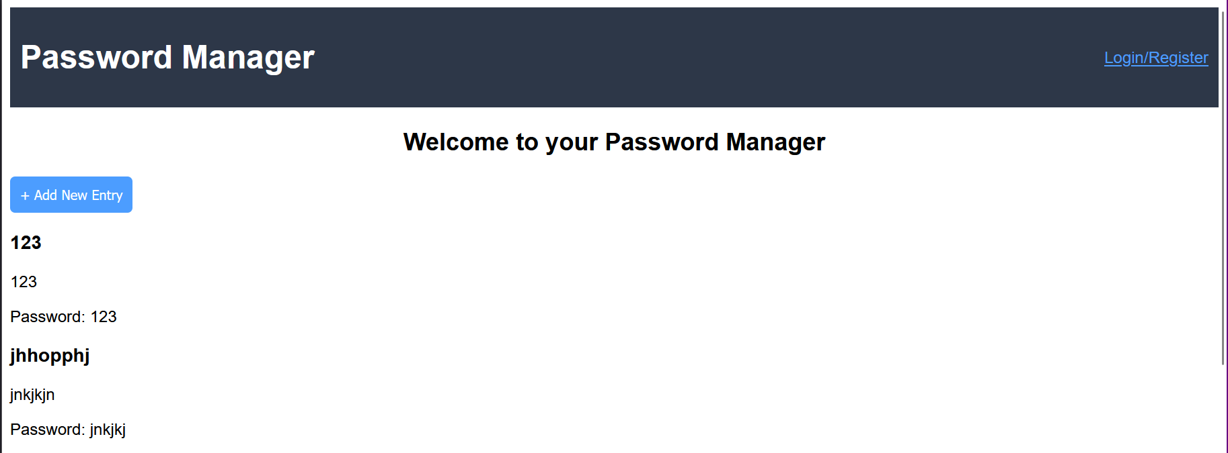
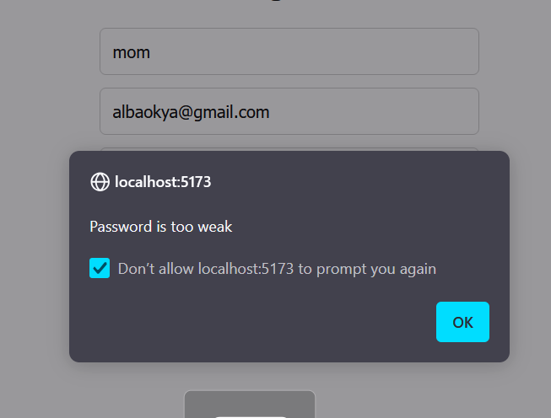
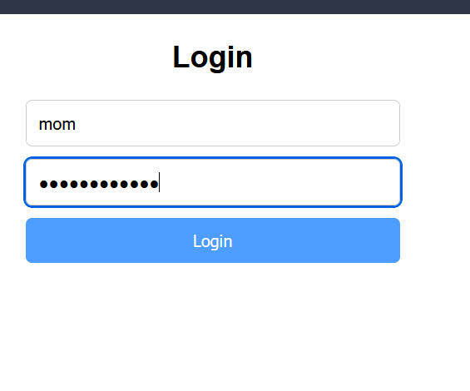
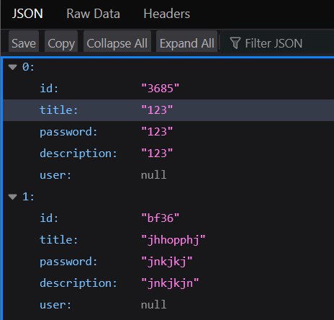
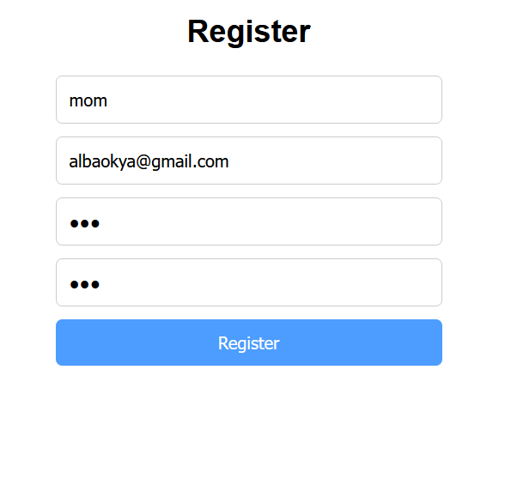
With the increasing number of online accounts, managing and securing passwords has become a major challenge.
This project aims to create a secure password manager that allows users to store, manage, and access passwords safely through encrypted storage and an easy-to-use interface.
The password manager addresses the issue of weak or reused passwords by offering encrypted storage and a user-friendly design.
Key questions included how to balance security and usability, and how to scale for multiple accounts.
Despite limitations in encryption due to technology constraints, the application successfully provides solution for password management
The project meets the basic requirements of secure password management but faces challenges in encryption and advanced security features.
Future work should focus on improving encryption, adding password generation tools, and enhancing user security.
Okyanus Albas University of Plymouth Contact: 079!494!!!0
References: https://www.nist.gov/sites/default/files/images/2020/04/21/shutterstock_1311034478.jpg

