Slide 1
COMP1004SPA Video Presentation

Slide 2
Introduction
This report presents the plan for my COMP1004 module project, which focuses on creating a single-page application (SPA) aimed at managing Passwords and saving them for different accounts. This project is intended to help users track and manage their passwords.
The report will outline the Software Development Lifecycle (SDLC) and its application to the project. Additionally, I will present the design document, including the project vision, system architecture, and UML diagrams. The document also discusses the challenges faced, the planning process, and how I approached the development of the application and several others.

Slide 3
Project Vision and Background (Introduction)
Purpose: Clearly articulate the problem you're solving with your SPA project.
Key Points:
What is the project? Describe what your single-page web application does.
Why is it important? Explain why your project matters, especially in terms of its relevance to your field of study. Discuss the problem or need it addresses. For example, if your SPA is a task management tool, explain how it can improve productivity or efficiency.
Target audience: Who is the end-user? Why would they find your solution valuable?
Tip: Keep this section concise but informative. It’s the context for your entire project, so aim to explain it in a way that engages the viewer.

Slide 4
Project Vision
Project Overview:
The PasswordManager application is designed to help users store, manage, and retrieve passwords for various online accounts securely. The application aims to provide an easy-to-use interface for storing encrypted passwords and supports generating strong, random passwords.
Target Users: • Individuals seeking a secure and easy way to store and manage multiple passwords. • Users who want to enhance their online security by using strong, unique passwords for each account.
Core Features: • User authentication with registration and login functionality. • Secure password storage using encryption. • Password generation tool for creating strong, random passwords. • User-friendly interface to easily add, view, edit, and delete passwords. • Password categorization to organize accounts. • Search functionality to quickly find stored passwords. • Backup and recovery options for user data.
Feedback: The project vision will be refined and presented during meetings with module staff and possibly fellow students to ensure it meets both security and usability standards.

Slide 5
Project Background

Slide 6
Your Project Plan and Sprints Carried Out to Date
Purpose: Show how you’ve planned your project development so far.
Key Points:
Project Plan: Outline the phases of your project development. How did you plan your sprints?
Sprints: Briefly summarize the work you’ve completed in the initial sprints. What tasks were planned, and what have you accomplished? Be specific about deliverables you’ve completed in each sprint (e.g., project design, homepage, first feature implementation).
Tip: Mention any adjustments made to your plan based on the feedback you received or challenges you encountered.

Slide 7
Sprints Carried Out to Date
Sprints | Task To Complete | TimeLine | Status
Sprint 1 | Research Project Background, Create project vision | Week 1 ((01/12/2024)- (06/12/2024)) | Completed
Sprint 2 | Create Login and Register Page (Front and Back End) | Week 2 ((06/12/2024)- (14/12/2024)) | Completed
Sprint 3 | Finalize Design Document | Week 3 ((07/01/2025)- (Current)) | Uncompleted
Sprint 4 | Create Password Management App page | Week 3 ((…)-(…)) | Uncompleted
Sprint 5 | Implement back End (data Storage) | Week 4 ((…)-(…)) | Uncompleted
Sprint 6 | Improve CSS and Design Front-end Refinement (UI/UX) | Week 5 ((…)-(…)) | Uncompleted
Sprint 7 | Testing, Debugging, finalize features, based on feedback, final presentation. | Week 6 ((…)-(…)) | Uncompleted

Slide 8
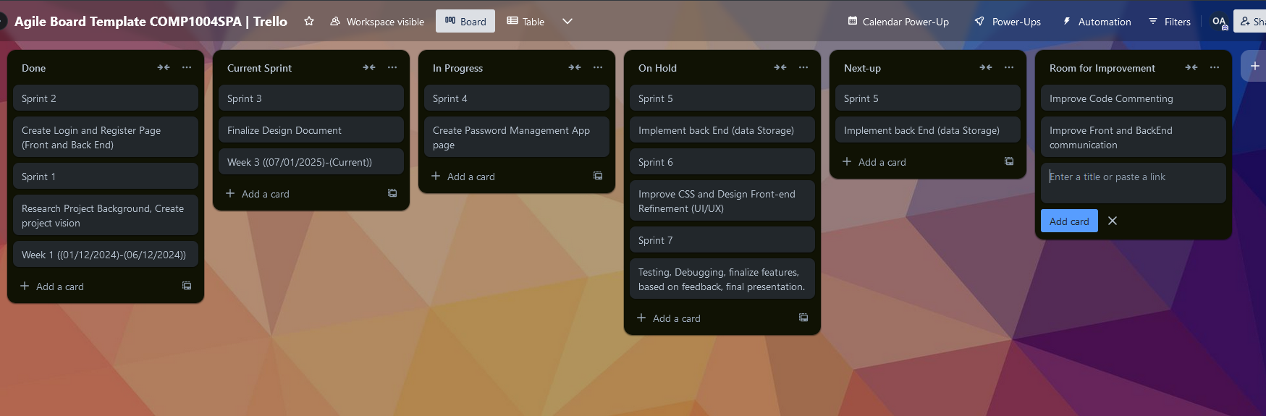

Slide 9
UML Models to Date
Purpose: Show your technical understanding of the project and how you've structured it.
Key Points:
UML Diagrams: Share your Use Case Diagram, Class Diagram, and any Interaction Diagrams you have worked on so far.
Explanation: Briefly explain the key elements of the diagrams. For example, for the Use Case Diagram, show how the user interacts with the system.
Tip: Make sure your UML diagrams are clear and easy to follow. Don’t just show the diagrams – describe their purpose and significance.

Slide 10
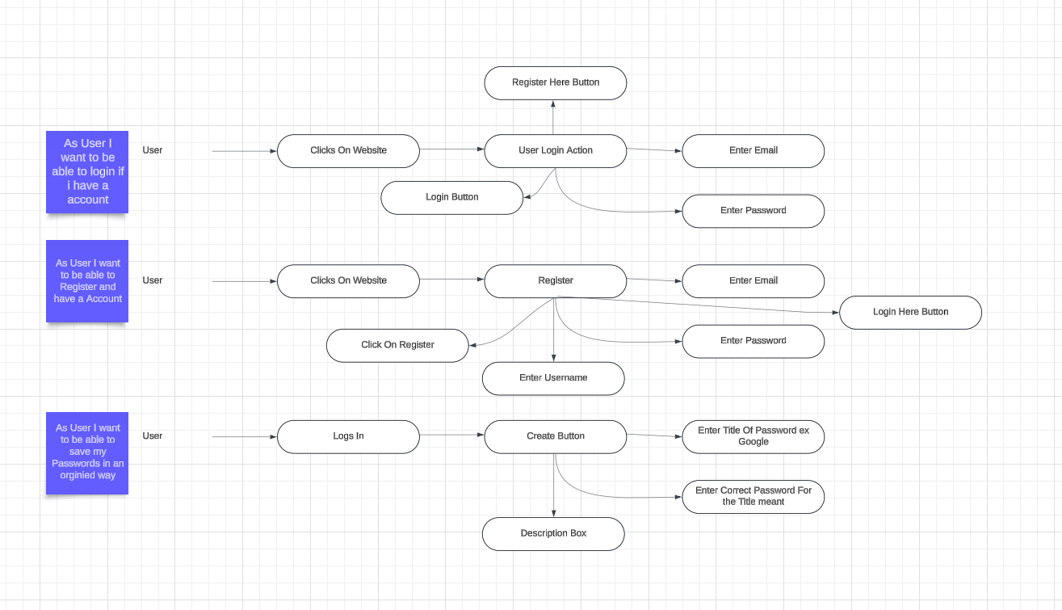
Use Case Diagram

Slide 11
Class Diagram

Slide 12
Sequence Diagram

Slide 13
An Initial Prototype Running (Demonstration)
Purpose: Show the prototype of your SPA, if possible, to give viewers a sense of what the project looks like in action.
Key Points:
Prototype demonstration: Showcase your homepage or any other functional aspect of your web application that you’ve implemented so far.
Tech stack: Briefly mention the technologies you're using (HTML, CSS, JavaScript, etc.).
Tip: If your prototype is still in progress, show what you have completed (e.g., the layout, homepage structure, some basic functionality). If there are bugs, acknowledge them and mention your plans to fix them.

Slide 14
Issues and Constraints
Challenges faced during development include:
Learning and implementing secure password encryption (Not implemented yet). Being Worked On
Ensuring the app works across multiple devices and browsers.
Time Management was a problem as I am juggling 2 jobs + University coursework so far it was the biggest constrain I have ever faced.
Money was another problem as my Student Finance isn’t approved yet I have to work to pay my university and Rent.
Coursework Restriction (Not Being able to use technologies other then html, JavaScript and CSS as coursework restricts what we can use as we are only allowed to use technologies we did in lecture.

