Slide 1

SMOKING DATASET
Groub number : 2
Groub names :
. Ola abu Saalek
. Sarah Kasasbeh
. Nermeen abu Snaineh

Slide 2
DATASET DISCRIPTION :
The dataset contain 55692 records and 27 attribute.
About smoking and analyze it
to explore the data relating to smoking habits ,health
and lifestyle factor
by understand and conclude the relationships
between them to generate visualize , predictive modeling
to help raising awareness, reduce the effects of smoking
on the individual and society and stop the smoking

Slide 3
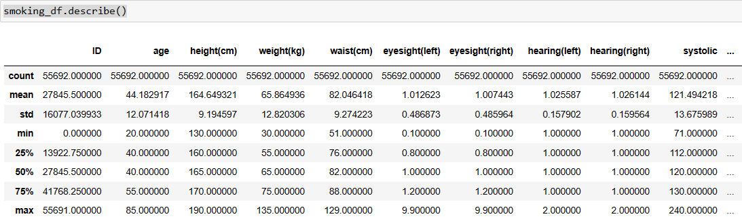
Result of datafram.describe()

Slide 4

Result of
datafram.shape

Slide 5
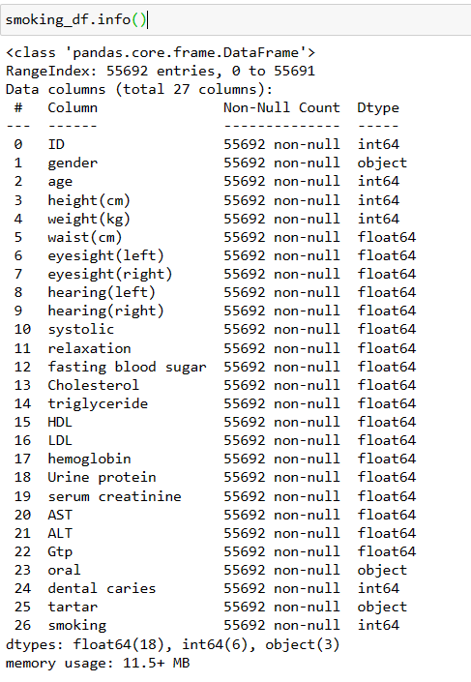
Result
of
datafram.info()

Slide 6
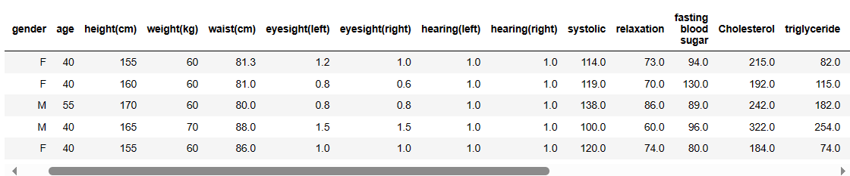
Dataset sample snapshot

Slide 7
DATASET
DEMO

Slide 8
REFERENCES :
kaggle
WWW

Slide 9
ANY
QUESTION
?

