Slide 1
Predicting Who Will Subscribe to a Bank Term Deposit
Can we predict whether a client will subscribe to a term deposit, based on demographic, financial, and previous campaign details for each client?
Bank Marketing — ML Classification Project
University of Toronto | Data Sciences Institute | Group 3
Dataset: UCI Bank Marketing (45,211 records, 2008-2010)
Project Team:
Morolake Nwokoro | Anthony Chude | Greg Ealeifo | Olga Drobushko

Slide 2
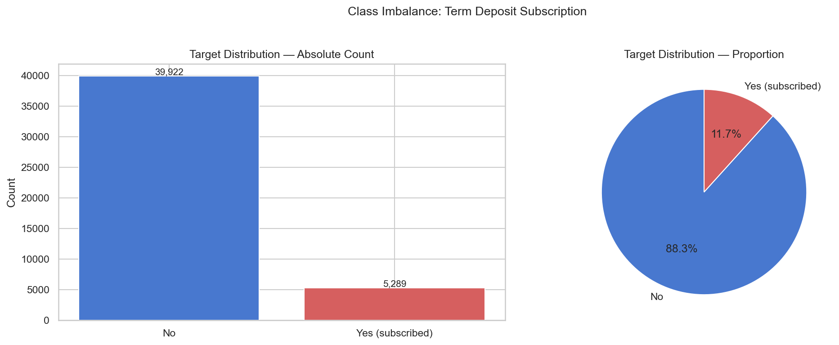
THE BUSINESS PROBLEM
88.3% of marketing calls are wasted
A Portuguese bank ran 45,211 client calls over 2 years.
Only 1 in 8.5 clients subscribed to a term deposit.
No way to predict in advance who would say YES.
>> Goal: Score clients BEFORE calling so sales teams focus only on likely subscribers.

Slide 3
The Dataset
UCI Bank Marketing (id=222) | Portuguese retail bank | May 2008 – Nov 2010
45,211
16
11.7%
2008-2010
Client Records
Input Features
Positive Rate (subscribed)
Campaign Period
Feature Groups
Demographic
age, job, marital, education
Financial
account balance, housing loan, personal loan, credit default
Campaign
number of contacts (campaign), days since last contact (pdays), previous contacts
Last Contact
contact type, month, day of month
Engineered
previously_contacted — binary flag from pdays=999 sentinel
EXCLUDED
duration (call length) — only known AFTER the call ends → data leakage

Slide 4
Our Approach: The End-to-End ML Pipeline Architecture
Automated | Reproducible | MLflow-tracked | Containerised with Docker
DATA SOURCE
PROCESS
OUTPUT & SERVE
6
EV
1
2
3
4
5
Evaluate
UCI
DL
CL
SP
TR
ROC-AUC, F1, Precision, Recall Confusion matrix + ROC curve Threshold analysis CSV reports/figures/*.png
UCI Repository
>>
Ingest
>
Preprocess
>
Split
>
Train
>>
Bank Marketing dataset 45,211 records Public, anonymised May 2008 - Nov 2010
Download via UCI API Save to CSV on disk Load to PostgreSQL raw_features table
Drop duration (leakage) Encode target yes/no Replace unknown -> NaN Engineer prev_contacted
Stratified 70/15/15 31,647 Train rows 6,782 Validation rows 6,782 Test rows
3 model classifiers 5-fold CV each model MLflow run logging Save .pkl to models/
v
7
DB
Store Results
Predictions -> PostgreSQL Experiment results -> PostgreSQL Models -> MLflow registry Artefacts -> mlflow/artifacts/
Platform
Docker Compose
PostgreSQL 16
MLflow 3.10
scikit-learn
uv
Containerised infrastructure
4-table data store
Experiment tracking & registry
ML pipeline (ColumnTransformer)
Locked dependency management

Slide 5
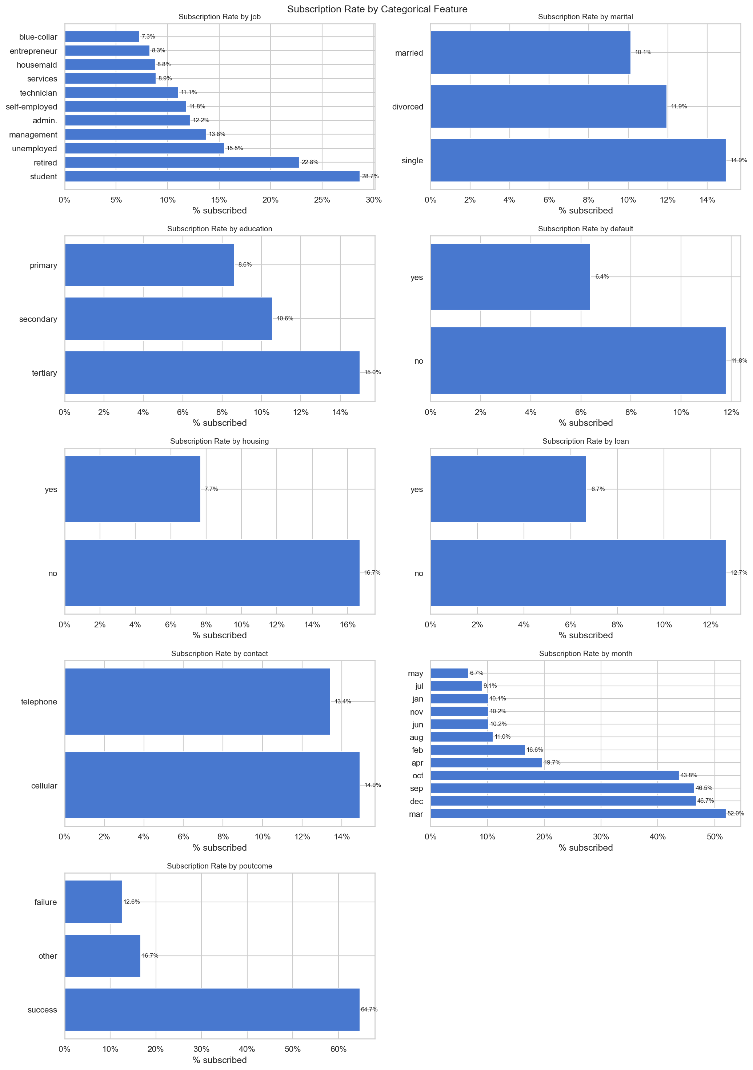
What the Data Tells Us
Key Insights
Previous campaign SUCCESS:
64.7% subscription rate (vs 11.7% baseline) — most actionable single signal
March & December peak:
Clients more open to term deposits at year-start/end
Students & Retired:
Highest subscription rate by job type — target them
No housing loan:
16.7% vs 7.7% for those with loans — indicates greater financial flexibility
Fewer prior contacts:
Success drops sharply after 3+ contact attempts — set outreach limits

Slide 6
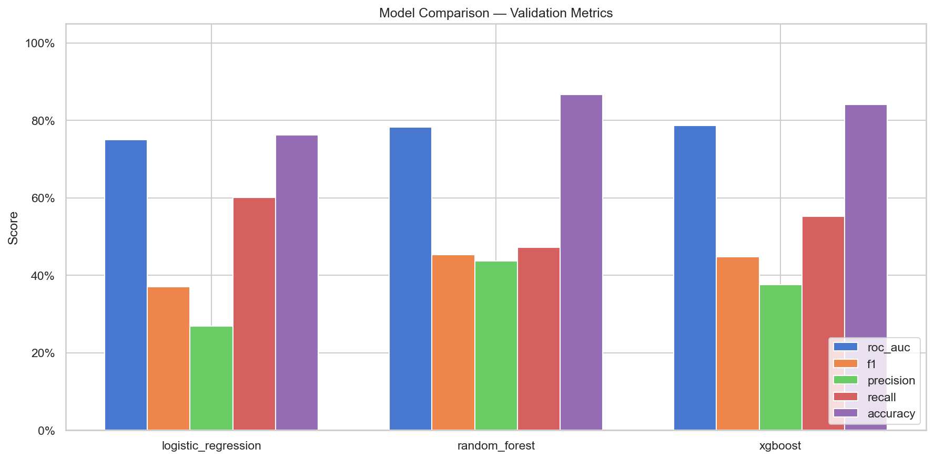
Three Models Compared
All trained with class-imbalance correction | 5-fold stratified cross-validation
Logistic Regression
ROC-AUC: 0.7719 F1: 0.378
Interpretable linear model. Balanced class weights. Good recall (0.64) but low precision.
Random Forest
ROC-AUC: 0.8036 F1: 0.471
300 estimators, balanced weights. Best overall ROC-AUC. Strongest balanced precision/recall.
XGBoost
ROC-AUC: 0.8022 F1: 0.463
scale_pos_weight=7 for imbalance. Close to Random Forest. Slightly higher recall.

Slide 7
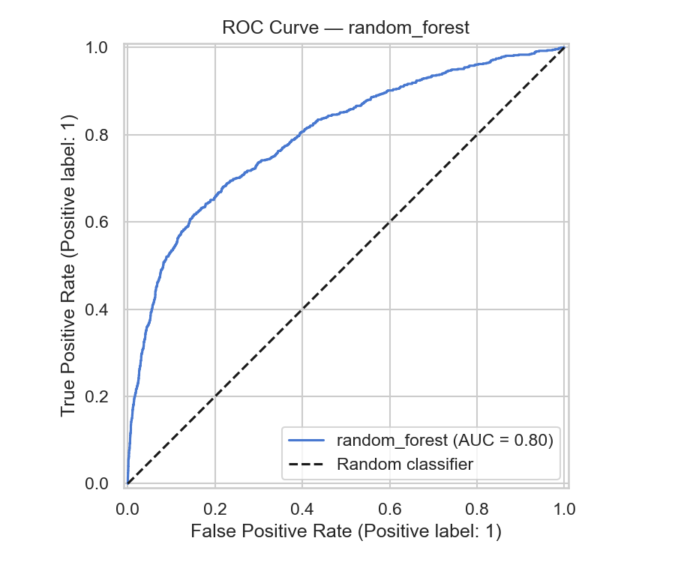
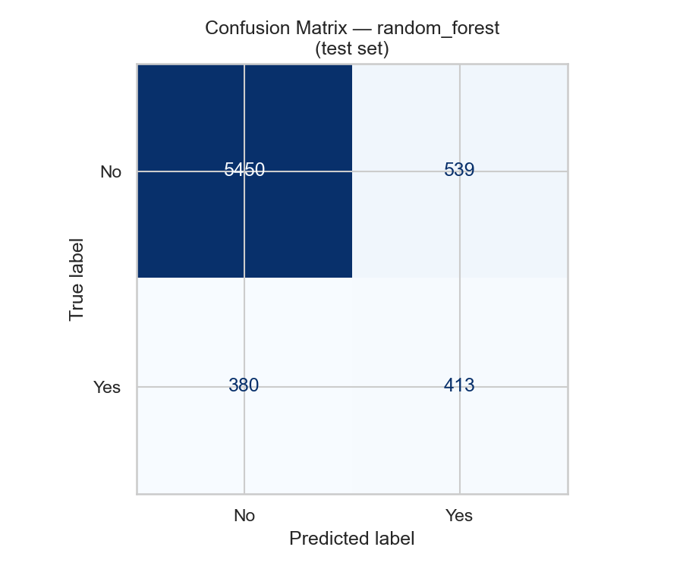
Best Model: Random Forest — Test Set (6,782 clients)
Held-out test set | Never seen during training or validation
AUC = 0.80 | Correctly identifies 52% of all actual subscribers
TP=413 FP=539 FN=380 TN=5450

Slide 8
Business Impact — Quantified
WITHOUT the Model
WITH the Model (Random Forest)
6,782
952
calls made across the test cohort
clients flagged as likely subscribers
793
413
actual subscribers in the test set
actual subscribers correctly captured
>>
11.7%
43.4%
success rate per call (baseline)
success rate — 3.7x improvement
5,989
86%
wasted calls — no subscription
reduction in wasted outreach calls
The model still captures 52% of ALL actual subscribers while reducing call volume by 86%

Slide 9
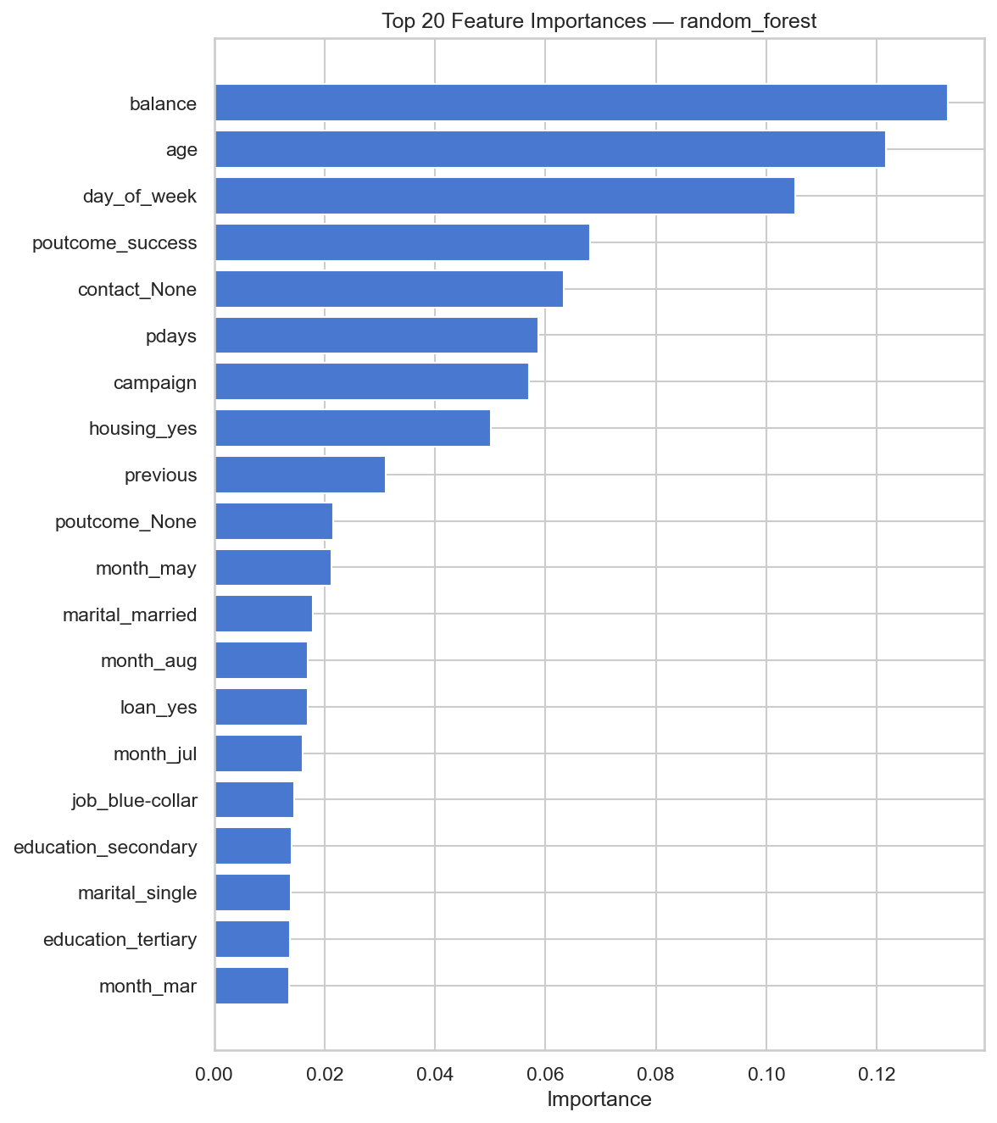
What Drives Subscription? — Actionable Insights from Feature Importance
Actionable Insights for Marketing
1. Account Balance (#1 driver)
Wealthier clients are more likely to invest. Segment campaigns by estimated wealth tier.
2. Client Age (#2 driver)
Middle-aged and retired clients subscribe most. Adjust messaging by life stage.
3. Previous Campaign Success (#4)
64.7% repeat rate. Re-contact previous subscribers first — highest ROI segment.
4. Number of Contacts (#7)
Diminishing returns beyond 3 contacts. Set a 3-call limit per campaign cycle.
5. Days Since Last Contact (#6)
Recent contacts are warmer leads. Prioritise clients contacted within 30 days.

Slide 10
Takeaways & Next Steps
Key Takeaways
If We Had More Time...
>> Random Forest: ROC-AUC = 0.80 on held-out test set
SHAP Explainability
Show per-client prediction drivers to support agent decision-making
>> 3.7x improvement in call success rate (43% vs 11.7% baseline)
Threshold Optimisation
Tune the 0.5 cutoff to maximise call-centre ROI given cost per call
>> 86% fewer calls needed to capture 52% of all actual subscribers
Hyperparameter Tuning
Bayesian search for RF/XGBoost; could push AUC above 0.82
>> Previous campaign success is the strongest actionable single predictor
Real-Time Scoring API
>> Balance + age enable wealth and life-stage targeting for personalized outreach
FastAPI endpoint: score a new client record before dialling
Fairness Audit
>> Full pipeline is reproducible end-to-end with Docker, MLflow, and PostgreSQL
Measure disparate impact across age, education, and job groups (SHAP)
MLflow UI: http://localhost:5000 | All code & data: see README | Group 3

Slide 11
Thank you!

