Slide 1
CIPHERS PROGRAM
Ola Mohamed
Doha Khaled –Maryam Fathi
Rana Osama – Yasmin Atyia

Slide 2
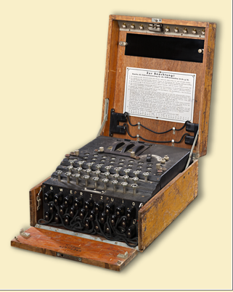
History
Before the modern era, security communication is the primary concern in government and military, As happened in the last century in the global war between the English and the Germans, the Enigma device was used to encrypt the messages of the German army generals.
Security communication become more important
today as a result increasing use of the electronic
communication for many daily activities such as
internet banking, and online shopping.

Slide 3

Cipher
To establish secure communication, Transmitted data must be encrypted using cipher algorithms to prevent attacking it.

Slide 4
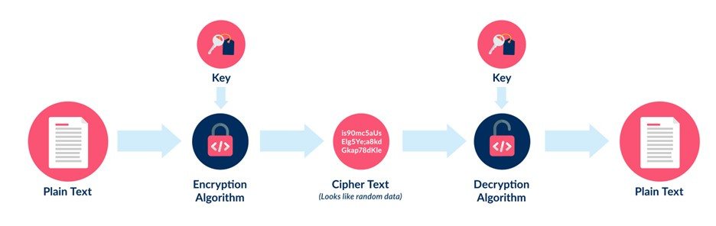
Encryption & Decryption process

Slide 5

Types of Ciphers
MonoNumeric
Monoalphabetic

Slide 6
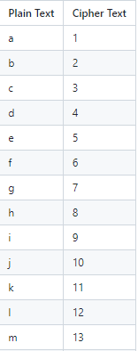
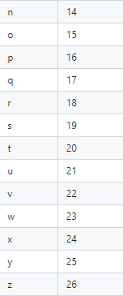
MonoNumeric:
In the mono-numeric substitution encryption,
each alphabetic letter is substituted by
a number according to the following table:

Slide 7
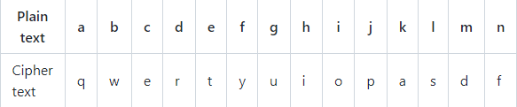
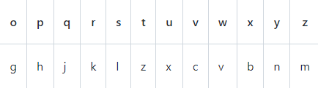
Monoalphabetic:
In the monoalphabetic substitution
encryption, each alphabetic letter is substituted
By another letter according to the following table:

Slide 8
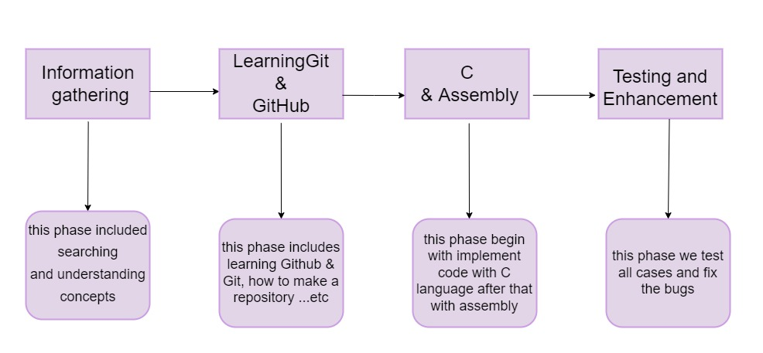
Project Phases

Slide 9
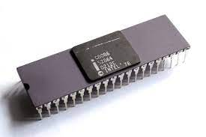
Implementation in Assembly

Slide 10
Some Instruction
1-LOAD EFFICTIVE ADDRESS (LEA) : The LEA instruction loads a 16- or 32-bit register with the offset address of the data specified byte operand.
Ex: LEA DX ,msg2
2- MOV INSTRUCTION (MOV) : copies the contents of the source operand into the destination operand. The source never changes for any instruction.
Ex:MOV AH,09h

Slide 11
Some Instruction
3- COMPARISON INSTRUCTION (CMP) :is a subtraction that changes only the flag bits; the destination operand never changes. A comparison is useful for checking the entire contents of a register a memory location against another value.
Ex:CMP AL,1
4-XLATB INSTRUCTION(XLATB) : converts the contents of the AL register into a number stored in memory table.
Ex:XLATB

Slide 12
Some Instruction
5-INT INSTRUCTION : generates a software interrupt. It takes the interrupt number formatted as a byte value.
Ex:INT 21h
6-JUMP INSTRUCTION : The jump instruction that causes processing to move to a different place in the program sequence..
EX:JE exit

Slide 13
TESTING THE PROGRAM

Slide 14
TEST PLANNING
1-We will implement every unit (procedure) test it individually first to expose as many defects as possible as early as possible.
2-After all, units are implemented, we will integrate them together in a fully working program and run various test cases.
3-After detecting and solving all the minor bugs if there are any we collect the code and upload it part by part to the main repo

Slide 15
Bugs
Bug Descriptions | Status
1- bug in take input from user | Solved
2-bug in storing tables of mononumeric cipher | Solved
3-bug of infinite loop | Solved

Slide 16
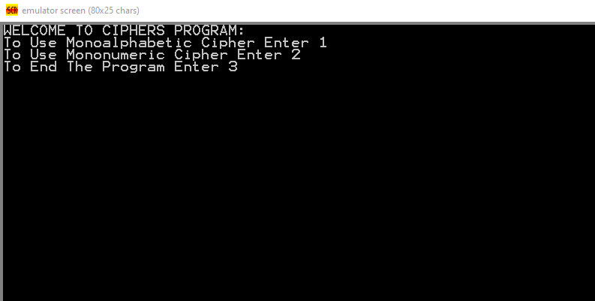
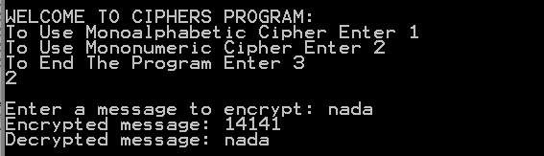
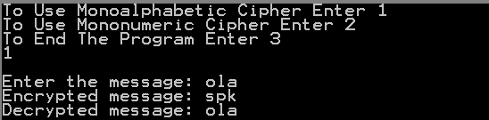
O
U
T
P
U
T

Slide 17
GITHUB PROJECT LINK
https://github.com/Ola-Mohamed/Ciphers

