Slide 1


GAP ANALYSIS AND PROCESS MAPPING FOR BARREL AND CREW.
Presented by Olabanji

Slide 2

Table Of Content
Introduction to the business
Gap identification
Issue categorization using the fishbone diagram
Process Mapping
Proposed Solutions
Proposed Solutions using the swim lane diagram
Meet the Team

Slide 3
Introduction to the Business
Barrel & Brew is a popular, family-owned craft winery that has been operating for a decade. Known for its unique, small-batch Wine, the company has built a loyal following in its local region. Over the past year, Barrel & Brew has seen a surge in demand, with its products now stocked in over 500 local restaurants. While this growth is a positive sign, the company is struggling to keep up.

Slide 4
Gap Identification
AREA | CURRENT STATE (GAPS) | DESIRED STATE (SOLUTION)
Production | Frequent delays, missed targets, inventory shortages | Reliable, consistent production output
Quality | Inconsistent taste, occasional spoiled batches | High, consistent quality for all batches
Employee Morale | Stressed, overworked staff, high overtime, resignations | Empowered, motivated, well-supported staff
Processes | Manual notebooks & outdated spreadsheets for tracking | Streamlined, digitalized, integrated operations
Forecasting | Informal, intuition-based demand prediction | Data-driven sales forecasting and production planning
Infrastructure | Aging tanks, bottling line jams, causing stoppages | Modern, reliable equipment and infrastructure
Communication | No coordination between sales and production; broken promises to customers

Slide 5
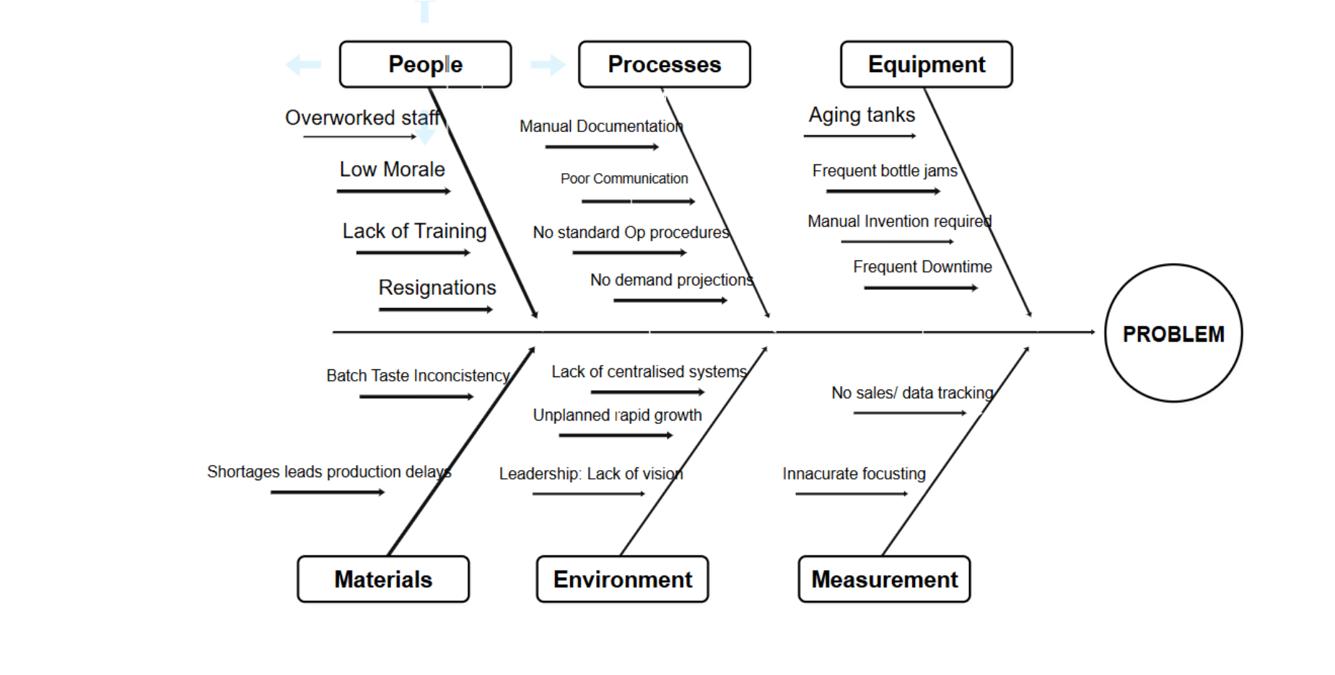
Issue Categorization using fishbone diagram

Slide 6
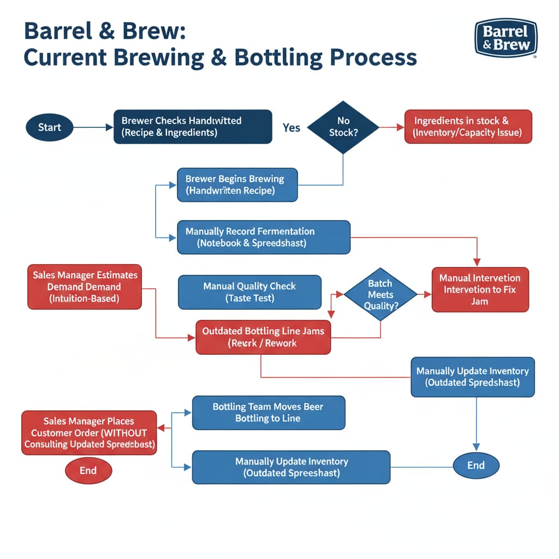
Process mapping (flowchart)

Slide 7
PROPOSED SOLUTIONS

Slide 8
Proposed Solutions
Since we are not making quick fixes but trying to ensure a long-term solution, we have developed a Three-Step Plan these include;​
Phase 1: Fix the Operations 🛠​
First, we have to get the day-to-day business under control. Think of this as putting a new engine in the car.​
Go Digital: We're going to ditch the notebooks and old spreadsheets. The team will get a new, all-in-one digital system for managing recipes, tracking ingredients, and scheduling production. This is the single biggest step we can take to eliminate errors and confusion.​
Upgrade the Equipment: We have to replace that old, jamming bottling line. We'll bring in a modern, automated one that won't just work faster but will also free up the team to focus on brewing, not fixing jams.​
Make it Reliable: We'll also replace the other aging equipment, like the fermentation tanks, to remove the risk of catastrophic failures and ensure consistent, high-quality beer.

Slide 9
Proposed Solutions
Phase 2: Get Smart with Data 📈​
Once the operations are smooth, we can start making smarter decisions. This is about trading intuition for intelligence.​
Forecast with Facts: We'll use data, not guesswork, to predict demand. This means no more overstocking or running out of a popular brew.​
Connect Everything: We'll link the new production system with sales and inventory data. Everyone will be on the same page, all the time.​
Track Quality: We'll implement a system to monitor quality from start to finish. This will help us catch problems early and maintain a consistent, excellent product.

Slide 10
Proposed Solutions
Phase 3: Invest in the Team 🤝
​Finally, none of this works without the people. We need to support the team so they can thrive.
​Set Clear Processes: We'll create clear, standardized procedures for everyone. This will reduce confusion and make sure the new team members can get up to speed quickly.​
Provide Training: We'll train the team on all the new systems and equipment. This not only makes them more efficient but also shows them we're invested in their professional growth.​
Improve Communication: We'll set up formal ways for the different teams to talk to each other, so there's less conflict and more collaboration.​
By following this three-phase plan, Barrel & Brew can move from a business that's just surviving to one that's ready to succeed and grow for years to come.

Slide 11
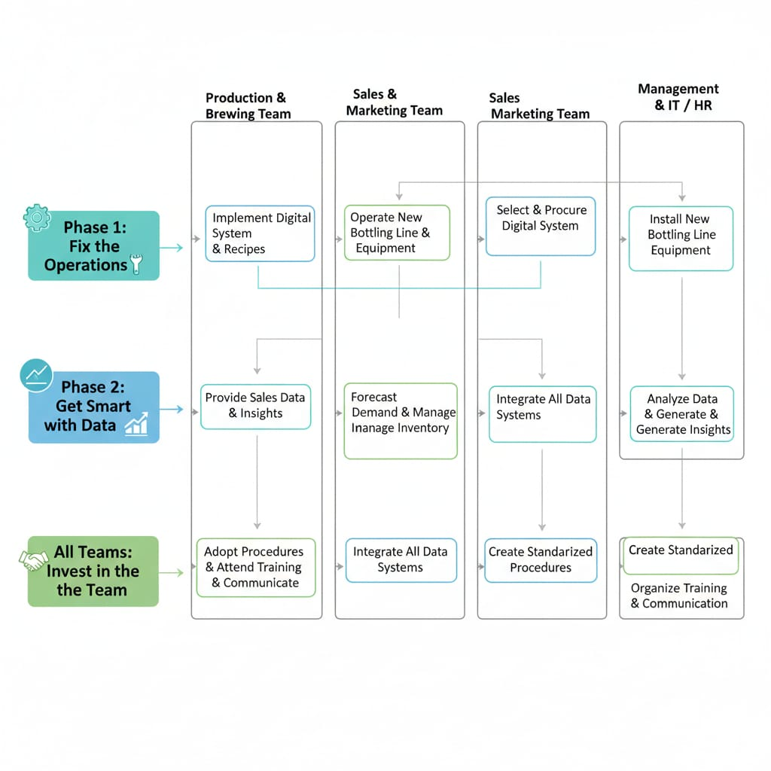
Proposed Solutions using the Swim lane diagram

