Slide 1
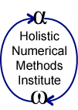
Gauss-Siedel Method
Computer Engineering Majors
Authors: Autar Kaw
http://numericalmethods.eng.usf.edu
Transforming Numerical Methods Education for STEM Undergraduates
http://numericalmethods.eng.usf.edu

Slide 2
Gauss-Seidel Method http://numericalmethods.eng.usf.edu

Slide 3
Gauss-Seidel Method
An iterative method.
Basic Procedure:
Algebraically solve each linear equation for x_{i}
Assume an initial guess solution array
Solve for each x_{i} and repeat
Use absolute relative approximate error after each iteration to check if error is within a pre-specified tolerance.
http://numericalmethods.eng.usf.edu

Slide 4
Gauss-Seidel Method
Why?
The Gauss-Seidel Method allows the user to control round-off error.
Elimination methods such as Gaussian Elimination and LU Decomposition are prone to prone to round-off error.
Also: If the physics of the problem are understood, a close initial guess can be made, decreasing the number of iterations needed.
http://numericalmethods.eng.usf.edu

Slide 5



Gauss-Seidel Method
Algorithm
A set of n equations and n unknowns:
If: the diagonal elements are non-zero
Rewrite each equation solving for the corresponding unknown
ex:
First equation, solve for x₁
Second equation, solve for x₂
. .
. .
. .
http://numericalmethods.eng.usf.edu

Slide 6
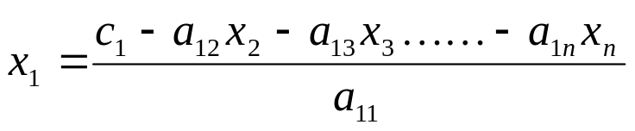
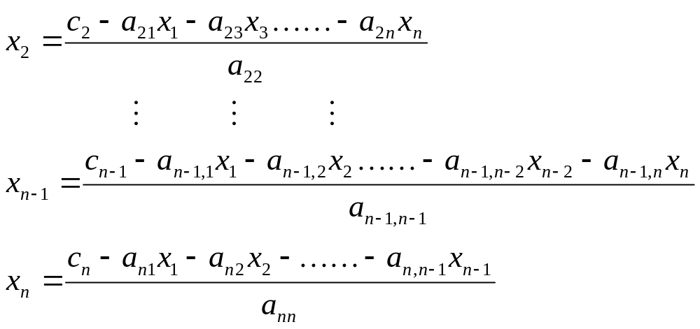
Gauss-Seidel Method
Algorithm
Rewriting each equation
From Equation 1
From equation 2
From equation n-1
From equation n
http://numericalmethods.eng.usf.edu

Slide 7
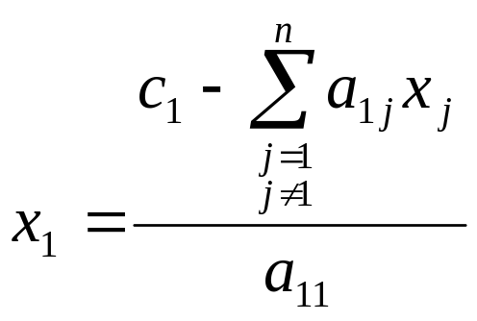
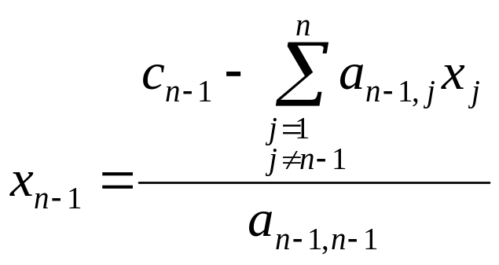
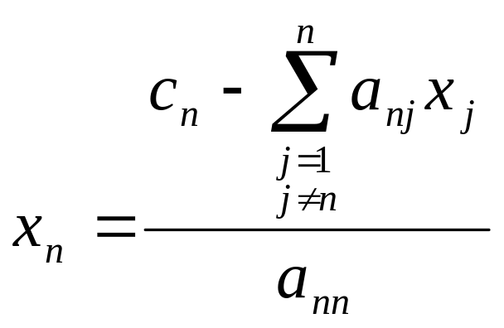
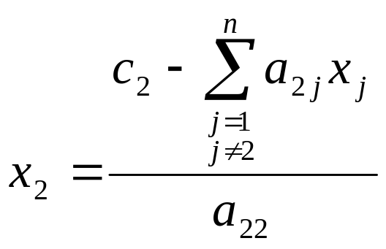
Gauss-Seidel Method
Algorithm
General Form of each equation
http://numericalmethods.eng.usf.edu

Slide 8
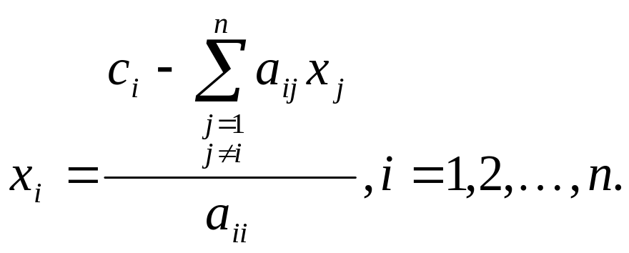
Gauss-Seidel Method
Algorithm
General Form for any row ‘i’
How or where can this equation be used?
http://numericalmethods.eng.usf.edu

Slide 9
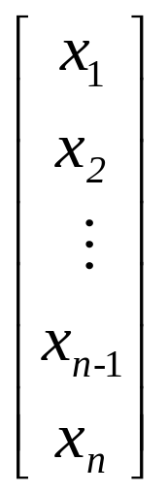
Gauss-Seidel Method
Solve for the unknowns
Assume an initial guess for [X]
Use rewritten equations to solve for each value of x_{i}.
Important: Remember to use the most recent value of x_{i}. Which means to apply values calculated to the calculations remaining in the current iteration.
http://numericalmethods.eng.usf.edu

Slide 10
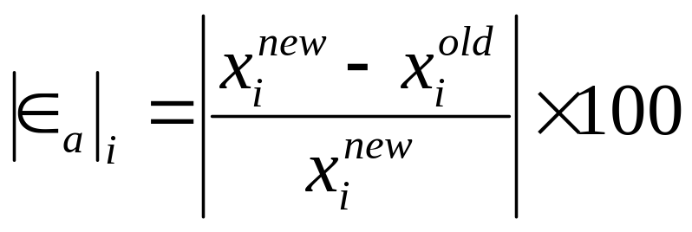
Gauss-Seidel Method
Calculate the Absolute Relative Approximate Error
So when has the answer been found?
The iterations are stopped when the absolute relative approximate error is less than a prespecified tolerance for all unknowns.
http://numericalmethods.eng.usf.edu

Slide 11
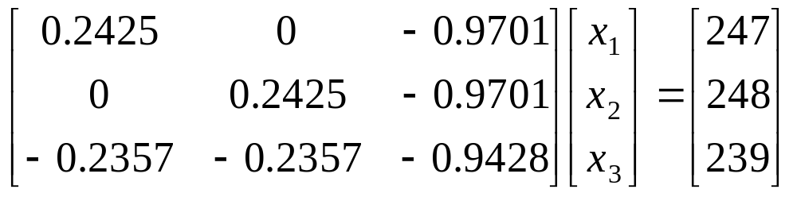
Example: Surface Shape Detection
To infer the surface shape of an object from images taken of a surface from three different directions, one needs to solve the following set of equations
The right hand side values are the light intensities from the middle of the images, while the coefficient matrix is dependent on the light source directions with respect to the camera. The unknowns are the incident intensities that will determine the shape of the object.
Find the values of x₁, x₂, and x₃ use the Gauss-Seidel method.

Slide 12
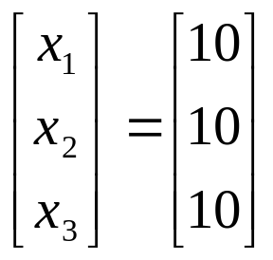
Example: Surface Shape Detection
The system of equations is:
Initial Guess:
Assume an initial guess of

Slide 13
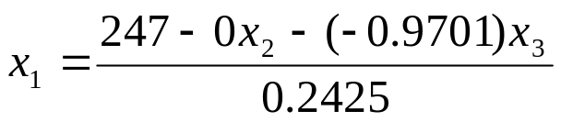
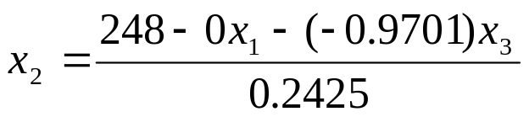
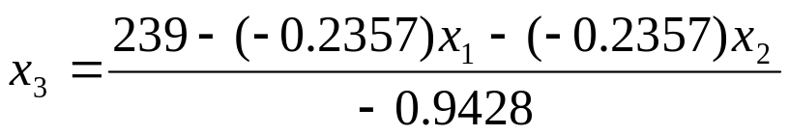
Example: Surface Shape Detection
Rewriting each equation

Slide 14
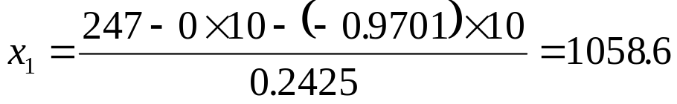
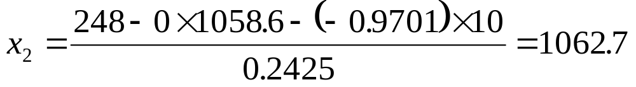
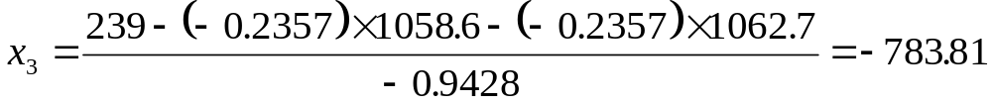
Example: Surface Shape Detection
Iteration 1
Substituting initial guesses into the equations

Slide 15
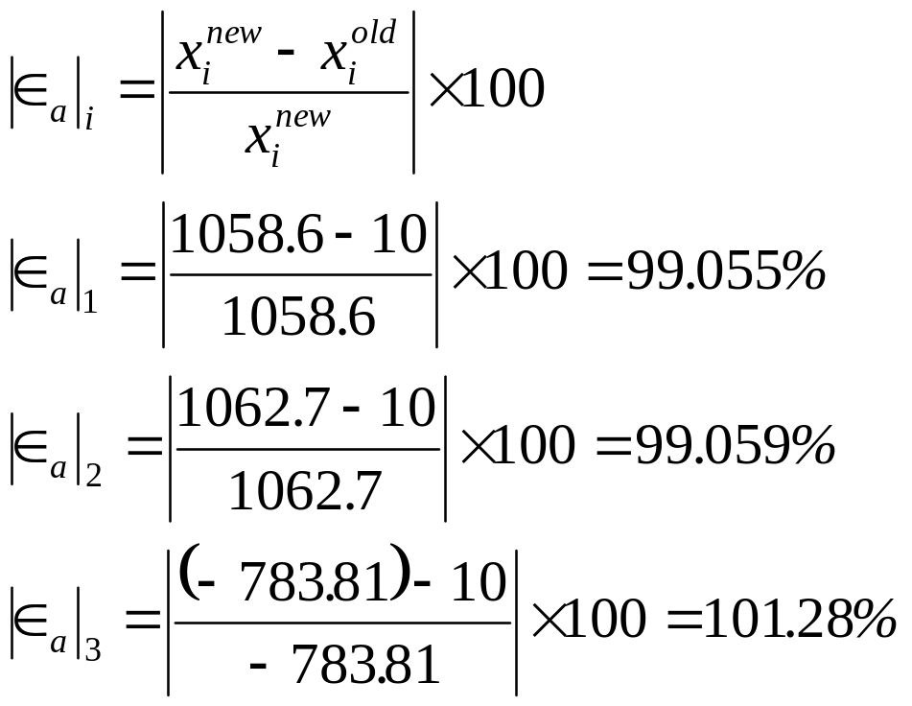
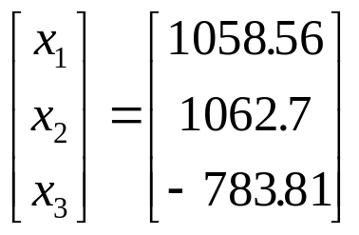
Example: Surface Shape Detection
Finding the absolute relative approximate error
At the end of the first iteration
The maximum absolute relative approximate error is 101.28%

Slide 16
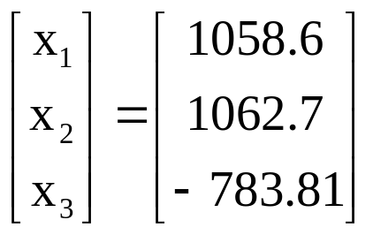
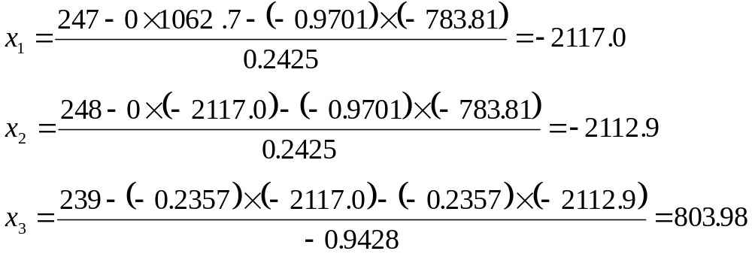
Example: Surface Shape Detection
Iteration 2
Using

Slide 17
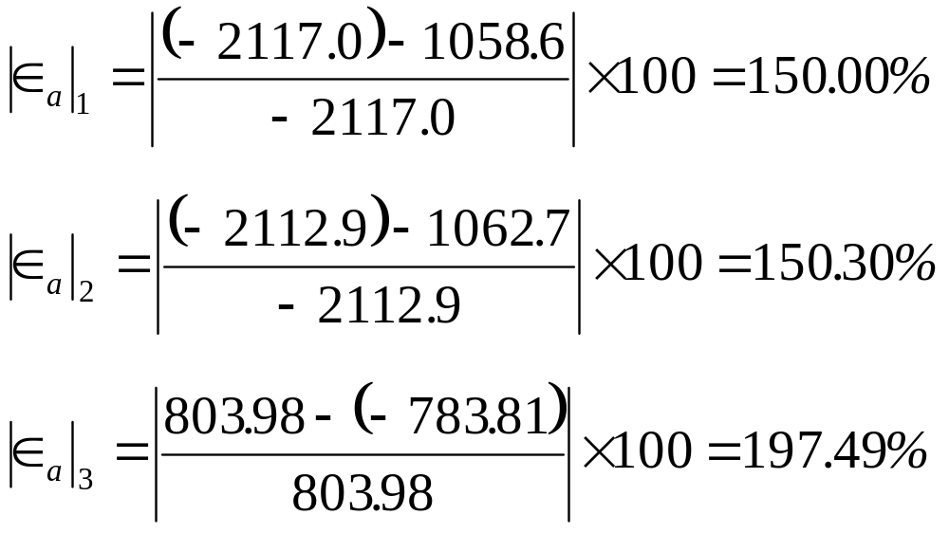
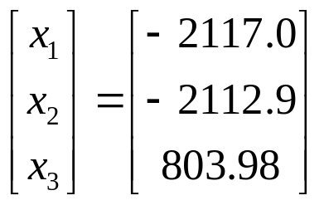
Example: Surface Shape Detection
Finding the absolute relative approximate error for the second iteration
At the end of the first iteration
The maximum absolute relative approximate error is 197.49%

Slide 18



Example: Surface Shape Detection
Repeating more iterations, the following values are obtained
Iteration | x₁ |  | x₂ |  | x₃
1 2 3 4 5 6 | 1058.6 −2117.0 4234.8 −8470.1 16942 −33888 | 99.055 150.00 149.99 150.00 149.99 150.00 | 1062.7 −2112.9 4238.9 −8466.0 16946 −33884 | 99.059 150.30 149.85 150.07 149.96 150.01 | −783.81 803.98 −2371.9 3980.5 −8725.7 16689 | 101.28 197.49 133.90 159.59 145.62 152.28
Notice: The absolute relative approximate errors are not decreasing.

Slide 19
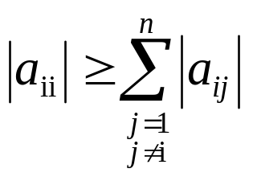
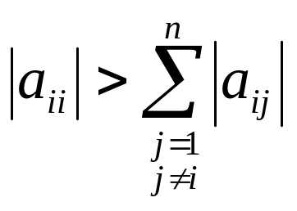
Gauss-Seidel Method: Pitfall
What went wrong?
Even though done correctly, the answer is not converging to the correct answer
This example illustrates a pitfall of the Gauss-Siedel method: not all systems of equations will converge.
Is there a fix?
One class of system of equations always converges: One with a diagonally dominant coefficient matrix.
Diagonally dominant: [A] in [A] [X] = [C] is diagonally dominant if:
for all ‘i’ and
for at least one ‘i’
http://numericalmethods.eng.usf.edu

Slide 20
Gauss-Seidel Method: Pitfall
Diagonally Dominant: In other words….
For every row: the element on the diagonal needs to be equal than or greater than the sum of the other elements of the coefficient matrix
For at least one row: The element on the diagonal needs to be greater than the sum of the elements.
What can be done? If the coefficient matrix is not originally diagonally dominant, the rows can be rearranged to make it diagonally dominant.

Slide 21
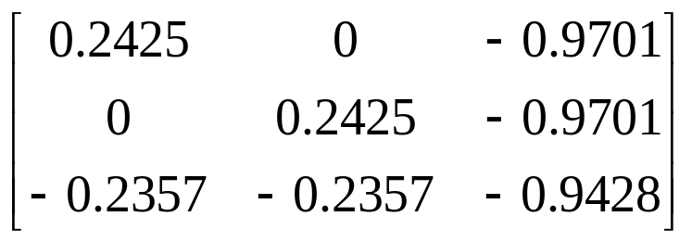
Example: Surface Shape Detection
Examination of the coefficient matrix reveals that it is not diagonally dominant and cannot be rearranged to become diagonally dominant
This particular problem is an example of a system of linear equations that cannot be solved using the Gauss-Seidel method.
Other methods that would work:
1. Gaussian elimination 2. LU Decomposition

Slide 22

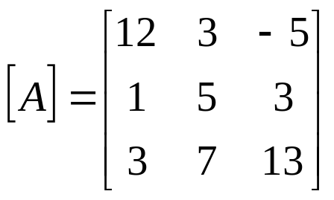


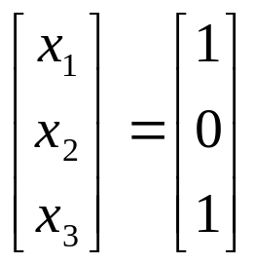
Gauss-Seidel Method: Example 2
Given the system of equations
The coefficient matrix is:
With an initial guess of
Will the solution converge using the Gauss-Siedel method?
http://numericalmethods.eng.usf.edu

Slide 23
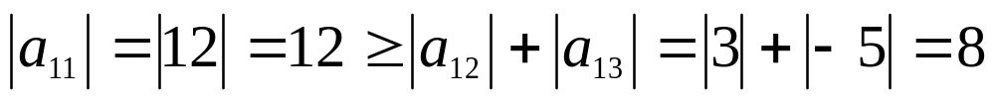
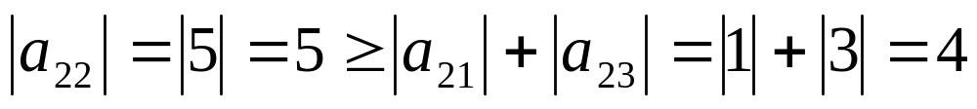
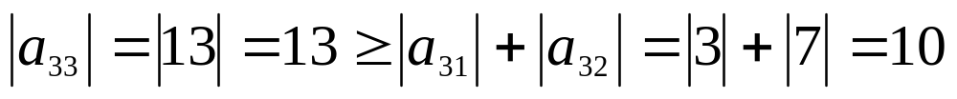
Gauss-Seidel Method: Example 2
Checking if the coefficient matrix is diagonally dominant
The inequalities are all true and at least one row is strictly greater than:
Therefore: The solution should converge using the Gauss-Siedel Method
http://numericalmethods.eng.usf.edu

Slide 24
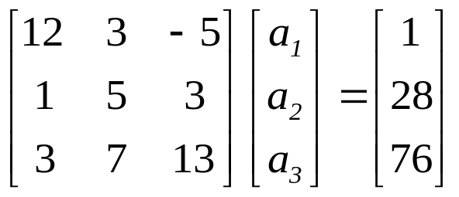
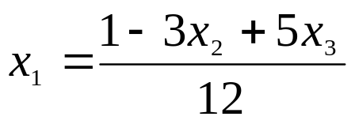
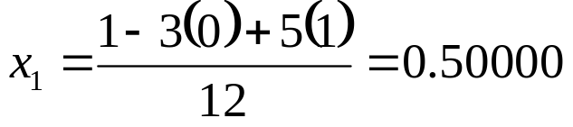
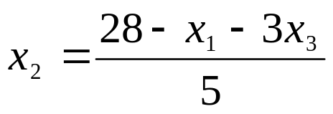
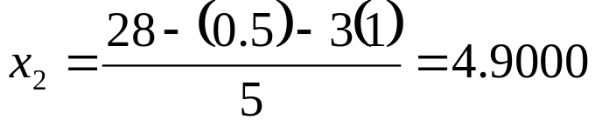
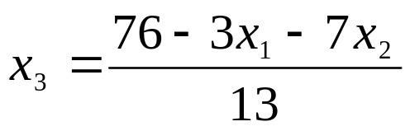
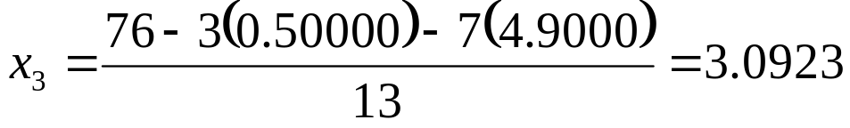
Gauss-Seidel Method: Example 2
Rewriting each equation
With an initial guess of
http://numericalmethods.eng.usf.edu

Slide 25
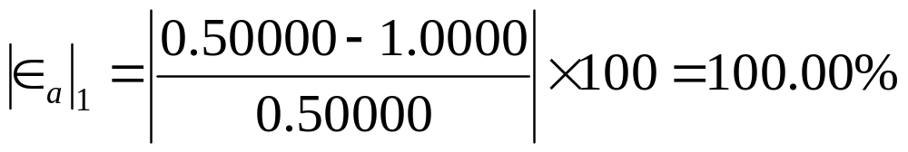
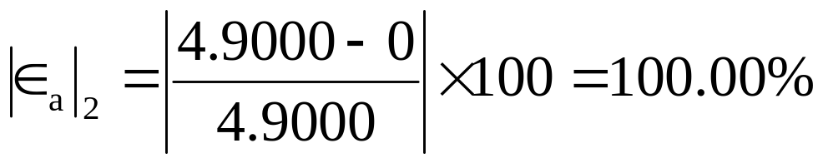
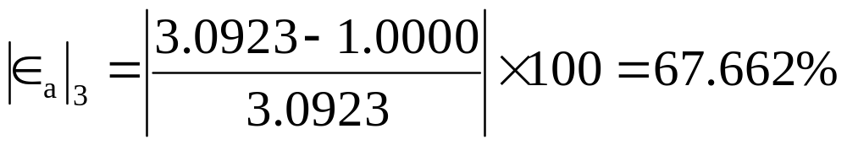
Gauss-Seidel Method: Example 2
The absolute relative approximate error
The maximum absolute relative error after the first iteration is 100%
http://numericalmethods.eng.usf.edu

Slide 26
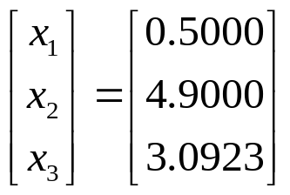
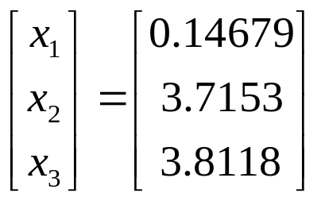
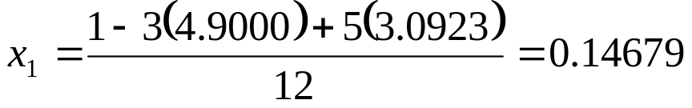
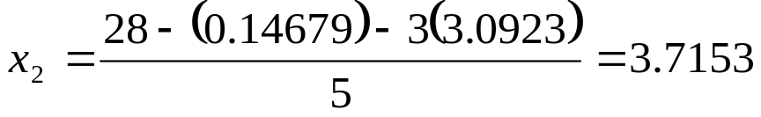

Gauss-Seidel Method: Example 2
After Iteration #1
Substituting the x values into the equations
After Iteration #2
http://numericalmethods.eng.usf.edu

Slide 27
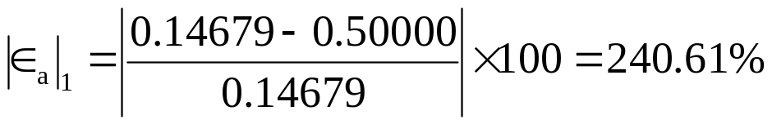
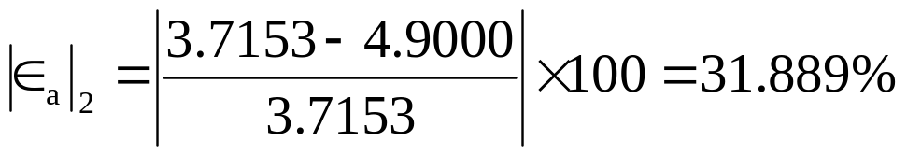
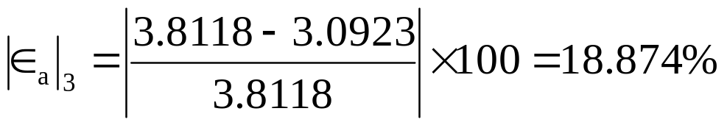
Gauss-Seidel Method: Example 2
Iteration 2 absolute relative approximate error
The maximum absolute relative error after the first iteration is 240.61%
This is much larger than the maximum absolute relative error obtained in iteration #1. Is this a problem?
http://numericalmethods.eng.usf.edu

Slide 28



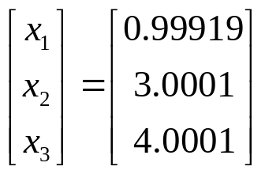

Gauss-Seidel Method: Example 2
Repeating more iterations, the following values are obtained
Iteration | a₁ |  | a₂ |  | a₃
1 2 3 4 5 6 | 0.50000 0.14679 0.74275 0.94675 0.99177 0.99919 | 100.00 240.61 80.236 21.546 4.5391 0.74307 | 4.9000 3.7153 3.1644 3.0281 3.0034 3.0001 | 100.00 31.889 17.408 4.4996 0.82499 0.10856 | 3.0923 3.8118 3.9708 3.9971 4.0001 4.0001 | 67.662 18.876 4.0042 0.65772 0.074383 0.00101
The solution obtained is close to the exact solution of .
http://numericalmethods.eng.usf.edu

Slide 29







Gauss-Seidel Method: Example 3
Given the system of equations
Rewriting the equations
With an initial guess of
http://numericalmethods.eng.usf.edu

Slide 30



Gauss-Seidel Method: Example 3
Conducting six iterations, the following values are obtained
Iteration | a₁ |  | A₂ |  | a₃
1 2 3 4 5 6 | 21.000 −196.15 −1995.0 −20149 2.0364×10⁵ −2.0579×10⁵ | 95.238 110.71 109.83 109.90 109.89 109.89 | 0.80000 14.421 −116.02 1204.6 −12140 1.2272×10⁵ | 100.00 94.453 112.43 109.63 109.92 109.89 | 50.680 −462.30 4718.1 −47636 4.8144×10⁵ −4.8653×10⁶ | 98.027 110.96 109.80 109.90 109.89 109.89
The values are not converging.
Does this mean that the Gauss-Seidel method cannot be used?
http://numericalmethods.eng.usf.edu

Slide 31

Gauss-Seidel Method
The Gauss-Seidel Method can still be used
The coefficient matrix is not diagonally dominant
But this is the same set of equations used in example #2, which did converge.
If a system of linear equations is not diagonally dominant, check to see if rearranging the equations can form a diagonally dominant matrix.
http://numericalmethods.eng.usf.edu

Slide 32



Gauss-Seidel Method
Not every system of equations can be rearranged to have a diagonally dominant coefficient matrix.
Observe the set of equations
Which equation(s) prevents this set of equation from having a diagonally dominant coefficient matrix?
http://numericalmethods.eng.usf.edu

Slide 33
Gauss-Seidel Method
Summary
Advantages of the Gauss-Seidel Method
Algorithm for the Gauss-Seidel Method
Pitfalls of the Gauss-Seidel Method
http://numericalmethods.eng.usf.edu

Slide 34
Gauss-Seidel Method
Questions?
http://numericalmethods.eng.usf.edu

Slide 35
Additional Resources
For all resources on this topic such as digital audiovisual lectures, primers, textbook chapters, multiple-choice tests, worksheets in MATLAB, MATHEMATICA, MathCad and MAPLE, blogs, related physical problems, please visit
http://numericalmethods.eng.usf.edu/topics/gauss_seidel.html

Slide 36
THE END
http://numericalmethods.eng.usf.edu

