Slide 1
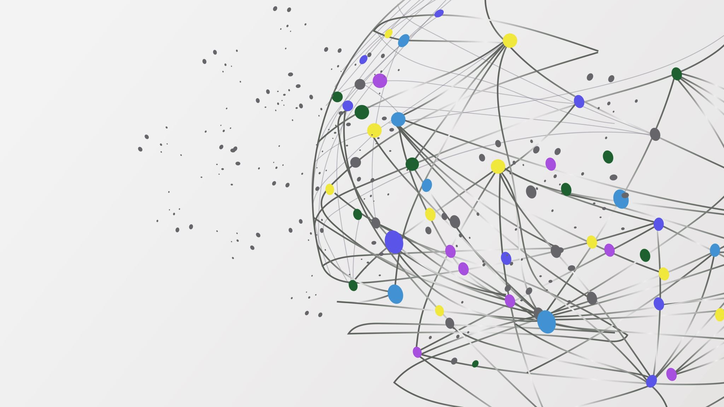
Social Media Impact

Slide 2
Introduction
In this study, I aimed to examine the influence of social media on users by analyzing a sample of 1000 individuals across three countries: the USA, UK, and Australia. These users represent diverse professions, financial backgrounds, genders, and residential areas. The research comprises two main studies: one investigates the relationship between various user characteristics and social media behavior, while the other delves into the influence of social media usage on financial behavior.

Slide 3
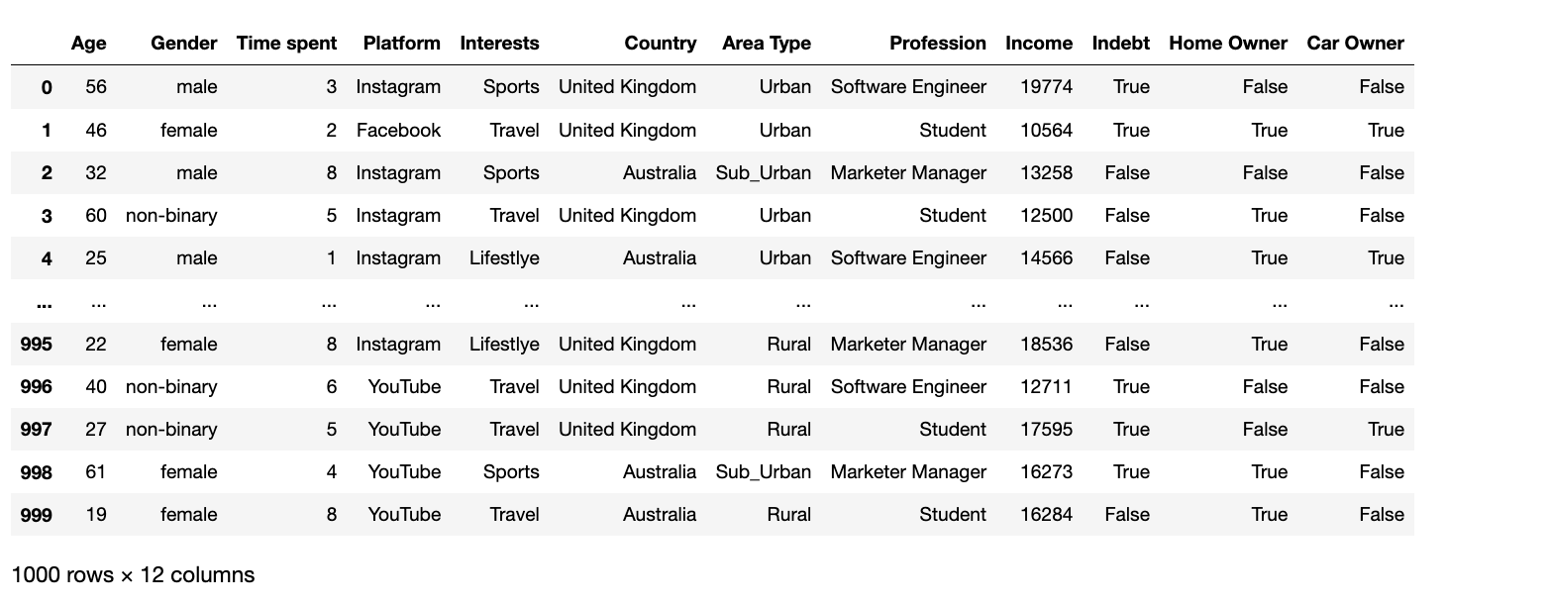
Dataset
Initially, the dataset was loaded, comprising 12 columns and 1000 rows.

Slide 4
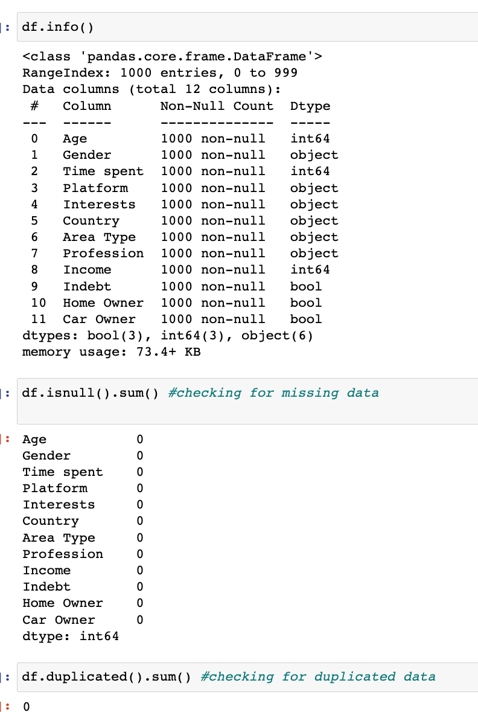
Data Cleaning and Exploration
Checks for missing or duplicated data were conducted, and none were found. Additionally, the data types were appropriate. However, the data in the columns "indebt," "home owner," and "car owner" were converted to binary data types to enhance numerical analysis.

Slide 5
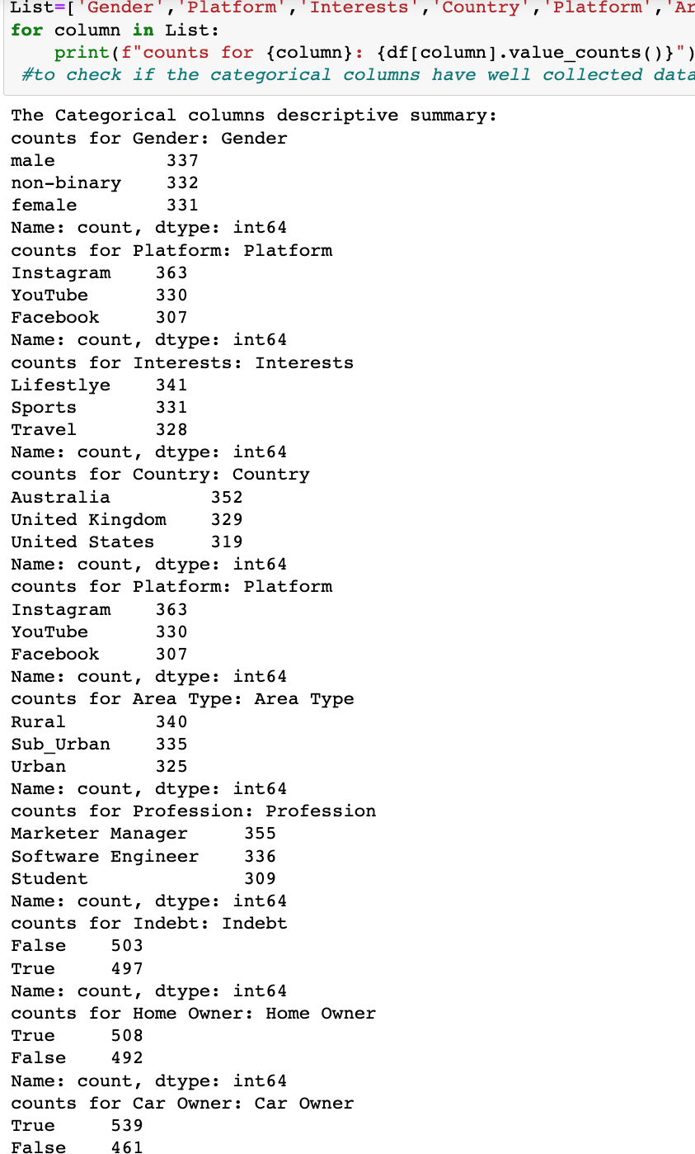

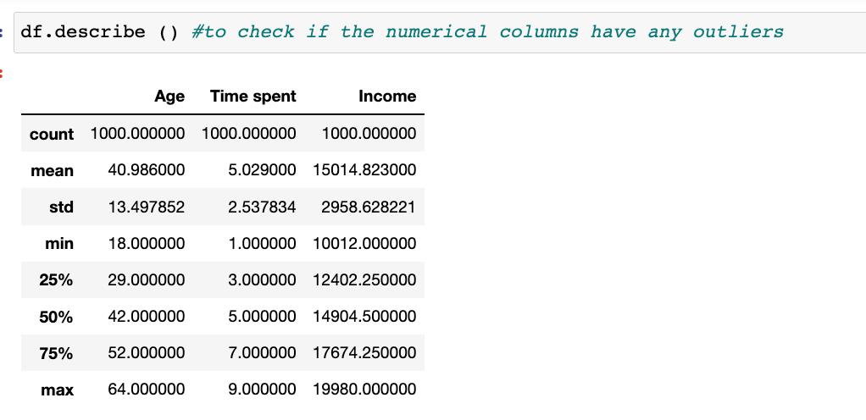
Data descriptive summary
Numerical columns, including "Age," "Time spent," and "Income" were summarized and no outliers were identified. Similarly, the categorical columns were summarized to assess the counts of categories per column. The distribution appeared relatively even, indicating the absence of outliers.

Slide 6
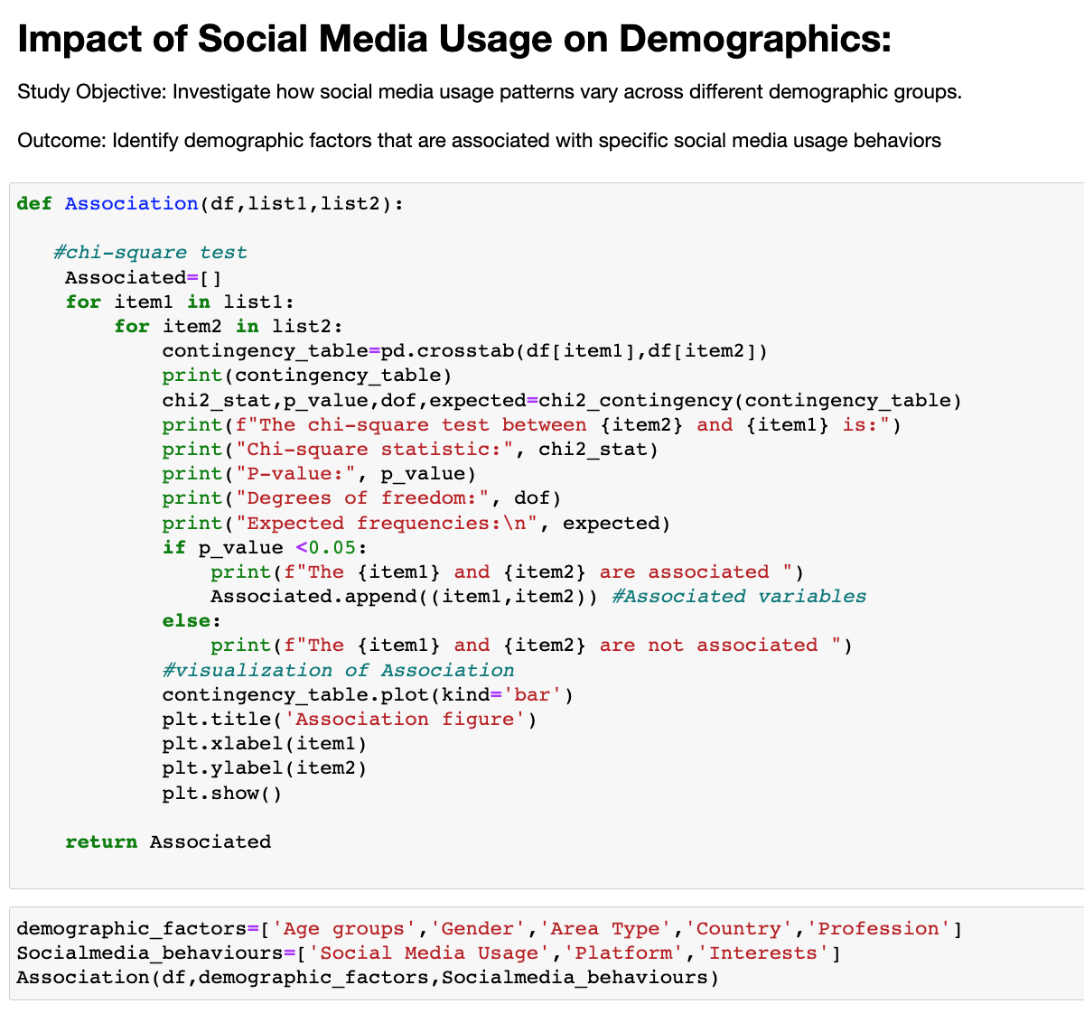
Impact of Social Media Usage on Demographics
In this study, the objective was to examine the variations in social media patterns, including social media usage, platform preferences, and interests, across various user demographics such as age, gender, area type, country, and profession. This exploration was conducted by performing chi-square tests to analyze the relationship between each demographic factor and each social media pattern.

Slide 7
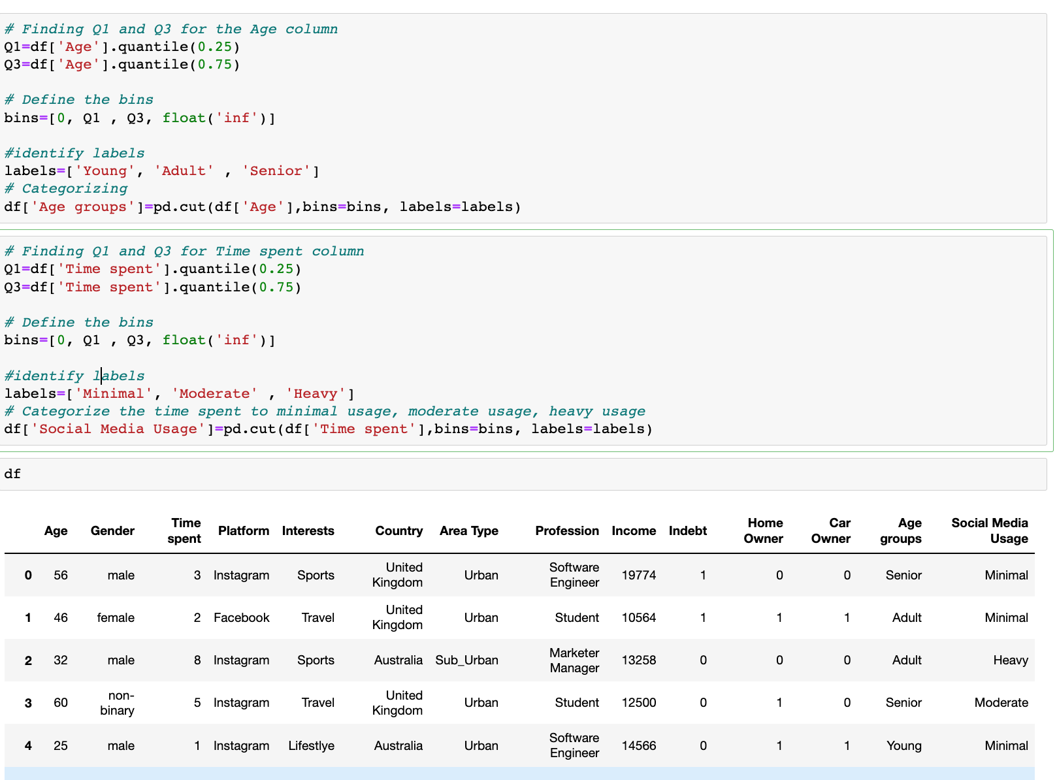
Impact of Social Media Usage on Demographics
Initially, I categorized the Time spent column into bins representing different levels of social media usage: minimal, moderate, and heavy. Similarly, the Age column was grouped into three categories: young, adult, and senior age groups.

Slide 8
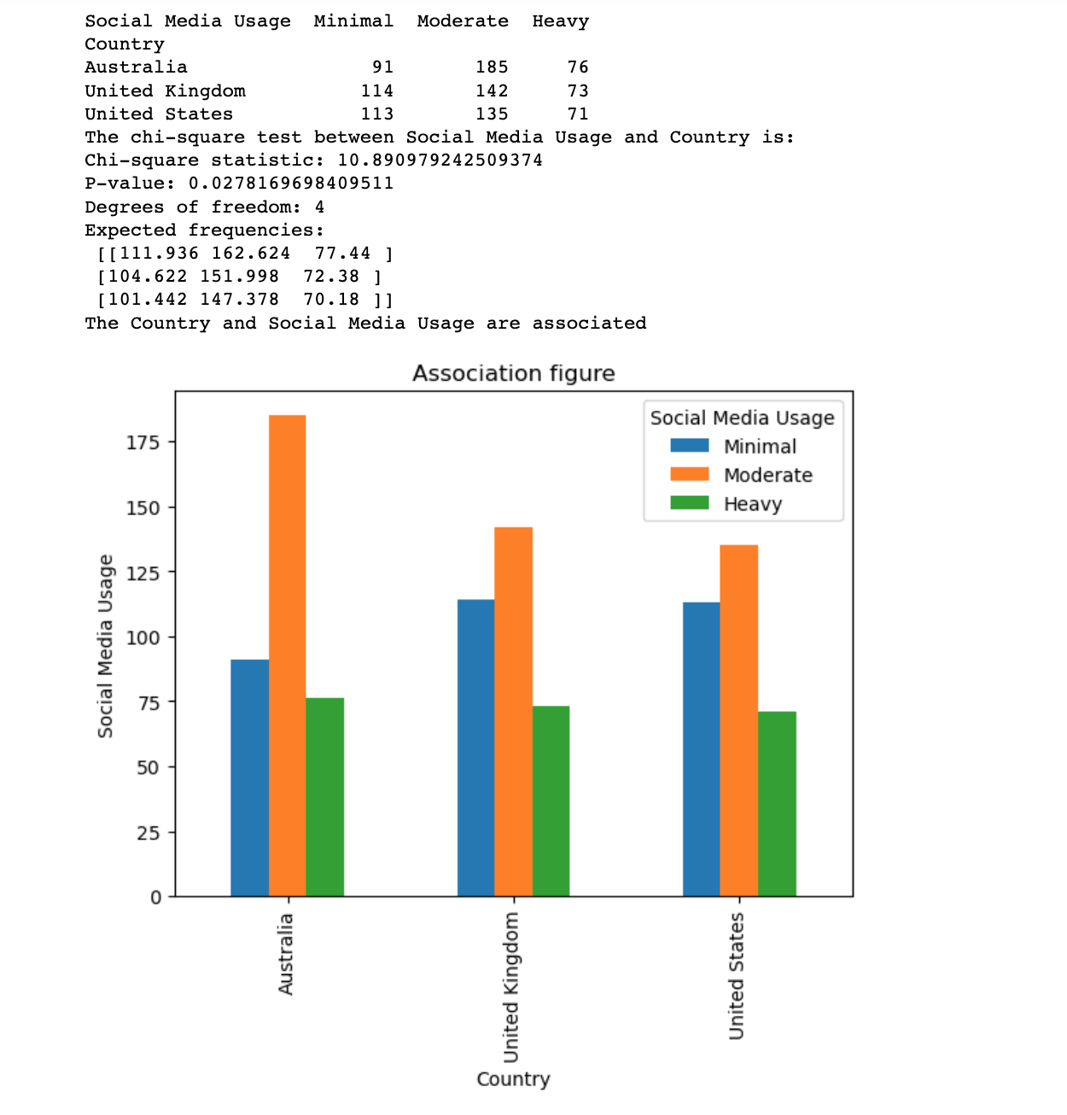
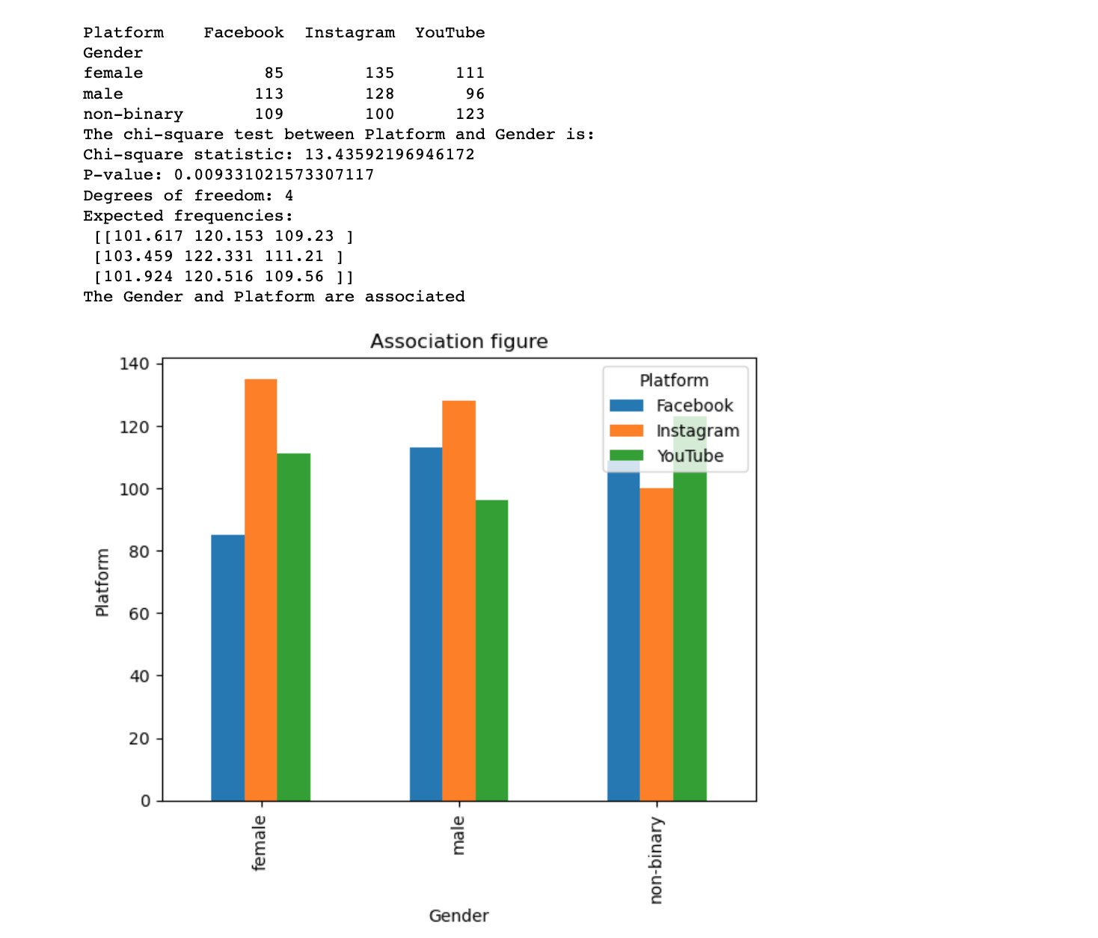
Impact of Social Media Usage on Demographics
The analysis indicated notable associations between gender and platform usage, as well as between country of residence and social media usage. The rejection of the null hypothesis at a 0.05 confidence level suggests that these variables are not independent.

Slide 9
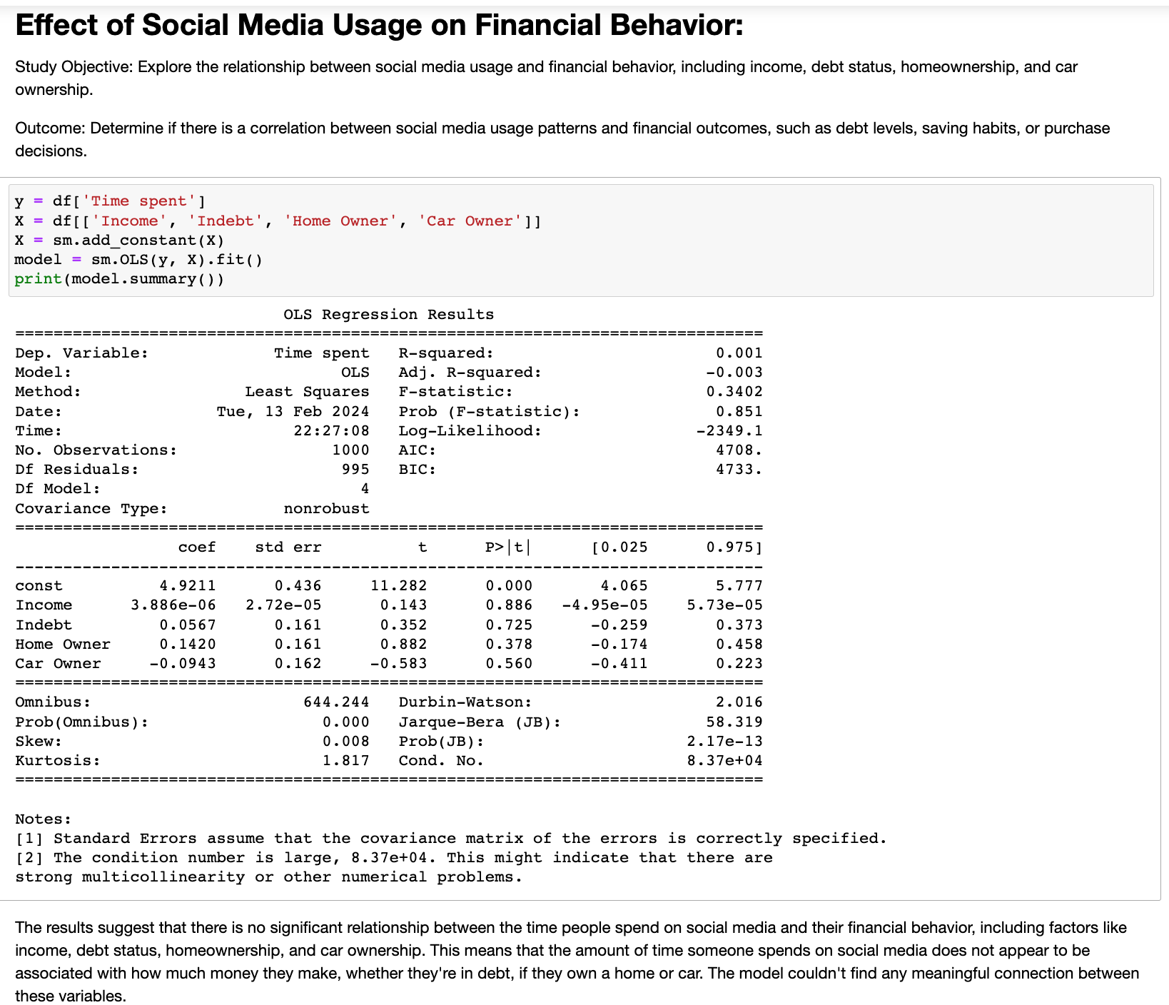
Effect of Social Media Usage on Financial Behavior
The second study aimed to investigate the correlation between social media usage patterns and financial behavior, specifically focusing on income, indebtedness, homeownership, and car ownership. Its objective was to determine if there exists a relationship between social media usage and financial outcomes such as debt levels, saving habits, or purchasing decisions through running correlation between the variables as well as regression analysis and association.

Slide 10
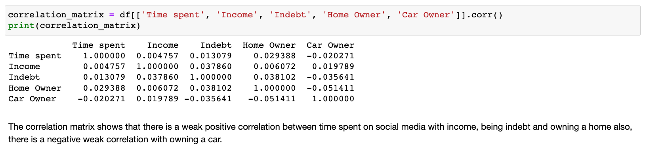
Effect of Social Media Usage on Financial Behavior
The study showed that there was a weak positive and negative correlation between the time spent on social media and financial behavior (income, being indebt, home and car ownership).

Slide 11
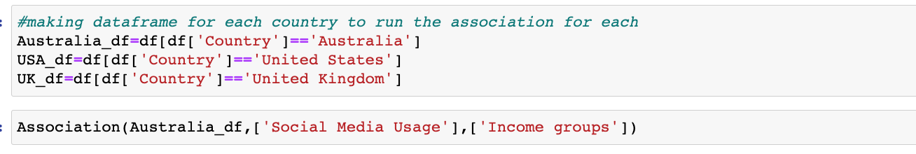
Effect of Social Media Usage on Financial Behavior
Following the observed association between country and social media usage in the first study, I proceeded to investigate the potential association between income and social media usage. To do this, I categorized income into three groups (low, medium, and high) and conducted a chi-square test for each country individually.

Slide 12
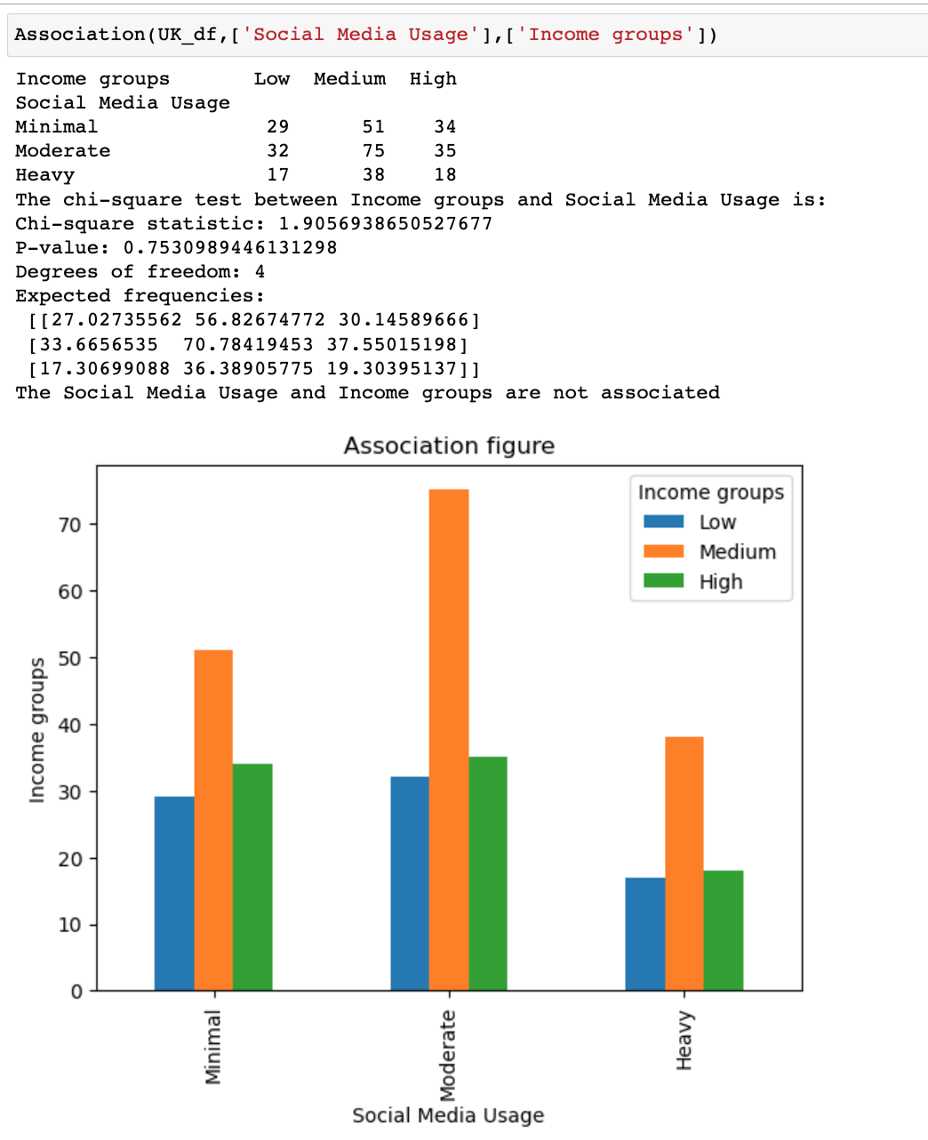
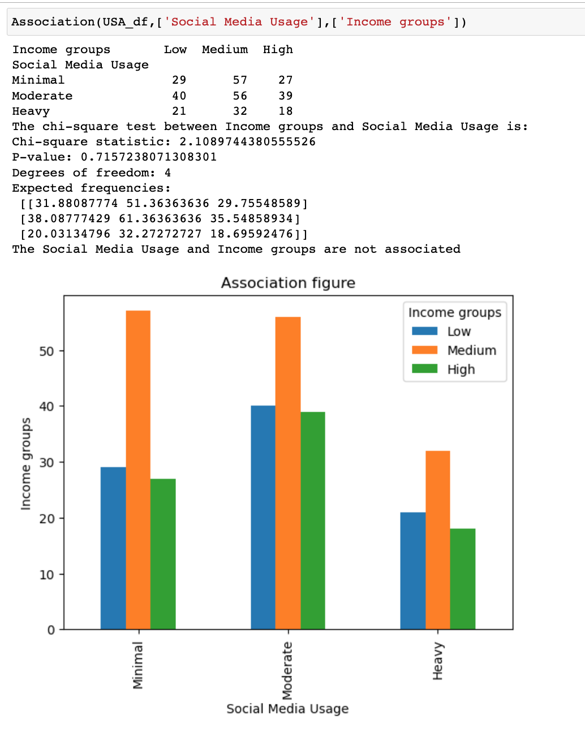
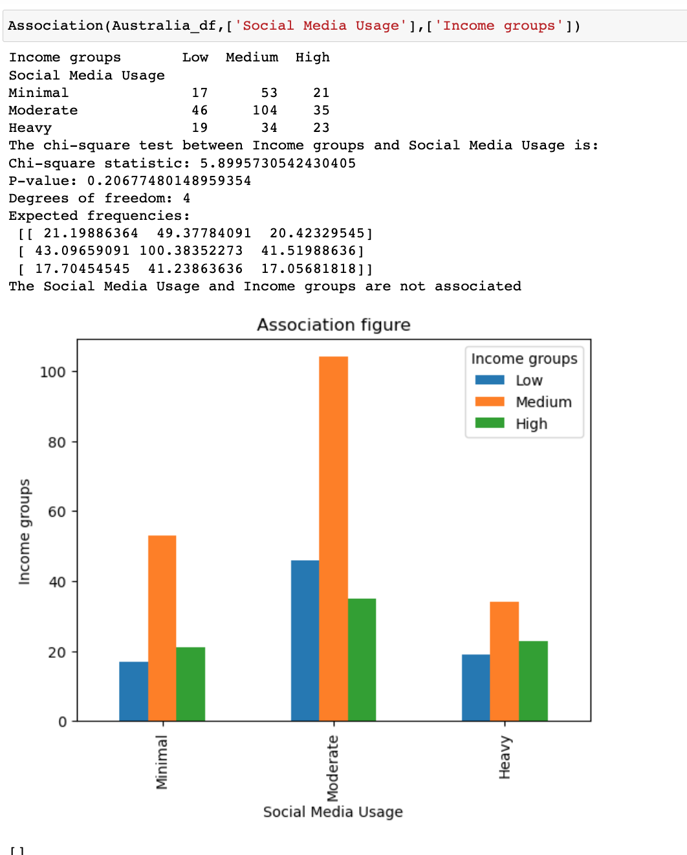
Effect of Social Media Usage on Financial Behavior
However, the results indicated no significant association between income and social media usage across all countries.

Slide 13
Reference
https://www.kaggle.com/datasets/imyjoshua/average-time-spent-by-a-user-on-social-media

