Slide 1
PBS MiniProject
Team Members: David Markachev, Scott klum, Jamal Afridi, Yaser
Spring 2013
CSE870 Advanced Software Engineering
Michigan State University
Instructor: Dr. B. Cheng
For further information: chengb at cse dot msu dot edu

Slide 2
Part I: Project Overview
System provides Detection and Prevention aspects of the PBS system
Motivation for project
reduce the number of injuries
safety of the driver
explore the current technologies in this related domain.

Slide 3
Overview of Features
Detection of Pedestrians
Prevention of backup accidents
Single access point
Security on Raising False Alarms

Slide 4
Domain Research
Investigated the current pedestrian detection architectures
Architecture related design for
sensor based Pedestrian detection
Data based security on Alarm system
Project Constraints
Simulated data to model pedestrians
Non-ideal/failure behavior of sensors not comprehensively dealt
Real recommendations are not generated in response to potential accident.

Slide 5
Security Analysis
Identify security factors affecting project
Any one can access any part of the system
If injected too many False alarms – user can lose trust– can lead to accident
How did you mitigate security risks?
Single access point –user authentication
Security on false Alarms

Slide 6
Part II: Model-based View of System
Give us use case diagram
Explain key use cases
Walk us through class diagram
Give us a few representative scenarios in terms of sequence diagrams
Walk us through the state diagram of a few key objects

Slide 7
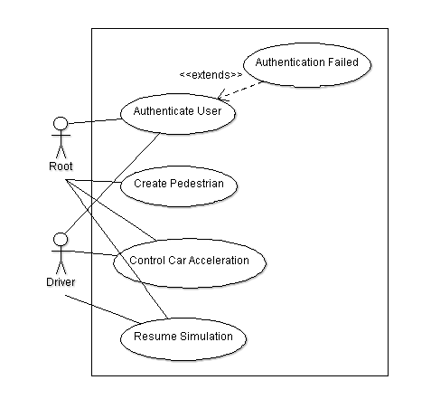
Description of Use Case Diagram

Slide 8
Comparison of Two Designs
Show us the two original designs
Show the “new” integrated deign
Explain the choice of design selected
Explain key differences in new design
Tell us about the major challenges with integration

Slide 9
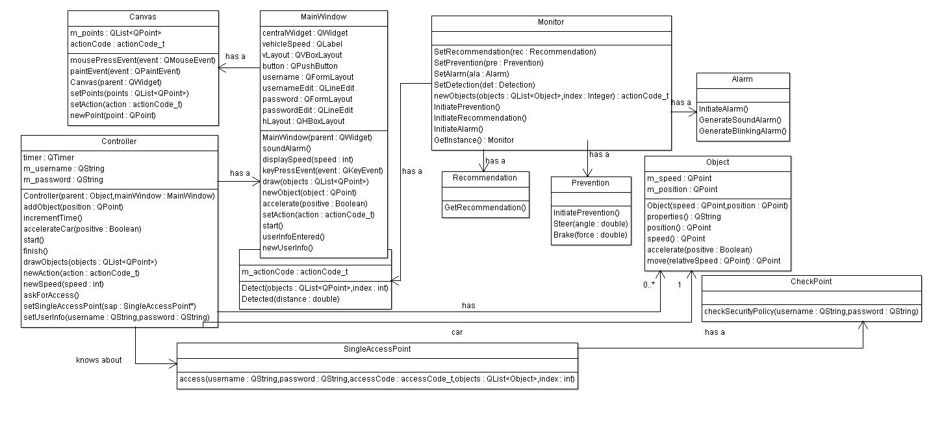
New System Class Diagram

Slide 10
Description of Class Diagram
General layout of class model
Why model is constructed this way
Identify the design patterns used for system (use color or other means to distinguish design patterns).
Explain the rationale for the design patterns used
AOP Projects:
Identify the cross-cutting concern(s)
How did you use aspect-oriented programming?

Slide 11
Behavior Model: Sequence Diagrams
Give 1 normal scenario in terms of sequence diagram
Give a scenario describing exceptional situation in terms of sequence diagram

Slide 12
Behavior Model: State Diagrams
Give state diagram for at least two key (interacting) classes.
Explain interaction

Slide 13
Related Work
How are they similar?
How are they different?

Slide 14
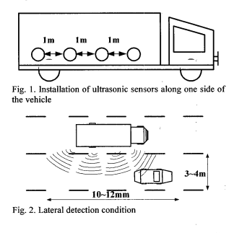
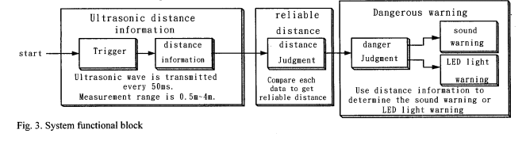
(1) Kai-Tai Song, Chih-Hao Chen and Cheng-Hsien Chiu Huang “Design and Experimental Study of an Ultrasonic Sensor System for Lateral Collision Avoidance at Low Speeds “ 2004 IEEE Intelligent Vehicles Symposium

Slide 15
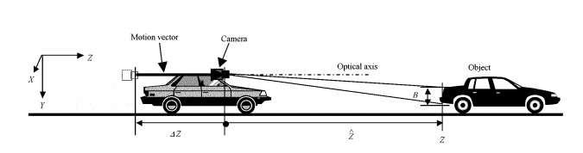
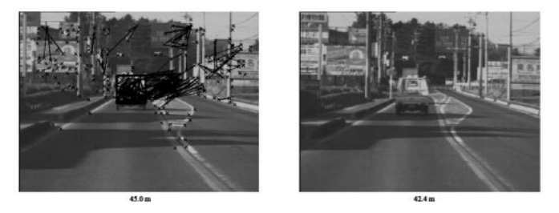
Takeo Kato, Yoshiki Ninomiya, and Ichiro Masaki, “ An Obstacle Detection Method by Fusion of Radar and Motion Stereo” IEEE Transactions on Intelligent Transportation Systems

Slide 16
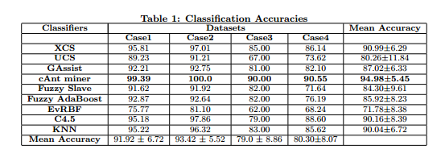
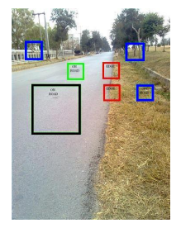
Performance Evaluation of Evolutionary Algorithms for Road Detection GECCO-2010

Slide 17
Lessons Learned
Use of QT interface API GUI
Proofread code more thoroughly
Open areas for future work
Implement other aspects of PBS.
generating a more realistic and more interactive simulation environment.
Comparative analysis of our final system with the existing architectures

Slide 18
Part III: Demo of Prototype
High-Level features of User Interface
Modeling pedestrians for the system
Distance calculation & detection for pedestrians
Accident Prevention and resuming the system
User authentication

Slide 19
Live Demonstration I
Prose description of scenario illustrating prototype functionality
Give live planned demonstration

Slide 20
Live Demonstration II
Solicit input from audience to walk through a few more scenarios
Alternatively let someone from audience try out the system.

