Slide 1
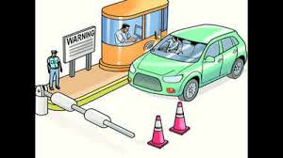

Fastag Fraud Detection
Presented By OLABUNTU BABATUNDE AFEEZ

Slide 2
CONTENTS
INTRODUCTION
FEATURES
DATASET DESCRIPTION
DATA CLEANING AND VISUALIZATION
DATA VISUALIZATION
MODEL COMPARISON
EVALUTATION OF BEST MODEL
FEATURES IMPORTANCE

Slide 3

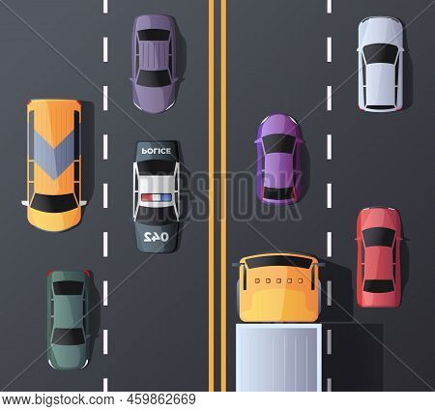
INTRODUCTION
Fastag fraud refers to illegal activities associated with the misuse of the Fastag electronic toll collection system in India.
The main goal is to develop a machine learning-based fraud detection system for Fastag transactions. By analyzing transaction details, vehicle information, location, and amounts, the system aims to accurately identify fraudulent activities, ensuring the security and integrity of Fastag transactions

Slide 4
Importance
Challenges
Features
The system ensures toll collection accuracy, minimizes losses, and enhances transparency in Fastag transactions.
Overcoming data imbalances, ensuring model accuracy, and Feature engineering to capture nuanced patterns indicative of fraud.
Approach
Utilizing machine learning to analyze transaction data, detect patterns, and identify potential fraud, thus safeguarding Fastag transactions.

Slide 5
Dataset Description:
1. Transaction_ID: Unique identifier for each transaction.
2. Timestamp: Date and time of the transaction.
3. Vehicle_Type: Type of vehicle involved in the transaction.
4. FastagID: Unique identifier for Fastag.
5. TollBoothID: Identifier for the toll booth.
6. Lane_Type: Type of lane used for the transaction.
7. Vehicle_Dimensions: Dimensions of the vehicle.
8. Transaction_Amount: Amount associated with the transaction.
9. Amount_paid: Amount paid for the transaction.
10. Geographical_Location: Location details of the transaction.
11. Vehicle_Speed: Speed of the vehicle during the transaction.
12. Vehicle_Plate_Number: License plate number of the vehicle.
13. Fraud_indicator: Binary indicator of fraudulent activity (target variable).

Slide 6
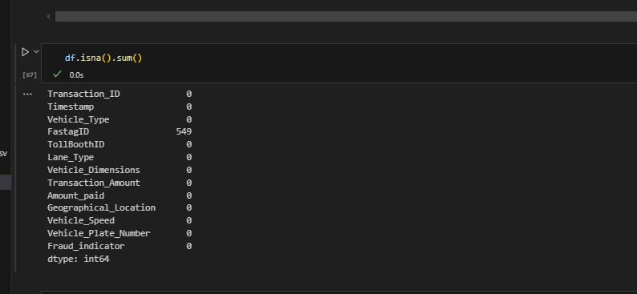
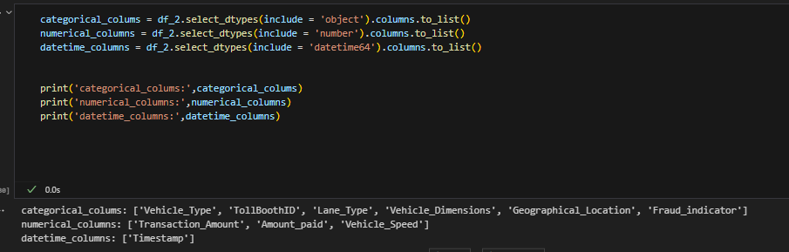
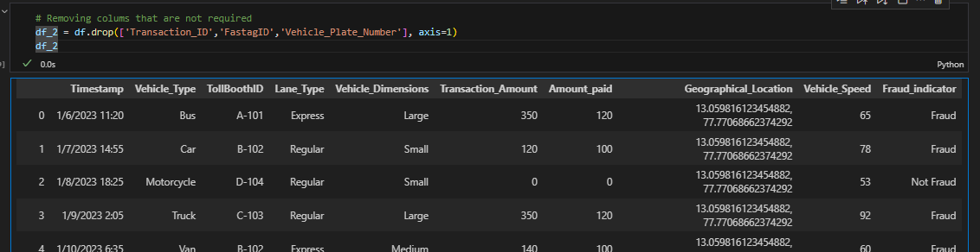
DATA CLEANING & PREPROCESSING
The data set was cleaned by removing duplicate, null and removing unimportant features
Then the dataset features were then classified into categorical, numerical and date time columns
Fig1: Showing how the data cleaning occurred with the classification of columns

Slide 7
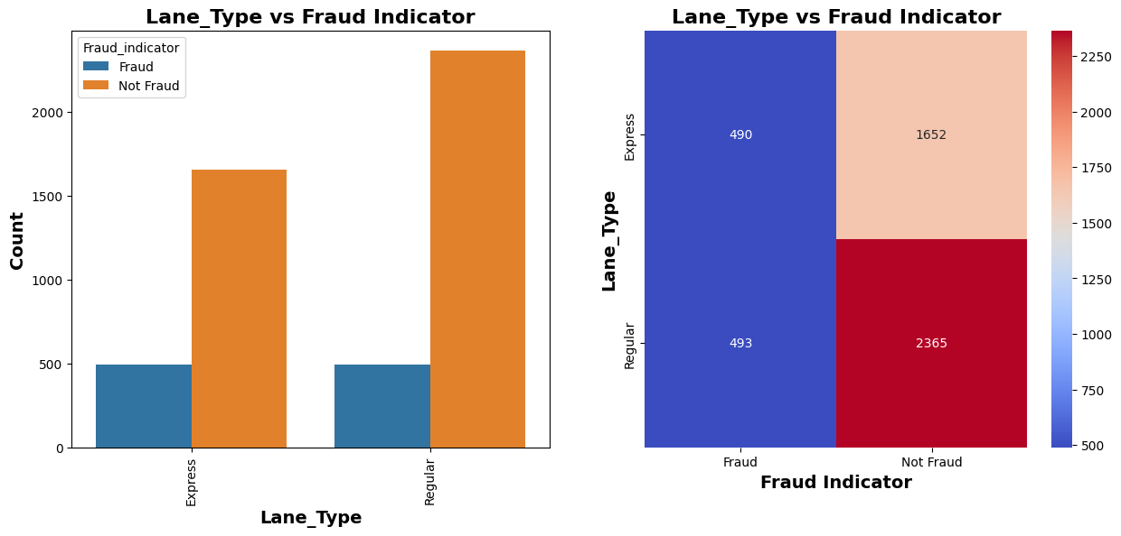
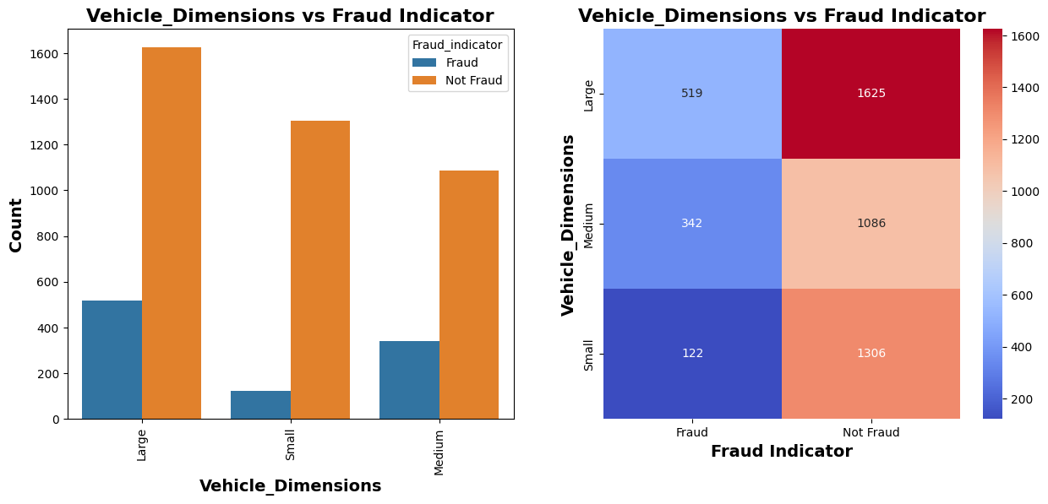
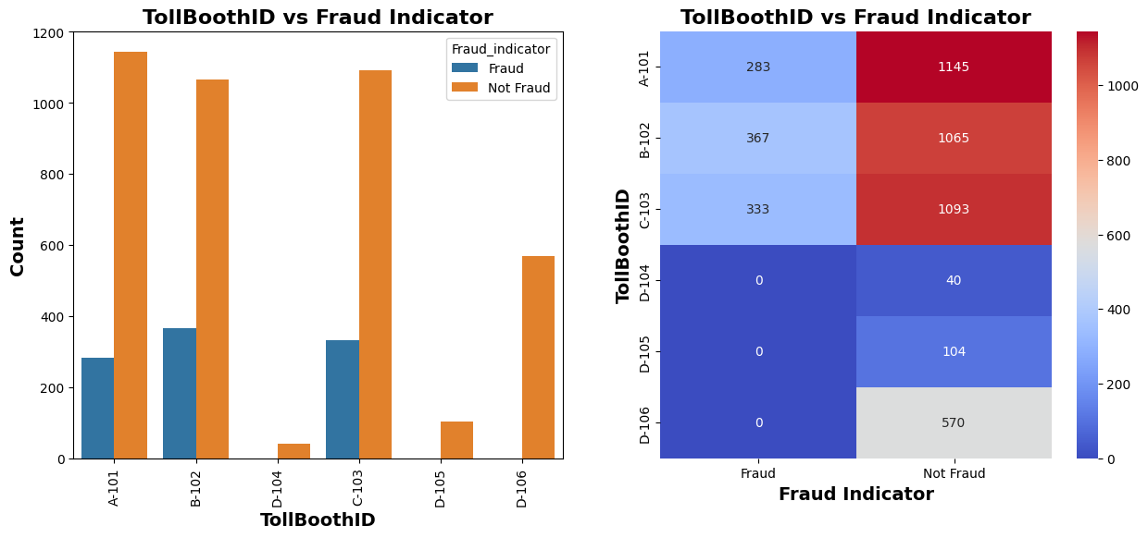
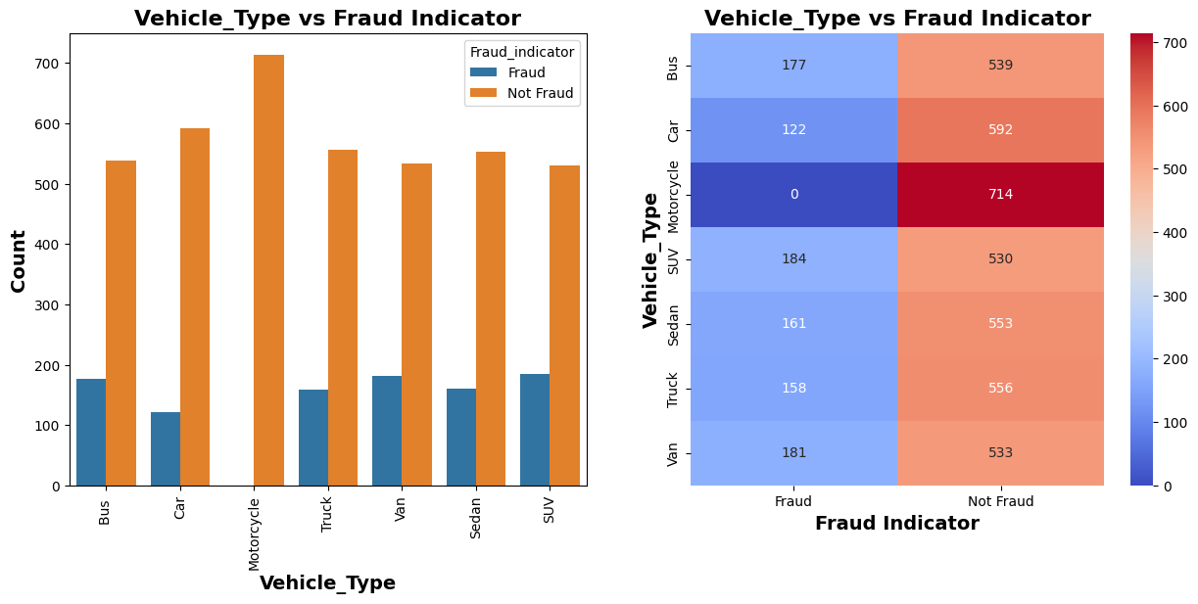
DATA VISUALIZATION
Fig 2: Data visualization of the categorical columns

Slide 8
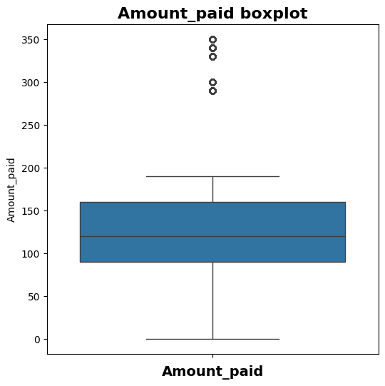
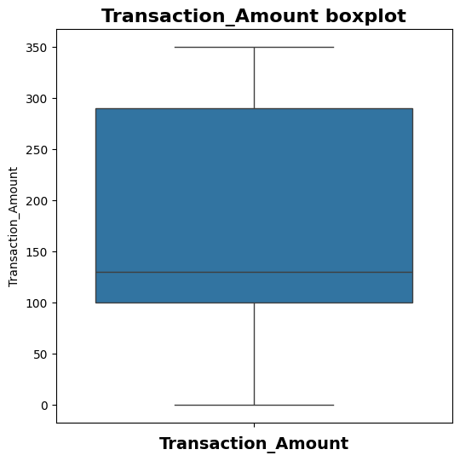
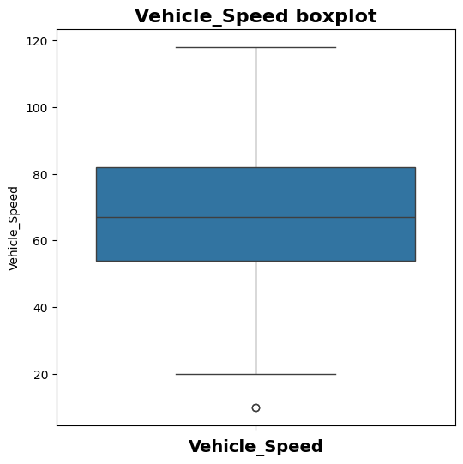
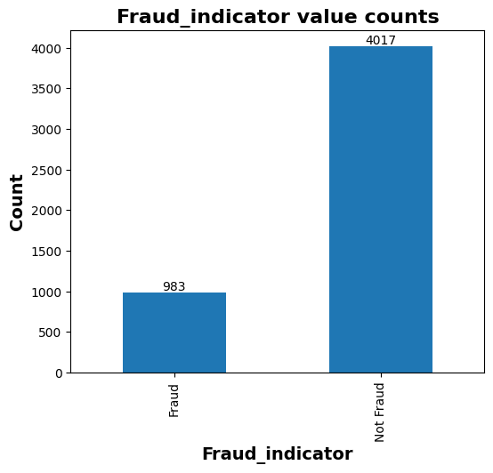
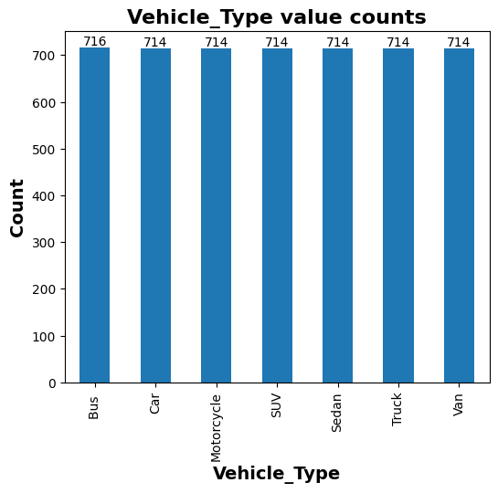
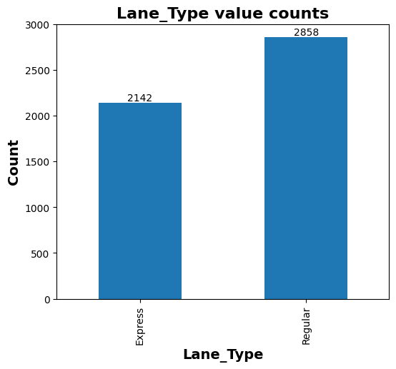
Fig 3: Data Visualization of both categorical and numerical columns

Slide 9
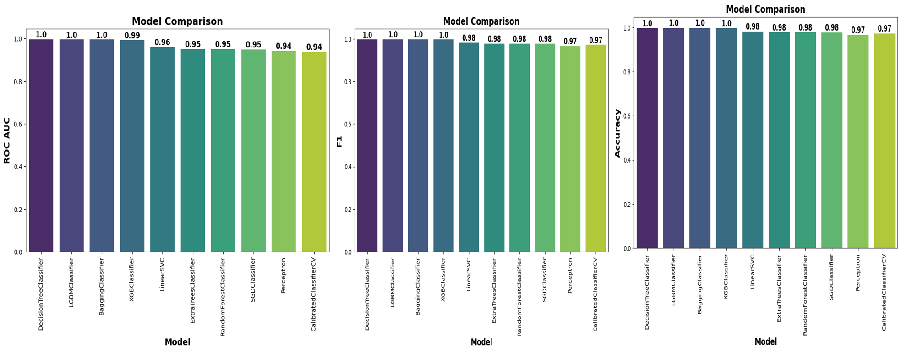
MODEL COMPARISON
Fig 4: comparing different evaluation metrics of the top 10 model out of the 42 built

Slide 10
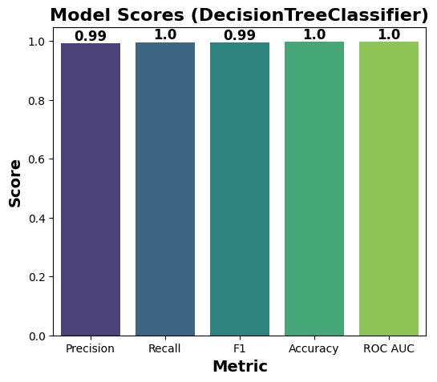
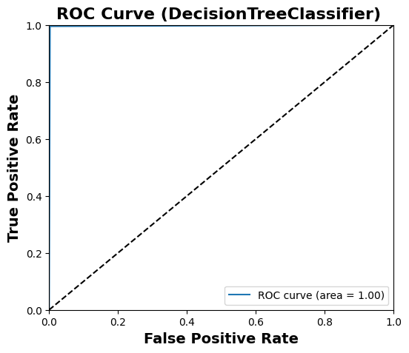
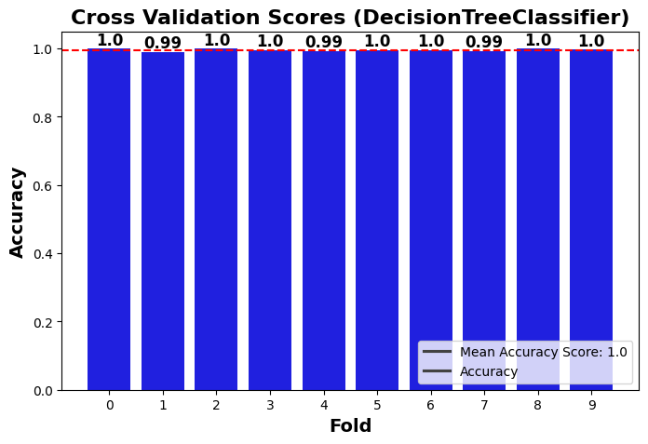
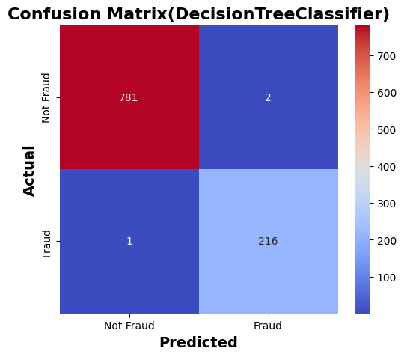
EVALUATION OF THE BEST MODEL (DecisionTreeClassifier):
Fig 5: Showing the different evaluation metrics for the performance of the best model

Slide 11
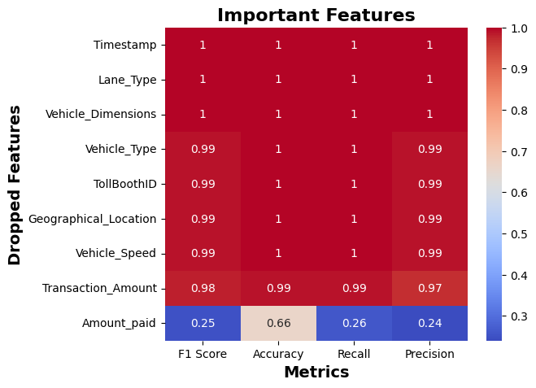
Features like Timestamp, lane type and vehicle type as zero effect on building the model
Features like vehicle type, TollBoothID , location, vehicle speed Transaction Amount have just little effect on the model
Amount paid is the main feature in the building of the model. It is the most important feat
RECOMMENDATION
Features with zero impact on the model can be removed while those with little or high effect most be included when building the model and when collecting data from users 👥
Fig 6: Showing the importance of each feature on the model after been dropped

