Slide 1

KEEL
Tradable MUSD positions on Mezo
A trove inside a vault, controlled by an NFT. Send the NFT, move the position.
Open the live app
keel-two-roan.vercel.app
Testnet. Not audited.
KEEL | Mezo testnet | not audited
1 / 11
Notes:
Not part of the timed cut. KEEL makes a MUSD position on Mezo something you can hand to someone else. A trove normally belongs to one address and cannot move. KEEL puts it in a vault controlled by an NFT. It is live on Mezo testnet, the link and QR code are on screen, and it is not audited.

Slide 2
A MUSD trove is stuck to one address
1
2
3
4
Repay all the debt
Close the trove
Open a new trove
At today's rate
The locked rate is lost. The opening fee is paid again.
KEEL | Mezo testnet | not audited
2 / 11
Notes:
[0:00 to 0:12] A MUSD trove belongs to one address and can't move. To hand a position over, you repay, close, and reopen at today's rate, and you pay the opening fee again.

Slide 3
A low fixed rate is worth something
1
2
3
Fixed at open
Market moves
The gap has value
Each trove keeps the rate it opened at.
Governance changes the global rate, with a 7 day delay.
Today it cannot be moved or priced.
KEEL | Mezo testnet | not audited
3 / 11
Notes:
[0:12 to 0:24] Each trove's interest rate is fixed when it opens, and the market rate can move later. The gap is real value, but it can't be moved or priced today.

Slide 4
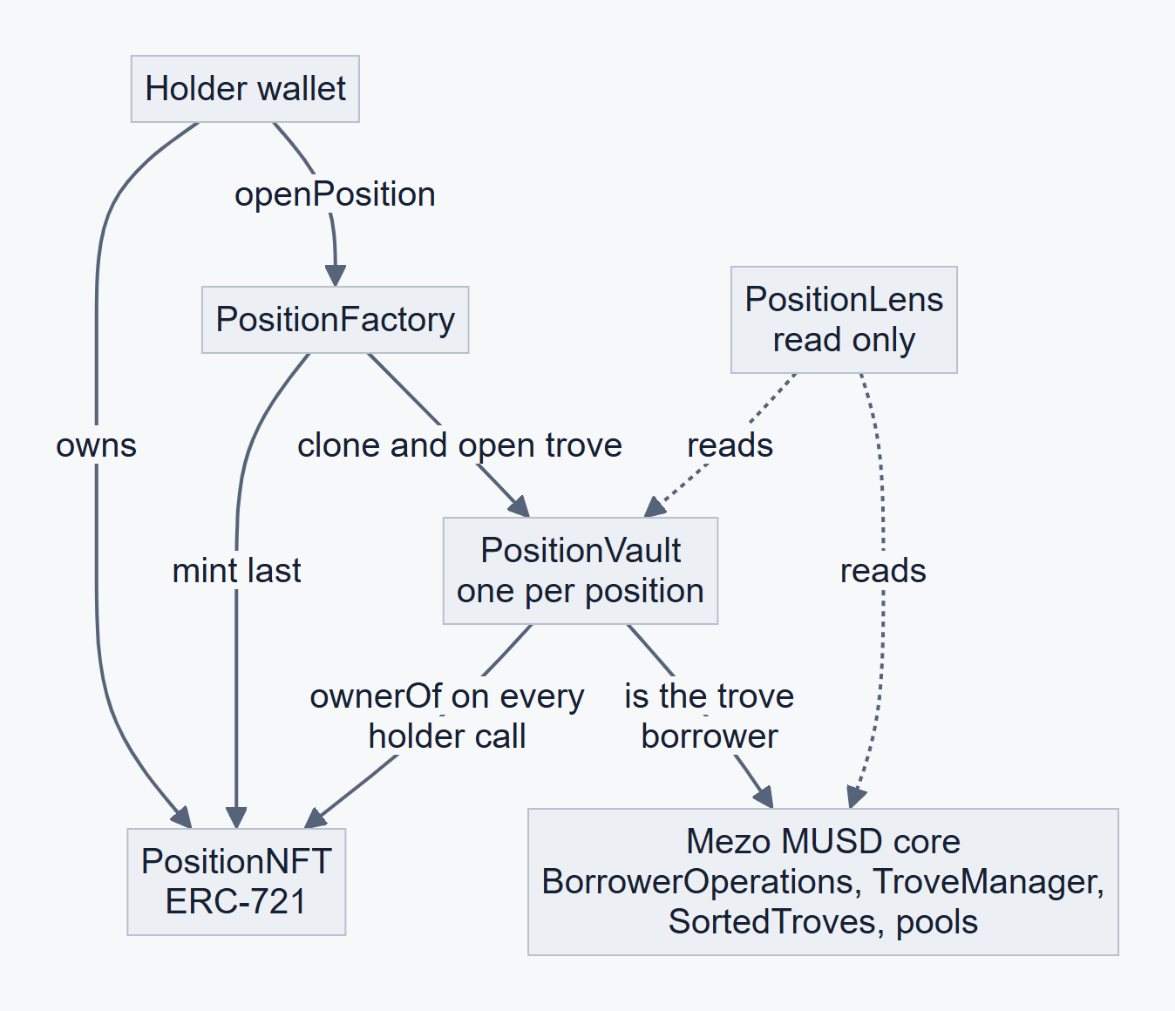
A vault holds the trove. An NFT holds the vault.
1
Vault is the borrower
One trove per vault.
2
The NFT owns the vault
ownerOf is read on every holder call.
3
Transfer the NFT
Collateral, debt and locked rate move together.
KEEL | Mezo testnet | not audited
4 / 11
Notes:
[0:24 to 0:42] KEEL opens each trove from a vault contract and puts the vault under an NFT. The vault asks the NFT who owns it on every call, so there is no stored owner to update. Send the NFT and the whole position moves.

Slide 5
Proven live on Mezo testnet
Old holder
New holder
Vault call reverts
Same call succeeds
NotHolder (0x7623fb52)
Full control. Transfer epoch 2.
Transfer out, position #2
0x8f6333d4d33da8081ce25d064f4b9349216bf52ff0e247882c75614c157e0299
Transfer back
0xf3bf6eae1f23703eb5163d088f373e11694d36debe39392ffd94b510a40a2266
KEEL | Mezo testnet | not audited
5 / 11
Notes:
[0:42 to 1:02] Here it is live on Mezo testnet. I sent position two to a second address. The old holder's call reverts with NotHolder. The same call from the new holder succeeds. Both transactions are on the explorer, and the hashes are on screen.

Slide 6
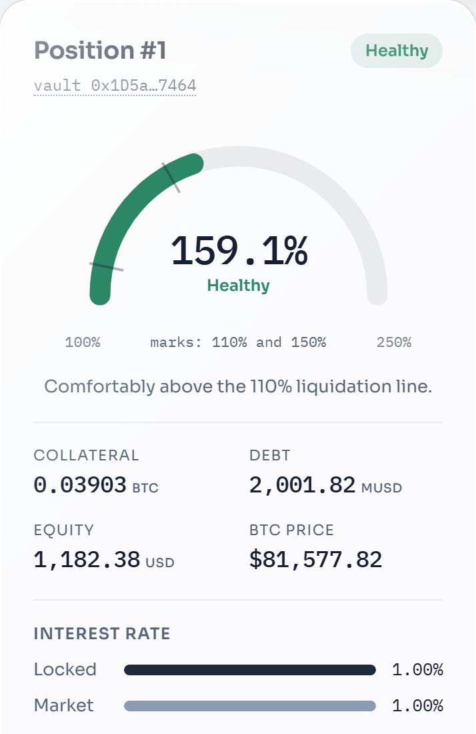
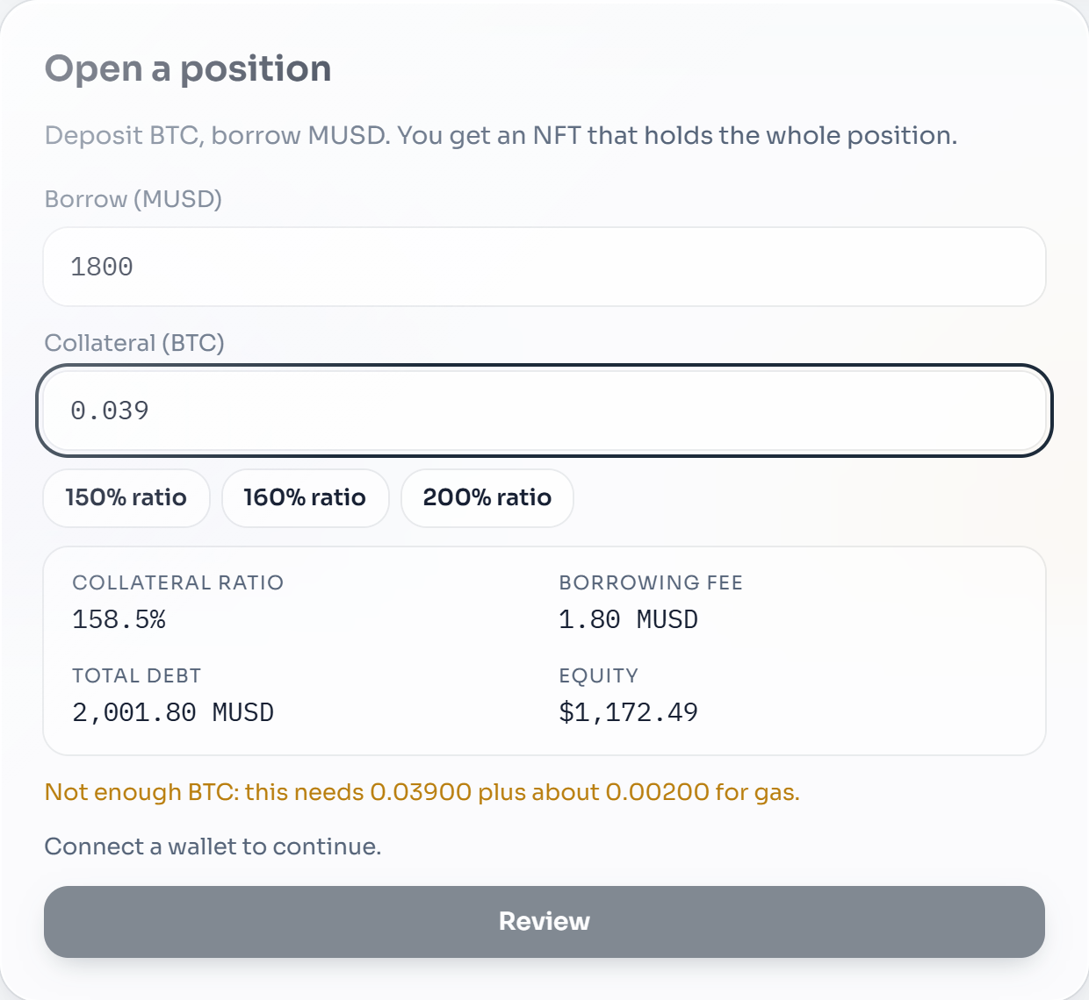
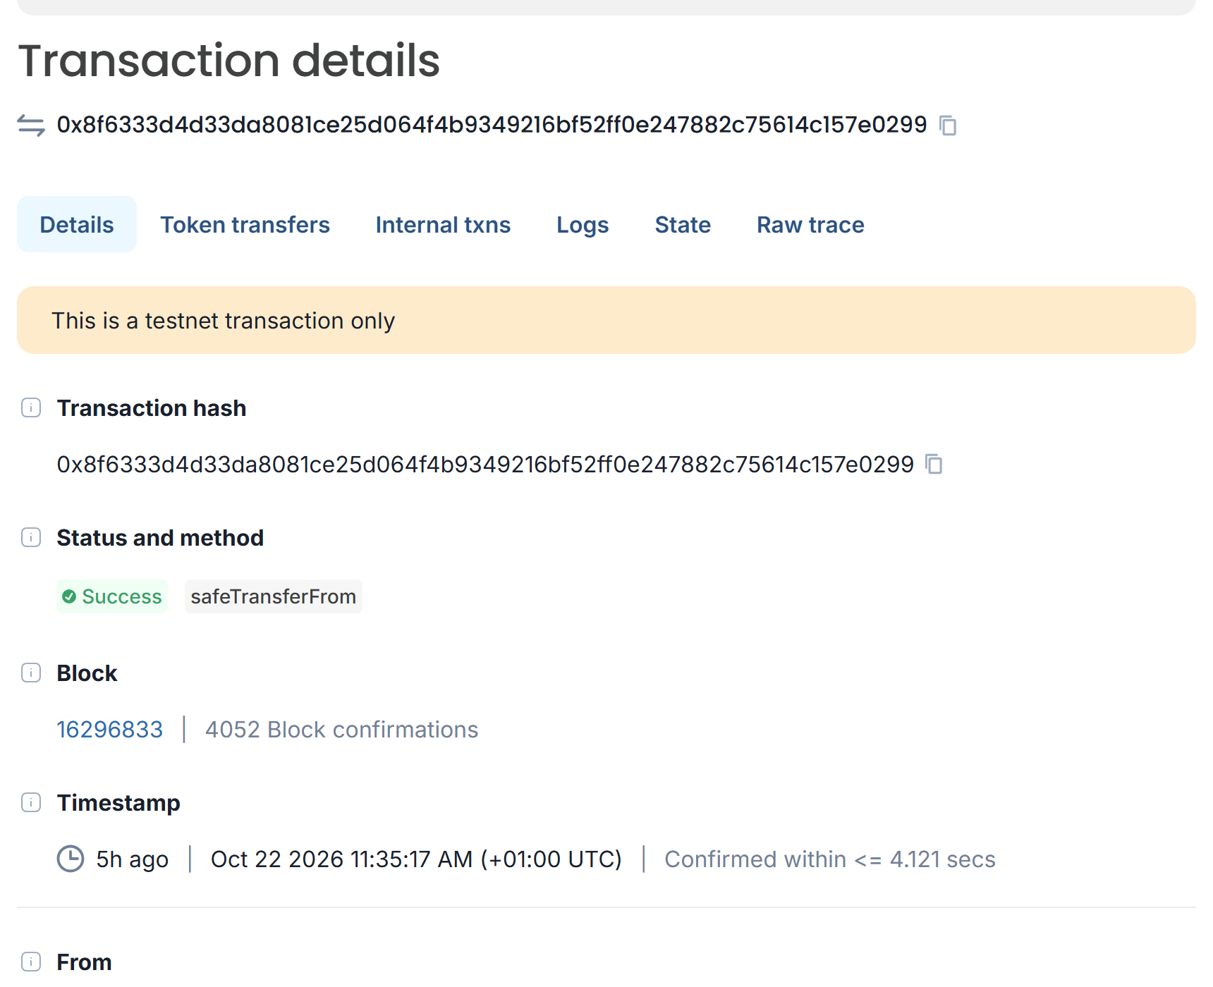
The product, live
Position #1: ratio gauge, locked and market rate (live)
Open flow, as a visitor without a wallet sees it (live)
The transfer of position #2 on the Mezo testnet explorer
KEEL | Mezo testnet | not audited
6 / 11
Notes:
[1:02 to 1:22] This is the live app. The gauge shows the collateral ratio next to the locked and market rates, and the redemption buffer on demand. You open a position from a form, and transfer it through a review step that shows ratio and equity first.

Slide 7
Built on the real MUSD contracts
1
2
3
Real MUSD contracts
Vault is the borrower
Safe refinance
Tested at a pinned commit.
One trove per vault.
Mezo's can raise your rate.
4
5
6
Complete debt reads
Sorted-list hints
Redemption buffer
Interest and redistribution included.
Looked up before sending.
MUSD ahead of your trove.
Wallets connect through Mezo Passport.
KEEL | Mezo testnet | not audited
7 / 11
Notes:
[1:22 to 1:46] It runs on the real MUSD contracts. The vault is the trove's borrower. Mezo's own refinance can raise your rate, so the wrapper only allows a lower one. Reads use getEntireDebtAndColl, so interest and redistribution are included. Hints are looked up right before sending.

Slide 8
Tested hard. Not audited.
90
7
22
42
3/3
Foundry tests
invariant tests
threats modelled
web tests
broken vaults caught
Five design invariants
How
Only the current holder moves funds
No idle funds in a vault
A transfer clears every permission
Payouts go to the caller
Outflow never exceeds collateral
Real MUSD, only the oracle mocked
Hostile-holder reentrancy tests
Fuzz of redemption, liquidation, transfer
Not independently audited
KEEL | Mezo testnet | not audited
8 / 11
Notes:
[1:46 to 2:00] 90 Foundry tests, 7 invariants and a state-machine fuzz run against the real MUSD contracts. Three broken vaults were each caught. It is testnet only and not audited.

Slide 9
Who it is for
DAOs and treasuries
Funds
OTC desks
Hand a position between signers.
Move exposure without closing it.
Settle a position as one asset.
Bitcoin holders who borrow MUSD
Builders
Hypotheses, not findings
No user or market data yet. This is what to test.
Gift or hand over a position.
Positions as composable NFTs.
KEEL | Mezo testnet | not audited
9 / 11
Notes:
Not part of the timed cut. These are the groups I expect to want transferable positions: teams that hold positions together, funds, OTC desks, Bitcoin holders who borrow MUSD, and builders who want positions as composable assets. These are hypotheses. I have no user or market data yet.

Slide 10
What comes next
1
2
3
Marketplace
Guardian
Independent audit
Target: by 15 Nov 2026
Target: after marketplace
Before any mainnet use
Buyer commits to bounds. The sale settles only if the position still matches.
Owner-set on-chain limits. Anyone can run it.
No mainnet until it is done.
KEEL | Mezo testnet | not audited
10 / 11
Notes:
Not part of the timed cut. Next is a marketplace where the buyer commits to bounds and the sale only settles if the position still matches, targeted by 15 November 2026. Then a guardian with on-chain policy bounds. Before any mainnet use, an independent audit. The later items are targets, not commitments.

Slide 11
Team and links
Team
Links
[Name]
GitHub
[Role]
github.com/Oladayo-Ahmod/keel
[X or LinkedIn]
Live app
[Name]
keel-two-roan.vercel.app
[Role]
Deployments
[X or LinkedIn]
docs/DEPLOYMENTS.md
[Name]
[Role]
Threat model
[X or LinkedIn]
docs/THREAT_MODEL.md
KEEL | Mezo testnet | not audited
11 / 11
Notes:
Not part of the timed cut. Names, roles and links are on screen. The code, the live app, the deployments and the threat model are all public, and everything here is testnet only.

