Slide 1

Airplane Crash
Since 1908
Wednesday, December 21, 2022

Slide 2

TEAM PYSCRIPT
Other active members
Adebisi Enochoghene | Reshma Jayaprakash
Alabi Elizabeth | Yusira Mutholib
Emmanuel Gasu | Michael Abifarin
Martha Edet
Oladimeji Williams
Role: Presenter 1
Project Lead
Oladimeji Williams
Assistant Project Lead
Zainab Akanji
Query Analyst
Ayodotun Ibrahim

Slide 3
PROBLEM STATEMENT
Airplanes are one of the most frequent modes of transportation across countries in the present world. Factors causing and contributing to crashes need to be well understood, studied and prevented in order to further minimize any kind of mishap.
Hence, using a vast dataset on airplane crashes, this project seeks to:
Find the root causes of plane crashes
Analyse the possible causes of plane crashes
Develop a ML model to make predictions of severity of crashes

Slide 4
EXISTING SOLUTIONS
Many of the relevant previous solutions on airplane crash have considered relationships between a number of variabilities.
However, since lives that are usually lost during airplane crash are irredeemable, more indepth analysis are needed with a view to better understanding everything around the crashes which would even better inform us on how to avoid it.

Slide 5
OUR APPROACH
Data Cleaning: We cleaned the dataset with a logical intuition
Exploratory Data Analysis: We performed indepth EDA
Deployment: Our analysis is published on tableau public

Slide 6
DATASET DESCRIPTION
Data is scraped from planecrashinfo.com and made available on kaggle.
Below are the descriptions of the dataset:
Date: Date of accident, in the format - January 01, 2001
Time: Local time, in 24 hr. format unless otherwise specified
Airline/Op: Airline or operator of the aircraft
Flight #: Flight number assigned by the aircraft operator
Route: Complete or partial route flown prior to the accident
AC Type: Aircraft type
Reg: ICAO registration of the aircraft
cn / ln: Construction or serial number / Line or fuselage number
Aboard: Total aboard (passengers / crew)
Fatalities: Total fatalities aboard (passengers / crew)
Ground: Total killed on the ground
Summary: Brief description of the accident and cause if known

Slide 7
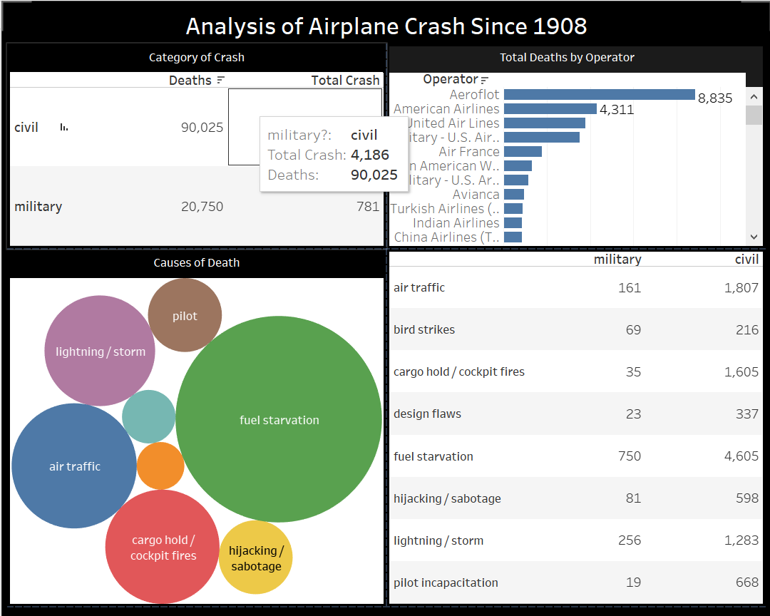
TABLEAU VISUALIZATION
A tableau dashboard is generated for further visualization.

Slide 8


MODEL
Train
Encode with Bag of Words
Train a Catboosting model
Validate and make predictions
Predict
Model Pipeline

Slide 9
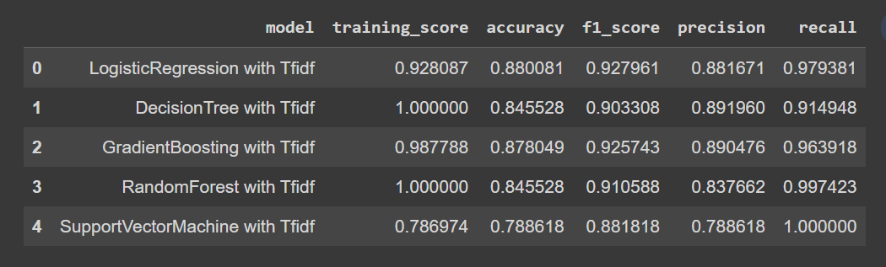
MODEL
Model Evaluation with Summary using TFIDF
SVM gives 0.79 training score and 0.88 f1 score

Slide 10
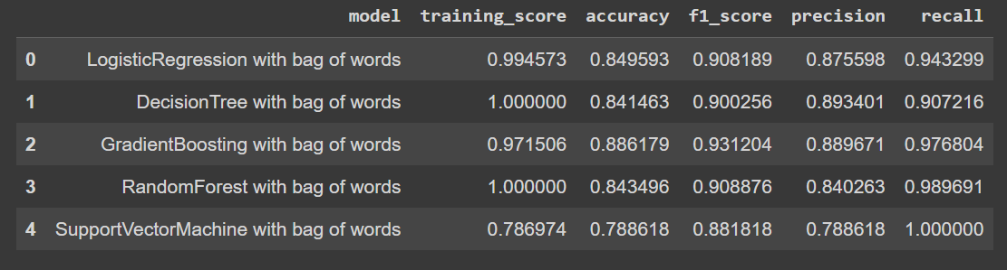
MODEL
Model Evaluation with Summary using Bag of Words
SVM gives 0.79 training score and 0.88 f1 score

Slide 11
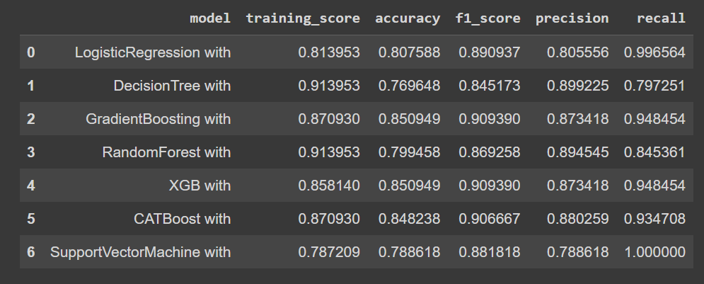
MODEL
Model Evaluation without categorical columns
SVM gives 0.86 training score and 0.91 f1 score

Slide 12
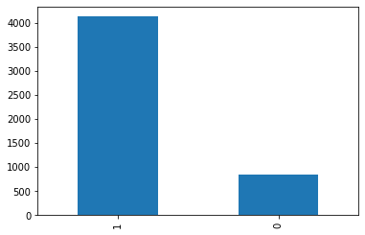
MODEL
Target Variable
Class Imbalance

Slide 13
SUMMARY
We were able to develop a dashboards that answers most of the questions around airplane crashes as contained in the dataset.
Amongst others, Aeroflot needs to improve on their operation, aircraft designs, and capabilities. All aircraft operators and airports also need to ensure more than enough fuel is provided throughout the entire trip of each flight.
CHALLENGES
There are many null values in the dataset, and the dataset is not suitable for a machine learning model to learn from.

Slide 14
PROJECT LINKS
You can react to this project on:
https://github.com/Oladimeji-Williams/AirplaneCrashAnalysis
https://www.canva.com/design/DAFUe1GdR4A/Yhosr6vSYzgX_8tPu_3Q1w/view?utm_content=DAFUe1GdR4A&utm_campaign=designshare&utm_medium=link2&utm_source=sharebutton#3

