Slide 1
Building a product modeller/configurator tool
Radu Mitache
March 2012

Slide 2
Overview
Abstract
Background & theory
Project goals
Requirements
Design and implementation
Future work

Slide 3
Project abstract
Construction of a web-based feature modeling tool
Support for visual modeling with focus on usability
Interactive configuration with an SMT solver

Slide 4
Background & theory
Product line engineering
Product line engineering:
Creation of an architecture of an organization’s product platform
Creation of products through re-use of sub-components
Benefits :
Higher productivity
Higher quality
Faster time-to-market
Lower labour needs

Slide 5
Background & theory
Feature Modeling
Feature modelling :
Method for modeling variability and commonality in a product line or system.
Feature model :
Describes variability and commonality in a product line.
Different notations and definitions
Visually represented through a Feature Diagram

Slide 6
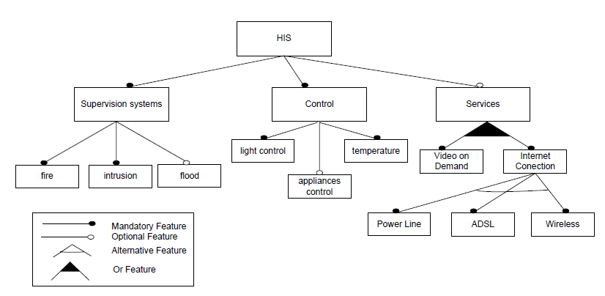
Background & theory
Feature Diagram

Slide 7
Visual modeling, usability & web 2.0
Background & theory
Modeling:
Abstraction of details
Allows for complex problems to be handled
Most modeling languages allow for visual representations
Usability:
Effiency, Effectivity and User Satisfaction
Web 2.0:
Rich internet application
Web-oriented architecture
Social web

Slide 8
Main project goals
Standard feature modeling functionality:
Mandatory/Optional Features
Or/XOR Groups
Requires/Excludes cross tree constraints
Configurator functionality provided by an SMT solver
Aid users during configuration process by ensuring the validity of the configuration
Advanced feature modeling primitives such as attributes and complex rules
Attributes
Complex rules written by users using text-based syntax
Visual modeling in a web 2.0 context
Rich and responsive graphical user interface
Dd
Dd
Dd

Slide 9
Requirement specifications

