Slide 1
nav
img
ul, li, a, span, div

Slide 2
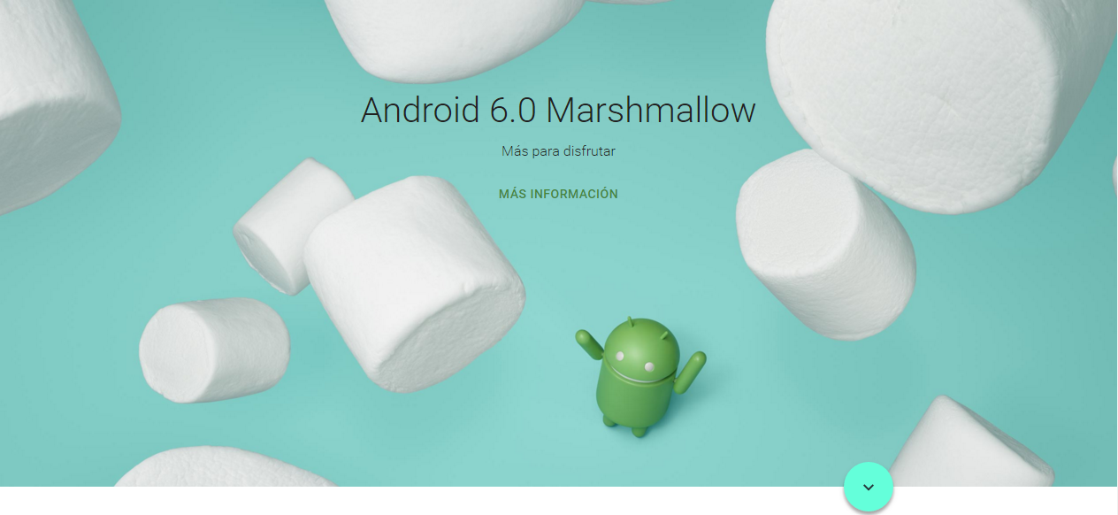
section
img
nav
h1
p
span
img
ul, li, a, span, div
div

Slide 3

section
h2
span

Slide 4
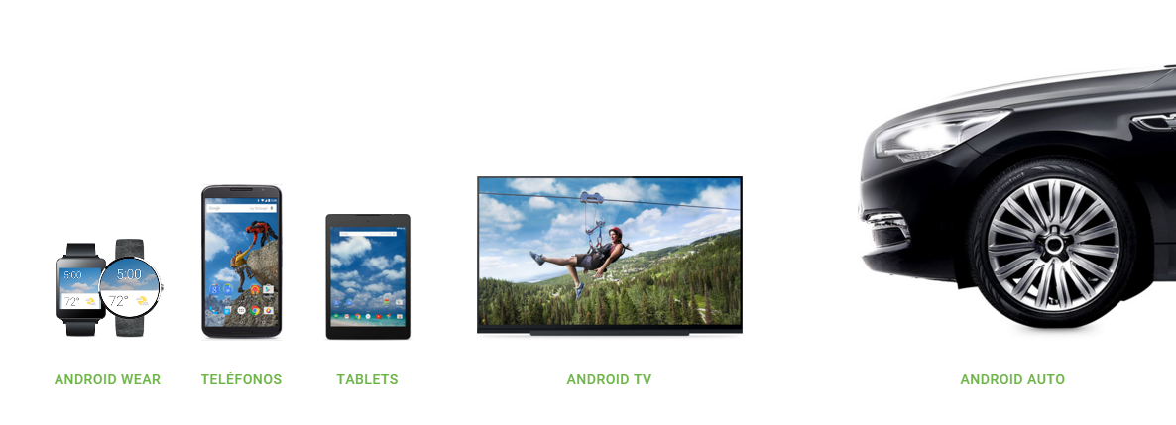
section
div
div, a, img ,p

Slide 5
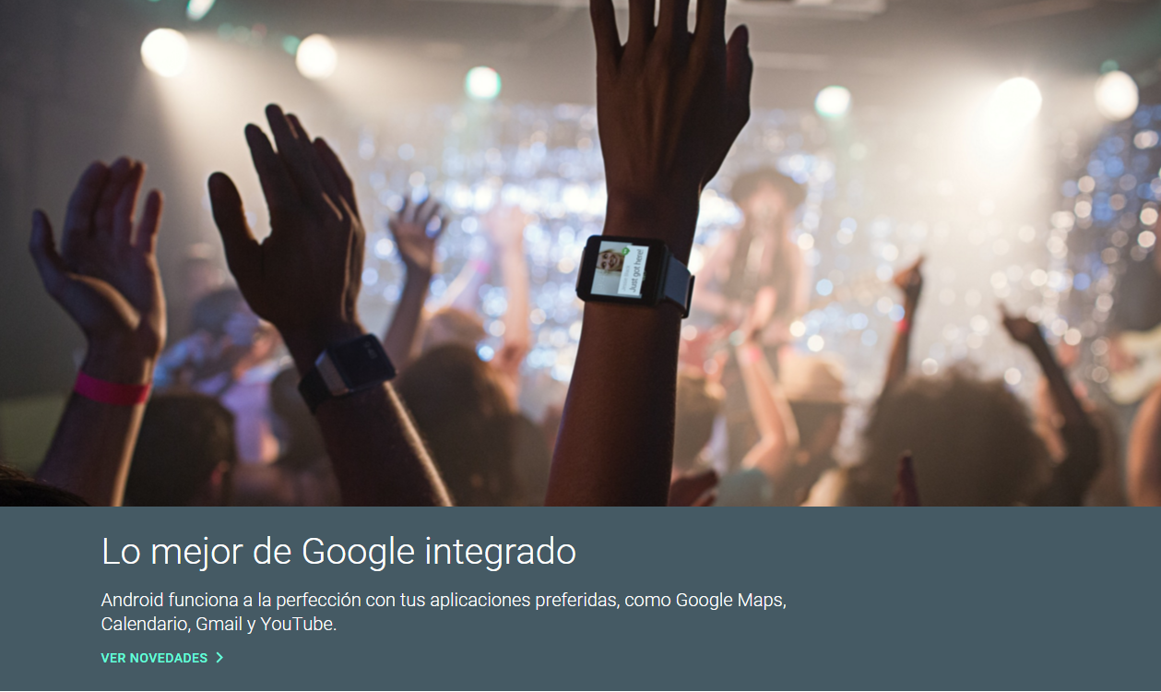
section
div, img
div, h2, p ,a

Slide 6
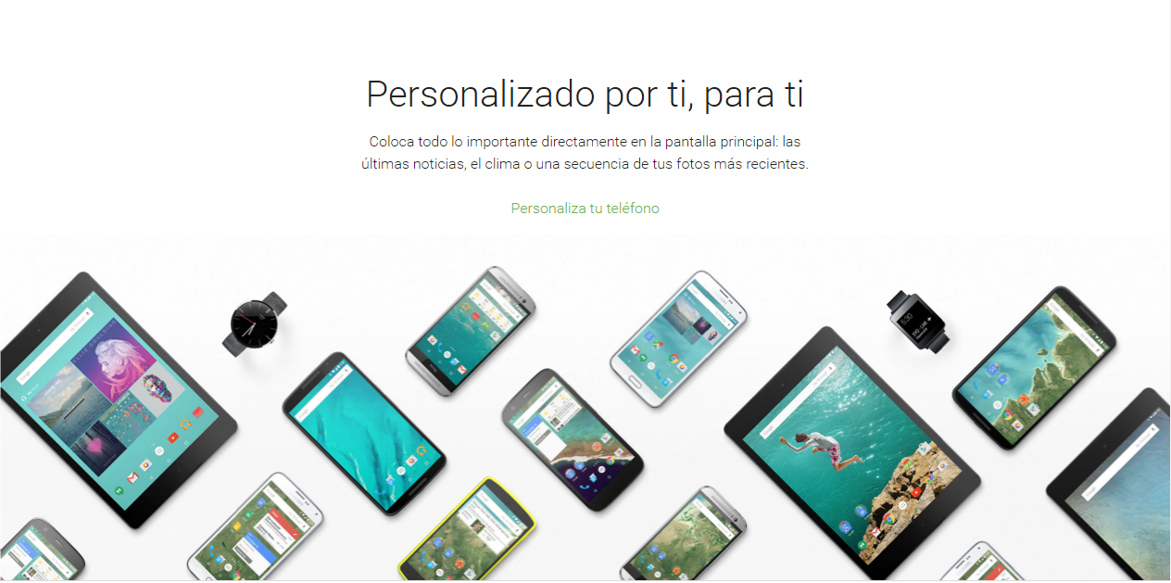
section
div, h2, p
img
div, h2, p ,a

Slide 7
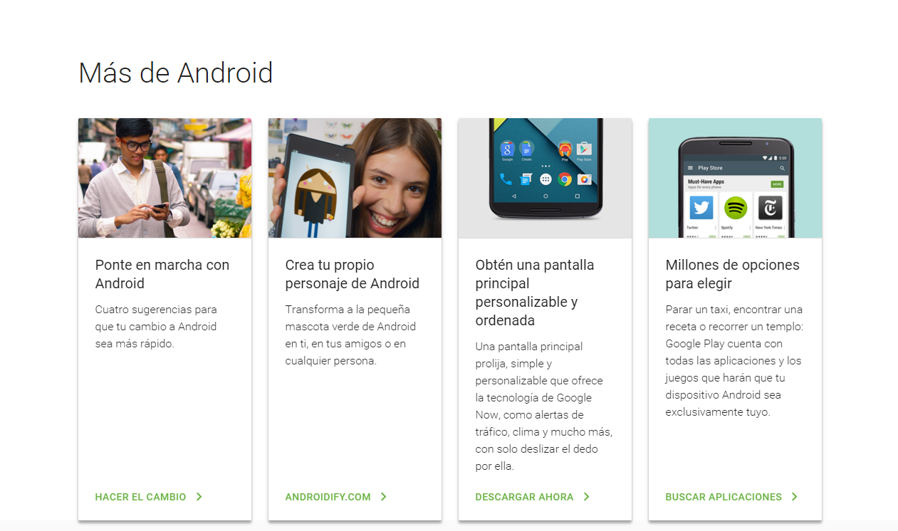
section
div, h2
div,div
div, img, h3 ,p, a

Slide 8
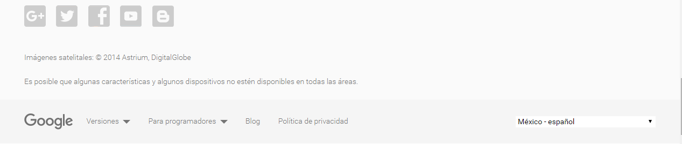
footer
ul, p

Slide 9
body
{
padding-top: 80px;
margin: 0;
text-rendering: optimizeLegibility;
font-family: Roboto, Helvetica, Arial, sans-serif;
}
html
{
color: #212121;
line-height: 24px;
}
nav
{
height: 80px;
position: fixed;
top: 0;
width: 100%;
box-shadow: 100px black;
}
nav img
{
float: left;
padding: 26px 0 26px 24px;
height: 28px;
}
nav ul
{
margin-right: 40px;
float: right;
list-style: none;
}
nav li
{
margin-left: 1px;
float: left;
padding: 4% 4px;
}
nav li a
{
text-transform: uppercase;
color: #757575;
font-size: 14px;
letter-spacing: 0.5px;
padding: 16px;
text-decoration: none;
}
nav span
{
display: inline-block;
border-right: 5px solid transparent;
border-top: 5px solid;
border-left: 5px solid transparent;
margin-left: 4px;
vertical-align: middle;
margin-top: -3px;
}
section
{
overflow: hidden;
position: relative;
}
.banner
{
position: relative;
}
.seccion-contenedor
{
margin-left: auto;
margin-right: auto;
max-width: 1044px;
padding-bottom: 85px;
}
.seccion-dos
{
padding-top: 80px;
padding-bottom: 24px;
margin-left: auto;
margin-right: auto;
max-width: 1044px;
color: #212121;
}
.seccion-dos h2
{
margin-bottom: 16px;
font-size: 40px;
font-weight: 300;
line-height: 48px;
}
.seccion-dos p
{
width: 49.9%;
font-size: 16px;
font-style: normal;
font-weight: 300;
line-height: 24px;
}
.centrar-texto
{
text-align: center;
margin-left: auto;
margin-right: auto;
}
.seccion-tres
{
display: table;
}
.secciontres-div
{
display: table-cell;
padding: 0 20px;
position: relative;
}
.secciontres-div img
{
width: 100%;
}
/*
@media only screen and (max-width: 480px)
{
body
{
background-color: red;
}
}
@media only screen and (min-width: 481px) and (max-width: 720px)
{
body
{
background-color: blue;
}
}
@media only screen and (min-width: 721px) and (max-width: 1280px)
{
body
{
background-color: blue;
}
}
*/

