Slide 1
Calculator game
by OLGA MAKAROVA

Slide 2
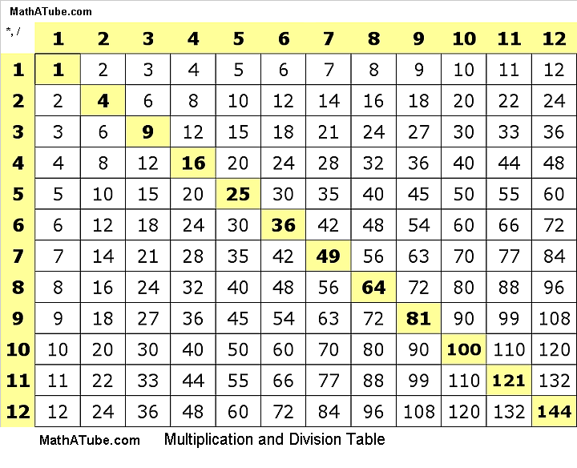
Description
This is a simple game checking user’s knowledge of the multiplication table.
This Photo by Unknown Author is licensed under CC BY

Slide 3
How does it work?
This game is written in a bash scripting language.
Program name: calculator_game.sh
The program borrowed some logics from the scripts used in class.
The key feature is the timer. Every time the user gives an answer the program displays the time left. If the user is out of time the program stops the game.
The user is allowed to give only a certain number of incorrect answers.

Slide 4
What Options can be changed?
Game duration
Total number of correct attempts
Total Number of incorrect attempts
Multiplication range

